Slide 1
REAL-TIME SCHEDULING
Dayang Norhayati Abang Jawawi
Department of Software Engineering
Faculty of Computer Science and Information System
Universiti Teknologi Malaysia
email : dayang@utm.my

Slide 2
The Structure of Presentation
Introduction
Scheduling
Real-time Scheduling
    Theory
    Pre-run-time scheduling
    Non-preemptive fixed-priority scheduling
    Preemptive fixed-priority scheduling
    Preemptive dynamic-priority scheduling
Schedulability Analysis
    Processor utilization analysis
    Processor workloads analysis
    Response time analysis
    Blocking on shared resources
Schedulability Analysis of an Mobile Robot Systems
Conclusion

Slide 3
Scheduling
General definition of scheduling – is the allocation of resources over time to perform a collection of tasks (Baker, 1974).
Examples
Resources | Tasks
machine in a factory, | operations in the factory,
runway at the airport, | takeoffs and landing at the airport,
operational rooms at hospital, | operations in the hospital,
lecture rooms in a university, | lectures at the university,
processing unit in a computer. | execution of the computer program

Slide 4
Scheduling
Concept (Cooling)
Basic scheduling Policies (page 202-206)
  Cyclic scheduling
  Time slicing
  Task priorities
  Using queues
  Ram’s problem
Scheduling Implementation
  The task control block
  The tick
  System responsiveness
  By-pass the scheduler
  Code sharing and re-entrancy
Task | Time | Deadline
Wife | 45 | Evening
Daughter | 30 | Evening
Son | 60 | -
Boss | 20 | -

Slide 5
Scheduling
ERT scheduling systems
ERT need to run several tasks on a limited set of processing unit, scheduling these tasks on processors is to ensure the real-time constraints are met.
Scheduling goal (Cheng, 2002-):
  Non-real-time systems – to maximize average throughput (number of task completed per unit time) and/or to minimize average waiting time of the tasks.
  Real-time systems – to meet the deadline of every task by ensuring that each task can complete execution by its specified deadline.

Slide 6
RT Scheduling
Theory
Scheduling theory assumes that RTS consists of:
  A set of computational tasks to be performed.
  A run-time scheduler which controls task execution at any given moment.
  A set of shared resources shared by the task.
Types of tasks:
  Periodic tasks – consist of an infinite sequence of identical invocations which arrive at fixed intervals.
  Aperiodic tasks – consists of a sequence of invocations which arrive randomly.
  Speriodic tasks – are special case of aperiodic ones in which there is a known worst-case arrival rate for the task.
Individual task invocation category:
  Non-preemptive task invocation execute to completion without interruption once started.
  Preemptive task invocations can be temporarily preempted during their execution by the arrival of a higher-priority invocation.

Slide 7
RT Scheduling
Typical periodic task
arrival time
start time
finishing time
deadline
next arrival time
T - period
D - deadline
R – response time
C – Worst-Case Computation time (WCET)
not runnable
preempted
blocked
locking resources
executing

Slide 8
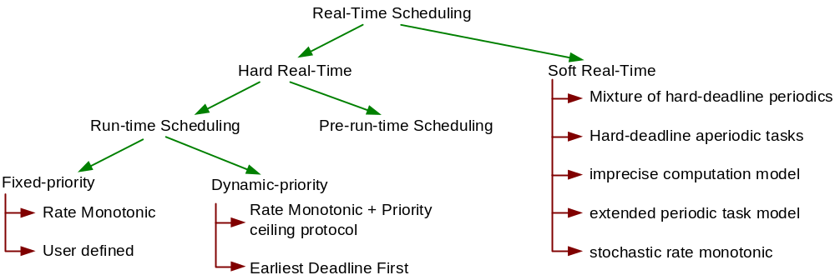
Analysis & Scheduling Policies
Classification of RT scheduling Policies
Pre-run-time scheduling – require the programmer to define the entire schedule prior to execution. E.g. run-robin.
Run-time scheduling – the algorithm make decision about which task to execute at run-time based on priorities of the tasks.

Slide 9
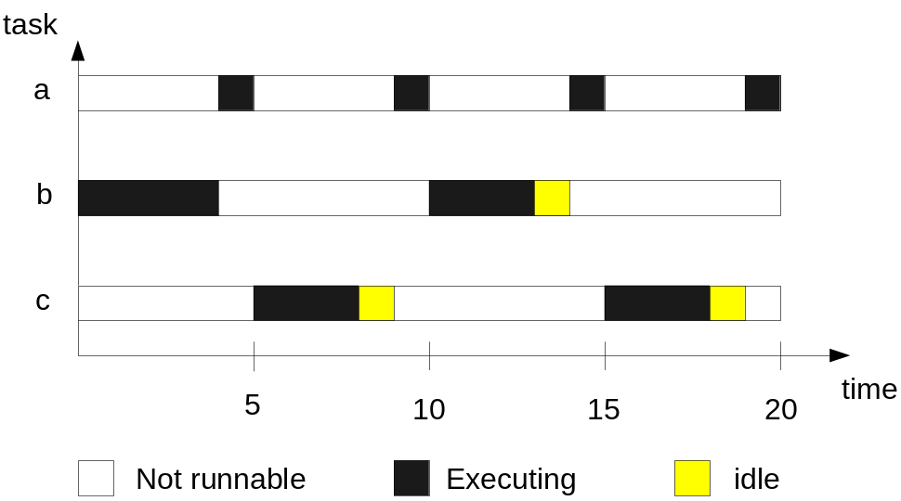
RT Scheduling
Pre-run-time Scheduling
Task | C (ms) | Occurrence in 20 ms (times)
a | 1 | 4
b | 7 | 1
c | 3 | 2
Notes:
ETHNOS – Expert Tribe in Hybrid Network OS

Slide 10
RT Scheduling
Fixed-priority Scheduling
Each task has a fixed, static priority.
The runnable task are executed in the order determined by their priority.
In RTS the priority of a task is derived from its temporal requirements.
Rate monotonic (RM) scheduling algorithm – a simple optimal priority assignment scheme (Burn, 2003).
  Preemptive priority-driven scheduling
  Priority assignment based on T - shorter T higher priority
RM was chosen by - Space Station Freedom Project & FAA Advanced Automation System (AAS)
RM influenced - the specs of IEEE Futurebus+
RMA is widely used for off-line analysis of time-critical systems.

Slide 11
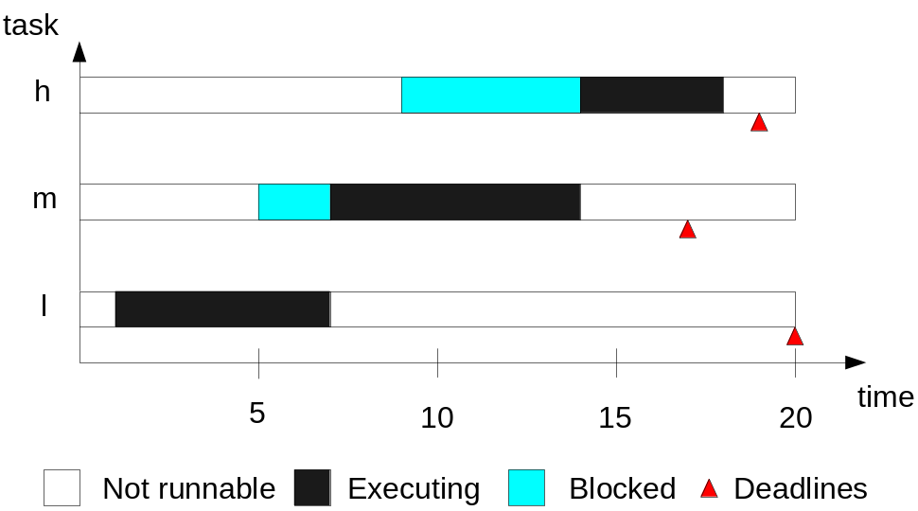
RT Scheduling
Fixed-priority Scheduling (Non-preemptive )
Task | C (ms) | arrival time | D (ms) | priority
h | 4 | 9 | 10 | high
m | 7 | 5 | 12 | medium
l | 6 | 1 | 19 | low

Slide 12
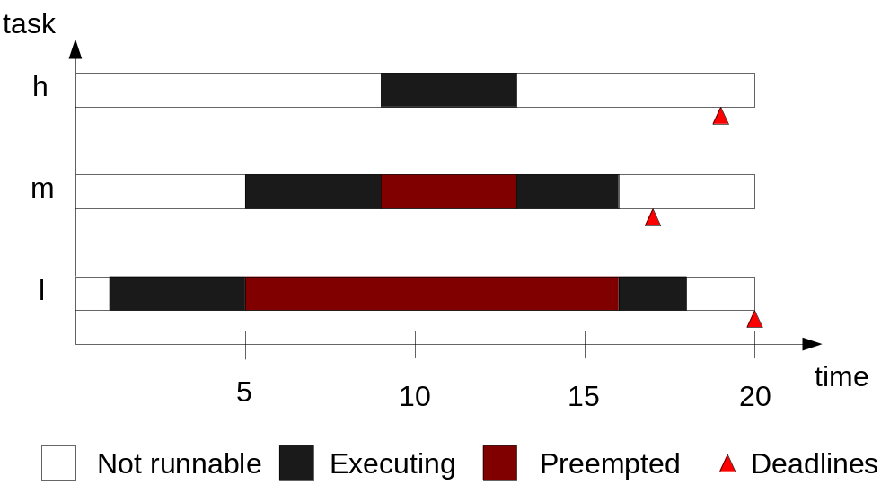
RT Scheduling
Fixed-priority Scheduling (Preemptive)
Task | C (ms) | arrival time | D (ms) | priority
h | 4 | 9 | 10 | high
m | 7 | 5 | 12 | medium
l | 6 | 1 | 19 | low

Slide 13
RT Scheduling
Dynamic-priority Scheduling
Each task has a dynamic priority.
The runnable task are executed in the order determined by their dynamic priority.
Earliest Deadline First (EDF) scheduling algorithm – a optimal priority assignment scheme (Burn, 2003).
  Preemptive priority-driven scheduling
  Priority assignment based on D - Always execute the task with the nearest absolute (D + arrival time)

Slide 14
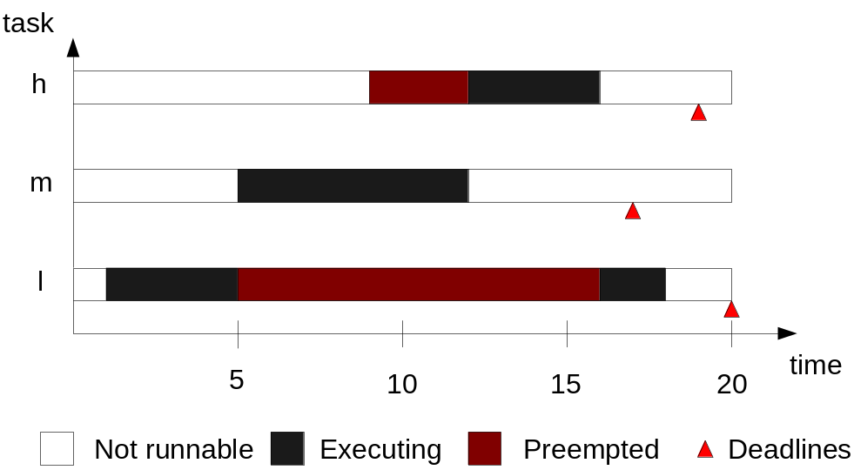
RT Scheduling
Preemptive Dynamic-priority Scheduling
Task | C (ms) | arrival time | D (ms)
h | 4 | 9 | 10
m | 7 | 5 | 12
l | 6 | 1 | 19

Slide 15
RT Scheduling
Comparison of the scheduling algorithm
 | Pre-run-time | Non-preemptive fixed-priority | Preemptive fixed-priority | Preemptive dynamic-priority
Adv | + entirely deterministic + not require RTOS + tasks are evenly spaced in time | + simple programming paradigm + allow individual task to be programmed separately + Can be formally analyzed for schedulability | + faster service to higher-priority task + RTOS available, simpler and easier to maintain + programmer free to choose task priorities, T & D + Schedulability test + stable | + guarantee tasks will meet their D
Dis-adv | rigid & difficult to construct support periodic task only inefficiency, some cycle were left idle Rewrite all code just to fit a task in the schedule makes program difficult to design Unstable when a task overrun | Unresponsive Overrunning low-priority task can delay higher-priority one | complex RTOS required High degree of jitter | higher run-time overhead Unstable under transient overload

Slide 16
Schedulability Analysis
Introduction
Schedulability - NP-hard if there are any resources dependencies
  provide a necessary and sufficient schedulability condition
  Find a schedule if it is easy to do
  Stuck in the middle somewhere
SA is to determine whether a specific set of tasks or a set of tasks satisfying certain constraints can be successfully scheduled (completing execution of every task by its specified deadline) (Cheng, 2002).
Schedulability test (ST) is used to validate that a given application can satisfy its specified deadlines when scheduled according to a specific scheduling algo.

Slide 17
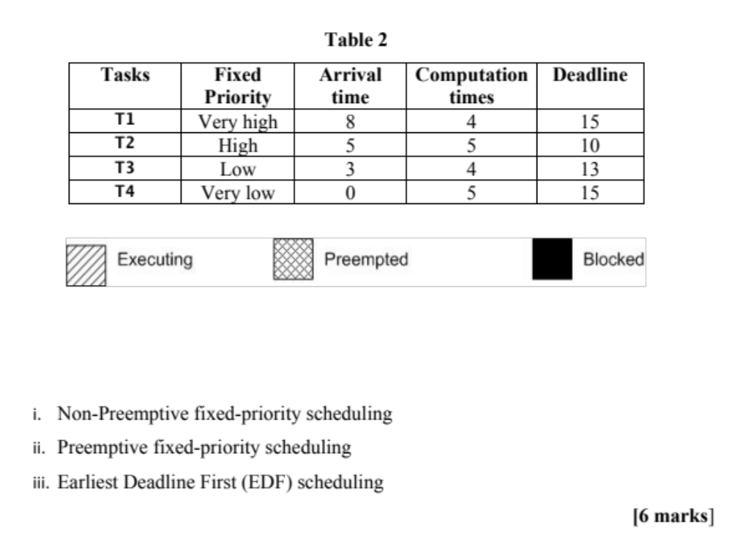

Slide 18
Schedulability Analysis
Introduction
3 basic approaches of ST
  Processor utilization analysis
  Processor workloads analysis
  Response time analysis

Slide 19

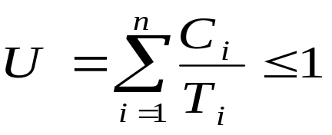
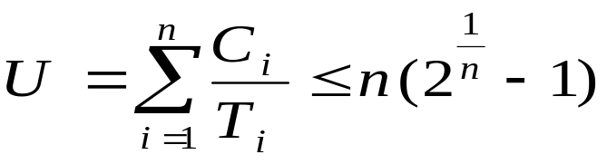
Schedulability Analysis
Processor Utilization Analysis
ST 1 : EDF - Given a set of n independent, preemptable, & periodic tasks on a uniprocessor such that D_{i} >= T_{i} & that their periods are exact (integer) multiples of each other. A necessary & sufficient condition for feasible scheduling of this task set is:
ST 2 : RM - Given a set of n independent, preemptable, & periodic tasks on a uniprocessor. A necessary & sufficient condition for feasible scheduling of this task set is:

Slide 20
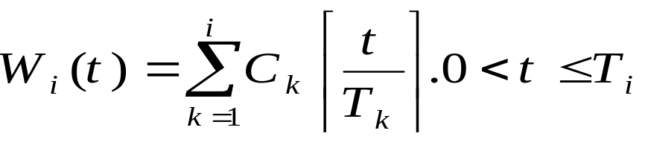

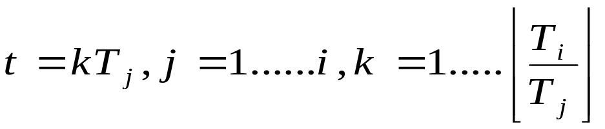
Schedulability Analysis
Processor Workload Analysis
ST 3 : RM - Let
The following inequality w_{i}(t) t hold for any time instant t chosen as follows:
iff task J_{i} is schedulable. If D_{i} <> T_{i}, we replace T_{i} by min(D_{i}, T_{i}) in the above expression.

Slide 21
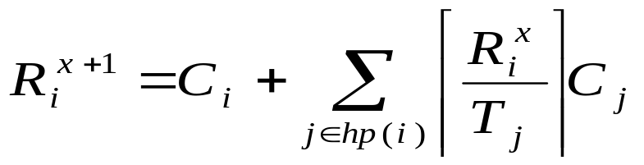
Schedulability Analysis
Response Time Analysis
ST 4 : RM - A task i is schedulable if R_{i} <= D_{i} , where

Slide 22
SA of a Mobile Robot Systems
Scheduling mobile robotic tasks
Scheduling theory assumes that RTS consists of:
  A set of computational tasks to be performed.
    The computational tasks in the AMR obtained using
  A run-time scheduler which controls task execution at any given moment.
    Support using a RTOS μcos-II - portable, ROMable, scalable, preemptive real-time, multitasking kernel for microprocessors and microcontrollers.
  A set of shared resources shared by the task. Hw & SW SHARING.

Slide 23
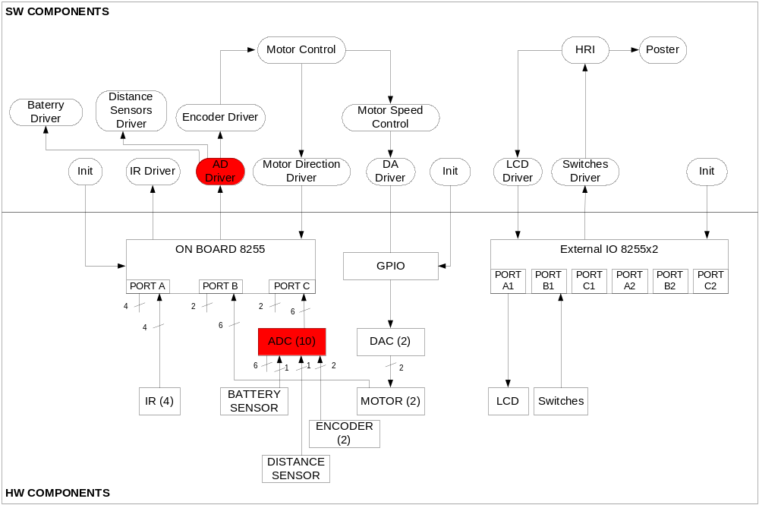
SA of a Mobile Robot Systems
Scheduling mobile robotic tasks
Resource sharing mostly due to hardware sharing.

Slide 24
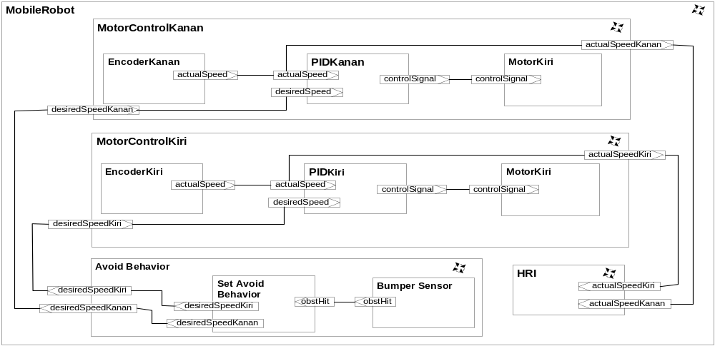
SA of a Mobile Robot Systems
Processor Utilization Analysis
Task | T_{i} | C_{i} | U_{i}
MotorControlKanan | 50 | 12
MotorControlKiri | 50 | 12
AvoidBehavior | 250 | 20
MobileRobot | 300 | 10
HRI | 500 | 125

Slide 25
SA of a Mobile Robot Systems
Processor Utilization Analysis
Task | T_{i} | C_{i} | U_{i} | U(n)
MotorControlKanan | 50 | 12 | 0.24 | 1.00
MotorControlKiri | 50 | 12 | 0.48 | 0.828
AvoidBehavior | 250 | 20 | 0.56 | 0.779
MobileRobot | 300 | 10 | 0.59 | 0.756
HRI | 500 | 125 | 0.84 | 0.743

Slide 26
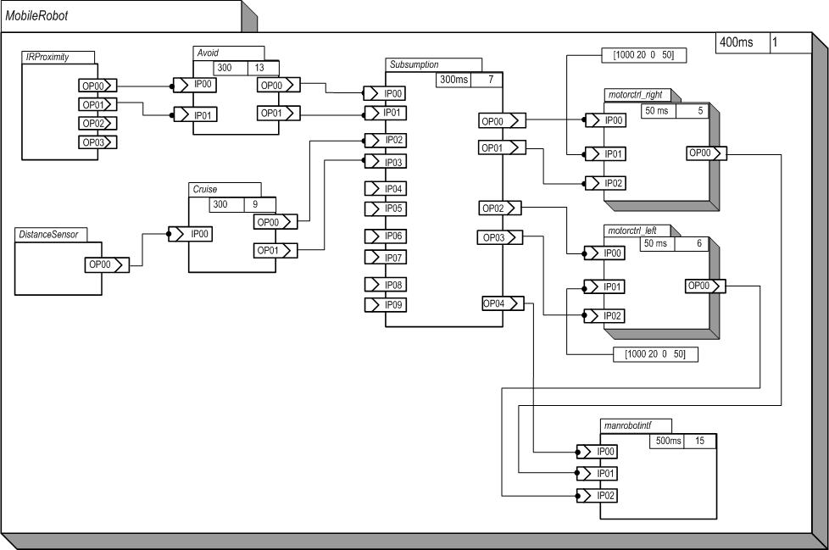
SA of a Mobile Robot Systems
Response Time Analysis

Slide 27
SA of a Mobile Robot Systems
Response Time Analysis
Step1: Compute the first approximation
Step 2: Calculate the next approximation
Step 3: Determine if the approximation is the answer.
  Condition 1: If (a_{n+1} is less than or equal to D_{i}) and (a_{n+1} is not equal to a_{n}), then repeat Step 2.
  Condition 2: If a_{n+1} is greater than D_{i}, then event a_{i} misses its deadline.
  Condition 3: a_{n+1} is equal to a_{n}, the technique terminates and a_{n} is the response time.

Slide 28
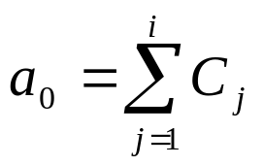
SA of a Mobile Robot Systems
Example: Response Time Analysis
Task | Period (ms) | WCET (ms) | R_{i}
MobileRobot | 50 | 1 | 1
Motorctrl_left | 50 | 20 | 21
Motorctrl_right | 50 | 20 | 41
Subsumption | 200 | 1 | 42
Avoid | 300 | 17 | 100
Cruise | 300 | 1 | 143
Manrobotintf | 500 | 16 | 200
Step1: Compute the first approximation
a₀=1+20+20+1 = 42

Slide 29
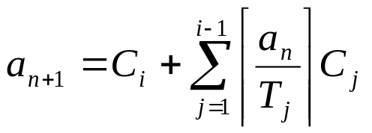
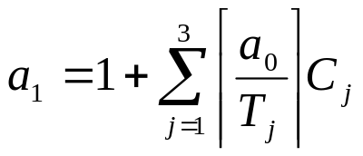
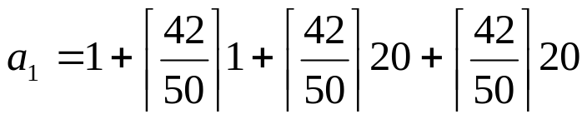
SA of a Mobile Robot Systems
Example: Response Time Analysis
Step 2: Calculate the next approximation
a=1+1+20+20 = 42
Step 3: Determine if the approximation is the answer.
Condition 1 & 2 (False): Since (a₁ is less than 200), (a₁ is equal to a₀) & 42ms <200ms
Condition 3 (True): (a₁ is equal to a₀), the techniques terminates, WCRT is 42ms & task Subsumption is schedulable.

Slide 30
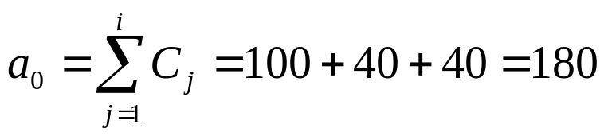
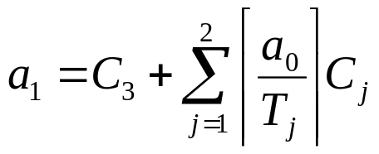
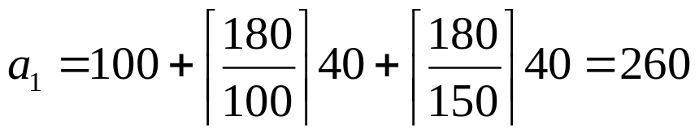
SA of a Mobile Robot Systems
Example: Response Time Analysis
Task | Period (ms) | WCET (ms) | Deadline
e1 | 100 | 40 | 100
e2 | 150 | 40 | 150
e3 | 350 | 100 | 350
Step1: Compute the first approximation
Step2: Calculate the next approximation
Step 3: Determine if the approximation is the answer.
Condition 1 (True): Since (a₀ is less than 350) and (a₁ is not equal to a₁), repeat step 2.

Slide 31
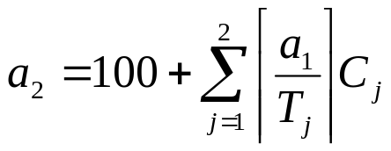
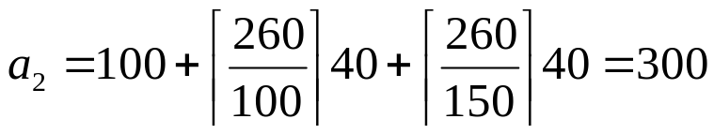
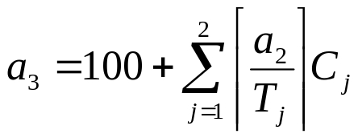

SA of a Mobile Robot Systems
Example: Response Time Analysis
Step 2: Calculate the next approximation
Step 3: Determine if the approximation is the answer.
Since (a₂ is less than 350) and (a₂ is equal to a₁), repeat Step 2
Step 2: Calculate the next approximation
Step 3: Determine if the approximation is the answer.
Since (a₃ is less than 350) and (a₃ is equal to a₂), the techniques terminates
WCRT is 300ms. Since 300ms <350ms, task a₃ is schedulable.

Slide 32
SA of a Mobile Robot Systems
Response Time Analysis
RMA verification is to check whether the entire components involved in the composition meet their deadlines.
Timing results of the mobile robot case study.
Di = Ti
Task | Period (ms) | WCET (ms) | R_{i}
MobileRobot | 50 | 1 | 1
Motorctrl_left | 50 | 20 | 21
Motorctrl_right | 50 | 20 | 41
Subsumption | 200 | 1 | 42
Avoid | 300 | 17 | 100
Cruise | 300 | 1 | 143
Manrobotintf | 500 | 16 | 200

Slide 33
SA of a Mobile Robot Systems
Scheduling mobile robotic tasks using RMA
In this example:
  RM theory was applied to the problem of scheduling of AMR systems.
  This approach allows:
    Clear separation of analysis of logical correctness and timing correctness
    To follow SE principle and simplified the component-based software development and and allows addition, modification, and deletion of tasks or components.

Slide 34
Schedulability Analysis
Class Exercise
Consider three periodic tasks with the following arrival times (S), computation times (c) and periods (p=t and d) (which are equal to their respective relative deadlines):
J₁: S₁ = 0, c₁= 2, p₁ = d₁ = 5.
J₂: S₂ = 1, c₂ = 1, p₂ = d₂ =5 and
J₃: S₃ = 2, c₃ = 2, p₃ = d₃ = 20.
Use the following techniques to perform the schedulability analysis of the above tasks. Assume Fixed-priority Scheduling (Preemptive) using RMA
  Sketch a timeline
  Processor utilization analysis (all S are 0)
  Processor workloads analysis (all S are 0)
  Response time analysis (all S are 0) S3

Slide 35

Schedulability Analysis
Team Assisted Individualization (TAI)
TAI is a Combination of cooperative learning and individualized instruction.
1. Small group, are Formed composed of students of varying ability.
2. Each student Works on individualized unit of instruction.
3. Team members use answer sheets to check each others' work, they are responsible For ensuring that all team members are ready to take the final test for each unit.
4. Discussion and peer tutoring take place for members of a group. Students are required to ask for team assistance before going to a teacher.
5. An individual will be selected from different team to discuss the answer in class.

Slide 36
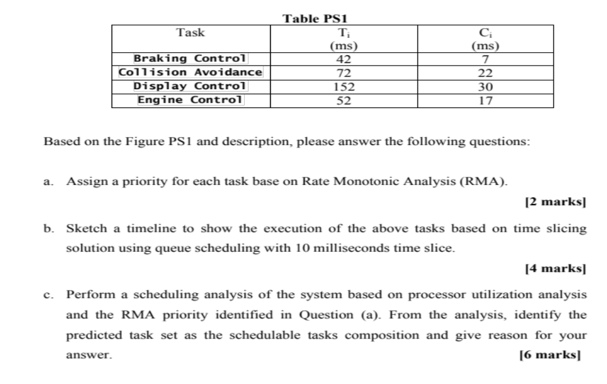
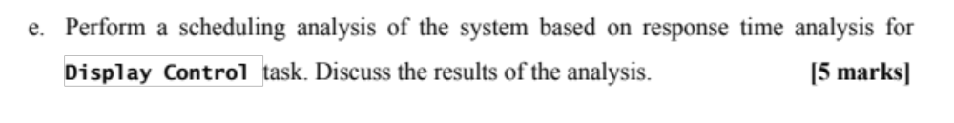

Slide 37
Schedulability Analysis
Blocking on Shared Resource
3 basic approach of ST discussed so far assumed all tasks are independent. More realistically, tasks need to synchronize with one another and communicate data values.
Task interaction & blocking will lead to priority inversion – if a task is suspended waiting for lower-priority task to complete some required computation then priority model is.

Slide 38
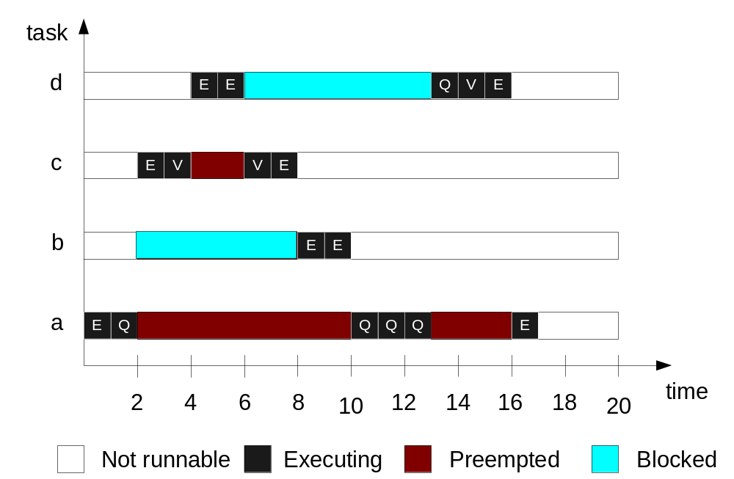
Schedulability Analysis
Blocking on Shared Resource
Task | Priority | Execution sequence | Arrival time
a | very low | EQQQQE | 0
b | low | EE | 2
c | high | EVVE | 2
d | very high | EEQVE | 4
task d suffer priority inversion

Slide 39
Schedulability Analysis
Blocking on Shared Resource
To limit the effect of priority inversion – use dynamic priority
  Priority inheritance (Cornhill er al., 1987)
  Priority ceiling protocols (Sha et al., 1990)
Priority inheritance – if a task p is suspended waiting for task q then priority of task q (locking res.) become equal to priority of task p (if it were lower).
Notes:
Structural model using UML
RT behavior using PECOS notation
Functional pattern interface using POAD interface definition

Slide 40
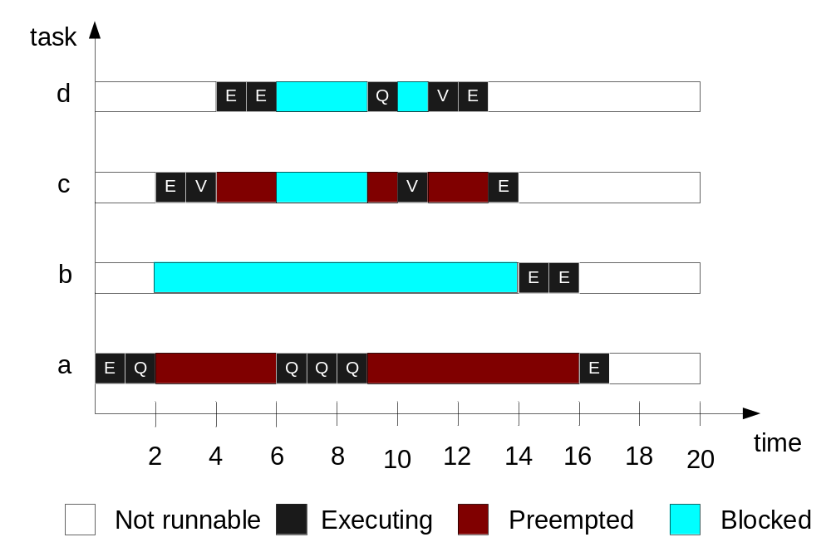
Schedulability Analysis
Blocking on Shared Resource
Task | Priority | Execution sequence | Arrival time
a | very low | EQQQQE | 0
b | low | EE | 2
c | high | EVVE | 2
d | very high | EEQVE | 4
priority inheritance - very high
priority inheritance - very high

Slide 41
Schedulability Analysis
Blocking on Shared Resource
Priority ceiling protocols (PCP) – resources protected by critical sections.
Example of PCP
  Original ceiling priority protocol
  Immediate ceiling priority protocol
Original ceiling priority protocol –
  Each task has a static default priority assigned
  Each resources has a static ceiling value defined – max priority task can use it
  A task has a dynamic priority that is the max of its own static priority & any inherits due to it blocking higher-priority task.
  A task can only lock a resource if its dynamics priority is higher than the ceiling of current lock resource.

Slide 42
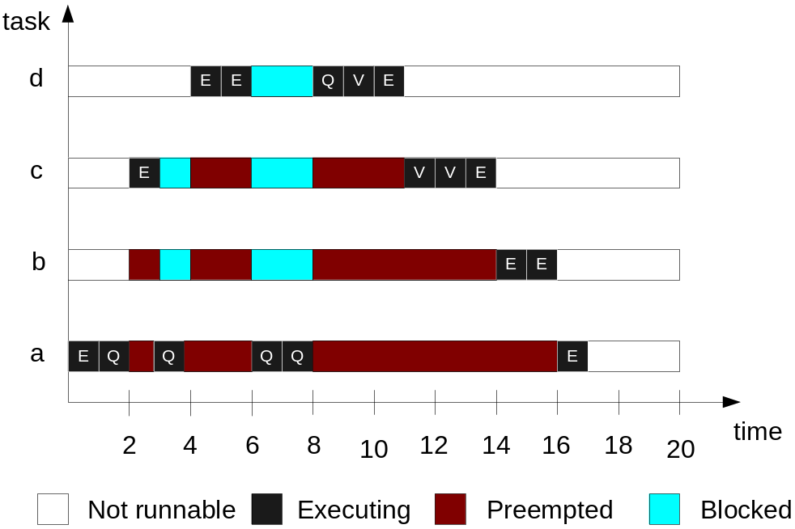
Schedulability Analysis
Blocking on Shared Resource
Task | Priority (p) | Execution sequence | Arrival time
a | very low - 1 | EQQQQE | 0
b | Low - 2 | EE | 2
c | High - 3 | EVVE | 2
d | very high -4 | EEQVE | 4
Fail to lock v resource static p (3) < ceiling of Q (4) & inherit level 3
Resource | ceiling value
Q | 4
V | 3
priority inherit level 4

Slide 43
Schedulability Analysis
Blocking on Shared Resource
Immediate ceiling priority protocol –
  Each task has a static default priority assigned
  Each resources has a static ceiling value defined – max priority task can use it
  A task has a dynamic priority that is the max of its own static priority & the ceiling values of any resources it has locked.

Slide 44
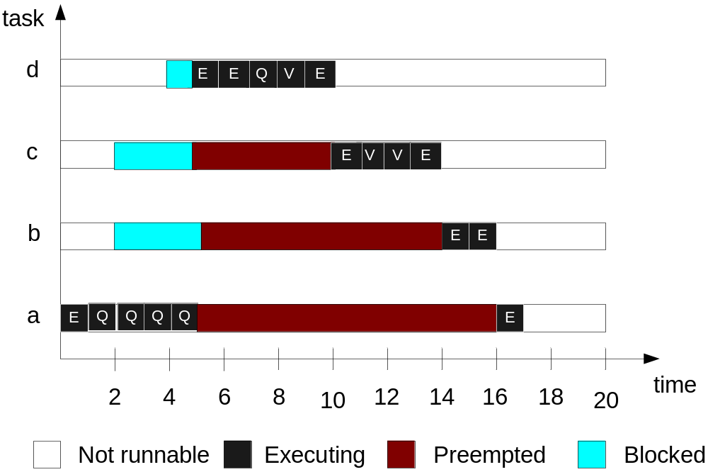
Schedulability Analysis
Blocking on Shared Resource
Task | Priority (p) | Execution sequence | Arrival time
a | very low - 1 | EQQQQE | 0
b | Low - 2 | EE | 2
c | High - 3 | EVVE | 2
d | very high -4 | EEQVE | 4
Resource | ceiling value
Q | 4
V | 4
P of a changes to ceiling of Q (4)

Slide 45
Process | Priority | Arrival time | Computation times | Execution sequence
T1 | Very high | 6 | 3 | EAB
T2 | High | 3 | 5 | EBABE
T3 | Low | 2 | 4 | EEEE
T4 | Very low | 0 | 3 | EAE
Sketch timeline diagrams to show the execution of the four tasks given the scheduling policies in Table Q4.1 In each timeline show the three situations: executing, preempted and blocked, when appropriate using the following legend.
b. Sketch a timeline diagram to show how priority inheritance can solve
the above priority inversion problem.

Slide 46
Conclusion
The abilities to predict and analyze timing are key requirements of real-time systems.
A temporal model of the system must be explicitly during the requirements, design and implementation phases to avoid timing error in the filed and costly late rework.
Proven representation analysis techniques such as RMA can be used to guarantee system predictability and performance.

Slide 47
Thank You.

