Slide 1
Software Engineering Case Studies
Software Engineering
School of Computing, Faculty of Engineering
Universiti Teknologi Malaysia

Slide 2
Case Studies
Mental Health Care Patient Management System (MHC-PMS)
  A system used to maintain records of people receiving care for mental health problems.
Wilderness Weather Station
  A data collection system that collects data about weather conditions in remote areas.
Note: The case studies are from the main reference that is Sommerville (2016)

Slide 3
Mental health care patient management system (MHC-PMS)
Case Study 1

Slide 4
Mental Health Care Patient Management System (MHC-PMS)
A patient information system to support mental health care is a medical information system that maintains information about patients suffering from mental health problems and the treatments that they have received.
Most mental health patients do not require dedicated hospital treatment but need to attend specialist clinics regularly where they can meet a doctor who has detailed knowledge of their problems.
To make it easier for patients to attend, these clinics are not just run in hospitals. They may also be held in local medical practices or community centres.

Slide 5
MHC-PMS
MHC-PMS is an information system that is intended for use in clinics.
It makes use of a centralized database of patient information but has also been designed to run on a PC, so that it may be accessed and used from sites that do not have secure network connectivity.
When the local systems have secure network access, they use patient information in the database, but they can download and use local copies of patient records when they are disconnected.

Slide 6
MHC-PMS Goals
To generate management information that allows health service managers to assess performance against local and government targets.
To provide medical staff with timely information to support the treatment of patients.

Slide 7
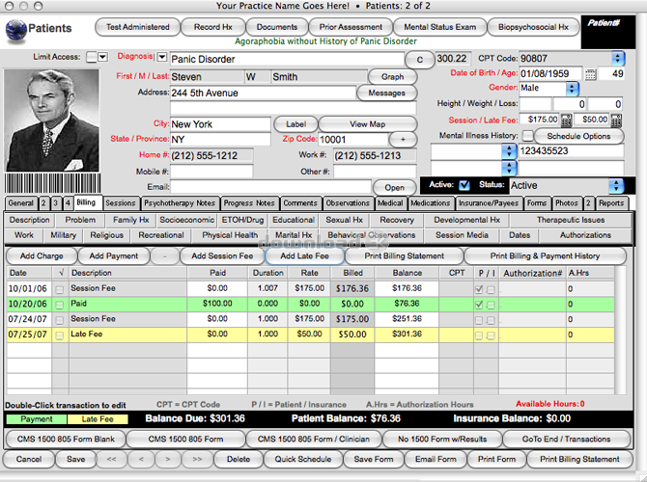

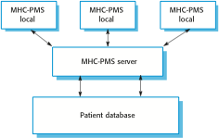
The Organization of the MHC-PMS

Slide 8
MHC-PMS Key Features
Individual care management
  Clinicians can create records for patients, edit the information in the system, view patient history, etc.
  The system supports data summaries so that doctors can quickly learn about the key problems and treatments that have been prescribed.
Patient monitoring
  The system monitors the records of patients that are involved in treatment and issues warnings if possible, problems are detected.
Administrative reporting
  The system generates monthly management reports showing the number of patients treated at each clinic, the number of patients who have entered and left the care system, number of patients sectioned, the drugs prescribed and their costs, etc.

Slide 9
MHC-PMS Concerns
Privacy
  It is essential that patient information is confidential and is never disclosed to anyone apart from authorised medical staff and the patient themselves.
Safety
  Some mental illnesses cause patients to become suicidal or a danger to other people. Wherever possible, the system should warn medical staff about potentially suicidal or dangerous patients.
  The system must be available when needed otherwise safety may be compromised and it may be impossible to prescribe the correct medication to patients.

Slide 10
Wilderness weather station
Case Study 2

Slide 11
Wilderness Weather Station
The government of a country with large areas of wilderness decides to deploy several hundred weather stations in remote areas.
Weather stations collect data from a set of instruments that measure temperature and pressure, sunshine, rainfall, wind speed and wind direction.
The weather station includes a number of instruments that measure weather parameters such as the wind speed and direction, the ground and air temperatures, the barometric pressure and the rainfall over a 24-hour period.
Each of these instruments is controlled by a software system that takes parameter readings periodically and manages the data collected from the instruments.

Slide 12
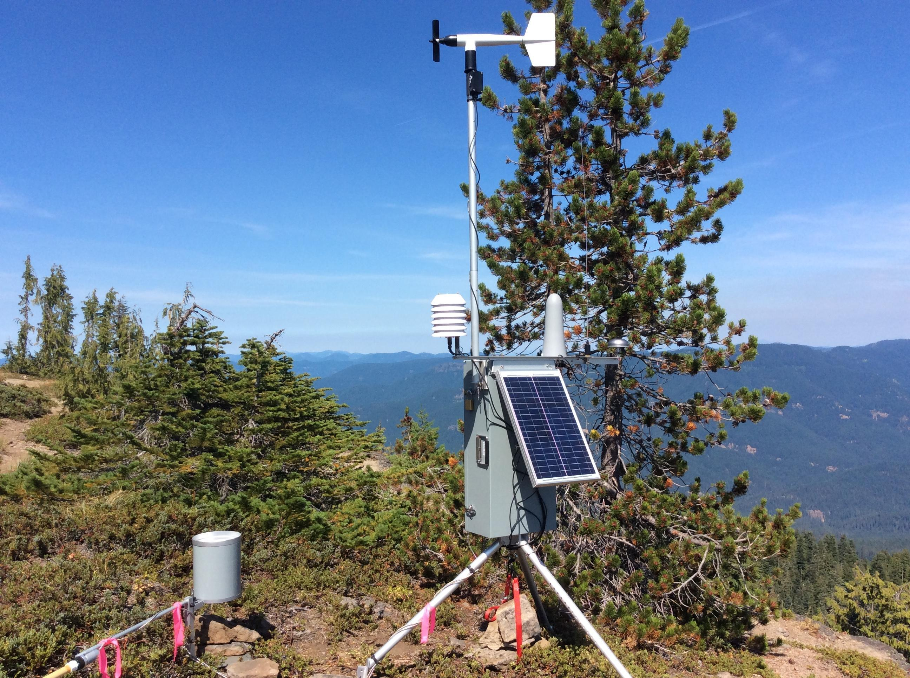

The Weather Station’s Environment

Slide 13
Weather Information System
The weather station system
  This is responsible for collecting weather data, carrying out some initial data processing and transmitting it to the data management system.
The data management and archiving system
  This system collects the data from all of the wilderness weather stations, carries out data processing and analysis and archives the data.
The station maintenance system
  This system can communicate by satellite with all wilderness weather stations to monitor the health of these systems and provide reports of problems.

Slide 14
Additional Software Functionality
Monitor the instruments, power and communication hardware and report faults to the management system.
Manage the system power, ensuring that batteries are charged whenever the environmental conditions permit but also that generators are shut down in potentially damaging weather conditions, such as high wind.
Support dynamic reconfiguration where parts of the software are replaced with new versions and where backup instruments are switched into the system in the event of system failure.

Slide 15
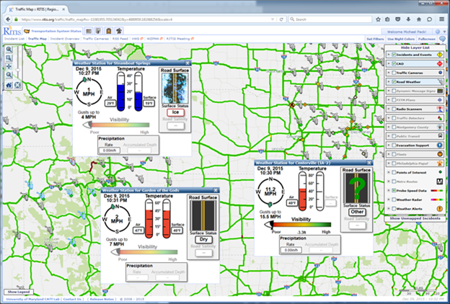
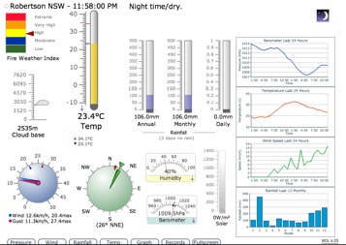
Examples of System Interface

