Slide 1
Module 1: Introduction to Software Engineering
Software Engineering
School of Computing, Faculty of Engineering
Universiti Teknologi Malaysia

Slide 2
Outline
Software engineering definition
Software engineering as a layered technology
Types of software
Inherent difficulties in software engineering
Software engineering quality focus
Documentation standard
Note: The overall contents of the slide are based on the main reference that is Sommerville (2016) with other references specified directly in respective slides

Slide 3
Objectives
The objectives of this module are:
To understand the importance of software engineering in software development
To understand the definition of software engineering
To know the difference between Software Engineering and Computer Science, Software Engineering and Software Programming
To understand the importance of software quality and documentation standard

Slide 4
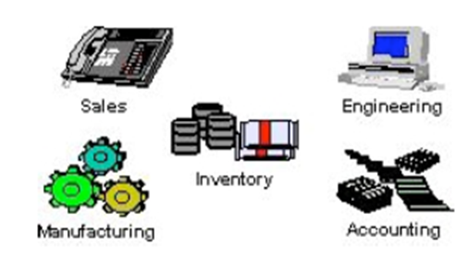
The Importance of Software Engineering
Software engineering is important because software is needed in almost every industry, business and transactions
If an application fails; a fast, efficient, and effective fix needs to happen as soon as possible

Slide 5
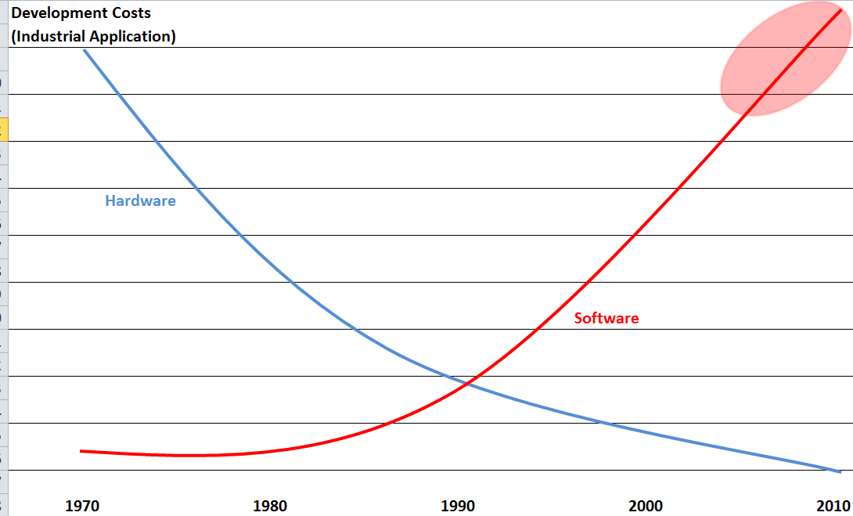
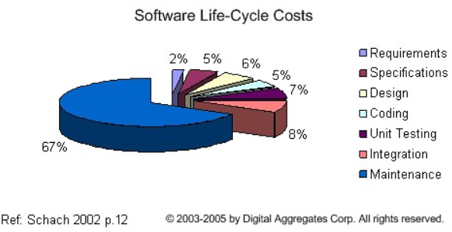
Software Engineering Costs
Software costs are often greater than that of hardware
Software costs more to maintain than it does to develop
For systems with a long life, maintenance costs may be several times higher than development costs
Therefore software engineering is concerned with cost-effective software development
Image source: http://cerescontrols.com/tutorials-3/

Slide 6
Software Engineering in Software Development
Software engineering is concerned with theories, methods and tools for professional software development
Software engineers should adopt a systematic and organised approach to their work and use appropriate tools and techniques depending on the problem to be solved, the development constraints and the resources available

Slide 7
Software Engineering Definition
Software engineering is an engineering discipline that is concerned with all aspects of software production.
“The application of a systematic, disciplines, quantifiable approach to the development, operation, and maintenance of software; that is the application of engineering to software.” (IEEE, 1993)

Slide 8
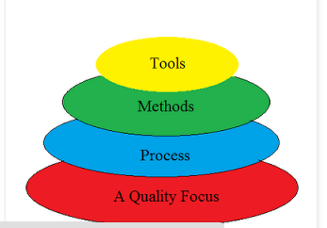
Software Engineering as a Layered Technology
Quality Focus: The bedrock that supports software engineering is quality focus where it ensures continuous process improvement culture.
Process:Foundation for software engineering which enables rational and timely development of computer software
Methods: provide technical how to’s for building software. Involve different tasks including requirements analysis, design, program construction, testing and support. Methods also include modeling activities
Tools: provide automated or semi-automated support for the process and methods
Note: The layered technology will be the focus in this lecture and throughout the semester
Source:
Agarwal, U. (2012). Software Engineering, Kataria and Sons.
http://sesolution.blogspot.my/p/software-engineering-layered-technology.html

Slide 9
Software Products and
Product Specification
Generic Products
Customized Products
Stand-alone systems that are marketed and sold to any customer who wishes to buy them.
Examples – PC software such as graphics programs, project management tools; CAD software; software for specific markets such as appointments systems for dentists.
The specification of what the software should do is owned by the software developer and decisions on software change are made by the developer.
Software that is commissioned by a specific customer to meet their own needs.
Examples – embedded control systems, air traffic control software, traffic monitoring systems.
The specification of what the software should do is owned by the customer for the software and they make decisions on software changes that are required.

Slide 10
Software Engineering Diversity:
Types of Software
System Software
Real Time Software
Systems for modeling and simulation
Embedded Software
Types of
Software
Interactive Transaction Based Software
Business Software
Stand alone application
Artificial Intelligence Software
Sources: Agarwal, U. (2012). Software Engineering, Kataria and Sons.
Sommerville, I. (2016). Software Engineering 10th edition, Pearson.

Slide 11
Different Types of Software…
System software
  To manage resources and provide clean interfaces to OS services
Real-time software
  monitors, analyzes, and controls real-world events as they occur in real-time; design efforts for this type of software is to guarantee the tasks complete within deadlines
  Response time typically ranges from 1 millisecond to 1 second
Business software
      Management information system (MIS) that accesses one or more databases containing business information (e.g. payroll, inventory)
Embedded software
  Runs on specific devices such as microwave ovens, washing machines, automobiles
  software resides in read only memory and used to control products and systems for the consumer and industrial market

Slide 12
Different Types of Software
System for modeling and simulation
    These are systems developed by scientist and engineers to model physical processes or situations, which often computationally intensive and require high-performance parallel systems for execution
Stand alone application
    Word processing, spreadsheets, computer graphics, multimedia, entertainment, personal and business financial applications, etc.
Interactive transaction-based software
      Applications that execute on a remote computer/server and accessed by users from their own devices that include web applications such as e-commerce that nowadays can be accessed as mobile applications
Artificial intelligence software
  Uses non-numerical algorithms to solve complex problems
  Applications: robotics, expert systems, pattern recognition, adaptive control, game playing

Slide 13
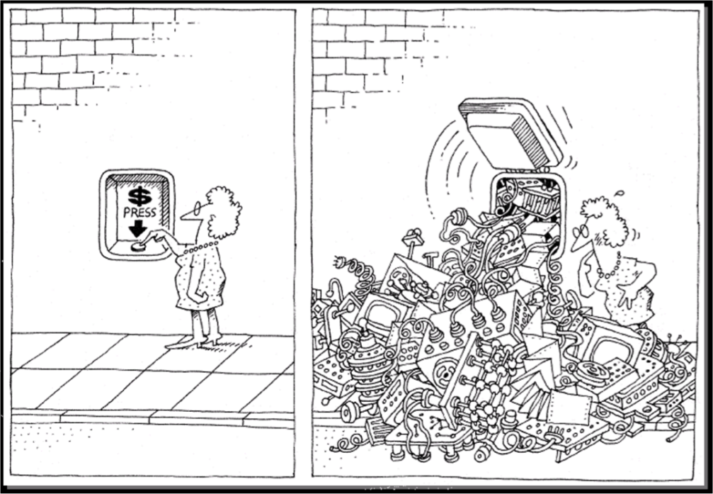
Inherent Difficulties
Software inherent difficulties include:
  Software complexity
  Software changeability
pautasso.info

Slide 14
Software Complexity…
Why is it complex?
No one really understands a large software product as a whole
faults in specifications are made simply because of a lack of understanding of all aspects of the product
no matter how trivial, the various pieces of the product will interact
difficulty due to invisible nature of relationships and imperfect model of reality
No silver bullet
There are many different types of software system and there is no universal set of software techniques that is applicable to all of these
The software engineering methods and tools used depend on the type of application being developed, the requirements of the customer and the background of the development team
    ©2009 J. L. Díaz-Herrera

Slide 15
Software Complexity…
The complexity comes from:
Application domain
  The problems are often very complex
  The developers are not domain experts
Communication among stakeholders (clients, developers)
  The stakeholders use different vocabulary:
    domain experts <=> developers <=> developers
  Human languages are inherently ambiguous
  The stakeholders have different background knowledge
Management of large software development projects
  Need to divide the project into pieces and reassemble the pieces
  Need to coordinate many people

Slide 16
Software Complexity…
Software complexity leads to software quality problems:
  Unreliable ➔ e.g. ARIANE 5 rocket
  Unsafe ➔ e.g. London Ambulance
  Abandoned ➔ e.g. London Stock Exchange
  Inflexible ➔ hard to change/maintain
Software project management problems
Often over schedule and over budget by an order of magnitude
Software engineer productivity problems

Slide 17
Software Complexity…
Ariane 5 rocket:
  Its maiden flight on June 4, 1996 ended in the launcher being exploded because of a chain of software failures
London Ambulance:
  Because of a succession of software engineering failures the system was introduced that failed twice in the autumn of 1992
  Although the monetary costed at “only” about £9m, was small by comparison with other examples, it is believed that PEOPLE DIED due to the ambulance do not come as promptly as they would
London Stock Exchange (LSE):
  The estimated loss to customers was around £450m and the damage to the reputation of the LSE was incalculable

Slide 18
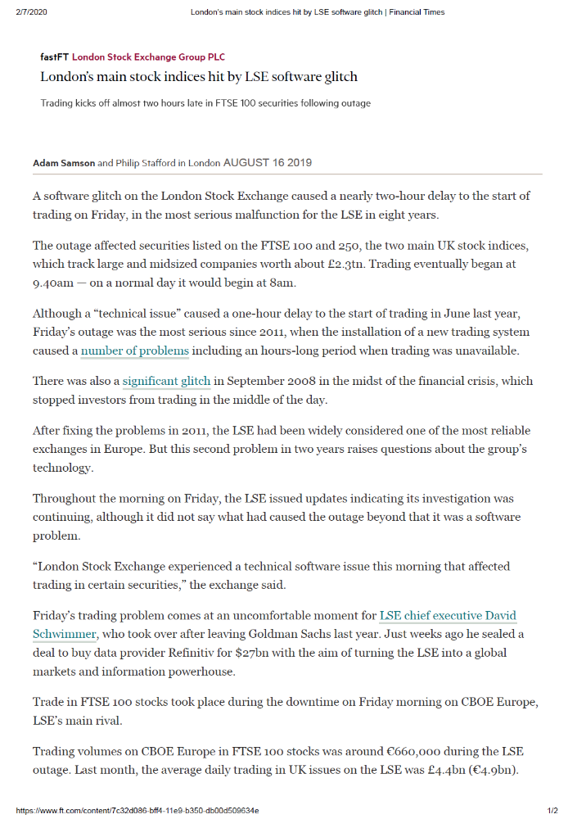
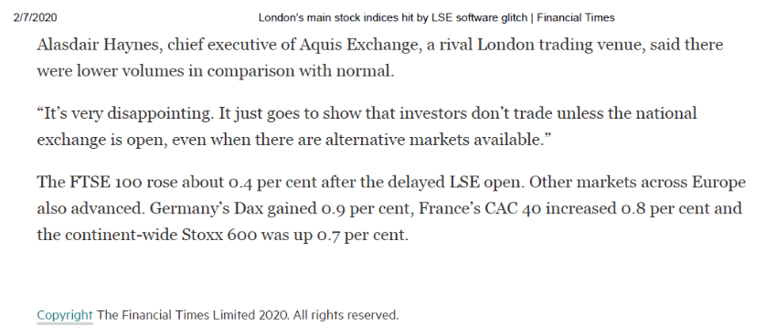
LSE Example
Source: Financial Times
https://www.ft.com/content/7c32d086-bff4-11e9-b350-db00d509634e

Slide 19
Software Changeability
Major changes to software will always and frequently be demanded
  successful software is required to provide more functionality
  software survives hardware
Changing software (“maintenance”)
  is difficult due to dynamic nature of relationships between its interacting parts
    ©2009 J. L. Díaz-Herrera

Slide 20
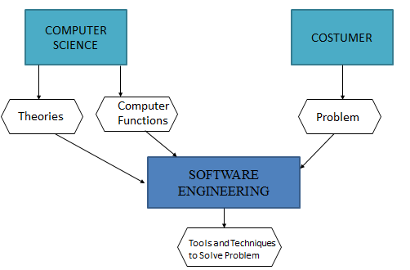
Computer Science vs.
Software Engineering
Computer science
- The study of computation & information processing, both in hardware and software
- The discipline concerned with developing large applications
Software engineering
- Covers not only the technical aspects of building software systems, but also management issues, such as directing programming teams, scheduling, and budgeting
Source : Agarwal, U. (2012). Software Engineering, Kataria and Sons.

Slide 21
Software Engineering vs.
Software Programming
Software Programming | Software Engineering
Single developer | Teams of developers with multiple roles
“Toy” applications | Complex systems
Short lifespan | Indefinite lifespan
One-of-a-kind systems | System families
Built from scratch | May be reused to reduce costs
Minimal maintenance | Maintenance accounts for over 60% of overall development costs

Slide 22
Quality Focus
Product
External qualities are visible to the user
  reliability, efficiency, usability
Internal qualities are the concern of developers
  they help developers achieve external qualities
  verifiability, maintainability, extensibility, evolvability, adaptability
Product vs. Process Qualities:
Product qualities concern the developed artifacts
  maintainability, understandability, performance
Process qualities deal with the development activity
Products are developed through process
  maintainability, productivity, timeliness
Process

Slide 23
Quality Focus: Example of Software Quality…
Product characteristic | Description
Maintainability | Software should be written in such a way so that it can evolve to meet the changing needs of customers. This is a critical attribute because software change is an inevitable requirement of a changing business environment.
Verifiability | Its properties can be verified easily performed by formal analysis or testing internal quality
Efficiency | Software should not make wasteful use of system resources such as memory and processor cycles. Efficiency therefore includes responsiveness, processing time, memory utilisation, etc.
Acceptability | Software must be acceptable to the type of users for which it is designed. This means that it must be understandable, usable and compatible with other systems that they use.

Slide 24
Quality Focus: Example of Software Quality
Product characteristic | Description
Usability | The higher the usability of software, the easier it is for users to work with it. There are several aspects of usability, including learnability for novices, efficiency of use for experts and handling of errors.
Reliability | Software is more reliable if it has fewer failures. Since software engineers do not deliberately plan for their software to fail, reliability depends on the number and types of mistakes they make.
Reusability | A software component is reusable if it can be used in several different systems with little or no modification. High reusability can reduce the long term costs faced by the development team.
Correctness | Ideal quality: established with respect to the requirements specification Absolute software quality: any deviation from the requirements makes the software incorrect, regardless of how minor or serious is the consequence of the deviation
Robustness | “Reasonable” behavior in unforeseen circumstances; subjective; a specified requirement is an issue of correctness; an unspecified requirement is an issue of robustness

Slide 25
Quality Priority
All the quality are important. However the importance of each quality differs from different application area and it can be costly where improving one quality can be an expense in cost to other quality.
Depends on the application area:-
  Information systems (library cataloguing, personnel system)
  Safety critical system (Nuclear power plant )
  Distributed systems (banking system)
  Embedded systems (vending machine, patient monitoring system )
Influenced by cost
  Efficiency vs. Cost: Improving efficiency may make the design less easy to be understood which make it costly to be maintained.
  Reliability vs. Cost: High reliability entails repeatedly checking for errors, adding redundant computations which make efficiency cannot be achieved.

Slide 26
Software Standard and Document
Standard contributes to software quality mainly in producing documents for each Software Development Life Cycle (SDLC)
Example of document standards by IEEE:
  IEEE-Std830-1998-Software Requirements Specifications
  IEEE-Std1016-2009-Software Design Desriptions
  IEEE 829 - Standard for Test Documentation Overview-Test Plan Outline
  IEEE Std829-2008-Software and System Test Documentation

Slide 27
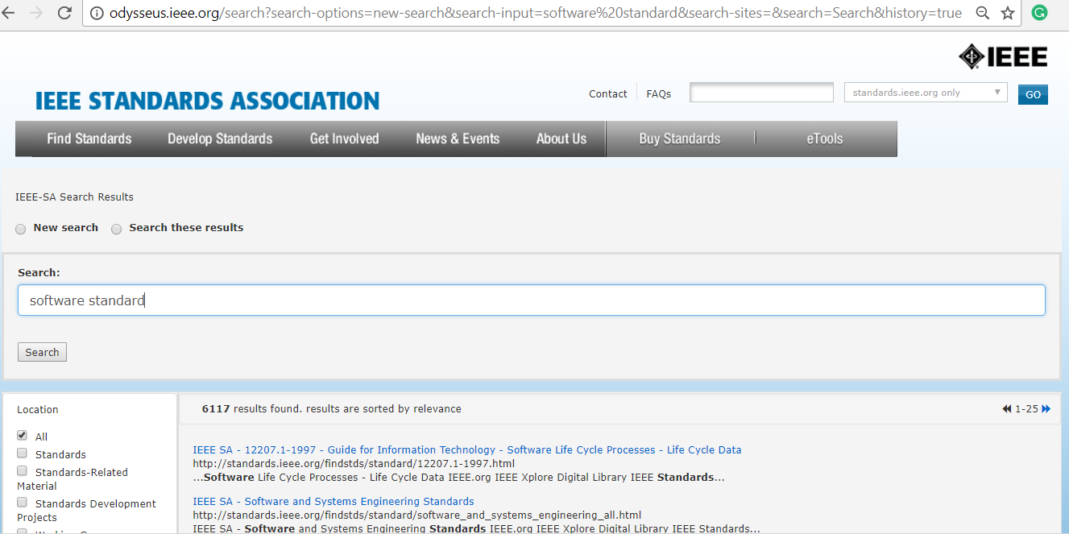
Example: IEEE Standards

