Slide 1
Module 6: Compute
AWS Academy Cloud Foundations
© 2019, Amazon Web Services, Inc. or its Affiliates. All rights reserved.
Notes:
Welcome to Module 6: Compute

Slide 2

Module overview
Topics
Compute services overview
Amazon EC2
Amazon EC2 cost optimization
Activities
Amazon EC2 versus Managed Service
Lab
Introduction to Amazon EC2
Knowledge check
Notes:
This module will address the following topics:
Compute services overview
Amazon EC2
Amazon EC2 cost optimization
Container services
Introduction to AWS Lambda
Introduction to AWS Elastic Beanstalk
Section 2 includes a recorded Amazon EC2 demonstration. The end of this same section includes a hands-on lab, where you will practice launching an EC2 instance by using the AWS Management Console. There is also an activity in this section that has you compare the advantages and disadvantages of running a database deployment on Amazon EC2, versus running it on Amazon Relational Database Service (RDS).
Section 5 includes a hands-on AWS Lambda activity and section 6 includes a hands-on Elastic Beanstalk activity.
Finally, you will be asked to complete a knowledge check that will test your understanding of the key concepts that are covered in this module.

Slide 3
Module objectives
After completing this module, you should be able to:
Demonstrate why to use Amazon Elastic Compute Cloud (Amazon EC2)
Identify the functionality in the EC2 console
Perform basic functions in Amazon EC2 to build a virtual computing environment
Identify Amazon EC2 cost optimization elements

Slide 4
Section 1: Compute services overview
Module 6: Compute
Notes:
Introducing Section 1: Compute services overview.

Slide 5














AWS compute services
Amazon Web Services (AWS) offers many compute services. This module will discuss the highlighted services.
Amazon EC2
Amazon EC2
Auto Scaling
Amazon Elastic
Container Registry (Amazon ECR)
Amazon Elastic
Container Service (Amazon ECS)
VMware Cloud
on AWS
AWS Elastic
Beanstalk
AWS Lambda
Amazon Elastic
Kubernetes Service (Amazon EKS)
Amazon Lightsail
AWS Batch
AWS Fargate
AWS Outposts
AWS Serverless Application Repository
Notes:
Amazon Web Services (AWS) offers many compute services. Here is a brief summary of what each compute service offers:
Amazon Elastic Compute Cloud (Amazon EC2) provides resizable virtual machines.
Amazon EC2 Auto Scaling supports application availability by allowing you to define conditions that will automatically launch or terminate EC2 instances.
Amazon Elastic Container Registry (Amazon ECR) is used to store and retrieve Docker images.
Amazon Elastic Container Service (Amazon ECS) is a container orchestration service that supports Docker.
VMware Cloud on AWS enables you to provision a hybrid cloud without custom hardware.
AWS Elastic Beanstalk provides a simple way to run and manage web applications.
AWS Lambda is a serverless compute solution. You pay only for the compute time that you use.
Amazon Elastic Kubernetes Service (Amazon EKS) enables you to run managed Kubernetes on AWS.
Amazon Lightsail provides a simple-to-use service for building an application or website.
AWS Batch provides a tool for running batch jobs at any scale.
AWS Fargate provides a way to run containers that reduce the need for you to manage servers or clusters.
AWS Outposts provides a way to run select AWS services in your on-premises data center.
AWS Serverless Application Repository provides a way to discover, deploy, and publish serverless applications.
This module will discuss details of the services that are highlighted on the slide.

Slide 6
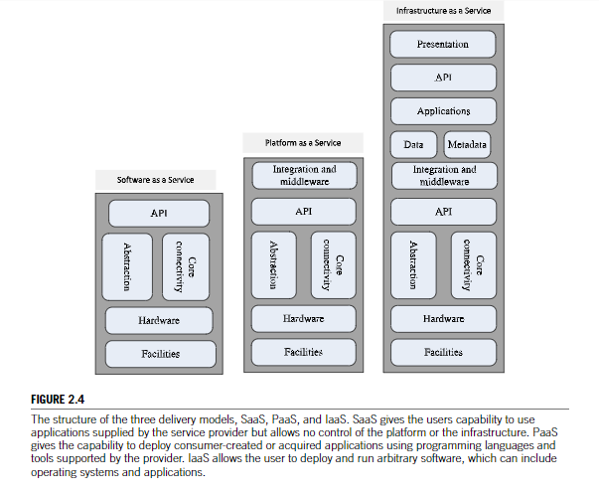
Cloud Computing Model

Slide 7
Section 2: Amazon EC2
Module 6: Compute
Notes:
Introducing Section 2: Amazon EC2.

Slide 8




Amazon Elastic Compute Cloud (Amazon EC2)
Example uses of Amazon EC2 instances
Application server
Web server
Database server
Game server
Mail server
Media server
Catalog server
File server
Computing server
Proxy server
Amazon EC2 instances
Photo by Taylor Vick on Unsplash
On-premises servers
Photo by panumas nikhomkhai from Pexels
Notes:
Running servers on-premises is an expensive undertaking. Hardware must be procured, and this procurement can be based on project plans instead of the reality of how the servers are used. Data centers are expensive to build, staff, and maintain. Organizations also need to permanently provision a sufficient amount of hardware to handle traffic spikes and peak workloads. After traditional on-premises deployments are built, server capacity might be unused and idle for a significant portion of the time that the servers are running, which is wasteful.
Amazon Elastic Compute Cloud (Amazon EC2) provides virtual machines where you can host the same kinds of applications that you might run on a traditional on-premises server. It provides secure, resizable compute capacity in the cloud. EC2 instances can support a variety of workloads. Common uses for EC2 instances include, but are not limited to:
Application servers
Web servers
Database servers
Game servers
Mail servers
Media servers
Catalog servers
File servers
Computing servers
Proxy servers

Slide 9
Amazon EC2 overview
Amazon Elastic Compute Cloud (Amazon EC2)
  Provides virtual machines—referred to as EC2 instances—in the cloud.
  Gives you full control over the guest operating system (Windows or Linux) on each instance.
You can launch instances of any size into an Availability Zone anywhere in the world.
  Launch instances from Amazon Machine Images (AMIs).
  Launch instances with a few clicks or a line of code, and they are ready in minutes.
You can control traffic to and from instances.
Amazon EC2
Notes:
The EC2 in Amazon EC2 stands for Elastic Compute Cloud:
Elastic refers to the fact that you can easily increase or decrease the number of servers you run to support an application automatically, and you can also increase or decrease the size of existing servers.
Compute refers to reason why most users run servers in the first place, which is to host running applications or process data—actions that require compute resources, including processing power (CPU) and memory (RAM).
Cloud refers to the fact that the EC2 instances that you run are hosted in the cloud.
Amazon EC2 provides virtual machines in the cloud and gives you full administrative control over the Windows or Linux operating system that runs on the instance. Most server operating systems are supported, including: Windows 2008, 2012, 2016, and 2019, Red Hat, SuSE, Ubuntu, and Amazon Linux.
An operating system that runs on a virtual machine is often called a guest operating system to distinguish it from the host operating system. The host operating system is directly installed on any server hardware that hosts one or more virtual machines.
With Amazon EC2, you can launch any number of instances of any size into any Availability Zone anywhere in the world in a matter of minutes. Instances launch from Amazon Machine Images (AMIs), which are effectively virtual machine templates. AMIs are discussed in more detail later in this module.
You can control traffic to and from instances by using security groups. Also, because the servers run in the AWS Cloud, you can build solutions that take use multiple AWS services.

Slide 10
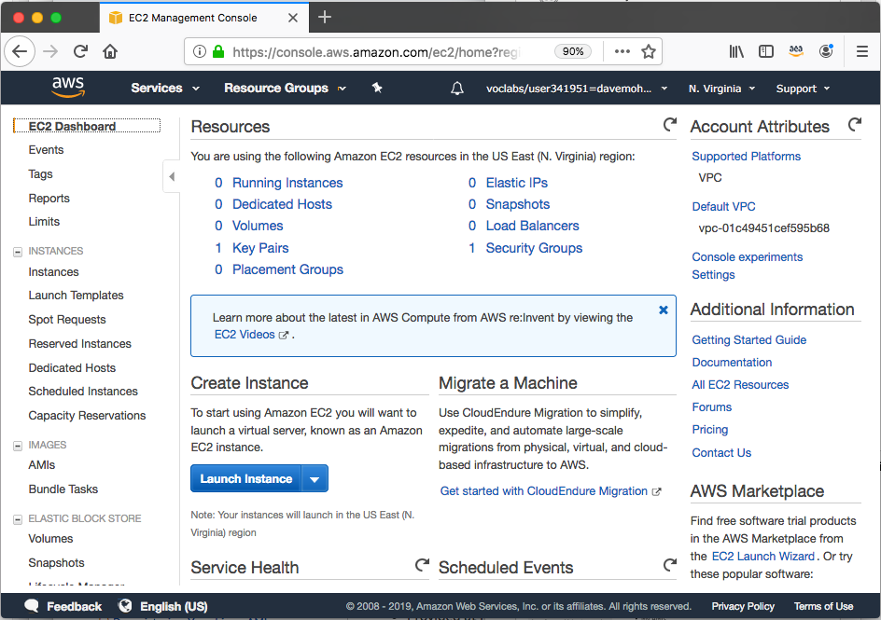

Launching an Amazon EC2 instance
This section of the module walks through nine key decisions to make when you create an EC2 instance by using the AWS Management Console Launch Instance Wizard.
Along the way, essential Amazon EC2 concepts will be explored.
Notes:
The first time you launch an Amazon EC2 instance, you will likely use the AWS Management Console Launch Instance Wizard. You will have the opportunity to experience using the Launch Wizard in the lab that is in this module.
The Launch Instance Wizard makes it easy to launch an instance. For example, if you choose to accept all the default settings, you can skip most of the steps that are provided by the wizard and launch an EC2 instance in as few as six clicks. An example of this process is shown in the demonstration at the end of this section.
However, for most deployments you will want to modify the default settings so that the servers you launch are deployed in a way that matches your specific needs.
The next series of slides introduce you to the essential choices that you must make when you launch an instance. The slides cover essential concepts that are good to know when you make these choices. These concepts are described to help you understand the options that are available, and the effects of the decisions that you will make.

Slide 11




1. Select an AMI
Choices made using the
Launch Instance Wizard:
AMI
Instance Type
Network settings
IAM role
User data
Storage options
Tags
Security group
Key pair
Launch
instance
AMI
Instance
Amazon Machine Image (AMI)
  Is a template that is used to create an EC2 instance (which is a virtual machine, or VM, that runs in the AWS Cloud)
  Contains a Windows or Linux operating system
  Often also has some software pre-installed
AMI choices:
  Quick Start – Linux and Windows AMIs that are provided by AWS
  My AMIs – Any AMIs that you created
  AWS Marketplace – Pre-configured templates from third parties
  Community AMIs – AMIs shared by others; use at your own risk
Notes:
An Amazon Machine Image (AMI) provides information that is required to launch an EC2 instance. You must specify a source AMI when you launch an instance. You can use different AMIs to launch different types of instances. For example, you can choose one AMI to launch an instance that will become a web server and another AMI to deploy an instance that will host an application server. You can also launch multiple instances from a single AMI.
An AMI includes the following components:
A template for the root volume of the instance. A root volume typically contains an operating system (OS) and everything that was installed in that OS (applications, libraries, etc.). Amazon EC2 copies the template to the root volume of a new EC2 instance, and then starts it.
Launch permissions that control which AWS accounts can use the AMI.
A block device mapping that specifies the volumes to attach to the instance (if any) when it is launched.
You can choose many AMIs:
Quick Start – AWS offers a number of pre-built AMIs for launching your instances. These AMIs include many Linux and Windows options.
My AMIs – These AMIs are AMIs that you created.
AWS Marketplace – The AWS Marketplace offers a digital catalog that lists thousands of software solutions. These AMIs can offer specific use cases to help you get started quickly.
Community AMIs – These AMIs are created by people all around the world. These AMIs are not checked by AWS, so use them at your own risk. Community AMIs can offer many different solutions to various problems, but use them with care. Avoid using them in any production or corporate environment.

Slide 12




Creating a new AMI: Example
AWS Cloud
AMI details
Region A
Connect to the instance and manually modify it or run a script that modifies the instance (for example, upgrade installed software)
Quick Start or other
existing AMI
Launch an instance
Capture as
a new AMI
Starter
AMI
1
2
Modified
Instance
3
Unmodified
Instance
New
AMI
(Optional) Import
a virtual machine
MyAMI
Region B
Copy the AMI to any other Regions
where you want to use it
New
AMI
4
Notes:
An AMI is created from an EC2 instance. You can import a virtual machine so that it becomes an EC2 instance, and then save the EC2 instance as an AMI. You can then launch an EC2 instance from that AMI. Alternatively, you can start with an existing AMI—such as of the Quick Start AMIs provided by AWS—and create an EC2 instance from it.
Regardless of which options you chose (step 1), you will have what the diagram refers to as an unmodified instance. From that instance, you might then create a golden instance—that is, a virtual machine that you configured with the specific OS and application settings that you want (step 2)—and then capture that as a new AMI (step 3). When you create an AMI, Amazon EC2 stops the instance, creates a snapshot of its root volume, and finally registers the snapshot as an AMI.
After an AMI is registered, the AMI can be used to launch new instances in the same AWS Region. The new AMI can now be thought of as a new starter AMI. You might want to also copy the AMI to other Regions (step 4), so that EC2 instances can also be launched in those locations.

Slide 13


2. Select an instance type
Choices made using the
Launch Instance Wizard:
AMI
Instance Type
Network settings
IAM role
User data
Storage options
Tags
Security group
Key pair
Consider your use case
  How will the EC2 instance you create be used?
The instance type that you choose determines –
  Memory (RAM)
  Processing power (CPU)
  Disk space and disk type (Storage)
  Network performance
Instance type categories –
  General purpose
  Compute optimized
  Memory optimized
  Storage optimized
  Accelerated computing
Instance types offer family, generation, and size
Notes:
After you choose the AMI for launching the instance, you must choose on an instance type.
Amazon EC2 provides a selection of instance types that optimized to fit different use cases. Instance types comprise varying combinations of CPU, memory, storage, and networking capacity. The different instance types give you the flexibility to choose the appropriate mix of resources for your applications. Each instance type includes one or more instance sizes, which enable you to scale your resources to the requirements of your target workload.
Instance type categories include general purpose, compute optimized, memory optimized, storage optimized, and accelerated computing instances. Each instance type category offers many instance types to choose from.

Slide 14

EC2 instance type naming and sizes
Instance type details
Example instance sizes
Instance Name | vCPU | Memory (GB) | Storage
t3.nano | 2 | 0.5 | EBS-Only
t3.micro | 2 | 1 | EBS-Only
t3.small | 2 | 2 | EBS-Only
t3.medium | 2 | 4 | EBS-Only
t3.large | 2 | 8 | EBS-Only
t3.xlarge | 4 | 16 | EBS-Only
t3.2xlarge | 8 | 32 | EBS-Only
Instance type naming
Example: t3.large
  T is the family name
  3 is the generation number
  Large is the size
Notes:
When you look at an EC2 instance type, you will see that its name has several parts. For example, consider the T type.
T is the family name, which is then followed by a number. Here, that number is 3.
The number is the generation number of that type. So, a t3 instance is the third generation of the T family. In general, instance types that are of a higher generation are more powerful and provide a better value for the price.
The next part of the name is the size portion of the instance. When you compare sizes, it is important to look at the coefficient portion of the size category.
For example, a t3.2xlarge has twice the vCPU and memory of a t3.xlarge. The t3.xlarge has, in turn, twice the vCPU and memory of a t3.large.
It is also important to note that network bandwidth is also tied to the size of the Amazon EC2 instance. If you will run jobs that will be very network-intensive, you might be required to increase the instance specifications to meet your needs.

Slide 15




Select instance type: Based on use case
Instance type details
 | General Purpose | Compute Optimized | Memory Optimized | Accelerated Computing | Storage Optimized
Instance Types | a1, m4, m5, t2, t3 | c4, c5 | r4, r5, x1, z1 | f1, g3, g4, p2, p3 | d2, h1, i3
Use Case | Broad | High performance | In-memory databases | Machine learning | Distributed file systems
Notes:
Instance types vary in several ways, including: CPU type, CPU or core count, storage type, storage amount, memory amount, and network performance. The chart provides a high-level view of the different instance categories, and which instance type families and generation numbers fit into each category type. Consider a few of the instance types in more detail:
T3 instances provide burstable performance general purpose instances that provide a baseline level of CPU performance with the ability to burst above the baseline. Use cases for this type of instance include websites and web applications, development environments, build servers, code repositories, microservices, test and staging environments, and line-of-business applications.
C5 instances are optimized for compute-intensive workloads, and deliver cost-effective high performance at a low price per compute ratio. Use cases include scientific modeling, batch processing, ad serving, highly scalable multiplayer gaming, and video encoding.
R5 instances are optimized for memory-intensive applications. Use cases include high-performance databases, data mining and analysis, in-memory databases, distributed web-scale in-memory caches, applications that perform real-time processing of unstructured big data, Apache Hadoop or Apache Spark clusters, and other enterprise applications.
To learn more about each instance type, see the Amazon EC2 Instance Types documentation.

Slide 16
Instance types: Networking features
The network bandwidth (Gbps) varies by instance type.
  See Amazon EC2 Instance Types to compare.
To maximize networking and bandwidth performance of your instance type:
  If you have interdependent instances, launch them into a cluster placement group.
  Enable enhanced networking.
Enhanced networking types are supported on most instance types.
  See the Networking and Storage Features documentation for details.
Enhanced networking types –
  Elastic Network Adapter (ENA): Supports network speeds of up to 100 Gbps.
  Intel 82599 Virtual Function interface: Supports network speeds of up to 10 Gbps.
Notes:
In addition to considering the CPU, RAM, and storage needs of your workloads, it is also important to consider your network bandwidth requirements.
Each instance type provides a documented network performance level. For example, an a1.medium instance will provide up to 10 Gbps, but a p3dn.24xlarge instance provides up to 100 Gbps. Choose an instance type that meets your requirements.
When you launch multiple new EC2 instances, Amazon EC2 attempts to place the instances so that they are spread out across the underlying hardware by default. It does this to minimize correlated failures. However, if you want to specify specific placement criteria, you can use placement groups to influence the placement of a group of interdependent instances to meet the needs of your workload. For example, you might specify that three instances should all be deployed in the same Availability Zone to ensure lower network latency and higher network throughput between instances. See the Placement Group documentation for details.
Many instance types also enable you to configure enhanced networking to get significantly higher packet per second (PPS) performance, lower delay variation in the arrival of packets over the network (network jitter), and lower latencies. See the Elastic Network Adapter (ENA) documentation for details.

Slide 17




3. Specify network settings
Choices made by using the
Launch Instance Wizard:
AMI
Instance Type
Network settings
IAM role
User data
Storage options
Tags
Security group
Key pair
Where should the instance be deployed?
  Identify the VPC and optionally the subnet
Should a public IP address be automatically assigned?
  To make it internet-accessible
AWS Cloud
Region
Availability Zone 1
Availability Zone 2
VPC
Example: specify to deploy the instance here
Public subnet
Instance
Private subnet
Notes:
After you have choose an AMI and an instance type, you must specify the network location where the EC2 instance will be deployed. The choice of Region must be made before you start the Launch Instance Wizard. Verify that you are in the correct Region page of the Amazon EC2 console before you choose Launch Instance.
When you launch an instance in a default VPC, AWS will assign it a public IP address by default. When you launch an instance into a nondefault VPC, the subnet has an attribute that determines whether instances launched into that subnet receive a public IP address from the public IPv4 address pool. By default, AWS will not assign a public IP address to instances that are launched in a nondefault subnet. You can control whether your instance receives a public IP address by either modifying the public IP addressing attribute of your subnet, or by enabling or disabling the public IP addressing feature during launch (which overrides the subnet's public IP addressing attribute).

Slide 18


4. Attach IAM role (optional)
Choices made by using the
Launch Instance Wizard:
AMI
Instance Type
Network settings
IAM role
User data
Storage options
Tags
Security group
Key pair
Will software on the EC2 instance need to interact with other AWS services?
  If yes, attach an appropriate IAM Role.
An AWS Identity and Access Management (IAM) role that is attached to an EC2 instance is kept in an instance profile.
You are not restricted to attaching a role only at instance launch.
  You can also attach a role to an instance that already exists.
Example:
Application on instance can access
attached to
Role that grants Amazon Simple Storage Service (Amazon S3) bucket access permissions
S3 bucket with objects
Instance
Notes:
It is common to use EC2 instances to run an application that must make secure API calls to other AWS services. To support these use cases, AWS enables you to attach an AWS Identity and Access Management (IAM) role to an EC2 instance. Without this feature, you might be tempted to place AWS credentials on an EC2 instance so an application that runs on that instance to use. However, you should never store AWS credentials on an EC2 instance. It is highly insecure. Instead, attach an IAM role to the EC2 instance. The IAM role then grants permission to make application programming interface (API) requests to the applications that run on the EC2 instance.
An instance profile is a container for an IAM role. If you use the AWS Management Console to create a role for Amazon EC2, the console automatically creates an instance profile and gives it the same name as the role. When you then use the Amazon EC2 console to launch an instance with an IAM role, you can select a role to associate with the instance. In the console, the list that displays is actually a list of instance profile names.
In the example, you see that an IAM role is used to grant permissions to an application that runs on an EC2 instance. The application must access a bucket in Amazon S3.
You can attach an IAM role when you launch the instance, but you can also attach a role to an already running EC2 instance. When you define a role that can be used by an EC2 instance, you define which accounts or AWS services can assume the role. You also define which API actions and resources the application can use after it assumes the role. If you change a role, the change is propagated to all instances that have the role attached to them.

Slide 19
5. User data script (optional)
Choices made by using the
Launch Instance Wizard:
AMI
Instance Type
Network settings
IAM role
User data
Storage options
Tags
Security group
Key pair
User data
#!/bin/bash
yum update –y
yum install -y wget
AMI
Running
EC2 instance
Optionally specify a user data script at instance launch
Use user data scripts to customize the runtime environment of your instance
  Script runs the first time the instance starts
Can be used strategically
  For example, reduce the number of custom AMIs that you build and maintain
Notes:
When you create your EC2 instances, you have the option of passing user data to the instance. User data can automate the completion of installations and configurations at instance launch. For example, a user data script might patch and update the instance's operating system, fetch and install software license keys, or install additional software.
In the example user data script, you see a simple three-line Linux Bash shell script. The first line indicates that the script should be run by the Bash shell. The second line invokes the Yellowdog Updater, Modified (YUM) utility, which is commonly used in many Linux distributions—such as Amazon Linux, CentOS, and Red Hat Linux—to retrieve software from an online repository and install it. In line two of the example, that command tells YUM to update all installed packages to the latest versions that are known to the software repository that it is configured to access. Line three of the script indicates that the Wget utility should be installed. Wget is a common utility for downloading files from the web.
For a Windows instance, the user data script should be written in a format that is compatible with a Command Prompt window (batch commands) or with Windows PowerShell. See the Windows User Data Scripts documentation for details.
When the EC2 instance is created, the user data script will run with root privileges during the final phases of the boot process. On Linux instances, it is run by the cloud-init service. On Windows instances, it is run by the EC2Config or EC2Launch utility. By default, user data only runs the first time that the instance starts up. However, if you would like your user data script to run every time the instance is booted, you can create a Multipurpose Internet Mail Extensions (MIME) multipart file user data script (this process is not commonly done).

Slide 20


6. Specify storage
Choices made by using the
Launch Instance Wizard:
AMI
Instance Type
Network settings
IAM role
User data
Storage options
Tags
Security group
Key pair
Configure the root volume
  Where the guest operating system is installed
Attach additional storage volumes (optional)
  AMI might already include more than one volume
For each volume, specify:
  The size of the disk (in GB)
  The volume type
    Different types of solid state drives (SSDs) and hard disk drives (HDDs) are available
  If the volume will be deleted when the instance is terminated
  If encryption should be used
Notes:
When you launch an EC2 instance, you can configure storage options. For example, you can configure the size of the root volume where the guest operating system is installed. You can also attach additional storage volumes when you launch the instance. Some AMIs are also configured to launch more than one storage volume by default to provide storage that is separate from the root volume.
For each volume that your instance will have, you can specify the size of the disks, the volume types, and whether the storage will be retained if the instance is terminated. You can also specify if encryption should be used.

Slide 21
Amazon EC2 storage options
Amazon Elastic Block Store (Amazon EBS) –
  Durable, block-level storage volumes.
  You can stop the instance and start it again, and the data will still be there.
Amazon EC2 Instance Store –
  Ephemeral storage is provided on disks that are attached to the host computer where the EC2 instance is running.
  If the instance stops, data stored here is deleted.
Other options for storage (not for the root volume) –
  Mount an Amazon Elastic File System (Amazon EFS) file system.
  Connect to Amazon Simple Storage Service (Amazon S3).
Notes:
Amazon Elastic Block Store (Amazon EBS) is an easy-to-use, high-performance durable block storage service that is designed to be used with Amazon EC2 for both throughput- and transaction-intensive workloads. With Amazon EBS, you can choose from four different volume types to balance the optimal price and performance. You can change volume types or increase volume size without disrupting your critical applications, so you can have cost-effective storage when you need it.
Amazon EC2 Instance Store provides ephemeral, or temporary, block-level storage for your instance. This storage is located on disks that are physically attached to the host computer. Instance Store works well when you must temporarily store information that changes frequently, such as buffers, caches, scratch data, and other temporary content. You can also use Instance Store for data that is replicated across a fleet of instances, such as a load balanced pool of web servers. If the instances are stopped—either because of user error or a malfunction—the data on the instance store will be deleted.
Amazon Elastic File System (Amazon EFS) provides a simple, scalable, fully managed elastic Network File System (NFS) file system for use with AWS Cloud services and on-premises resources. It is built to scale on-demand to petabytes without disrupting applications. It grows and shrinks automatically as you add and remove files, which reduces the need to provision and manage capacity to accommodate growth.
Amazon Simple Storage Service (Amazon S3) is an object storage service that offers scalability, data availability, security, and performance. You can store and protect any amount of data for a variety of use cases, such as websites, mobile apps, backup and restore, archive, enterprise applications, Internet of Things (IoT) devices, and big data analytics.

Slide 22




Example storage options
Instance 1 characteristics –
  It has an Amazon EBS root volume type for the operating system.
  What will happen if the instance is stopped and then started again?
Instance 2 characteristics –
  It has an Instance Store root volume type for the operating system.
  What will happen if the instance stops (because of user error or a system malfunction)?
Host computer
Amazon Elastic Block Store (Amazon EBS)
Instance Store
Attached as
Root volume
Attached as
Storage volume
20-GB volume
Instance 1
Ephemeral
volume 1
Attached as
Storage volume
Attached as
Root volume
500-GB volume
Instance 2
Ephemeral volume 2
Notes:
Here, you see two examples of how storage options could be configured for EC2 instances.
The Instance 1 example shows that the root volume—which contains the OS and possibly other data—is stored on Amazon EBS. This instance also has two attached volumes. One volume is a 500-GB Amazon EBS storage volume, and the other volume is an Instance Store volume. If this instance was stopped and then started again, the OS would survive and any data that was stored on either the 20-GB Amazon EBS volume or the 500-GB Amazon EBS volume would remain intact. However, any data that was stored on Ephemeral volume 1 would be permanently lost. Instance Store works well for temporarily storing information that changes frequently, such as buffers, caches, scratch data, and other temporary content.
The Instance 2 example shows that the root volume is on an instance store (Ephemeral volume 2). An instance with an Instance Store root volume cannot be stopped by an Amazon EC2 API call. It can only be terminated. However, it could be stopped from within the instance's OS (for example, by issuing a shutdown command)—or it could stop because of OS or disk failure—which would cause the instance to be terminated. If the instance was terminated, all the data that was stored on Ephemeral volume 2 would be lost, including the OS. You would not be able to start the instance again. Therefore, do not rely on Instance Store for valuable, long-term data. Instead, use more durable data storage, such as Amazon EBS, Amazon EFS, or Amazon S3.
If an instance reboots (intentionally or unintentionally), data on the instance store root volume does persist.

Slide 23
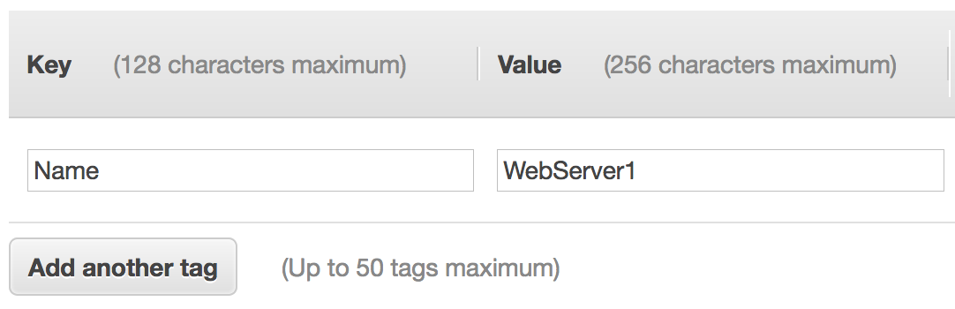
7. Add tags
Choices made by using the
Launch Instance Wizard:
AMI
Instance Type
Network settings
IAM role
User data
Storage options
Tags
Security group
Key pair
A tag is a label that you can assign to an AWS resource.
  Consists of a key and an optional value.
Tagging is how you can attach metadata to an EC2 instance.
Potential benefits of tagging—Filtering, automation, cost allocation, and access control.
Example:
Notes:
A tag is a label that you assign to an AWS resource. Each tag consists of a key and an optional value, both of which you define. Tags enable you to categorize AWS resources, such as EC2 instances, in different ways. For example, you might tag instances by purpose, owner, or environment.
Tagging is how you can attach metadata to an EC2 instance.
Tag keys and tag values are case-sensitive. For example, a commonly used tag for EC2 instances is a tag key that is called Name and a tag value that describes the instance, such as My Web Server. The Name tag is exposed by default in the Amazon EC2 console Instances page. However, if you create a key that is called name (with lower-case n), it will not appear in the Name column for the list of instances (though it will still appear in the instance details panel in the Tags tab).
It is a best practice to develop tagging strategies. Using a consistent set of tag keys makes it easier for you to manage your resources. You can also search and filter the resources based on the tags that you add.

Slide 24
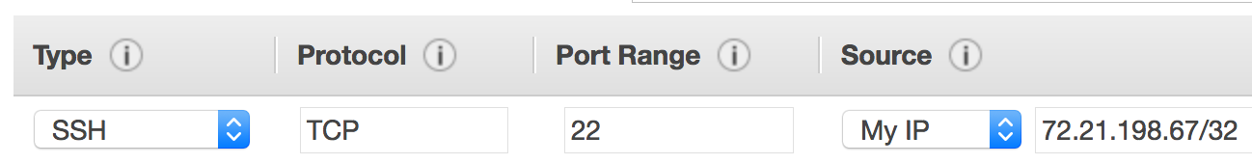
8. Security group settings
Choices made by using the
Launch Instance Wizard:
AMI
Instance Type
Network settings
IAM role
User data
Storage options
Tags
Security group
Key pair
A security group is a set of firewall rules that control traffic to the instance.
  It exists outside of the instance's guest OS.
Create rules that specify the source and which ports that network communications can use.
  Specify the port number and the protocol, such as Transmission Control Protocol (TCP), User Datagram Protocol (UDP), or Internet Control Message Protocol (ICMP).
  Specify the source (for example, an IP address or another security group) that is allowed to use the rule.
Example rule:
Notes:
A security group acts as a virtual firewall that controls network traffic for one or more instances. When you launch an instance, you can specify one or more security groups; otherwise, the default security group is used.
You can add rules to each security group. Rules allow traffic to or from its associated instances. You can modify the rules for a security group at any time, and the new rules will be automatically applied to all instances that are associated with the security group. When AWS decides whether to allow traffic to reach an instance, all the rules from all the security groups that are associated with the instance are evaluated. When you launch an instance in a virtual private cloud (VPC), you must either create a new security group or use one that already exists in that VPC. After you launch an instance, you can change its security groups.
When you define a rule, you can specify the allowable source of the network communication (inbound rules) or destination (outbound rules). The source can be an IP address, an IP address range, another security group, a gateway VPC endpoint, or anywhere (which means that all sources will be allowed). By default, a security group includes an outbound rule that allows all outbound traffic. You can remove the rule and add outbound rules that only allow specific outbound traffic. If your security group has no outbound rules, no outbound traffic that originates from your instance is allowed.
In the example rule, the rule allows Secure Shell (SSH) traffic over Transmission Control Protocol (TCP) port 22 if the source of the request is My IP. The My IP IP address is calculated by determining what IP address you are currently connected to the AWS Cloud from when you define the rule.
Network access control lists (network ACLs) can also be used are firewalls to protect subnets in a VPC.

Slide 25


9. Identify or create the key pair
Choices made by using the
Launch Instance Wizard:
AMI
Instance Type
Network settings
IAM role
User data
Storage options
Tags
Security group
Key pair
At instance launch, you specify an existing key pair or create a new key pair.
A key pair consists of –
  A public key that AWS stores.
  A private key file that you store.
It enables secure connections to the instance.
For Windows AMIs –
  Use the private key to obtain the administrator password that you need to log in to your instance.
For Linux AMIs –
  Use the private key to use SSH to securely connect to your instance.
mykey.pem
Notes:
After you specify all the required configurations to launch an EC2 instance, and after you customize any optional EC2 launch wizard configuration settings, you are presented with a Review Instance Launch window. If you then choose Launch, a dialog asks you to choose an existing key pair, proceed without a key pair, or create a new key pair before you can choose Launch Instances and create the EC2 instance.
Amazon EC2 uses public–key cryptography to encrypt and decrypt login information. The technology uses a public key to encrypt a piece of data, and then the recipient uses the private key to decrypt the data. The public and private keys are known as a key pair. Public-key cryptography enables you to securely access your instances by using a private key instead of a password.
When you launch an instance, you specify a key pair. You can specify an existing key pair or a new key pair that you create at launch. If you create a new key pair, download it and save it in a safe location. This opportunity is the only chance you get to save the private key file.
To connect to a Windows instance, use the private key to obtain the administrator password, and then log in to the EC2 instance's Windows Desktop by using Remote Desktop Protocol (RDP). To establish an SSH connection from a Windows machine to an Amazon EC2 instance, you can use a tool such as PuTTY, which will require the same private key.
With Linux instances, at boot time, the public key content is placed on the instance. An entry is created in within ~/.ssh/authorized_keys. To log in to your Linux instance (for example, by using SSH), you must provide the private key when you establish the connection.

Slide 26
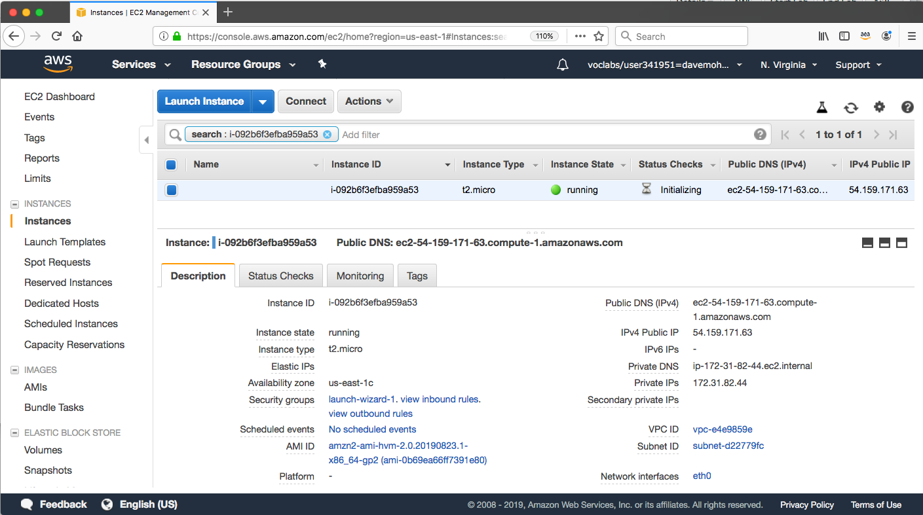
Amazon EC2 console view of a running EC2 instance
Notes:
After you choose Launch Instances and then choose View Instances, you will be presented with a screen that looks similar to the example.
Many of the settings that you specified during launch are visible in the Description panel.
Information about the available instance includes IP address and DNS address information, the instance type, the unique instance ID that was assigned to the instance, the AMI ID of the AMI that you used to launch the instance, the VPC ID, the subnet ID, and more.
Many of these details provide hyperlinks that you can choose to learn more information about the resources that are relevant to the EC2 instance you launched.

Slide 27

Another option: Launch an EC2 instance with the AWS Command Line Interface
EC2 instances can also be created programmatically.
This example shows how simple the command can be.
  This command assumes that the key pair and security group already exist.
  More options could be specified. See the AWS CLI Command Reference for details.
AWS Command Line Interface (AWS CLI)
Example command:
aws ec2 run-instances \
--image-id ami-1a2b3c4d \
--count 1 \
--instance-type c3.large \
--key-name MyKeyPair \
--security-groups MySecurityGroup \
--region us-east-1
Notes:
You can also launch EC2 instances programmatically, either by using the AWS Command Line Interface (AWS CLI) or one of the AWS software development kits (SDKs).
In the example AWS CLI command, you see a single command that specifies the minimal information that is needed to launch an instance. The command includes the following information:
aws – Specifies an invocation of the aws command line utility.
ec2 – Specifies an invocation of the ec2 service command.
run-instances – Is the subcommand that is being invoked.
The rest of the command specifies several parameters, including:
image-id – This parameter is followed by an AMI ID. All AMIs have a unique AMI ID.
count – You can specify more than one.
instance-type – You can specify the instance type to create (for example) a c3.large instance
key-name – In the example, assume that MyKeyPair already exists.
security-groups - In this example, assume that MySecurityGroup already exists.
region - AMIs exist in an AWS Region, so you must specify the Region where the AWS CLI will find the AMI and launch the EC2 instance.
The command should successfully create an EC2 instance if:
The command is properly formed
The resources that the command needs already exist
You have sufficient permissions to run the command
You have sufficient capacity in the AWS account
If the command is successful, the API responds to the command with the instance ID and other relevant data for your application to use in subsequent API requests.

Slide 28
Amazon EC2 instance lifecycle
Only instances backed by Amazon EBS
Launch
pending
Start
AMI
rebooting
Reboot
running
Stop
Stop-Hibernate
stopping
stopped
Terminate
shutting-down
terminated
Terminate
Notes:
Here, you see the lifecycle of an instance. The arrows show actions that you can take and the boxes show the state the instance will enter after that action. An instance can be in one of the following states:
Pending – When an instance is first launched from an AMI, or when you start a stopped instance, it enters the pending state when the instance is booted and deployed to a host computer. The instance type that you specified at launch determines the hardware of the host computer for your instance.
Running – When the instance is fully booted and ready, it exits the pending state and enters the running state. You can connect over the internet to your running instance.
Rebooting – AWS recommends you reboot an instance by using the Amazon EC2 console, AWS CLI, or AWS SDKs instead of invoking a reboot from within the guest operating system (OS). A rebooted instance stays on the same physical host, maintains the same public DNS name and public IP address, and if it has instance store volumes, it retains the data on those volumes.
Shutting down – This state is an intermediary state between running and terminated.
Terminated – A terminated instance remains visible in the Amazon EC2 console for a while before the virtual machine is deleted. However, you can’t connect to or recover a terminated instance.
Stopping – Instances that are backed by Amazon EBS can be stopped. They enter the stopping state before they attain the fully stopped state.
Stopped – A stopped instance will not incur the same cost as a running instance. Starting a stopped instance puts it back into the pending state, which moves the instance to a new host machine.

Slide 29
Instance hibernation option
Benefits
  It saves the contents from the instance memory (RAM).
  On instance restart, RAM contents are reloaded, previously running processes are resumed.
  You can save on cost in a hibernated state versus a running state (costs are similar to a stopped instance).
Prerequisites
  Only certain Linux AMIs (such as Amazon Linux 2) and only certain instance families support it.
  Instance must have an encrypted Amazon EBS root volume and a maximum of150 GB RAM.
  Hibernation must be enabled at instance launch.
Notes:
Some instances that are backed by Amazon EBS support hibernation. When you hibernate an instance, the guest OS saves the contents from the instance memory (RAM) to your Amazon EBS root volume. When you restart the instance, the root volume is restored to its previous state, the RAM contents are reloaded, and the processes that were previously running on the instance are resumed.
Only certain Linux AMIs that are backed by Amazon EBS and other certain instance types support hibernation. Hibernation also requires that you encrypt the root EBS volume. In addition, you must enable hibernation when the instance is first launched. You cannot enable hibernation on an existing instance that did not originally have hibernation enabled.
For further details about prerequisites and cost, see the Hibernate Your Linux Instance AWS documentation page.

Slide 30

Consider using an Elastic IP address
Rebooting an instance will not change any IP addresses or DNS hostnames.
When an instance is stopped and then started again –
  The public IPv4 address and external DNS hostname will change.
  The private IPv4 address and internal DNS hostname do not change.
If you require a persistent public IP address –
  Associate an Elastic IP address with the instance.
Elastic IP address characteristics –
  Can be associated with instances in the Region as needed.
  Remains allocated to your account until you choose to release it.
Elastic IP Address
Notes:
A public IP address is an IPv4 address that is reachable from the internet. Each instance that receives a public IP address is also given an external DNS hostname. For example, if the public IP address assigned to the instance is 203.0.113.25, then the external DNS hostname might be ec2-203-0-113-25.compute-1.amazonaws.com.
If you specify that a public IP address should be assigned to your instance, it is assigned from the AWS pool of public IPv4 addresses. The public IP address is not associated with your AWS account. When a public IP address is disassociated from your instance, it is released back into the public IPv4 address pool, and you will not be able to specify that you want to reuse it. AWS releases your instance's public IP address when the instance is stopped or terminated. Your stopped instance receives a new public IP address when it is restarted.
If you require a persistent public IP address, you might want to associate an Elastic IP address with the instance. To associate an Elastic IP address, you must first allocate a new Elastic IP address in the Region where the instance exists. After the Elastic IP address is allocated, you can associate the Elastic IP address with an EC2 instance.
By default, all AWS accounts are limited to five (5) Elastic IP addresses per Region because public (IPv4) internet addresses are a scarce public resource. However, this is a soft limit, and you can request a limit increase (which might be approved).

Slide 31
EC2 instance metadata
Instance metadata is data about your instance.
While you are connected to the instance, you can view it –
  In a browser: http://169.254.169.254/latest/meta-data/
  In a terminal window: curl http://169.254.169.254/latest/meta-data/
Example retrievable values –
  Public IP address, private IP address, public hostname, instance ID, security groups, Region, Availability Zone.
  Any user data specified at instance launch can also be accessed at: http://169.254.169.254/latest/user-data/
It can be used to configure or manage a running instance.
  For example, author a configuration script that reads the metadata and uses it to configure applications or OS settings.
Notes:
Instance metadata is data about your instance. You can view it while you are connected to the instance. To access it in a browser, go to the following URL: http://169.254.169.254/latest/meta-data/. The data can also be read programmatically, such as from a terminal window that has the cURL utility. In the terminal window, run curl http://169.254.169.254/latest/meta-data/ to retrieve it. The IP address 169.254.169.254 is a link-local address and it is valid only from the instance.
Instance metadata provides much of the same information about the running instance that you can find in the AWS Management Console. For example, you can discover the public IP address, private IP address, public hostname, instance ID, security groups, Region, Availability Zone, and more.
Any user data that is specified at instance launch can also be accessed at the following URL: http://169.254.169.254/latest/user-data.
EC2 instance metadata can be used to configure or manage a running instance. For example, you can author a configuration script that accesses the metadata information and uses it to configure applications or OS settings.

Slide 32


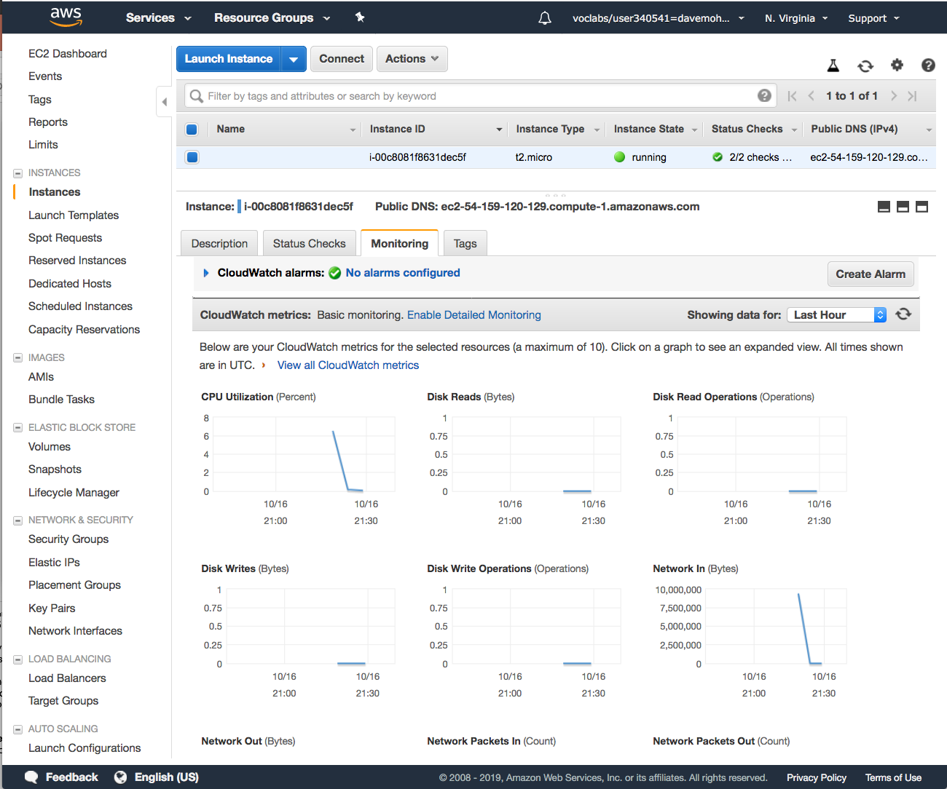
Amazon CloudWatch for monitoring
Use Amazon CloudWatch to monitor EC2 instances
  Provides near-real-time metrics
  Provides charts in the Amazon EC2 console Monitoring tab that you can view
  Maintains 15 months of historical data
Basic monitoring
  Default, no additional cost
  Metric data sent to CloudWatch every 5 minutes
Detailed monitoring
  Fixed monthly rate for seven pre-selected metrics
  Metric data delivered every 1 minute
Amazon CloudWatch
Instance with CloudWatch
Notes:
You can monitor your instances by using Amazon CloudWatch, which collects and processes raw data from Amazon EC2 into readable, near-real-time metrics. These statistics are recorded for a period of 15 months, so you can access historical information and gain a better perspective on how your web application or service is performing.
By default, Amazon EC2 provides basic monitoring, which sends metric data to CloudWatch in 5-minute periods. To send metric data for your instance to CloudWatch in 1-minute periods, you can enable detailed monitoring on the instance. For more information, see Enable or Disable Detailed Monitoring for Your Instances.
The Amazon EC2 console displays a series of graphs based on the raw data from Amazon CloudWatch. Depending on your needs, you might prefer to get data for your instances from Amazon CloudWatch instead of through the graphs in the console. By default, Amazon CloudWatch does not provide RAM metrics for EC2 instances, though that is an option that you can configure if you want to CloudWatch to collect that data.

Slide 33

Section 2 key takeaways
Amazon EC2 enables you to run Windows and Linux virtual machines in the cloud.
You launch EC2 instances from an AMI template into a VPC in your account.
You can choose from many instance types. Each instance type offers different combinations of CPU, RAM, storage, and networking capabilities.
You can configure security groups to control access to instances (specify allowed ports and source).
User data enables you to specify a script to run the first time that an instance launches.
Only instances that are backed by Amazon EBS can be stopped.
You can use Amazon CloudWatch to capture and review metrics on EC2 instances.
Notes:
Some key takeaways from this section of the module include:
Amazon EC2 enables you to run Windows and Linux virtual machines in the cloud.
You launch EC2 instances from an AMI template into a VPC in your account.
You can choose from many instance types. Each instance type offers different combinations of CPU, RAM, storage, and networking capabilities.
You can configure security groups to control access to instances (specify allowed ports and source).
User data enables you to specify a script to run the first time that an instance launches.
Only instances that are backed by Amazon EBS can be stopped.
You can use Amazon CloudWatch to capture and review metrics on EC2 instances.

Slide 34
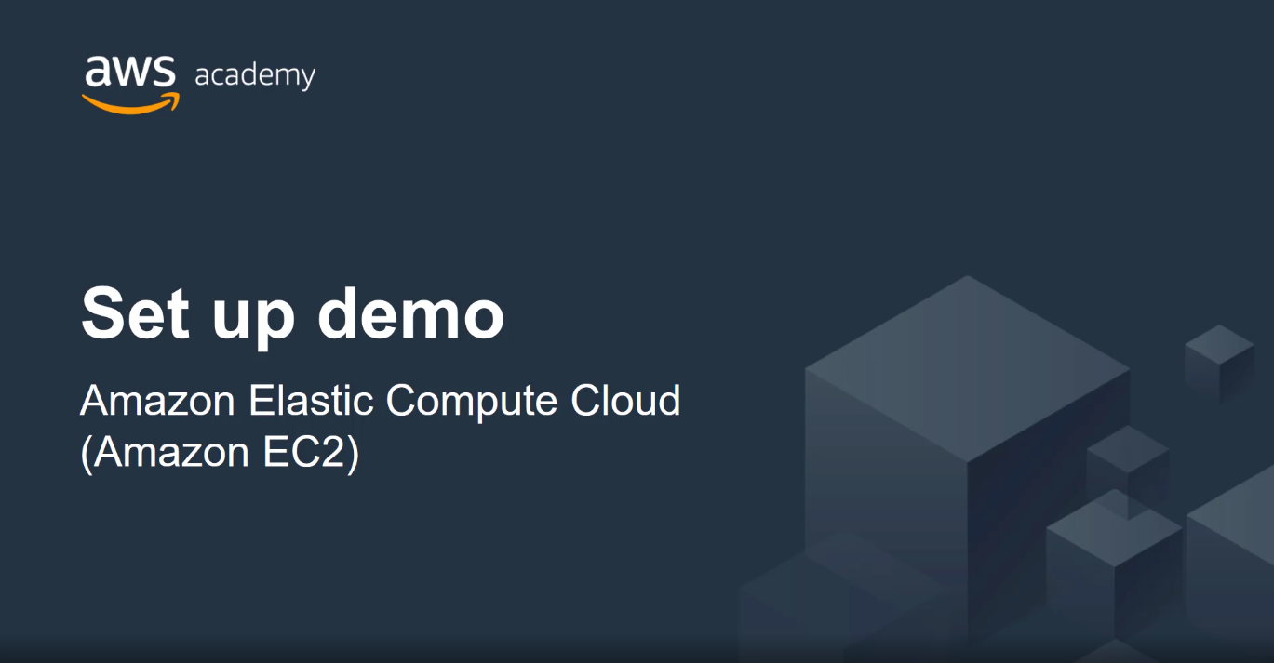
Recorded Amazon EC2 demonstration
Notes:
Now, take a moment to watch the EC2 Demo. The recording runs just over 3 minutes and reinforces some of the concepts that were discussed in this section of the module.
The demonstration shows:
How to use the AWS Management Console to launch an Amazon EC2 instance (with all the default instance settings accepted).
How to connect to the Windows instance by using a Remote Desktop client and the key pair that was identified during instance launch to decrypt the Windows password for login.
How to terminate the instance after it is no longer needed.

Slide 35

Lab 3:
Introduction to Amazon EC2
Notes:
Introducing Lab 3: Introduction to Amazon EC2. This lab provides hands-on practice with launching, resizing, managing, and monitoring an Amazon EC2 instance.

Slide 36
Lab 3 scenario
  In this lab, you will launch and configure your first virtual machine that runs on Amazon EC2.
AWS Cloud
Region
Availability Zone 1
Lab VPC
Public subnet
Web server
instance
Notes:
Introducing Lab 3: Introduction to Amazon EC2.
In this lab, you will launch and configure a virtual machine that runs on Amazon EC2.

Slide 37
Lab 3: Tasks
Task 1 – Launch Your Amazon EC2 Instance
Task 2 – Monitor Your Instance
Task 3 – Update Your Security Group and Access the Web Server
Task 4 – Resize Your Instance: Instance Type and EBS Volume
Task 5 – Explore EC2 Limits
Task 6 – Test Termination Protection
Notes:
In this hands-on lab, you will:
Launch Your Amazon EC2 Instance
Monitor Your Instance
Update Your Security Group and Access the Web Server
Resize Your Instance: Instance Type and EBS Volume
Explore EC2 Limits
Test Termination Protection

Slide 38
Lab 3: Final product
Amazon EC2
By the end of the lab, you will have:
Launched an instance that is configured as a web server
Viewed the instance system log
Reconfigured a security group
Modified the instance type and root volume size
VPC
AMI
Security group
t2.micro
instance
t2.small
instance
Amazon Elastic Block Store (Amazon EBS)
8-GB root volume
10-GB root volume
Notes:
By the end of the lab, you will have:
Launched an instance that is configured as a web server
Viewed the instance system log
Reconfigured a security group
Modified the instance type and root volume size

Slide 39


Begin Lab 1: Introduction to AWS IAM
~ 35 minutes
Begin Lab 3: Introduction to Amazon EC2
Notes:
It is now time to start the lab.

Slide 40
Lab debrief:
Key takeaways
Notes:
The instructor will lead a conversation about the key takeaways from the lab after you have completed it.

Slide 41

Activity: Amazon EC2
Photo by Pixabay from Pexels.
Notes:
In this educator-led activity, you will discuss the advantages and disadvantages of using Amazon EC2 versus using a managed service like Amazon Relational Database Service (Amazon RDS).

Slide 42

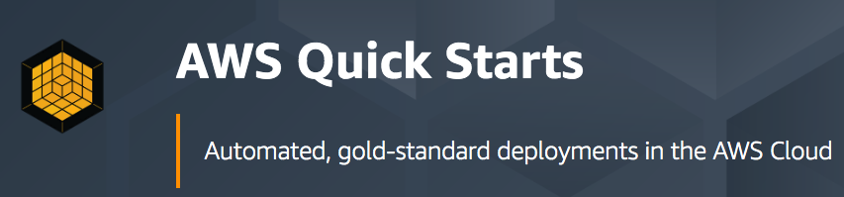
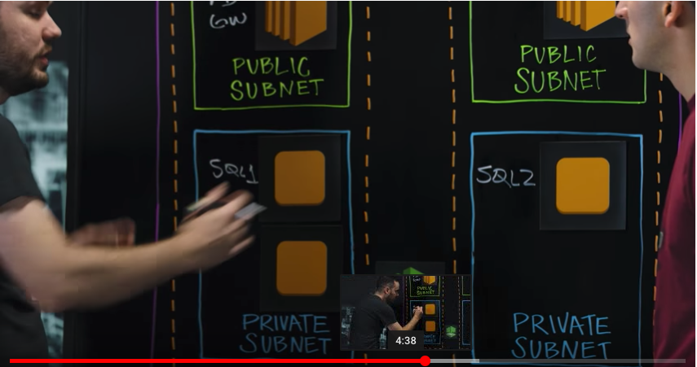

Activity: Gather information
Amazon EC2
Amazon RDS
AWS Cloud
Availability Zone 1
Availability Zone 2
MS SQL Server primary DB instance
MS SQL Server secondary
DB instance
Always-on
mirroring
Volume
Volume
replica
Volume
Volume replica
Notes:
The objective of this activity is to demonstrate that you understand the differences between building a deployment that uses Amazon EC2 and using a fully managed service, such as Amazon RDS, to deploy your solution. At the end of this activity, you should be prepared to discuss the advantages and disadvantages of deploying Microsoft SQL Server on Amazon EC2 versus deploying it on Amazon RDS.
The educator will ask you to:
1. Watch an 8-minute video that explains the benefits of deploying Microsoft SQL Server on Amazon EC2 by using the AWS Quick Start – SQL Server Reference Architecture deployment. You are encouraged to take notes.
2. Read a blog post about the benefits of running Microsoft SQL Server on Amazon RDS. You are again encouraged to take notes.
3. Participate in the class conversation about the questions posed on the next slide.

Slide 43
Activity: Check your understanding
Between Amazon EC2 or Amazon RDS, which provides a managed service? What does managed service mean?
  ANSWER: Amazon RDS provides a managed service. Amazon RDS handles provisioning, installation and patching, automated backups, restoring snapshots from points in time, high availability, and monitoring.
Name at least one advantage of deploying Microsoft SQL Server on Amazon EC2 instead of Amazon RDS.
  ANSWER: Amazon EC2 offers complete control over every configuration, the OS, and the software stack.
What advantage does the Quick Start provide over a manual installation on Amazon EC2?
  ANSWER: The Quick Start is a reference architecture with proven best practices built into the design.
Which deployment option offers the best approach for all use cases?
  ANSWER: Neither. The correct deployment option depends on your specific needs.
Which approach costs more: using Amazon EC2 or using Amazon RDS?
  ANSWER: It depends. Managing the database deployment on Amazon EC2 requires more customer oversight and time. If time is your priority, then Amazon RDS might be less expensive. If you have in-house expertise, Amazon EC2 might be more cost-effective.
Notes:
The educator will lead the class in a conversation as each question is revealed. Then, the educator will display the written suggested responses and you can discuss these points further.
Regarding question 5, the answer was based on the information that is listed on the AWS Pricing pages as of October, 2019.
For Amazon RDS, you pay $0.977 per hour if you run Microsoft SQL Server based on these parameters:
Instance – Standard (Single-AZ) instance
Instance size – db.m5.large
Region – US East (Ohio)
Pricing – On-Demand Instance
For Amazon EC2, you pay $0.668 per hour if you run Microsoft SQL Server based on these parameters:
Instance – Windows instance
Instance size – m5.large
Region – US East (Ohio)
Pricing – On-Demand Instance
As you consider cost, do not forget to include the cost of labor. For example, keep in mind that with a standard Single-AZ Amazon RDS deployment—which is the basis of the example price reference—automated backups are provided. With Amazon RDS, if a DB instance component failed and a user-initiated restore operation is required, you would have a restorable backup that you could use. If you run the database on Amazon EC2, you could configure an equally robust backup procedure for Microsoft SQL Server. However, it would take time, knowledge, and technical skill to build the solution. You would also need to pre-configure the solution before you encounter the situation where you need it. For these reasons, when you consider the needs of your deployments holistically, you might find that using Amazon RDS is less expensive than using Amazon EC2. However, if you have skilled database administrators on staff—and you also have very specific deployment requirements that make it preferable for you to have total control over all aspects of the deployment—you could use Amazon EC2. In this case, you might find Amazon EC2 to be the more cost-effective solution.

Slide 44
Section 3: Amazon EC2 cost optimization
Module 6: Compute
Notes:
Introducing Section 3: Amazon EC2 cost optimization.

Slide 45
Amazon EC2 pricing models
On-Demand Instances
Pay by the hour
No long-term commitments.
Eligible for the AWS Free Tier.
Dedicated Hosts
A physical server with EC2 instance capacity fully dedicated to your use.
Dedicated Instances
Instances that run in a VPC on hardware that is dedicated to a single customer.
Reserved Instances
Full, partial, or no upfront payment for instance you reserve.
Discount on hourly charge for that instance.
1-year or 3-year term.
Scheduled Reserved Instances
Purchase a capacity reservation that is always available on a recurring schedule you specify.
1-year term.
Spot Instances
Instances run as long as they are available and your bid is above the Spot Instance price.
They can be interrupted by AWS with a 2-minute notification.
Interruption options include terminated, stopped or hibernated.
Prices can be significantly less expensive compared to On-Demand Instances
Good choice when you have flexibility in when your applications can run.
Per second billing available for On-Demand Instances, Reserved Instances, and
Spot Instances that run Amazon Linux or Ubuntu.
Notes:
Amazon offers different pricing models to choose from when you want to run EC2 instances.
Per second billing is only available for On-Demand Instances, Reserved Instances, and Spot Instances that run Amazon Linux or Ubuntu.
On-Demand Instances are eligible for the AWS Free Tier. They have the lowest upfront cost and the most flexibility. There are no upfront commitments or long-term contracts. It is a good choice for applications with short-term, spiky, or unpredictable workloads.
Dedicated Hosts are physical servers with instance capacity that is dedicated to your use. They enable you to use your existing per-socket, per-core, or per-VM software licenses, such as for Microsoft Windows or Microsoft SQL Server.
Dedicated Instances are instances that run in a virtual private cloud (VPC) on hardware that’s dedicated to a single customer. They are physically isolated at the host hardware level from instances that belong to other AWS accounts.
Reserved Instance enable you to reserve computing capacity for 1-year or 3-year term with lower hourly running costs. The discounted usage price is fixed for as long as you own the Reserved Instance. If you expect consistent, heavy use, they can provide substantial savings compared to On-Demand Instances.
Scheduled Reserved Instances enable you to purchase capacity reservations that recur on a daily, weekly, or monthly basis, with a specified duration, for a 1-year term. You pay for the time that the instances are scheduled, even if you do not use them.
Spot Instances enable you to bid on unused EC2 instances, which can lower your costs. The hourly price for a Spot Instance fluctuates depending on supply and demand. Your Spot Instance runs whenever your bid exceeds the current market price.

Slide 46




Amazon EC2 pricing models: Benefits
On-Demand Instances | Spot Instances | Reserved Instances | Dedicated Hosts
Low cost and flexibility | Large scale, dynamic workload | Predictability ensures compute capacity is available when needed | Save money on licensing costs Help meet compliance and regulatory requirements
Notes:
Each Amazon EC2 pricing model provides a different set of benefits.
On-Demand Instances offer the most flexibility, with no long-term contract and low rates.
Spot Instances provide large scale at a significantly discounted price.
Reserved Instances are a good choice if you have predictable or steady-state compute needs (for example, an instance that you know you want to keep running most or all of the time for months or years).
Dedicated Hosts are a good choice when you have licensing restrictions for the software you want to run on Amazon EC2, or when you have specific compliance or regulatory requirements that preclude you from using the other deployment options.

Slide 47
Amazon EC2 pricing models: Use cases
Spiky Workloads
Time-Insensitive Workloads
Steady-State Workloads
Highly Sensitive Workloads
On-Demand Instances | Spot Instances | Reserved Instances | Dedicated Hosts
Short-term, spiky, or unpredictable workloads Application development or testing | Applications with flexible start and end times Applications only feasible at very low compute prices Users with urgent computing needs for large amounts of additional capacity | Steady state or predictable usage workloads Applications that require reserved capacity, including disaster recovery Users able to make upfront payments to reduce total computing costs even further | Bring your own license (BYOL) Compliance and regulatory restrictions Usage and licensing tracking Control instance placement
Notes:
Here is a review of some use cases for the various pricing options.
On-Demand Instance pricing works well for spiky workloads or if you only need to test or run an application for a short time (for example, during application development or testing). Sometimes, your workloads are unpredictable, and On-Demand Instances are a good choice for these cases.
Spot Instances are a good choice if your applications can tolerate interruption with a 2-minute warning notification. By default, instances are terminated, but you can configure them to stop or hibernate instead. Common use cases include fault-tolerant applications such as web servers, API backends, and big data processing. Workloads that constantly save data to persistent storage (such as Amazon S3) are also good candidates.
Reserved Instances are a good choice when you have long-term workloads with predictable usage patterns, such as servers that you know you will want to run in a consistent way over many months.
Dedicated Hosts are a good choice when you have existing per-socket, per-core, or per-VM software licenses, or when you must address specific corporate compliance and regulatory requirements.

Slide 48





The four pillars of cost optimization
Cost Optimization
Increase elasticity
Optimal pricing model
Optimize storage choices
Right size
Notes:
To optimize costs, you must consider four consistent, powerful drivers:
Right-size – Choose the right balance of instance types. Notice when servers can be either sized down or turned off, and still meet your performance requirements.
Increase elasticity – Design your deployments to reduce the amount of server capacity that is idle by implementing deployments that are elastic, such as deployments that use automatic scaling to handle peak loads.
Optimal pricing model – Recognize the available pricing options. Analyze your usage patterns so that you can run EC2 instances with the right mix of pricing options.
Optimize storage choices – Analyze the storage requirements of your deployments. Reduce unused storage overhead when possible, and choose less expensive storage options if they can still meet your requirements for storage performance.

Slide 49
Pillar 1: Right size
Provision instances to match the need
  CPU, memory, storage, and network throughput
  Select appropriate instance types for your use
Use Amazon CloudWatch metrics
  How idle are instances? When?
  Downsize instances
Best practice: Right size, then reserve
Pillars:

1. Right size
2. Increase elasticity
3. Optimal pricing model
4. Optimize storage choices

Notes:
First, consider right-sizing. AWS offers approximately 60 instance types and sizes. The wide choice of options enables customers to select the instance that best fits their workload. It can be difficult to know where to start and what instance choice will prove to be the best, from both a technical perspective and a cost perspective. Right-sizing is the process of reviewing deployed resources and looking for opportunities to downsize when possible.
To right-size:
Select the cheapest instance available that still meets your performance requirements.
Review CPU, RAM, storage, and network utilization to identify instances that could be downsized. You might want to provision a variety of instance types and sizes in a test environment, and then test your application on those different test deployments to identify which instances offer the best performance-to-cost ratio. For right-sizing, use techniques such as load testing to your advantage.
Use Amazon CloudWatch metrics and set up custom metrics. A metric represents a time-ordered set of values that are published to CloudWatch (for example, the CPU usage of a particular EC2 instance). Data points can come from any application or business activity for which you collect data.

Slide 50
Pillar 2: Increase elasticity
Stop or hibernate Amazon EBS-backed instances that are not actively in use
  Example: non-production development or test instances
Use automatic scaling to match needs based on usage
  Automated and time-based elasticity
Pillars:
1. Right-Size
2. Increase Elasticity
3. Optimal pricing model
4. Optimize storage choices


Notes:
One form of elasticity is to create, start, or use EC2 instances when they are needed, but then to turn them off when they are not in use. Elasticity is one of the central tenets of the cloud, but customers often go through a learning process to operationalize elasticity to drive cost savings.
The easiest way for large customers to embrace elasticity is to look for resources that look like good candidates for stopping or hibernating, such as non-production environments, development workloads, or test workloads. For example, if you run development or test workloads in a single time zone, you can easily turn off those instances outside of business hours and thus reduce runtime costs by perhaps 65 percent. The concept is similar to why there is a light switch next to the door, and why most offices encourage employees to turn off the lights on their way out of the office each night.
For production workloads, configuring more precise and granular automatic scaling policies can help you take advantage of horizontal scaling to meet peak capacity needs and to not pay for peak capacity all the time.
As a rule of thumb, you should target 20–30 percent of your Amazon EC2 instances to run as On-Demand Instances or Spot Instances, and you should also actively look for ways to maximize elasticity.

Slide 51
Pillar 3: Optimal pricing model
Leverage the right pricing model for your use case
  Consider your usage patterns
Optimize and combine purchase types
Examples:
  Use On-Demand Instance and Spot Instances for variable workloads
  Use Reserved Instances for predictable workloads
Consider serverless solutions (AWS Lambda)
Pillars:
1. Right-Size
2. Increase Elasticity
3. Optimal pricing model
4. Optimize storage choices


Notes:
AWS provides a number of pricing models for Amazon EC2 to help customers save money. The models available were discussed in detail earlier in this module. Customers can combine multiple purchase types to optimize pricing based on their current and forecast capacity needs.
Customers are also encouraged to consider their application architecture. For example, does the functionality provided by your application need to run on an EC2 virtual machine? Perhaps by making use of the AWS Lambda service instead, you could significantly decrease your costs.
AWS Lambda is discussed later in this module.

Slide 52
Pillar 4: Optimize storage choices
Reduce costs while maintaining storage performance and availability
Resize EBS volumes
Change EBS volume types
  Can you meet performance requirements with less expensive storage?
  Example: Amazon EBS Throughput Optimized HDD (st1) storage typically costs half as much as the default General Purpose SSD (gp2) storage option.
Delete EBS snapshots that are no longer needed
Identify the most appropriate destination for specific types of data
  Does the application need the instance to reside on Amazon EBS?
  Amazon S3 storage options with lifecycle policies can reduce costs
Pillars:
1. Right-Size
2. Increase Elasticity
3. Optimal pricing model
4. Optimize storage choices


Notes:
Customers can also reduce storage costs. When you launch EC2 instances, different instance types offer different storage options. It is a best practice to try to reduce costs while also maintaining storage performance and availability.
One way you can accomplish this is by resizing EBS volumes. For example, if you originally provisioned a 500-GB volume for an EC2 instance that will only need a maximum of 20 GB of storage space, you can reduce the size of the volume and save on costs.
There are also a variety of EBS volume types. Choose the least expensive type that still meets your performance requirements. For example, Amazon EBS Throughput Optimized HDD (st1) storage typically costs half as much as the default General Purpose SSD (gp2) storage option. If an st1 drive will meet the needs of your workload, take advantage of the cost savings.
Customers often use EBS snapshots to create data backups. However, some customers forget to delete snapshots that are no longer needed. Delete these unneeded snapshots to save on costs.
Finally, try to identify the most appropriate destination for specific types of data. Does your application need the data it uses to reside on Amazon EBS? Would the application run equally as well if it used Amazon S3 for storage instead? Configuring data lifecycle policies can also reduce costs. For example, you might automate the migration of older infrequently accessed data to cheaper storage locations, such as Amazon Simple Storage Service Glacier.

Slide 53




Measure, monitor, and improve
Cost optimization is an ongoing process.
Recommendations –
  Define and enforce cost allocation tagging.
  Define metrics, set targets, and review regularly.
  Encourage teams to architect for cost.
  Assign the responsibility of optimization to an individual or to a team.
Notes:
If it is done correctly, cost optimization is not a one-time process that a customer completes. Instead, by routinely measuring and analyzing your systems, you can continually improve and adjust your costs.
Tagging helps provide information about what resources are being used by whom and for what purpose. You can activate cost allocation tags in the Billing and Cost Management console, and AWS can generate a cost allocation report with usage and costs grouped by your active tags. Apply tags that represent business categories (such as cost centers, application names, or owners) to organize your costs across multiple services.
Encourage teams to architect for cost. AWS Cost Explorer is a free tool that you can use to view graphs of your costs. You can use Cost Explorer to see patterns in how much you spend on AWS resources over time, identify areas that need further inquiry, and see trends that you can use to understand your costs.
Use AWS services such as AWS Trusted Advisor, which provides real-time guidance to help you provision resources that follow AWS best practices.
Cost-optimization efforts are typically more successful when the responsibility for cost optimization is assigned to an individual or to a team.

Slide 54
Section 3 key takeaways
Amazon EC2 pricing models include On-Demand Instances, Reserved Instances, Spot Instances, Dedicated Instances, and Dedicated Hosts.
Spot Instances can be interrupted with a 2-minute notification. However, they can offer significant cost savings over On-Demand Instances.
The four pillars of cost optimization are:
  Right size
  Increase elasticity
  Optimal pricing model
  Optimize storage choices
Notes:
Some key takeaways from this section of the module are:
Amazon EC2 pricing models include On-Demand Instances, Reserved Instances, Spot Instances, Dedicated Instances, and Dedicated Hosts. Per second billing is available for On-Demand Instances, Reserved Instances, and Spot Instances that use only Amazon Linux and Ubuntu.
Spot Instances can be interrupted with a 2-minute notification. However, they can offer significant cost savings over On-Demand Instances.
The four pillars of cost optimization are –
Right size
Increase elasticity
Optimal pricing model
Optimize storage choices

Slide 55
Thank you
Notes:
Thank you for completing this module.

