Slide 1
Entity Relationship Modeling
SECD/SCSD2523 Database
Semester 2 2020/2021

Slide 2
Learning Objective
At the end of the topic, students will be able to:
  Define basic concepts associated with ER diagram
  Produce ER model to represent information to application system.

Slide 3
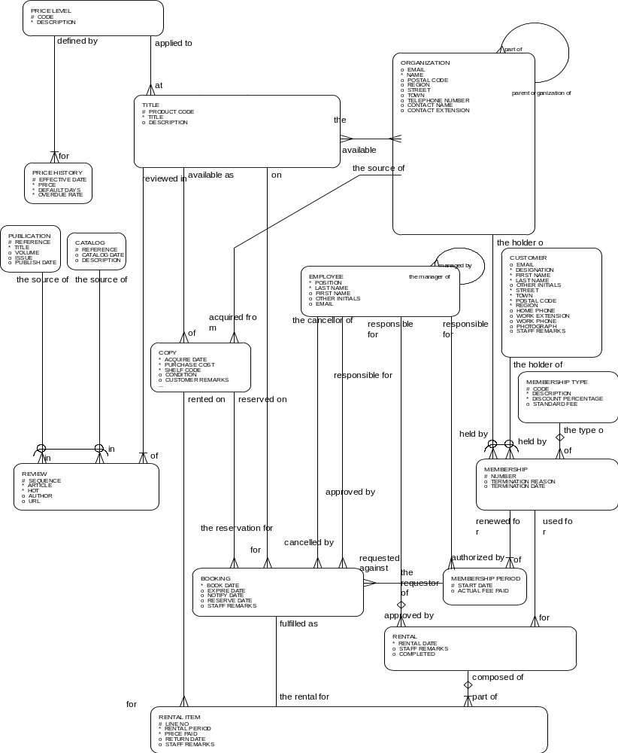
Entity Relationship Modeling
Models business, not implementation
Is a well-established technique
Has a robust syntax
Results in easy-to-read diagrams…
…although they may look rather complex at first sight

Slide 4
Goals of Entity Relationship Modeling
Capture all required information
Information appears only once
Model no information that is derivable from other information already modelled
Information is in a predictable, logical place

Slide 5
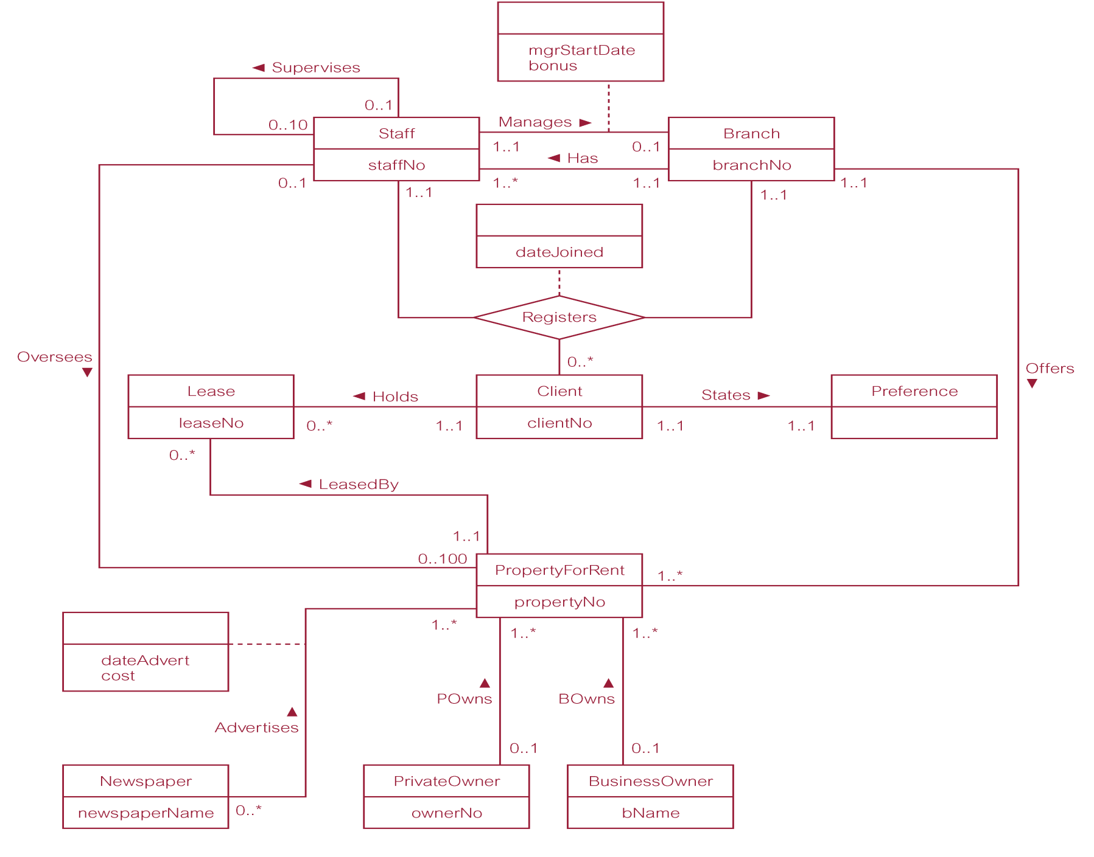
ER Diagram of Branch View of DreamHome

Slide 6
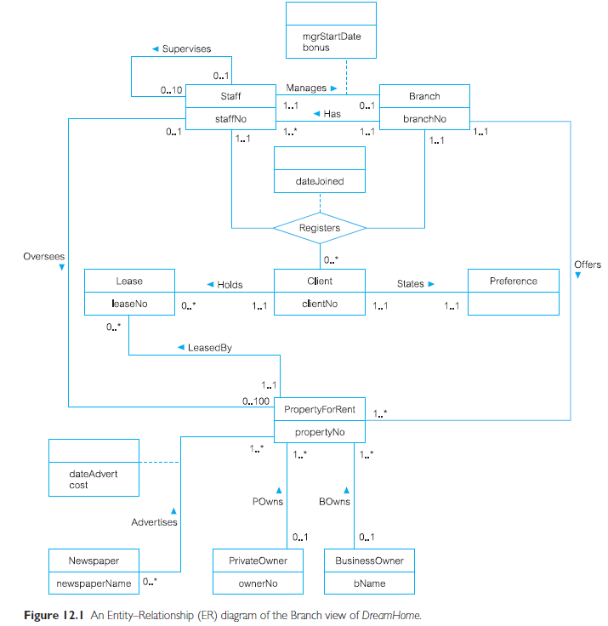
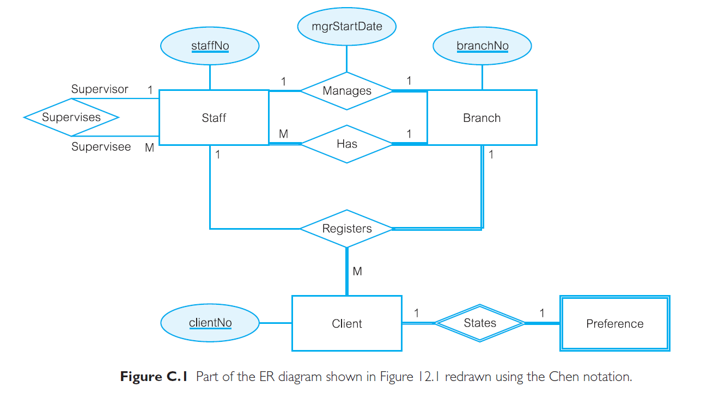
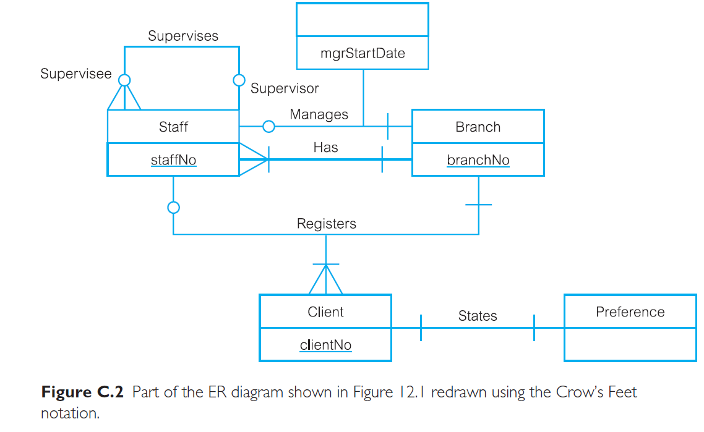
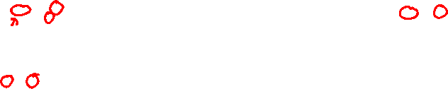
ER Modelling Notations
UML Notation | Chen’s Notation | Crow’s Feet Notation
We are using this in this course

Slide 7
Concepts of the ER Model
Entity types
Relationship types
Attributes

Slide 8
Entity Types
Entity types
  Group of objects with same properties, identified by enterprise as having an independent existence.
  “Something” of significance to the business about which data must be known
  A name for the things that you can list
  Usually a noun
Entity occurrence/instances
  Uniquely identifiable object of an entity type.

Slide 9
Example of Entities and Instances
ENTITY
INSTANCES
PERSON
PRODUCT
PRODUCT TYPE
EMPLOYMENT CONTRACT
JOB
SKILL LEVEL
TICKET RESERVATION
PURCHASE
ELECTION
PRINTER PREFERENCE
DOCUMENT VERSION
Mahatma Gandhi
2.5 x 35 mm copper nail
nail
my previous contract
violinist
fluent
tonight: Hamlet in the Royal
the CD I bought yesterday
for parliament next fall
…

Slide 10
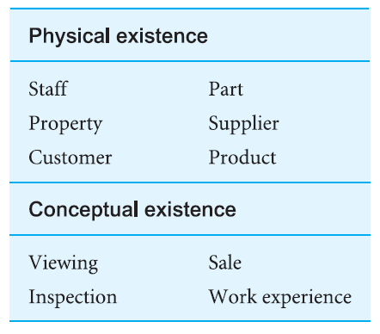
Examples of Entity Types
Something that exists physically or conceptually

Slide 11
Entities and Sets
An entity represents a set of instances that are of interest to a particular business.
Set of instances of entity JOB
manager
JOB
cook
waitress
dish washer
financial controller
entity
waiter
porter
piano player

Slide 12
Entity Representation in Diagram
EMPLOYEE
JOB
Drawn as a box
Name singular
Name inside
Neither size,
nor position
has a special
meaning
ELECTION
TICKET
RESERVATION
ORDER
JOB ASSIGNMENT
During design, entities usually lead to tables.

Slide 13
Remarks on creating Entities
Give the entity a unique name
Create a formal description of
the entity
Add a few attributes, if possible
Be aware of homonyms (words with same pronunciation but different meaning)
Check entity names and descriptions regularly
Avoid use of reserved words
Remove relationship name from entity name

Slide 14
Relationship
Relationship type
  Set of meaningful associations among entity types.
  Express how entities are mutually related
  Always exist between two entities (or one entity twice)
Relationship occurrence
  Uniquely identifiable association, which includes one occurrence from each participating entity type.

Slide 15
Relationship Examples
BRANCH has STAFF
STAFF belongs to BRANCH
EMPLOYEES have JOBS
JOBS are held by EMPLOYEES
PEOPLE make TICKET RESERVATIONS
TICKET RESERVATIONS are made by PEOPLE

Slide 16
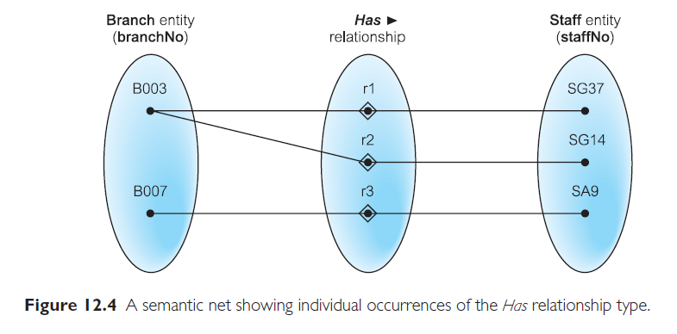
Semantic Net of Has Relationship Type

Slide 17
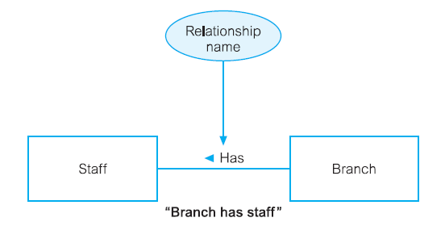
Relationship Has Between Staff and Branch

Slide 18
Employees have Jobs
JOB
manager
EMPLOYEE
cook
Shintaro
waitress
dish washer
Jill
financial controller
Adam
Ahmed
waiter
porter
Maria
piano player
Numerical observation:
All EMPLOYEES have a JOB
No EMPLOYEE has more than one JOB
Not all JOBS are held by an EMPLOYEE
Some JOBS are held by more than one EMPLOYEE
Whether all these are true, it all depends on business rules

Slide 19
Employees Have Jobs
EMPLOYEES
HAVE
JOBS

Slide 20
Relationship Types
Degree of a Relationship
  Number of participating entities in relationship.
Degree of relationship:
  two entities → binary;
  three entities → ternary;
  four entities → quaternary.

Slide 21
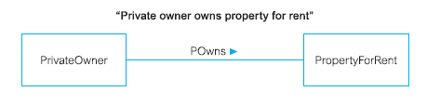
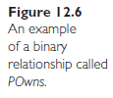
Example a binary relationship called: POwns

Slide 22
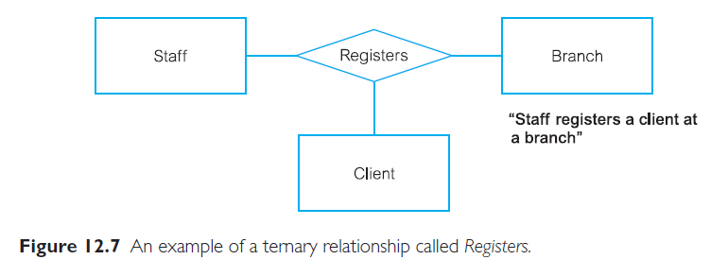
Example of a ternary relationship called: Registers

Slide 23
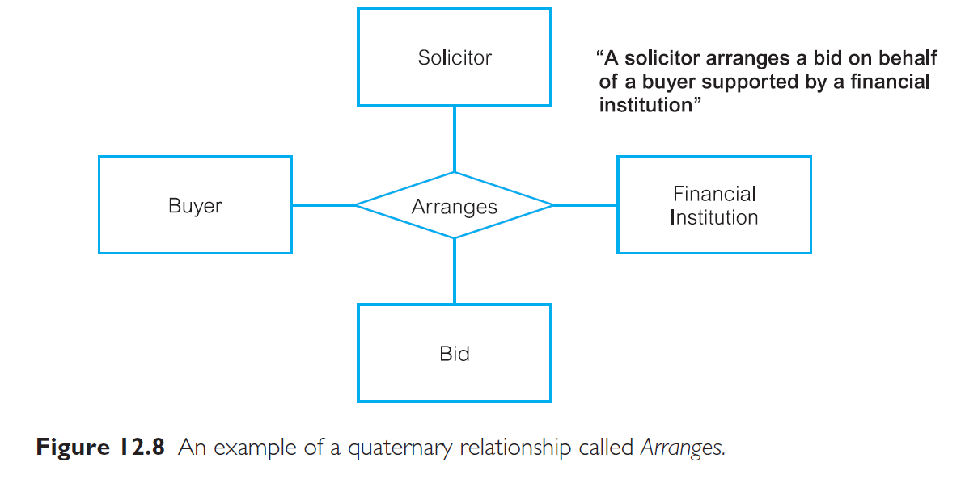
Example of a quaternary relationship called: Arranges

Slide 24
Relationship Types
Recursive Relationship
  Relationship type where same entity type participates more than once in different roles.
Relationships may be given role names to indicate purpose that each participating entity type plays in a relationship.

Slide 25
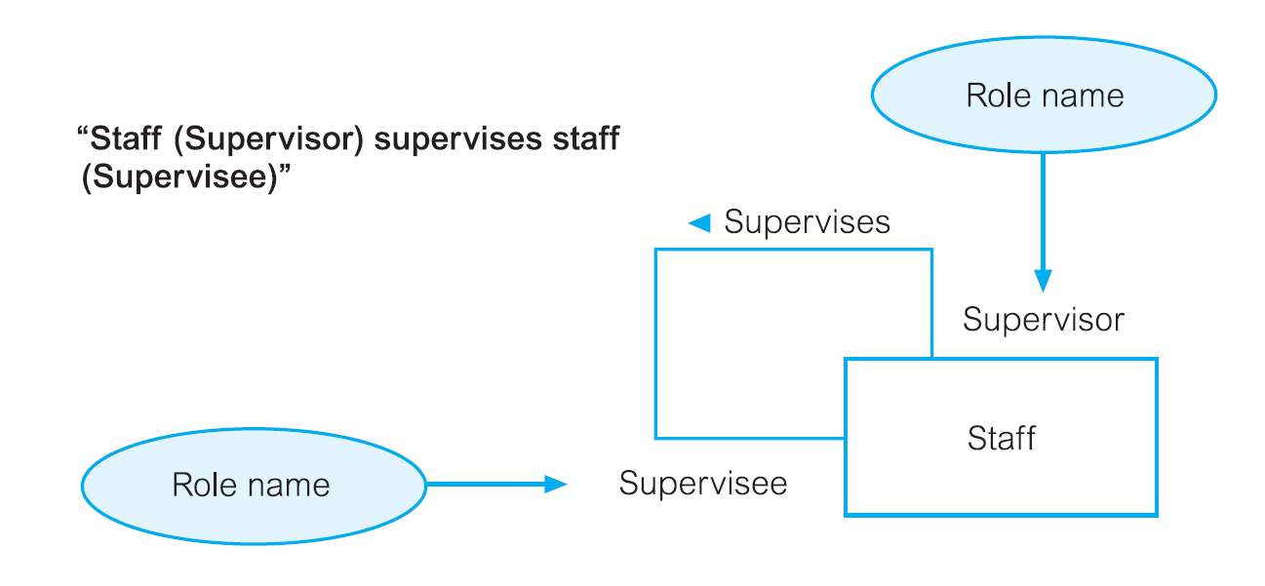
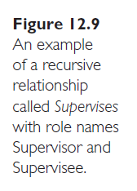
Example of recursive relationship called: Supervises with role names

Slide 26
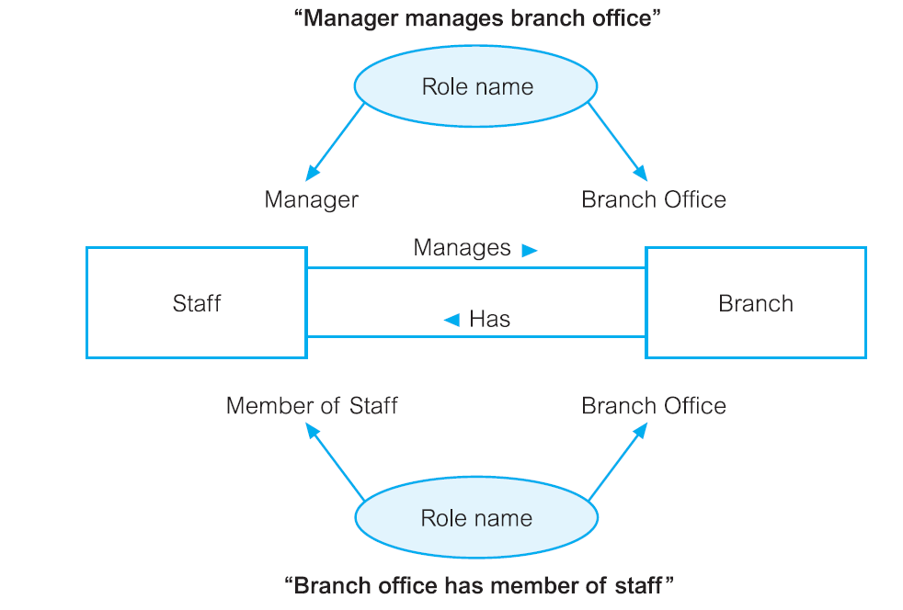
Entities associated through two distinct Relationships with Role Names

Slide 27
Practice 1 (Problem 1): Identify all entities and relationship between entities.
I am the manager of a training company that provides instructor-led courses in management techniques. We teach many courses, each of which has a code, a name and a fee. Introduction to UNIX and C Programming are two of our more popular courses. Courses vary in length from one day to four days. An instructor can teach several courses. Paul Rogers and Maria Gonzales are two of our best teachers. We track each instructor's name and phone number. Each course is taught by only one instructor. We create a course and then line up an instructor. The students can take several courses over time, and many of them do this. Jamie Brown from AT&T took every course we offer! We track each student's name and phone number. Some of our students and instructors do not give us their phone numbers.

Slide 28
Attributes
Attribute
  Also represents something of significance to the business
  Is a specific piece of information that:
    Describes
    Quantifies
    Qualifies
    Classifies
    Specifies an entity
  Is a property of an entity or a relationship type.
Attribute Domain
  Set of allowable values for one or more attributes.

Slide 29
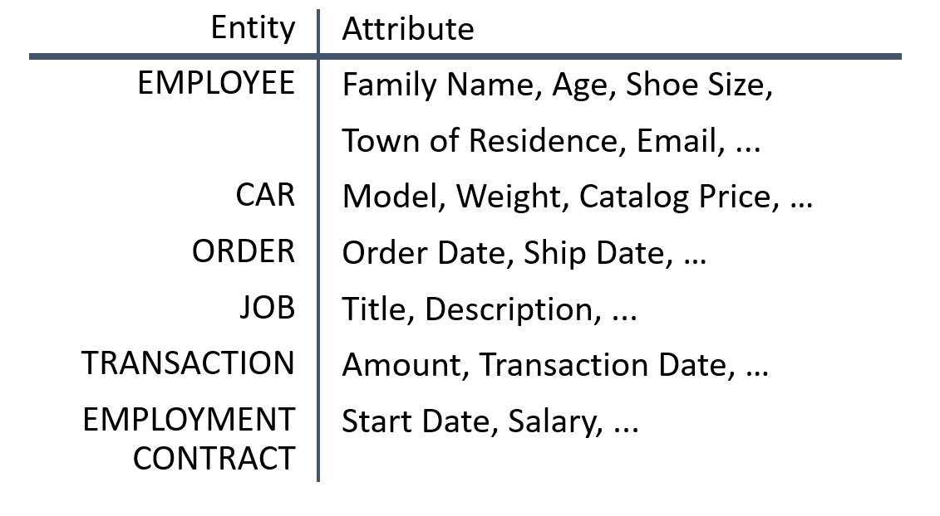
Attribute examples

Slide 30
Attribute (Simple vs Composite)
Simple Attribute
  Attribute composed of a single component with an independent existence.
  Cannot be further subdivided into smaller components.
Composite Attribute
  Attribute composed of multiple components, each with an independent existence.
  Example: address (simple attribute) → can be subdivided into attributes of street, city, postcode

Slide 31
Attribute (Single-valued vs Multi-valued)
Single-valued Attribute
  Attribute that holds a single value for each occurrence of an entity type.
  Majority of attributes are single-valued.
Multi-valued Attribute
  Attribute that holds multiple values for each occurrence of an entity type.
  E.g.: Each branch have multiple telephone numbers. Thus, in this case, the attribute telNo is multi-valued.

Slide 32
Attribute (Derived)
Derived Attribute
  Attribute that represents a value that is derivable from value of a related attribute, or set of attributes, not necessarily in the same entity type.
  E.g.: the value for the duration attribute of the Lease entity is calculated from the rentStart and rentFinish attributes, also of the Lease entity type.

Slide 33
Practice 2 (Problem 1)
Identify all attributes for each entity identified in Practice 1.
Can you determine the type of each attribute?

Slide 34
Attribute: Keys
Candidate Key
  Minimal set of attributes that uniquely identifies each occurrence of an entity type.
Composite Key
  A candidate key that consists of two or more attributes.
Primary Key
  Candidate key selected to uniquely identify each occurrence of an entity type.

Slide 35
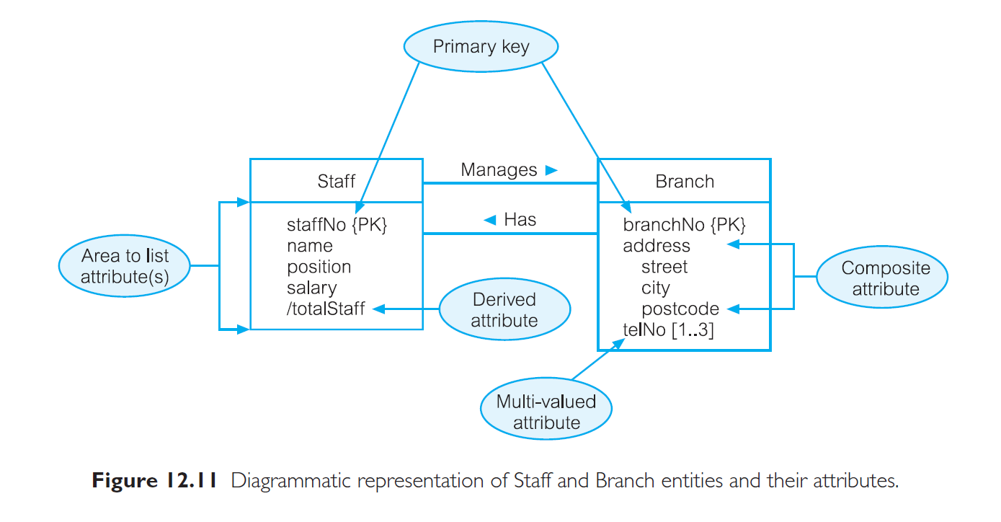
ER Diagram of Staff and Branch Entities and their Attributes

Slide 36
Practice 3 (Problem 1)
Identify the primary key for each entity.

Slide 37
Entity Type
Strong Entity Type
  Entity type that is not existence-dependent on some other entity type.
  Characteristic:
    Each entity occurrence is uniquely identifiable using PK attribute of the entity type
Weak Entity Type
  Entity type that is existence-dependent on some other entity type.
  Characteristic:
    Each entity occurrence cannot be uniquely identified using attributes associated with the entity type

Slide 38
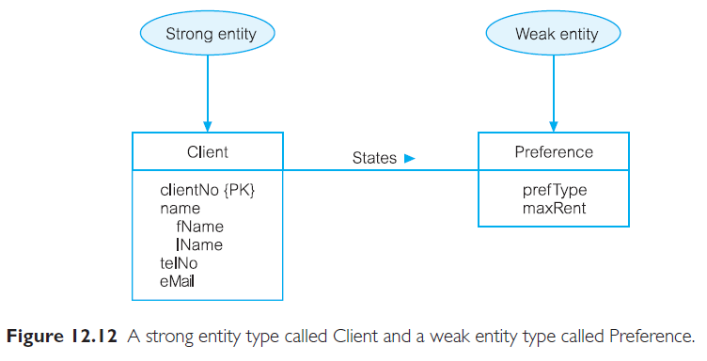
Strong vs Weak Entity

Slide 39
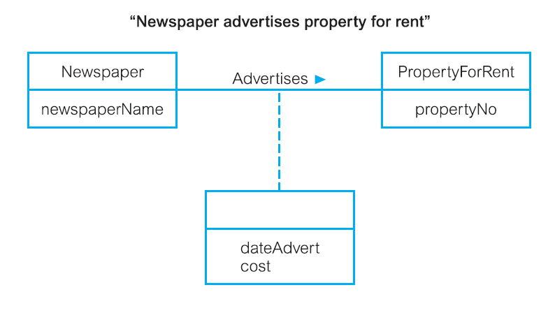
Relationship with Attributes
When to have relationship with attributes?

Slide 40
Structural Constraints
Main type of constraint on relationships is called multiplicity.
Multiplicity: number (or range) of possible occurrences of an entity type that may relate to a single occurrence of an associated entity type through a particular relationship.
  Constrains the way the entities are related in the relationship
  Represents policies (called business rules) established by user or company.

Slide 41
Structural Constraint (Binary Relationship)
Binary relationship (i.e. the most common degree for relationships) is generally referred to as having a multiplicity of:
  one-to-one (1:1), or
  one-to-many (1:*), or
  many-to-many (*:*)
How to determine multiplicity:
  Produce a semantic net with sample occurrences that can best represent the relationship of entities
  Analyze the semantic net

Slide 42
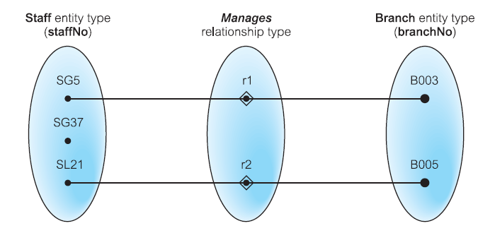
Semantic Net: Staff manages Branch

Slide 43
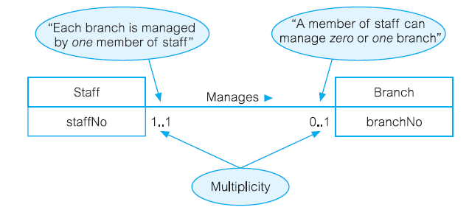
ERD: Staff manages Branch
Multiplicity of Manages relationship is one-to-one (1:1) → shown through the maximum range value on the multiplicities at both ends of relationship

Slide 44
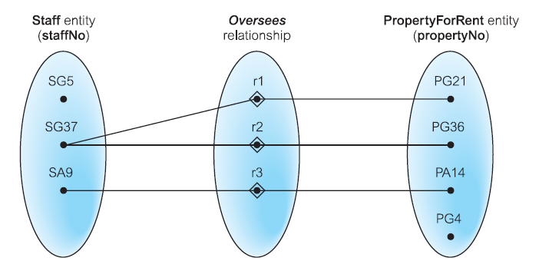
Semantic Net: Staff oversees PropertyForRent

Slide 45
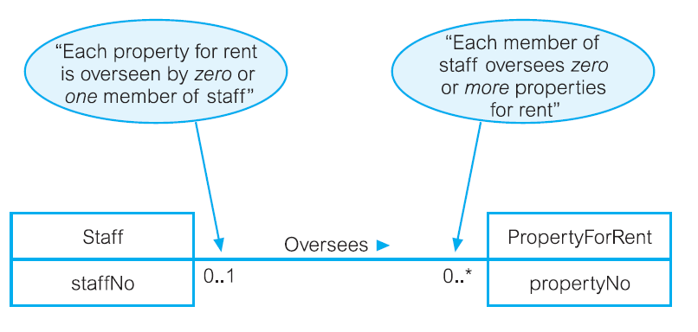
ERD: Staff oversees PropertyForRent
Oversees is a one-to-many (1:*) relationship

Slide 46
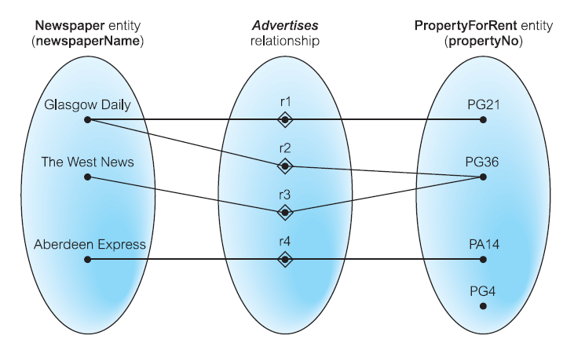
Semantic Net: Newspaper Advertises PropertyForRent

Slide 47
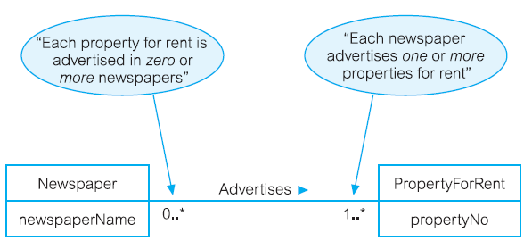
ERD: Newspaper Advertises PropertyForRent
Advertises is a many-to-many (*:*) relationship

Slide 48
Structural Constraint (Complex Relationship)
Multiplicity for Complex Relationships
  Complex relationship – relationship higher than binary
  Number (or range) of possible occurrences of an entity type in an n-ary relationship when other (n-1) values are fixed.

Slide 49
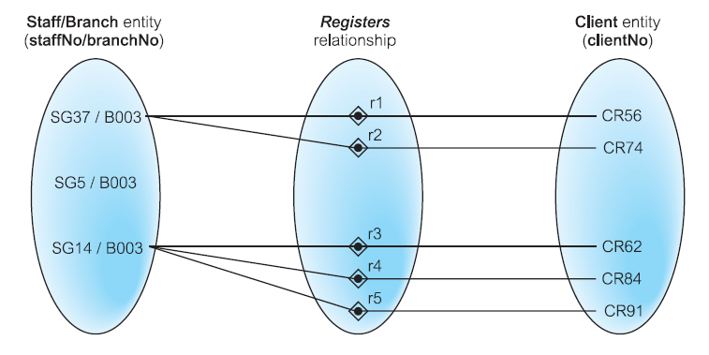
Semantic Net: Ternary Registers Relationship with Values for Staff and Branch Entities Fixed

Slide 50
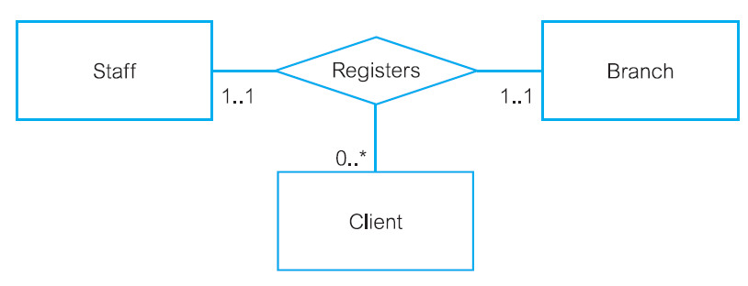
Multiplicity of Ternary Registers Relationship
Staff of a branch registers zero client or more

Slide 51
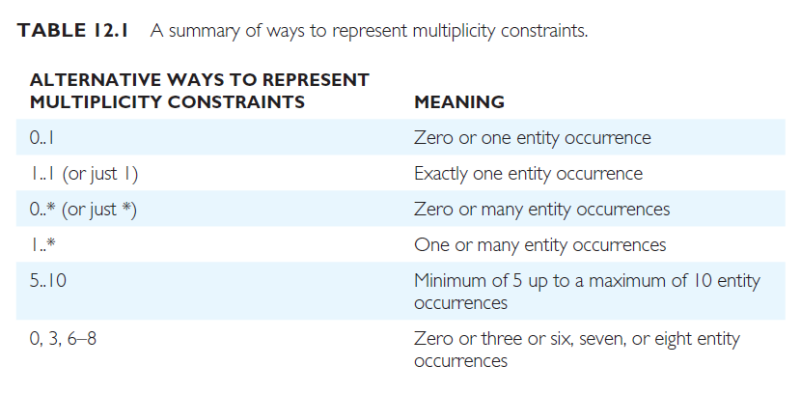
Summary of Multiplicity Constraints

Slide 52
Constraints (Cardinality & Participation)
From multiplicity we can actually identify two type of restrictions on relationships: cardinality and participation.
Cardinality
  Describes maximum number of possible relationship occurrences for an entity participating in a given relationship type.
  Appears as the maximum values for the multiplicity ranges on either side of the relationship

Slide 53
Constraints (Cardinality & Participation)
Participation (mandatory/optional)
  determines whether all or only some entity occurrences are involved (participate) in a relationship.
  All is mandatory (minimum value 1) ;
  only some is optional (minimum value 0)
  How to determine an entity’s participation on a diagram?
    Look at the minimum value of a range at one entity.
    If value is 0, then the opposite entity (in that relationship) has an optional participation
    If value is 1, then the opposite entity (in that relationship) has a mandatory participation

Slide 54
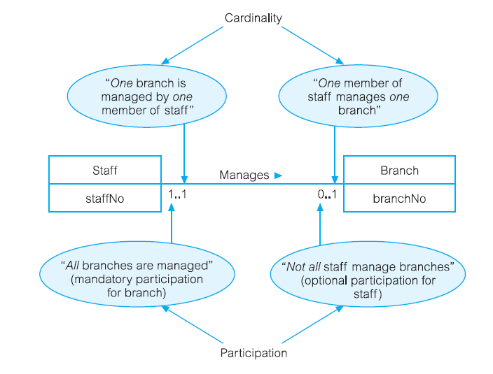
Multiplicity as Cardinality and Participation Constraints

Slide 55
Practice 4: Problem 1
Complete the ERD for the problem by:
  Determine whether the entities are strong entity or weak entity;
  Determine the multiplicity and structural constraints (cardinality and participation) for each relationship in the diagram

Slide 56
Structural Constraints (cont)
Why need to understand and able to differentiate between the different type of structural constraints in data model (ERD)?
  Relational schemas will be created from entities-relationship in ERD
  Different type of constraints will affect the schemas created (will be discussed in logical database design topic)

Slide 57
Problem 2: Produce ERD to represent the following situation
Model the USA-type geography, where the following is of interest:
  States of a country including their name, population, area and date established.
  Cities including their name, population, date established and founder's name.
  Rivers including their name and length.
  The capital city of each state, including the date declared.
  The source of each river, i.e. the state in which it begins (which may be none)
  The fact that cities may be located on particular rivers.
  The fact that cities are located in states.
  The length of each river within each state.
  Information about states that adjoin each another, and the length of their common border.
  Assume that the names of states and rivers are unique. City names are only unique within a state.

Slide 58
Problem 3: Produce ERD to represent the following situation
Consider the following set of requirements for a university database that is used to keep track of students' transcripts.
  The university keeps track of each student's name, student number, current address, permanent address and phone, birthdate, gender, year of study (1st, 2nd, 3rd, 4th ), major department, minor department (if any), and degree program (B.A., B.Sc., ..., Ph.D.). Some user applications need to refer to the city, county, and post code of the student's permanent address and to the student's last name.
  Each department is described by name, department code, office number and office phones. Both name and code have unique values for each department.
  Each course has a course name, description, code number, number of semester hours and offering department. The value of the code number is unique for each course.
  Each module has an instructor, semester, year, course and module number. The module number distinguishes different modules of the same course that are taught during the same semester/year; its values are 1, 2, 3, ..., up to the number of taught during each semester.
  A grade report has a student, module and grade. modules

