Slide 1
A Connectome-Wide Analysis of Cognitive Control in Young Adults
Ursula Tooley
Notes:
Should be saying EF or cognitive control?

Slide 2
Background
EF/Cognitive control: definition
Has been linked to achievement and life outcomes (Moffett 20xx)
One well-known theoretical model divides EF into domain-general EF, an updating-specific component, and a switching-specific component (Miyake et al 2012)
Cite differences in connectivity related to EF in dev. Medaglia paper

Slide 3
What is a CWAS?
A novel method using multivariate distance matrix regression (MDMR) to examine the differences in connectivity across subjects and how these differences relate to a predictor variable.
Yields a map of brain areas where differences in connectivity are significantly related to differences in a predictor variable
When controlling for covariates

Slide 4
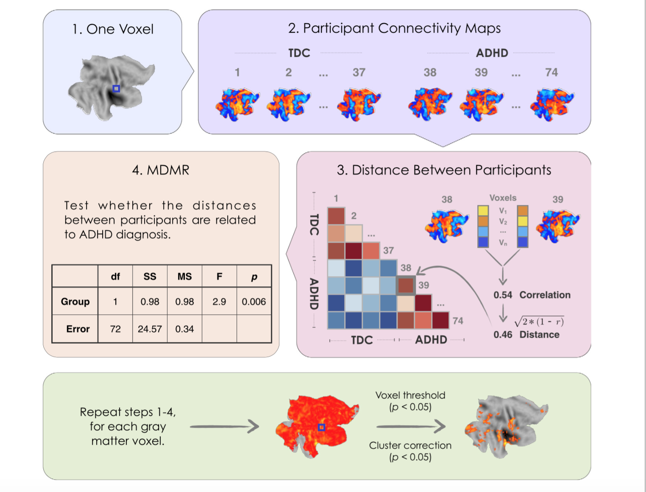
Shehzad et al., 2014
Notes:
This should come later? Should make own graphic that shows this simpler?

Slide 5
Goal/Hypotheses
To examine how differences in connectivity underlie domain-general and specific components of cognitive control
We predict that connectivity in areas of the PFC, particularly xxxx, will be posiively related to domain general cognitive control

Slide 6
Steps
Factor analysis of EF task data
Creation of predictor variables for CWAS
CWAS
Calculation of distances between subjects connectivity for each voxel (4 mm)
MDMR permuting variable of interest while controlling for covariates
Visualization of results

Slide 7
The CogTrain Dataset

Slide 8
Tasks

Slide 9
Factor Analysis of EF Task Data
Graphs here

Slide 12
Conclusions/Takeaways
Working with open-source scripts is fun!

