Slide 1
Department of Electronics Engineering (VLSI Design and Technology)
IV SEMESTER
Group Project/ Mini Project(22VLP47)
Presentation on
LOW POWER 16-BIT ALU DESIGN USING CLOCK GATING AND PIPELINING
By
Harshitha A 1NT24VL019
Thommandru Rushasree 1NT24VL053
Sachin Shivakumar Sabarad 1NT24VL047

Slide 2
Introduction
High-performance and low-power VLSI designs
Increasing transistor density raises power dissipation
ALUs essential in modern digital systems
Dynamic power caused by switching activity
Clock networks consume major chip power
Clock gating reduces unnecessary clock transitions
Pipelining improves throughput and timing performance
Project compares three ALU architectures

Slide 3
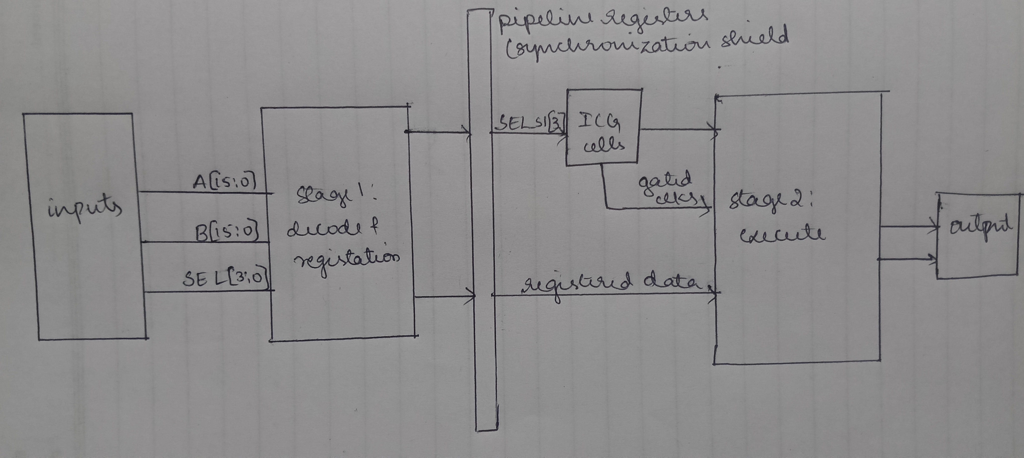
Block Diagram/Circuit Diagram
Notes:
nputs:
A[15:0] → First 16-bit operand
B[15:0] → Second 16-bit operand
SEL[3:0] → 4-bit select line choosing the ALU operation
The select lines determine which operation the ALU performs.
Stage 1 Decode Logic
The select signal SEL[3:0] is decoded to identify the required ALU operation
(b) Registration
The inputs are stored in registers.
This means:
A and B are synchronized with the clock
Temporary storage is created
Signal glitches are reduced
Timing becomes stable
Pipeline Registers (Synchronization Shield)
This section separates Stage 1 and Stage 2.
It acts as the boundary between the two pipeline stages.
Data Synchronization
Ensures:
Stable data transfer
No race conditions
No combinational glitches
Stable SEL_s1[3:0]
This is the registered select signal from Stage 1.
It becomes stable before entering the clock gating logic.
ICG
he ICG cell disables the clock for unused ALU sections.
Gated Clocks
The ICG outputs gated clocks to Stage 2.
These clocks activate only required execution units.
Example:
During ADD operation → adder section clock active
During AND operation → logic section clock active
Stage 2 – Execute
This is the second pipeline stage.
Here the actual ALU operation is performed.
Output Registers
After execution, results are stored in output registers.

Slide 4
Hardware Equipment/Software Tools Used
The complete implementation of the project was performed using open-source VLSI tools and the SKY130 process design kit. 1. Verilog HDL: Used for RTL design of the ALU architectures. 2. Yosys: Used for logic synthesis and technology mapping using SKY130 standard cells.
3. GTKWave: Used for waveform visualization and verification. 4. SKY130 PDK: Used as the standard cell technology library for synthesis and implementation. 5. Ubuntu Linux: Used as the development environment for executing the complete design flow.

Slide 5
CMOS Power Dissipation
CMOS power dissipation consists of dynamic power and static leakage power. Dynamic power is caused by charging and discharging capacitances during switching activity.
P = αCV²f
Where: α = switching activity C = load capacitance V = supply voltage f = operating frequency
Dynamic power includes: 1. Internal Power 2. Switching Power
Notes:
Explain dynamiv power, internal power, switching power
Tell that in this project we are focusing on switching activity reduction

Slide 6
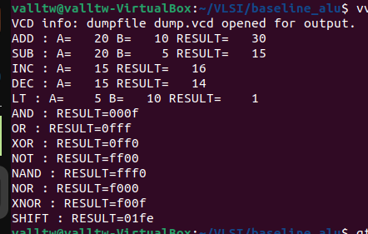
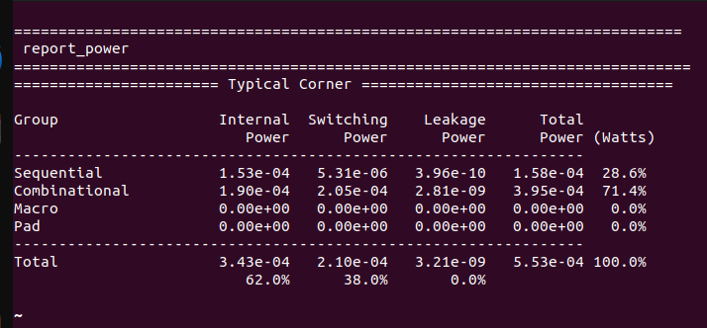
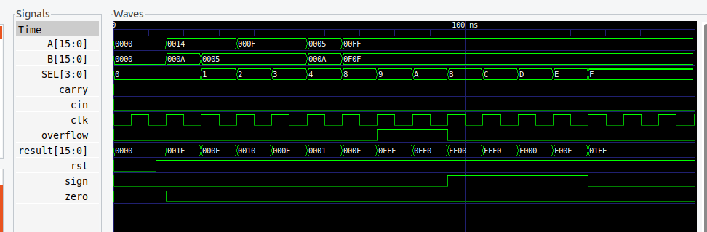
Baseline 16-bit ALU Architecture
Notes:
Explain the theoretical results, power report, and waveform
The baseline architecture consists of a standard 16-bit ALU without clock gating and without pipelining. The ALU supports arithmetic operations such as ADD, SUB, INC, DEC, and SLT, along with logical operations including AND, OR, XOR, NAND, NOR, XNOR, NOT, and shift operations. The baseline architecture serves as the reference design for all power and performance comparisons. Since no clock optimization techniques are used, all sequential elements receive continuous clock transitions regardless of activity.

Slide 7
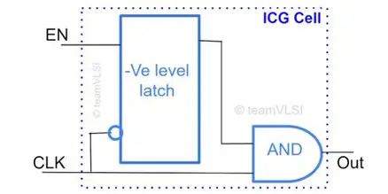
Integrated Clock Gating Cell (ICG)
module icg_cell( input CLK, input EN, output CLK_GATED ); reg en_latch;
always @(CLK or EN) begin if(!CLK) en_latch <= EN; end assign CLK_GATED = CLK & en_latch; endmodule
Notes:
First explain what is clock gating
Clock gating is one of the most effective low-power design techniques used in synchronous digital systems. Instead of continuously driving the clock signal to all registers, clock gating disables the clock to inactive modules. This reduces unnecessary switching activity and lowers dynamic power consumption.
Later start explaining ICG(integrated clock gating)
Integrated Clock Gating (ICG) cells are specialized standard cells designed to safely gate clocks without introducing glitches. In this project, latch-based clock gating architecture was studied and implemented. The ICG cell consists of: 1. low Level-sensitive latch 2. AND gate 3. Enable control signal The latch captures the enable signal during the inactive phase of the clock and prevents glitches during active clock transitions. The main advantages of latch-based ICG are: 1. Glitch-free clock gating 2. Reduced clock switching power 3. Safe clock operation 4. Better timing reliability
Later explain code

Slide 8
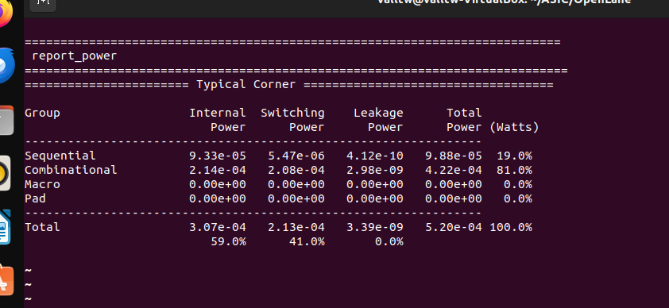
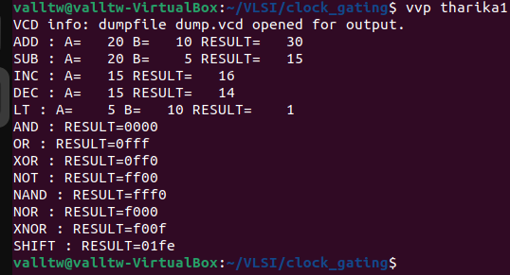
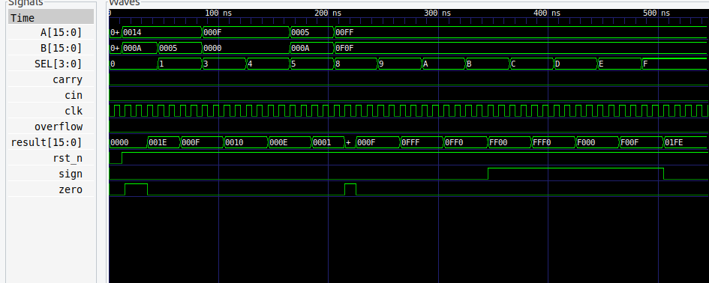
ICG 16 bit ALU architecture
Notes:
Explain everything oin the slide deck
Explain the glich

Slide 9
Two-Stage Pipelining
//stage 1 (decode)
reg [15:0] A_s1, B_s1;
reg [3:0] SEL_s1;
reg cin_s1;
//stage 2 (execute)
reg [15:0] arith_r;
reg a_carry, a_ovf;
reg [15:0] logic_r;
Stage 1: Decode Stage - Opcode decoding - Operand preparation - Control generation Stage 2: Execute Stage - Arithmetic and logical computation - Result generation - Flag generation
Notes:
Pipeline registers were inserted between stages to reduce combinational delay and improve timing performance. Advantages of pipelining: 1. Higher operating frequency 2. Improved throughput 3. Reduced critical path delay Disadvantages: 1. Additional registers 2. Increased clock power 3. Higher switching activity 4. Larger area

Slide 10
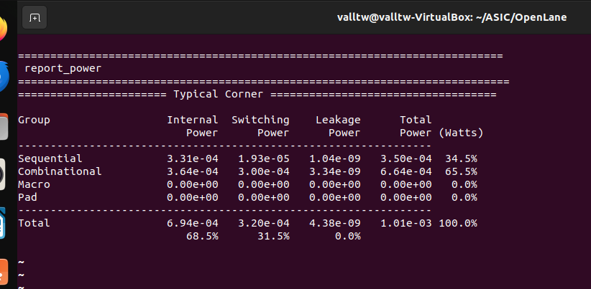
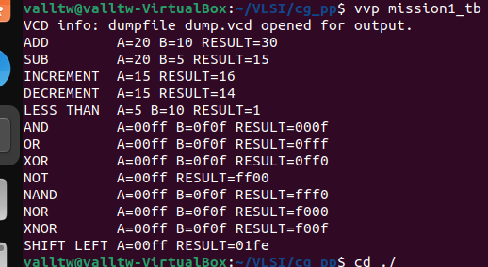
ICG and Pipelining 16 bit architecture
Notes:
Explain eeverything

Slide 11
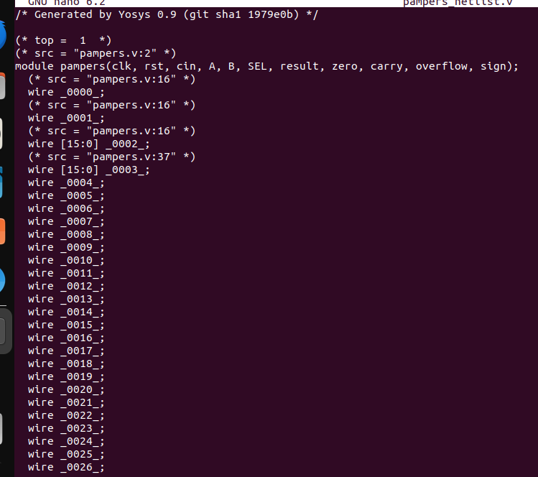
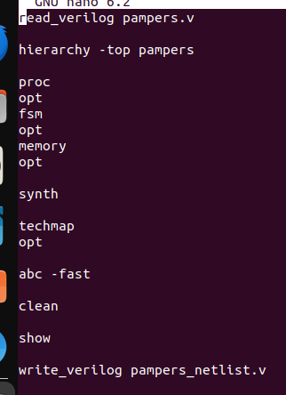
yosys script
Generated netlist of ICG and clock gating architecture
Notes:
Only explain the yosys script

Slide 12
Comparative power analysis of ALU architecture
Power Metric | Baseline ALU (No Clock Gating / No Pipelining) | ALU with Clock Gating Only | ALU with Clock Gating + Pipelining | Observation
Internal Power | 3.43 × 10⁻⁴ W | 3.07 × 10⁻⁴ W | 6.94 × 10⁻⁴ W | Reduced with clock gating, increased significantly with pipelining due to additional registers and clock activity
Switching Power | 2.10 × 10⁻⁴ W | 2.13 × 10⁻⁴ W | 3.20 × 10⁻⁴ W | Nearly same for clock gating, increased in pipelining because of higher switching transitions
Leakage Power | 3.21 × 10⁻⁹ W | 3.39 × 10⁻⁹ W | 4.38 × 10⁻⁹ W | Slight increase due to additional cells and sequential elements
Dynamic Power (Internal + Switching) | 5.53 × 10⁻⁴ W | 5.20 × 10⁻⁴ W | 1.014 × 10⁻³ W | Clock gating reduced dynamic power; pipelining increased dynamic power
Total Power | 5.53 × 10⁻⁴ W | 5.20 × 10⁻⁴ W | 1.01 × 10⁻³ W | Lowest power achieved using only clock gating
Relative Power (%) | 100% (Reference) | ~94% of baseline | ~182% of baseline | Pipeline register overhead increased total power significantly
Comparison | Power Change
Baseline → Clock Gating | ~6% power reduction
Baseline → Clock Gating + Pipelining | ~82% power increase
Clock Gating → Clock Gating + Pipelining | ~94% power increase
Notes:
Explain increment and decrement of all power
Add this line Although theoretical expectations suggested reduced dynamic power with pipelining and clock gating, practical synthesis results for the 16-bit ALU showed increased dynamic power due to added sequential elements, higher clock tree activity, and increased register switching overhead. This demonstrates the real-world tradeoff between performance optimization and power consumption in small-scale digital designs.

Slide 13
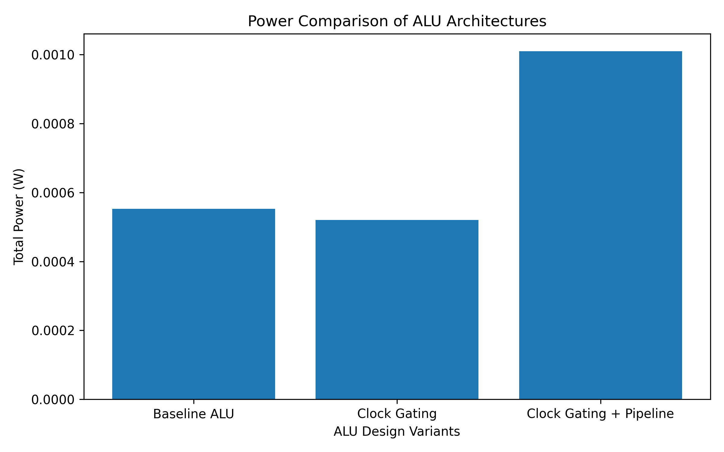
Results
Notes:
Explain the bar graph

Slide 14
Applications
Microprocessors
Embedded systems
Low-power portable devices
Smartphones and tablets
IoT devices
Wearable electronics
Digital Signal Processing (DSP) systems
AI and edge computing hardware
FPGA-based systems
System-on-Chip (SoC) designs
Notes:
1. Microprocessors
ALU is the core computational unit inside processors.
Your design can be used in:
CPUs
microcontrollers
embedded processors
Examples:
ARM processors
RISC-V cores
DSP processors
2. Low-Power Embedded Systems
Because your design uses:
clock gating
pipelining
it reduces:
dynamic power
unnecessary switching activity
Useful in:
battery-powered devices
portable systems
Examples:
smart watches
fitness bands
IoT nodes
3. Mobile Devices
Modern mobile chips require:
low power
high speed
efficient arithmetic computation
Your project techniques are used in:
smartphones
tablets
wearable electronics
4. DSP (Digital Signal Processing)
DSP systems continuously perform:
additions
subtractions
logic operations
shifting
Your ALU can be integrated into:
FIR filters
image processing units
audio processors
5. AI and Edge Computing Hardware
AI accelerators require:
fast arithmetic
optimized power consumption
Clock gating is heavily used in:
TPUs
NPUs
edge AI chips
6. FPGA-Based Systems
Your design can be synthesized on:
Xilinx FPGA
Intel FPGA
Applications:
hardware prototyping
custom accelerators
educational processor cores
7. SoC (System-on-Chip) Design
ALUs are essential blocks inside:
processors
memory controllers
hardware accelerators
Your project demonstrates:
RTL design
low-power techniques
pipeline architecture
which are directly relevant to SoC design.

Slide 15
Future Scope
Future improvements may include: 1. Multi-stage advanced pipelining 2. Operand isolation techniques 3. Fine-grain clock gating 4. Dynamic voltage and frequency scaling 5. Multi-Vt optimization 6. Glitch power reduction 7. Physical clock tree optimization 8. FPGA implementation and hardware validation 9. Advanced low-power synthesis techniques 10. ASIC tapeout implementation
11.Full RTL to GDSII flow
Notes:
Say we can to full rtl to gds2 implementation by taking it forward from synthesis

Slide 16
References
Yosys Open SYnthesis Suite Used for RTL synthesis and technology mapping of the Verilog ALU design.
Google SkyWater SKY130 PDK Documentation Used as the standard cell library and technology platform for synthesis and implementation.
GTKWave Waveform Viewer Used for waveform visualization and functional verification.
Reference YouTube video/tutorial on Integrated Clock Gating (ICG) design and low-power VLSI techniques. Used for understanding latch-based clock gating implementation and ICG requirements.
Neil H. E. Weste and David Harris, CMOS VLSI Design: A Circuits and Systems Perspective, Pearson Education. Referred for CMOS power dissipation, clock gating concepts, and pipelining theory.
Jan M. Rabaey, Digital Integrated Circuits: A Design Perspective, Prentice Hall. Referred for dynamic power analysis, switching activity, and low-power digital design concepts.
M. Morris Mano, Digital Design, Pearson Education. Referred for ALU architecture, arithmetic operations, and digital logic fundamentals.
8. Verilog HDL documentation and online tutorials for RTL coding and testbench development.
9. Open-source VLSI community forums and documentation

Slide 17
THANK YOU

