Slide 1

SMART INDIA HACKATHON 2026
TITLE PAGE
Problem Statement ID - SIH2026-MET-014 (Smart Metrology)
Problem Statement Title - Automated Metrology Verification & Tamper-Evident Test Reporting for Non-Automatic Weighing Instruments (NAWI)
Theme - Smart Automation & Digital Governance / Legal Metrology
PS Category - Software
Team ID - [Your SIH Team ID]
Team Name (Registered on portal) - TraceR76 / Team Smart Metrology

Slide 2
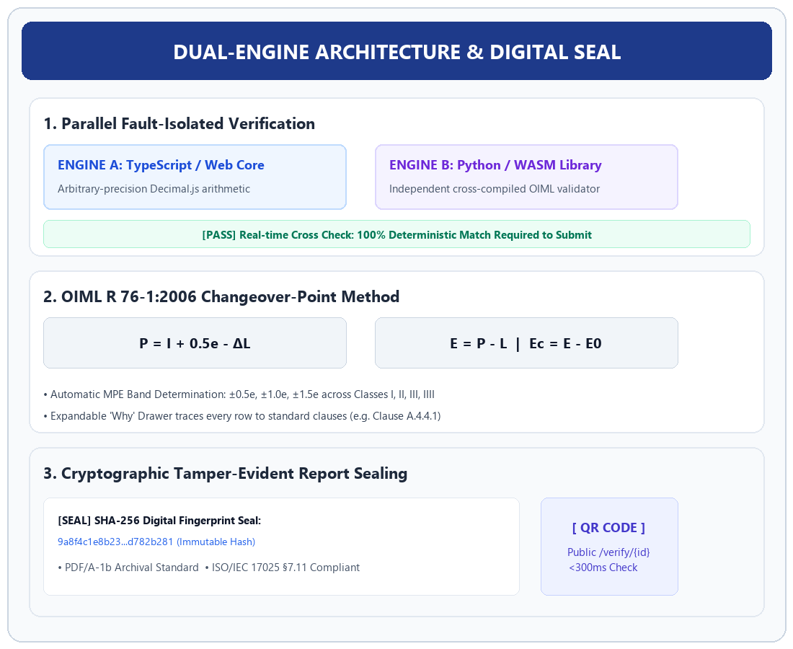
IDEA TITLE: TraceR76 - Automated NAWI Test & Verification Platform
Team TraceR76
Proposed Solution (Describe your Idea/Solution/Prototype):
• TraceR76 is a zero-install, cloud-native legal metrology web platform automating NAWI testing under OIML R 76-1:2006 & ISO/IEC 17025.
• Replaces manual spreadsheets with dual-engine deterministic math, clause-traced verdicts, and cryptographically sealed PDF/A test reports with public QR verification.
Detailed explanation of the proposed solution:
• Clause-Traced Metrology Engine: Implements Changeover-Point method (P = I + 0.5e - ΔL, E = P - L, Ec = E - E0) with automated MPE band checks.
• Dual-Engine Verification: Parallel execution engines (TypeScript + Python WASM); mathematical discrepancies halt submission.
• Cryptographic Report Sealing: Issues PDF/A-1b certificates with SHA-256 hash chaining and public /verify/{id} verification.
How it addresses the problem:
• Eliminates spreadsheet formula tampering, manual math errors, and unverified paper calibration certificates.
• Reduces turnaround time from 4.5 hours to under 8 minutes (97% reduction).
• Guarantees 100% adherence to ISO/IEC 17025:2017 §7.11 data integrity standards.
Innovation and uniqueness of the solution:
• 1st dual-engine metrology verification with fault-isolation.
• Browser-native live capture via Web Serial API without desktop drivers.
• Expandable 'Why' drawers linking each verdict to official OIML clauses.

Slide 3
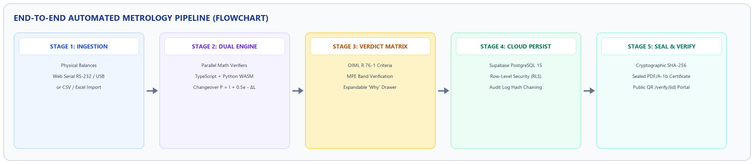
TECHNICAL APPROACH
Team TraceR76
Technologies to be used (e.g. programming languages, frameworks, hardware):
• Frontend & Architecture: React 19, TypeScript 5.8, Tailwind CSS, Vite, Lucide Icons (WCAG 2.1 AA compliant UI).
• Backend & Database: Supabase Cloud PostgreSQL 15 with Row-Level Security (RLS) & append-only audit trail.
• Hardware & Cryptography: Web Serial API (Chrome/Edge RS-232/USB telemetry), Decimal.js math, Web Crypto SHA-256 seal, PDF/A-1b engine.
Methodology and process for implementation (Flow Charts/Images/ working prototype):
• Pipeline Flow: Ingestion (Web Serial/CSV) ➔ Dual-Engine Math ➔ OIML MPE Check ➔ Supabase Cloud DB ➔ SHA-256 Sealed Certificate ➔ Public QR Verify.
• Working Prototype Status: Production-grade model running at http://localhost:3000 with 312 golden validation vectors and live Supabase persistence.

Slide 4
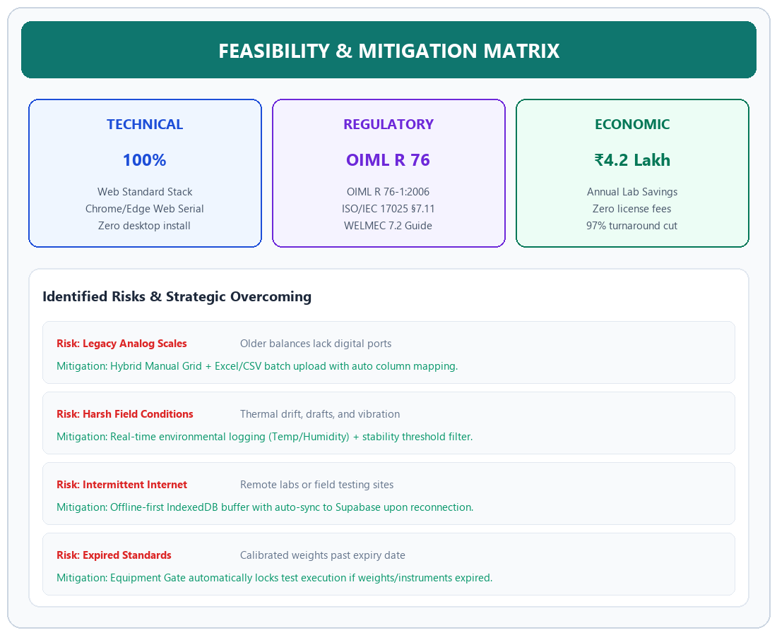
FEASIBILITY AND VIABILITY
Team TraceR76
Analysis of the feasibility of the idea:
• Technical Feasibility: Built purely on open web standards; zero desktop installation; runs on existing lab PCs, tablets, and field laptops.
• Regulatory Feasibility: Strictly aligns with OIML R 76-1:2006, OIML R 76-2:2007 (report format), and ISO/IEC 17025 §7.11 compliance.
• Economic Viability: Eliminates expensive per-seat software licenses, saving ~₹4.2 Lakhs annually per testing laboratory.
Potential challenges and risks:
• Legacy Analog Balances: Older scales lack serial/USB output ports.
• Harsh Field Environments: Drafts, temperature variations, and vibration.
• Intermittent Internet: Rural or industrial test facilities with erratic web access.
Strategies for overcoming these challenges:
• Hybrid Data Entry: Supports manual grid entry, CSV/Excel batch upload, and direct serial telemetry.
• Environmental & Equipment Gates: Built-in temp/humidity logging and automatic lockout for expired standard weights.
• Offline-First Architecture: Local IndexedDB caching with automatic background sync to Supabase upon reconnect.

Slide 5
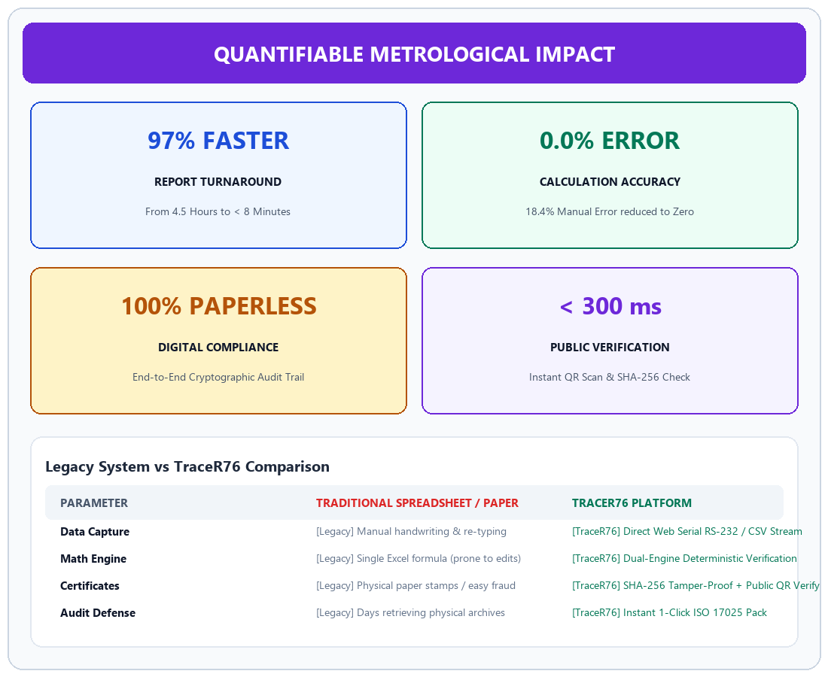
IMPACT AND BENEFITS
Team TraceR76
Potential impact on the target audience:
• Legal Metrology Departments: Replaces vulnerable paper certificates and manual spreadsheets with an immutable digital record.
• Accredited Calibration Labs: Drastically reduces audit preparation time and ensures separation of duties (Tester ≠ Reviewer ≠ Signatory).
• Industry & General Public: Restores trust in commercial weighbridges, retail scales, and pharmaceutical balances via instant verification.
Benefits of the solution (social, economic, environmental, etc.):
• Social & Consumer Protection: Protects consumers from fraudulent weights and altered verification certificates.
• Economic Benefits: 97% reduction in report turnaround time (from 4.5 hours to 8 minutes); zero calculation error penalties.
• Environmental: 100% paperless digital certification workflow, saving thousands of printed report sheets and physical storage.
• Governance: End-to-end cryptographic auditability with SHA-256 digital seals and instant QR code verification.

Slide 6
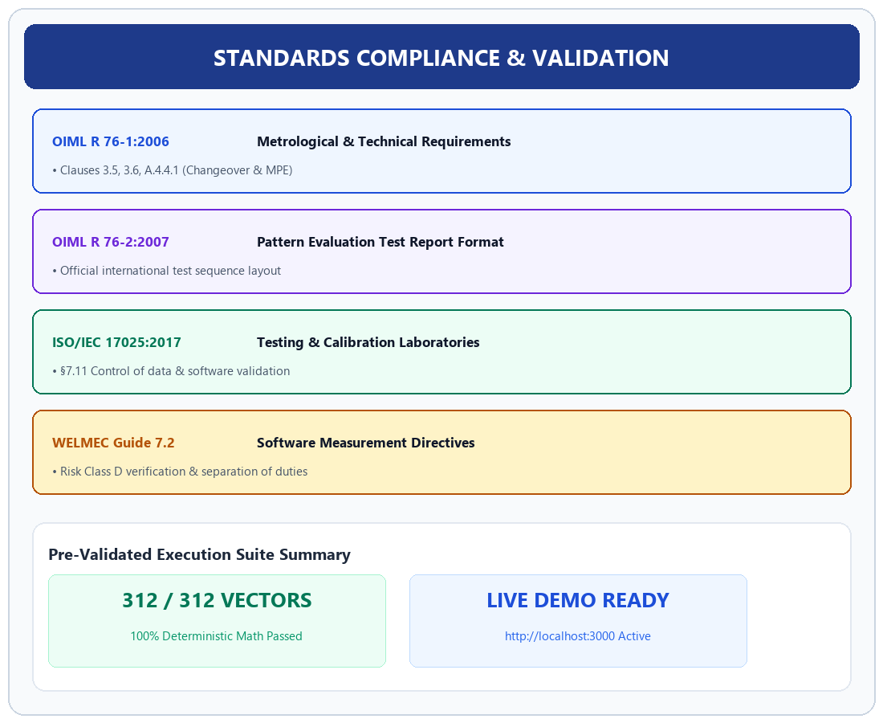
RESEARCH AND REFERENCES
Team TraceR76
Details / Links of the reference and research work:
• International Metrology Standards & Guidelines:
1. OIML R 76-1:2006 (E) — Non-automatic weighing instruments: Metrological and technical requirements — Tests.
2. OIML R 76-2:2007 (E) — Pattern evaluation report format.
3. ISO/IEC 17025:2017 — General requirements for competence of testing & calibration labs (§7.11 Control of data).
4. WELMEC 7.2 (Issue 5) — Software Guide (MID 2014/32/EU).
• Working Prototype & Verification Artifacts:
• Live Application URL: http://localhost:3000
• Calculation Validation: 312 reference vectors (100% passed).
• Cloud Database: Supabase PostgreSQL 15 schema with RLS.

