Slide 1
Coderetreat
17-11-2018
Utrecht

Slide 2
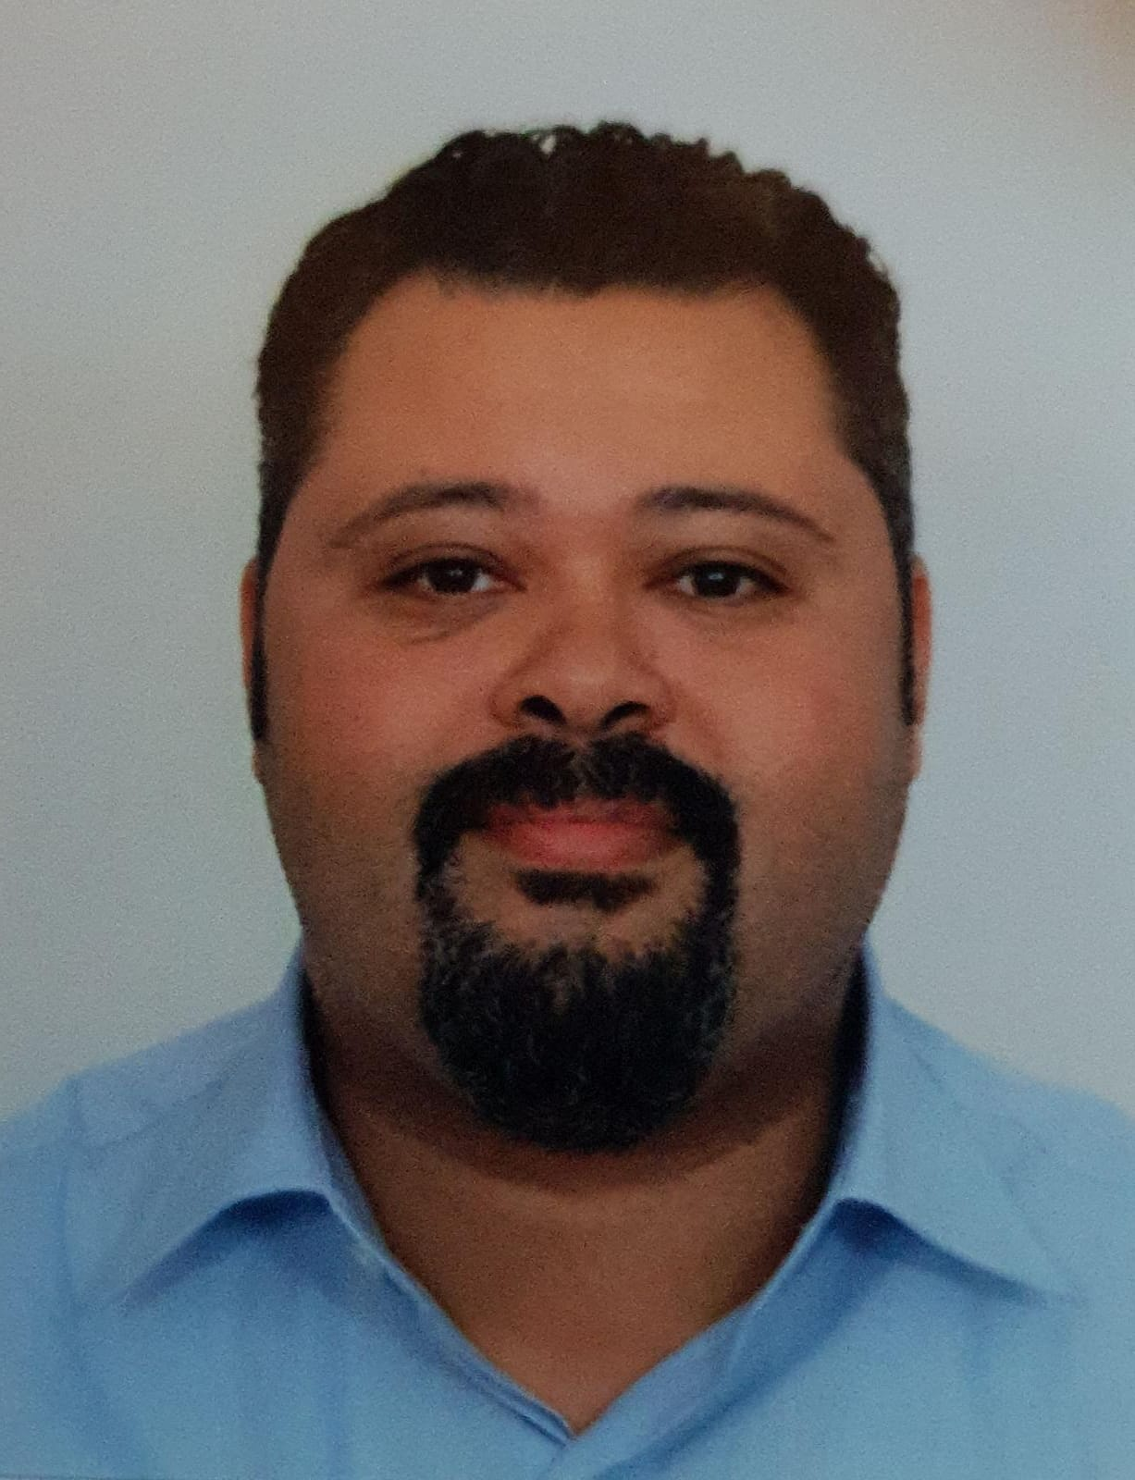
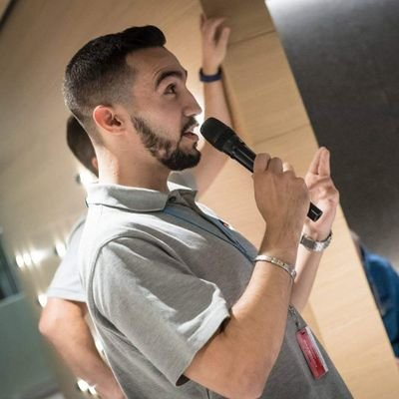
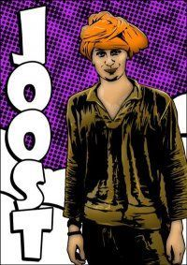
Who

Slide 3
What do we learn?
Design skills
minute-by-minute decisions we do daily
Delete code

Slide 4
What is (a typical) coderetreat
•
•
1 day of coding
Conway’s game of life
(simple rules, learning to program - not the domain)
X pairing partners
•
•
•
~5 constraints
Language agnostic

Slide 5
What to expect today?
Practice the fundamentals of programming
OO, functional, clean code, TDD, refactoring
An intense day of coding
And a lot of fun

Slide 6
Structure of the day
15-30 min intro
1 session of 45' + 15’ retro
Coffee break
1 session of 45min + 15min retro
Lunch + something cool!

Slide 7
Structure of the day
1 session of 45' + 15’ retro
Snack break
1 session of 45’ + 15' retro
Coffee 15’
1 session of 45’ + 15' retro
30’ RETRO

Slide 8
principles
We are all valued - everyone counts
We are all here to learn.
Focus on practice & experiment
Try not to finish the problem
DELETE YOUR CODE after each session
Have Fun

Slide 9
prerequisites
Computer
Coding environment
Test environment
unless you want to start by creating one of your own
Source control (git, SVN, mercurial, etc.)

Slide 10
The 4 elements of simple design
Passes its tests
Maximizes clarity
Minimizes duplication
Has fewer elements

Slide 11
1. Passes its tests
Not “automated tests”
About correctness and verification. Faster feedback cycle is better.
“If you are to ask how fast your test suite should be, it should be faster”

Slide 12
2. Maximizes clarity
How quickly can you find the part that should be changed?
A source of code smells - if it is hard to give an expressive name, maybe the (unit) is doing too much

Slide 13
3. No Duplication
Not about code, but knowledge.
“Every piece of knowledge should have one and only one representation”

Slide 14
4. Small
Code that is no longer used?
Duplicate abstractions - could I combine
Duplication in behaviour -> sign of a missing Abstraction?

Slide 15
Conway’s game of life
Having an infinite 2D orthogonal universe. Being given an initial generation called a seed. The following rules are applied simultaneously

Slide 16
The rules
A live cell having less than 2 live neighbors dies
A live cell having 2 or 3 live neighbors lives
A live cell having more than 3 neighbors dies
A dead cell having 3 neighbors becomes alive

Slide 17
First session
Find a pair
Choose programming language
Setup the environment
Make a decision on how to start
We’ll start in 5 minutes.
https://github.com/thodorisbais/coderetreat

Slide 18
Why coderetreats?
Learn through pairing
… out of comfort zone
deliberate practice
experiment
...safely in safe environment

Slide 19
2nd session – strict ping pong
Ahmed?

Slide 20
2nd session – retro
And then lunch!

Slide 21
3nd session -
no talking
Joost?

Slide 22
3nd session -
retro
… (does this imply “no talking”?)

Slide 23
Snack
For 15 min

Slide 24
4th session – 4 statements per method
Ahmed?

Slide 25
4th session -
retro

Slide 26
5th session -Legacy
Joost?

Slide 27
5th session - Retro

Slide 28
Closing circle
What, if any, did you learn today?
What, if any, did surprise you?
What, if any, will you take to work with you ‘tomorrow’?

Slide 29
Thank you
Thanks CodeSquad!

