Slide 1
Competing with the Sharing Economy: Incumbents’ Reaction on Review Manipulation
Conceptual replication
Nie, Zheng & Sarkar (2022) MISQ
Uttaran Tribedi
Notes:
Title slide. One sentence: this is a conceptual replication: same question, same design, public data in place of the paper’s proprietary sources, plus two extensions.

Slide 2
Replication strategy with two independent setups
The paper’s shared data and code are not available and three of its six sources cannot be obtained. The replication therefore keeps the design and rebuilds every input from public data, twice.
Texas
Europe
Austin, Dallas, Fort Worth · 2011 Q1 – 2019 Q2 · 448 hotels · 10,068 hotel-quarters
London, Paris, Barcelona, Amsterdam, Milan, Vienna · 2015 Q3 – 2017 Q3 · 903 hotels · 7,101 hotel-quarters
Same geography and design, longer horizon. No verified-review platform is public, so manipulation is proxied by reviews from one-time reviewers.
Different geography, but the paper’s exact measure, TripAdvisor against Booking.com, where only verified stays can review.
Both panels use a hotel-quarter unit, 1 km radius, lagged Airbnb supply, hotel + quarter + city × season fixed effects, 2SLS
2
Notes:
Texas tests the finding on its home turf with a proxy measure. Europe tests the paper’s own measure in a different market. They turn out to fail in different ways, which is informative.

Slide 3
Data and what each source became
Paper’s source | Role | Replication | Status
TripAdvisor (own crawler) | unverified reviews | HotelRec corpus (Antognini & Faltings 2020), 50 M reviews | Public
Expedia (own crawler) | verified benchmark | None exists for Texas. Booking.com 515K (verified stays) for Europe | Unobtainable / public substitute
Airbnb.com + AirDNA | supply, entry date, prices | Inside Airbnb, entry date from host tenure, AirDNA prices replaced by listed prices | Public (AirDNA commercial)
Smith Travel Research | price tier, address, rooms | STR economy-class brand list (26% low-end vs paper’s 24%) | Commercial, substituted
Texas Comptroller | operating period | First-to-last review window | Public, substituted
Expedia coordinates | distances | TripAdvisor hotel pages (449 of 449) and the Booking.com file for Europe | Public
Tables 6 and 7 (LA-PSM, synthetic control) use STR covariates (price, rooms, chain status, location type) that cannot be obtained, so they are rebuilt on observable covariates and with a different estimator
3
Notes:
The one input that cannot be replaced for Texas is the verified-review benchmark. Everything else has a public substitute, and the substitutes are listed so the assessment is explicit about what changed.

Slide 4
Data pipeline
1 · FILTER
2 · LINK
3 · AIRBNB
4 · PANELS
50.4 GB
1,125 · 449
253 k
10,068 · 7,101
50.3 M TripAdvisor reviews scanned in one resumable pass, 2.54 M kept for Texas and the six European cities, 10,732 hotels
Booking hotels matched to TripAdvisor by name (score ≥ 90). Texas hotels geocoded from their own TripAdvisor pages, 449 of 449
Inside Airbnb listings for nine cities, entry quarter from host tenure, listings within 1 km counted per hotel-quarter, lagged
Hotel-quarters with reviews. Texas has 448 hotels over 2011–2019 and Europe 903 hotels over 2015–2017. The same code produces both
How the hotel counts arise:
Texas has 449 geocoded hotels, but one has its last TripAdvisor review in 2008, before the panel starts in 2011 Q1, so it contributes no hotel-quarters and the panel has 448.
Europe starts from 1,492 Booking.com hotels, 1,125 matched to a TripAdvisor hotel by name at similarity 90 or above, 186 of those lack coordinates and are dropped, leaving 939, and 903 have at least one quarter with both TripAdvisor and Booking reviews between 2015 Q3 and 2017 Q3, which gives 7,118 hotel-quarters (7,101 once the lagged controls are formed).
In both panels a hotel counts if it has at least one usable hotel-quarter in the window, which is also how the paper counts its 2,188 hotels out of a larger census.
4
Notes:
Mention the obstacle that mattered most. OpenStreetMap name-geocoding put 30% of hotels at the wrong branch of the same brand, and reading coordinates from TripAdvisor’s own pages fixed it.

Slide 5
Measures
Construct | Paper | Texas replication | Europe replication
Self-promotion | share 5-star on TripAdvisor − share 5-star on Expedia | share of reviews that are 5-star and by a one-time reviewer (Luca & Zervas 2016) | share 5-star on TripAdvisor − share 9–10 on Booking.com
Demotion received | share 1–2-star TripAdvisor − Expedia | share 1–2-star by one-time reviewers | share 1–2-star TripAdvisor − share ≤ 5 on Booking.com
Demoting others | competitors’ demoting reviews attributed evenly, averaged | identical construction | identical construction
Low-end hotel | STR budget price tier (24%) | STR economy-class brands (26%) | budget brands (2 hotels, so the moderation is not estimable)
Airbnb supply | listings within 1 km by host registration date, lagged | listings within 1 km by host start date (host tenure), lagged | same as Texas
Instrument | Airbnb listings near competing hotels, excluding own | identical construction | identical construction
Low-end hotels use 4–5-star and 1-star thresholds, as in the paper. Booking’s 0–10 scale mapped to 5-star bands is a stated assumption.
5
Notes:
The Texas proxy is validated later. In Europe, where both measures exist, the one-time-reviewer excess correlates 0.69 with the Mayzlin gap.

Slide 6
Table 1. Summary statistics, Texas hotel-quarter level
-----------------------------------------------------------
mean sd min max
-----------------------------------------------------------
TripAdvisor reviews per quarter 12.39 19.55 1 418
1-star reviews 0.89 1.76 0 31
2-star reviews 0.84 1.60 0 24
3-star reviews 1.49 2.34 0 34
4-star reviews 3.02 4.63 0 79
5-star reviews 6.15 13.20 0 318
Competing Airbnb listings 11.84 33.89 0 282
Competing hotels 3.27 3.42 0 22
-----------------------------------------------------------
448 hotels and 10,068 hotel-quarters with reviews. The paper reports 10.9 TripAdvisor reviews per quarter, 3.3 competing Airbnb listings and 5.0 competing hotels, with 2,188 hotels and 38,759 hotel-quarters. Europe has 903 hotels, 7,101 hotel-quarters and 526 competing listings on average.
6
Notes:
The Texas panel is a smaller but faithful image of the paper’s. In 2015 Q4 the mean Airbnb supply per hotel is 9.29 here and 9.19 in the paper.

Slide 7
Table 2. Self-promotion, 2SLS, Texas
-----------------------------------------------------
(1) (2) (3)
Model 1 Model 2 Model 3
-----------------------------------------------------
log(Airbnb) 0.022 0.018 0.022
(0.017) (0.016) (0.015)
log(CompetingHotels) 0.013 0.009 0.001
(0.024) (0.023) (0.024)
Log(ReviewCount) 0.028*** 0.028***
(0.005) (0.005)
log(Airbnb) x Low-end -0.023
(0.023)
-----------------------------------------------------
Observations 10,068 10,068 10,068
Kleibergen-Paap F 85.7 86.0 41.1
-----------------------------------------------------
Paper, same three columns. log(Airbnb) 0.021*** (0.006), 0.020** (0.006), 0.020*** (0.006). Interaction with low-end −0.054* (0.022). 32,122 observations, Kleibergen-Paap F 796.5. Same sign and same magnitude here, with a standard error three times the paper’s. Outcome in Texas is the one-time-reviewer 5-star share.
7
Notes:
The headline comparison. The point estimate lands on the paper’s number. The sample is one third the size and the outcome is a proxy, so the interval includes zero. Say directionally reproduced, underpowered, and reuse the phrase.

Slide 8
Table 3. Demoting others, 2SLS, Texas
---------------------------------------------------
(1) (2) (3)
Model 1 Model 2 Model 3
---------------------------------------------------
log(Airbnb) -0.128 -0.130 -0.128
(0.090) (0.091) (0.091)
log(CompetingHotels) -0.157 -0.156 -0.160
(0.099) (0.100) (0.104)
Log(ReviewCount) 0.010 0.009
(0.023) (0.023)
log(Airbnb) x Low-end -0.013
(0.067)
---------------------------------------------------
Observations 7,487 7,487 7,487
Kleibergen-Paap F 69.7 69.9 34.6
---------------------------------------------------
Paper. log(Airbnb) −0.035*** (0.009) in all three columns, log(CompetingHotels) −0.297*** (0.044), interaction −0.006 (0.049), 24,713 observations. Both regressors keep the paper’s sign here. The OLS two-way FE estimate on competing hotels is −0.260** against the paper’s −0.297***.
8
Notes:
The competing-hotels result, the strategic-group prediction that incumbents demote each other less when there are more of them, reproduces at conventional significance in OLS and keeps its sign in 2SLS.

Slide 9
Table 4. Mutual demotion, hotel-pair level, 2SLS, Texas
-----------------------------------------------------
(1) (2) (3)
Model 1 Model 2 Model 3
-----------------------------------------------------
log(Airbnb) -0.191* -0.177* -0.164*
(0.079) (0.073) (0.072)
log(CompetingHotels) -0.077 -0.100 -0.112*
(0.057) (0.054) (0.057)
Log(ReviewCount) 0.179*** 0.178***
(0.028) (0.028)
log(Airbnb) x Low-end -0.072
(0.052)
-----------------------------------------------------
Observations 15,516 15,516 15,516
Kleibergen-Paap F 106.2 105.5 51.0
-----------------------------------------------------
Paper. log(Airbnb) −0.107*** (0.008), −0.092*** (0.008), −0.092*** (0.008), log(CompetingHotels) −0.370***, Log(ReviewCount) 0.050***, interaction +0.136*** (0.040), 104,424 pair-quarters. The pair-level test is the first Texas result to reach significance. The low-end interaction does not reproduce. 991 pairs of same-tier hotels within 1 km, pair and quarter and city × season fixed effects, standard errors clustered by pair.
9
Notes:
Pairs multiply the observations and sharpen the test. The paper’s positive low-end interaction, that budget hotels keep demoting, is the one coefficient whose sign we do not reproduce.

Slide 10
Table 8. Being demoted, 2SLS, Texas
---------------------------------------------------
(1) (2) (3)
Model 1 Model 2 Model 3
---------------------------------------------------
log(Airbnb) 0.022 0.021 0.017
(0.013) (0.012) (0.012)
log(CompetingHotels) -0.005 -0.003 0.006
(0.018) (0.018) (0.018)
Log(ReviewCount) 0.001 0.001
(0.004) (0.004)
log(Airbnb) x Low-end 0.027
(0.020)
---------------------------------------------------
Observations 10,068 10,068 10,068
Kleibergen-Paap F 85.7 86.0 41.1
---------------------------------------------------
Paper. log(Airbnb) 0.123* (0.048), 0.137** (0.048), 0.139** (0.048), Log(ReviewCount) 0.171***, interaction −0.161 (0.174), 32,122 observations. Same sign here with p = 0.09 and a smaller magnitude. The Texas outcome counts only 1–2-star reviews by one-time reviewers, a narrower measure than the paper’s cross-platform gap.
10
Notes:
Table 8 is the mirror image of Table 3. Hotels that demote others less are themselves demoted less. Both move the right way.

Slide 11
Table 5. Validity of the instrument, Texas
---------------------------------------------------------------------------------------------
(1) (2) (3) (4)
No Airbnb: pro~e No Airbnb: dem~e Airbnb: promote Airbnb: demote
---------------------------------------------------------------------------------------------
log(Cmp_Airbnb) -0.021 0.286 0.005 -0.097*
(0.023) (0.172) (0.007) (0.045)
log(CompetingHotels) -0.058 0.017 0.025 -0.148
(0.068) (0.187) (0.023) (0.095)
Log(ReviewCount) 0.030* -0.016 0.028*** 0.017
(0.013) (0.042) (0.006) (0.025)
---------------------------------------------------------------------------------------------
Observations 2,242 1,454 7,826 6,033
---------------------------------------------------------------------------------------------
The instrument, competitors’ Airbnb supply, should not move manipulation directly in hotels that never had an Airbnb competitor, and should in hotels that did. Paper, columns in the same order. 0.004 (0.019), −0.009 (0.015), 0.012** (0.004), −0.032*** (0.010). The placebo pattern reproduces. The paper’s PSM-matched sample needs STR covariates and is not reproducible. OLS with hotel, quarter and city × season fixed effects.
11
Notes:
This test is only possible in Texas, where 98 hotels never get an Airbnb competitor within 1 km. In Europe there are none.

Slide 12
Table 6. Look-ahead PSM-matched hotels, 2SLS, Texas
------------------------------------------------------------------------------------------
(1) (2) (3) (4) (5) (6)
Promote 1 Promote 2 Promote 3 Demote 1 Demote 2 Demote 3
------------------------------------------------------------------------------------------
log(Airbnb) 0.050 0.035 0.010 -0.515 -0.527 -0.755
(0.042) (0.036) (0.076) (0.408) (0.407) (0.660)
log(CompetingHotels) 0.035 0.019 -0.011 -0.535 -0.544 -1.182
(0.048) (0.043) (0.111) (0.307) (0.311) (0.959)
Log(ReviewCount) 0.033*** 0.031** 0.025 -0.054
(0.008) (0.010) (0.055) (0.112)
log(Airbnb) x Low-end -0.096 -4.828
(0.368) (6.012)
------------------------------------------------------------------------------------------
Observations 4,424 4,424 4,424 2,916 2,916 2,916
Kleibergen-Paap F 13.5 13.7 0.3 9.0 9.1 0.5
------------------------------------------------------------------------------------------
Hotels that face Airbnb in Period 1 (Group A) are matched to hotels that do not yet (Groups B and C) on what is observable, pre-period reviews, rating, 5-star and 1 to 2-star shares, tier, competing hotels, city and opening date. Nearest neighbour without replacement, caliper 0.1, 101 pairs, mean bias falls from 30 to 12 percent. The paper matches on STR price, rooms, chain status and location type, which are not available. log(Airbnb) 0.050, 0.035 for self-promotion and −0.52 for demoting others, the paper’s signs (0.034*, 0.031*, −0.084**) without significance on 4,424 observations. Model 3 has no first stage in the matched sample, so the interaction is not estimable.
12
Notes:
Table 6 is rebuilt with the covariates we have. Say plainly that the paper's matching variables are proprietary and that the sample is a fifth of the original.

Slide 13
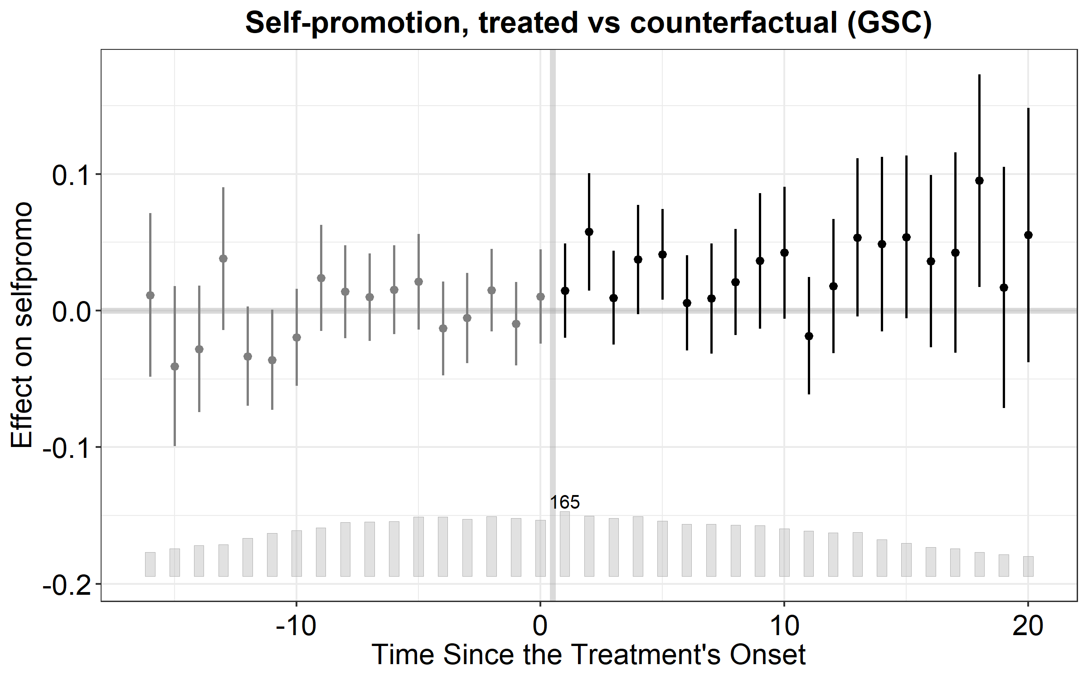
Table 7. Generalized synthetic control, Texas
R, fect (Xu 2017 estimator), full panel
model ATT SE p r treated controls
Promote all 0.033 0.015 0.027 0 165 101
Promote high 0.039 0.017 0.024 0 130 61
Promote low 0.009 0.042 0.829 0 35 40
Demote all 0.046 0.066 0.487 0 121 62
Demote high 0.004 0.069 0.953 0 107 47
Demote low 0.417 0.381 0.273 0 14 15
Stata, sdid cross-check, balanced panel 2012 Q1 to 2019 Q2
-------------------------------------------------------------
ATT SE Treated Controls Quarters
-------------------------------------------------------------
Promote all -0.028 0.023 64 24 30
Promote high -0.025 0.022 60 23 30
Promote low 0.006 0.112 4 1 30
Demote all 0.015 0.083 48 13 30
Demote high 0.006 0.094 48 12 30
Demote low . . 0 1 30
-------------------------------------------------------------
Treatment is the first competing listing within 1 km, as in the paper. The paper’s estimator (interactive fixed effects, factors chosen by cross-validation) uses all 448 hotels. Self-promotion rises by 0.033 (SE 0.015) for all hotels and 0.039 for high-end, against the paper’s 0.029* and 0.033*, with no effect for low-end hotels in either. Demoting others is null here where the paper finds −0.037* for high-end. The figure shows no pre-trend and a positive post-treatment effect. Stata’s sdid, which needs a balanced panel of 88 hotels, gives −0.028 (SE 0.023) and is reported as a cross-check.
13
Notes:
Self-promotion reproduces with the paper's own estimator. Demotion does not. Say that the sdid row differs because of the sample, not the method.

Slide 14
Europe. The paper’s measure, but no identification
-----------------------------------------------------------------------
(1) (2) (3)
Self-promotion Demoting others Being demoted
-----------------------------------------------------------------------
log(Airbnb) -0.162 -0.563 -0.002
(0.092) (0.503) (0.059)
log(CompetingHotels) 0.028 0.069 0.011
(0.054) (0.165) (0.034)
-----------------------------------------------------------------------
Observations 7,101 6,584 7,101
Kleibergen-Paap F 2.8 5.0 2.8
-----------------------------------------------------------------------
Every hotel has hundreds of listings within 1 km, so there is no untreated group, and after hotel and quarter fixed effects the competitors’ Airbnb instrument has no independent variation. The Stock-Yogo 10% critical value is 16.4 and the paper reports 796. The pair-level Table 4 has a first-stage F of 0.3. This is a boundary condition of the design rather than a failed replication. The identification strategy works where Airbnb is sparse and spatially uneven, as in mid-2010s Texas, and not in dense European centres.
14
Notes:
The message is not that Europe differs but that the design has a domain of validity, which the paper does not state.

Slide 15
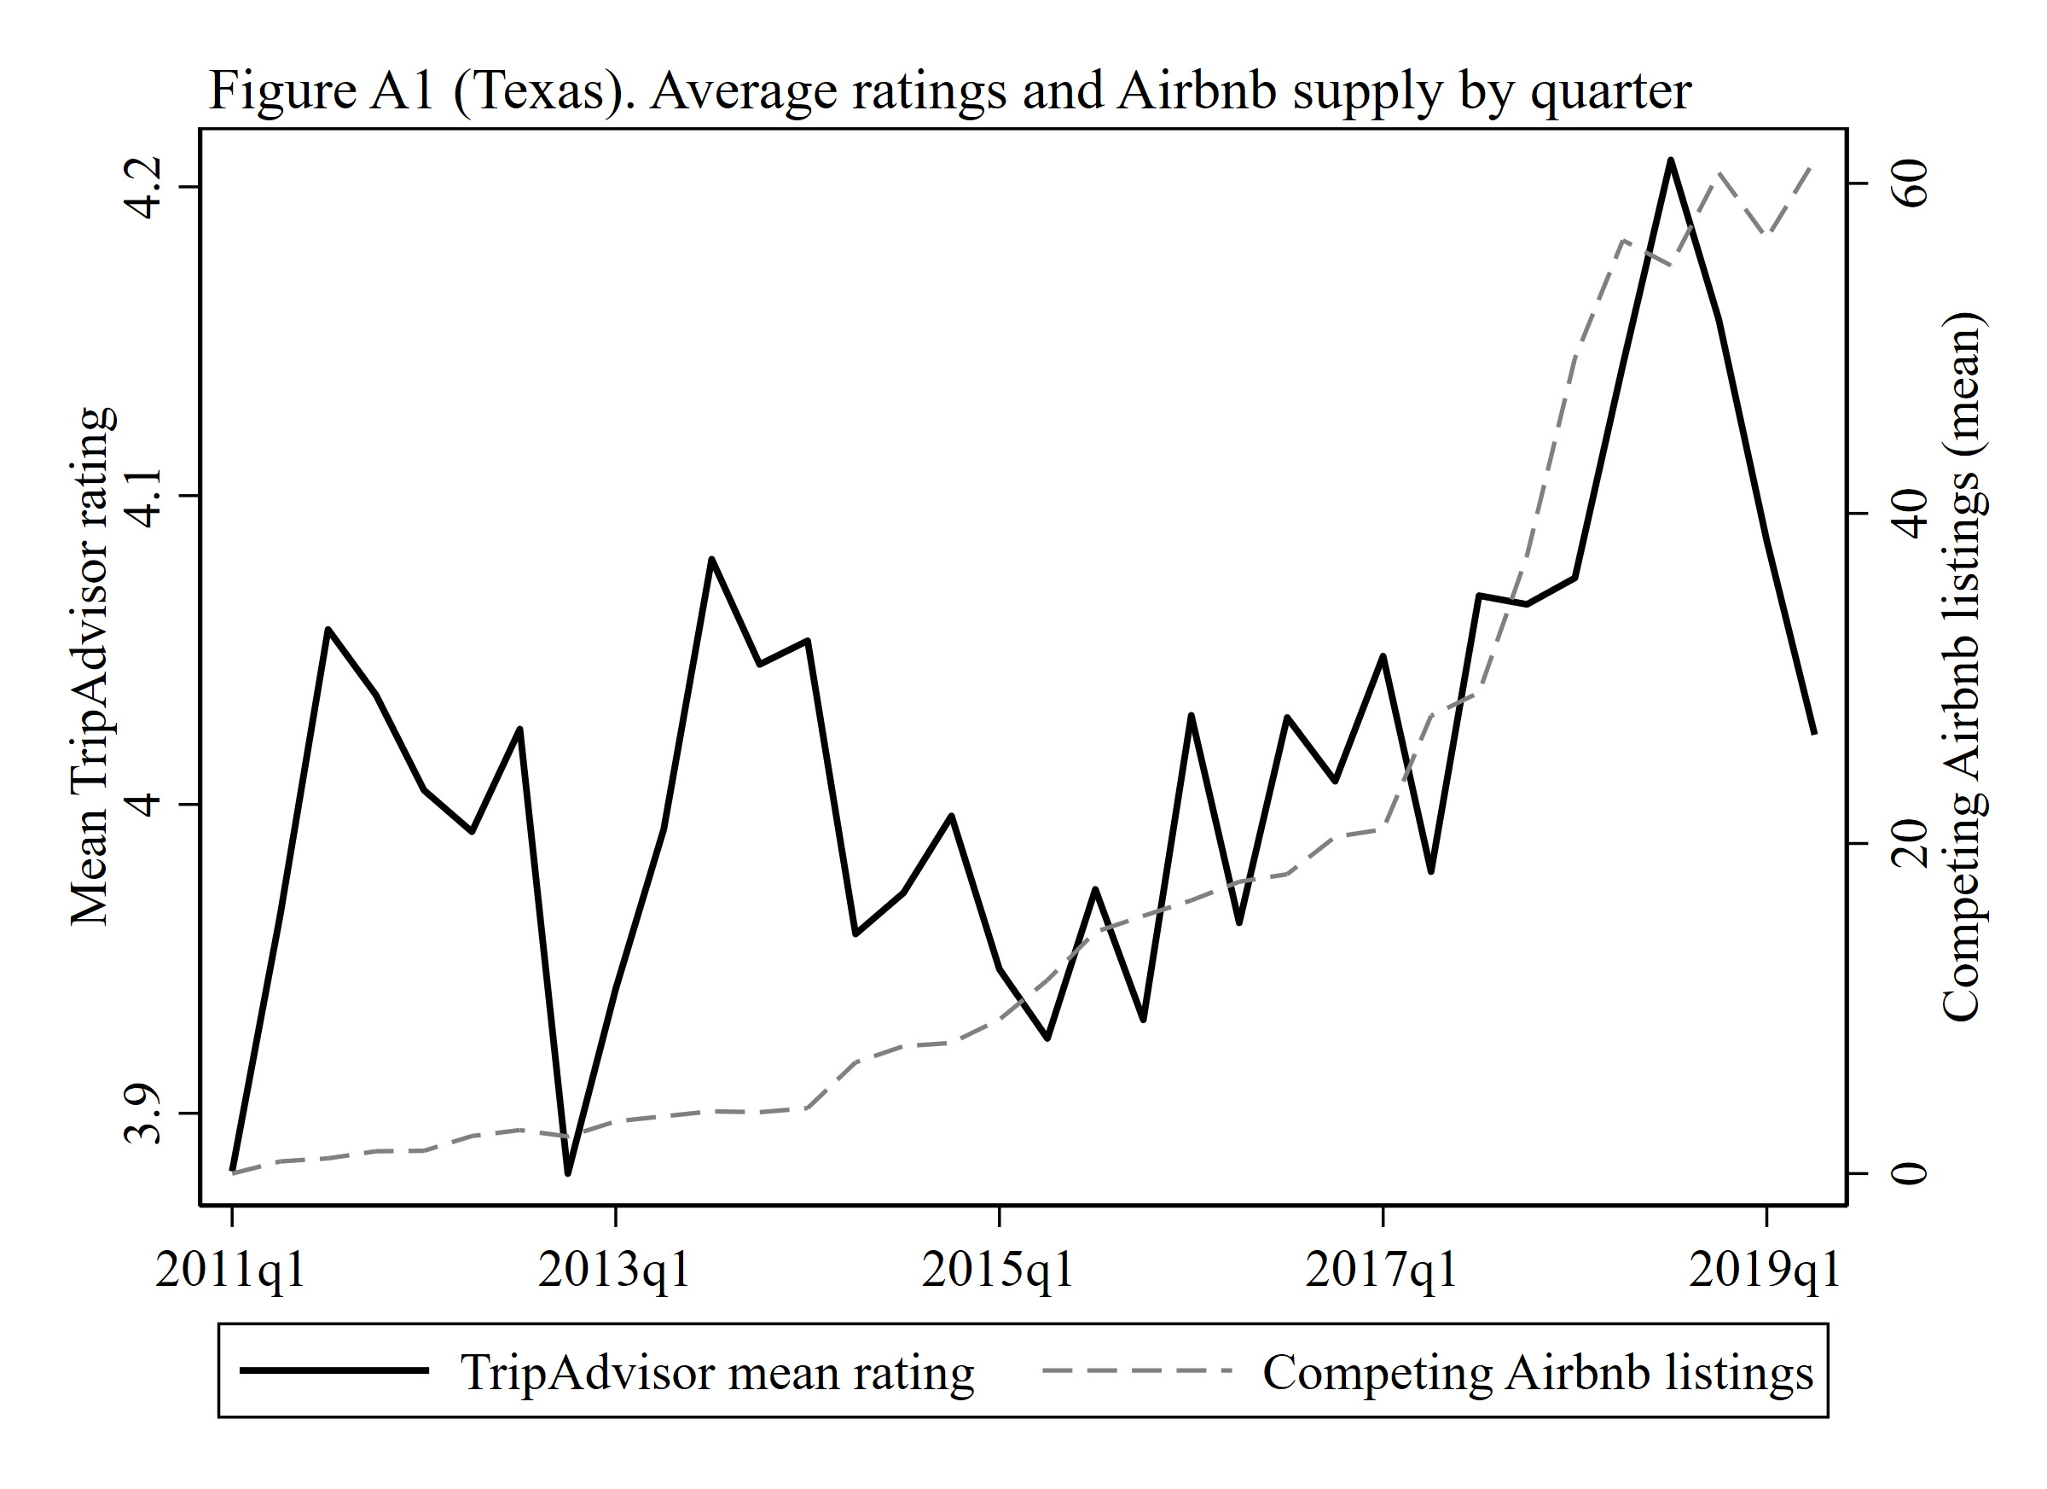
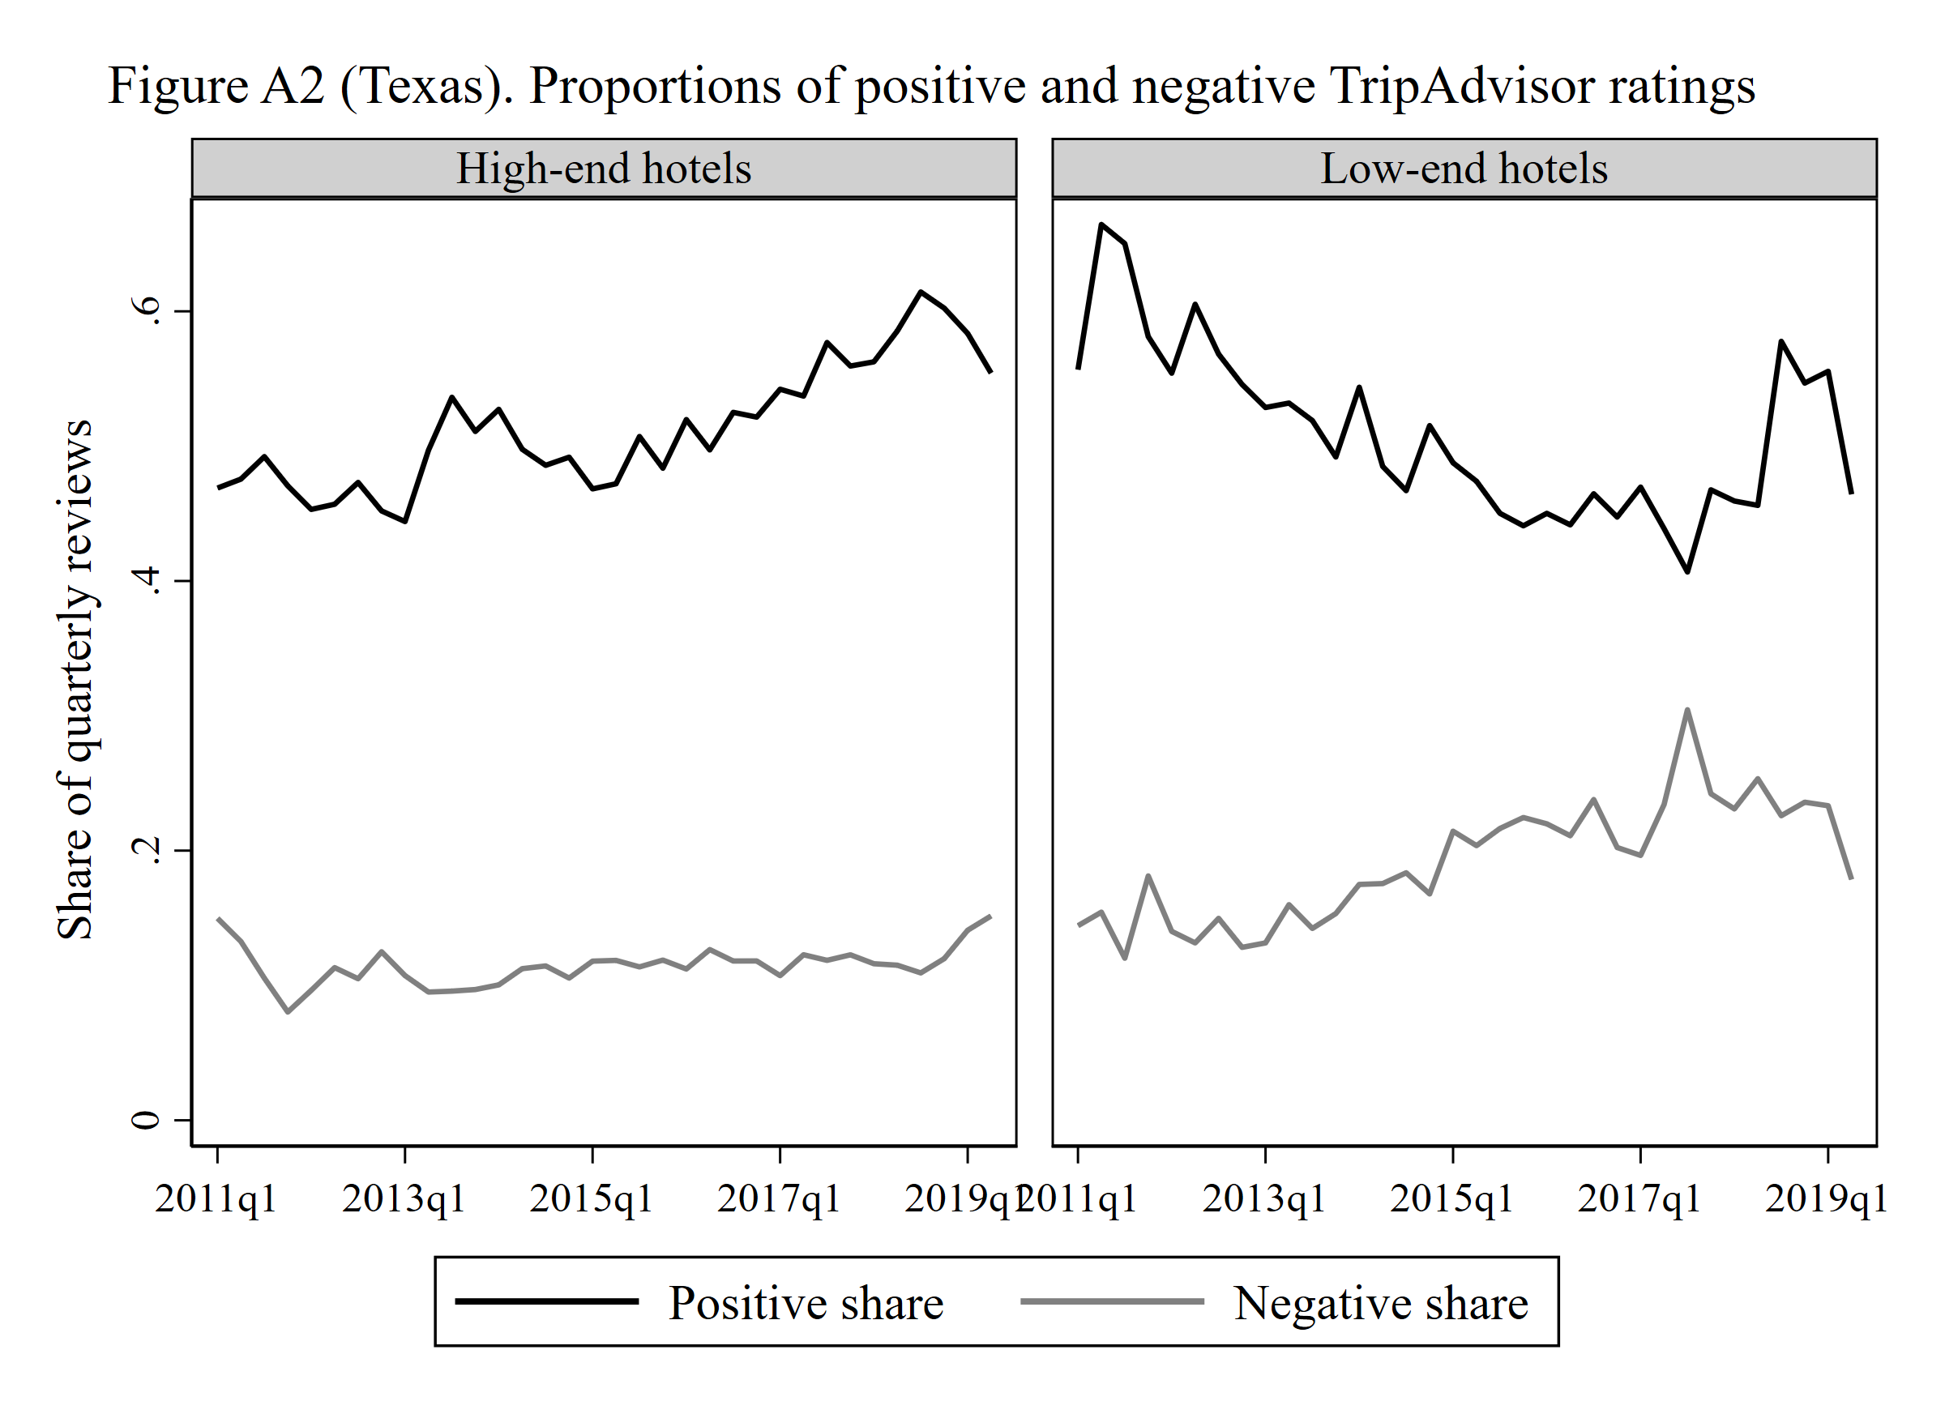
Figures A1 and A2. Model-free evidence, Texas
As in the paper, average TripAdvisor ratings rise with Airbnb supply. High-end hotels show a rising share of positive ratings with flat negatives, while low-end hotels do not.
15
Notes:
Model-free, so no identification is needed. This is the pattern the paper’s Appendix A shows and it reproduces cleanly in the longer Texas window.

Slide 16
Reproduction status, table by table
Item in the manuscript | Status | Obstacle
Table 1 Summary statistics | Reproduced, both panels | n/a
Tables 2, 3, 8 (2SLS, hotel level) | Structure and signs reproduced, significance not (Texas). Not identified (Europe) | One third of the sample, proxy outcome, weak instrument in dense cities
Table 4 Mutual demotion (pairs) | Reproduced with significance (Texas) | Low-end interaction sign differs
Table 5 IV validity | Reproduced (Texas, columns 1–4) | PSM columns need STR covariates
Table 6 LA-PSM | Rebuilt on observable covariates (Texas), signs hold, not significant | STR matching covariates unobtainable, 202 matched hotels
Table 7 Generalized synthetic control | Reproduced for self-promotion (R, fect), demotion null | Estimator exists only in R, sdid in Stata as cross-check
Figure 1 treatment groups | Reproduced as counts, A = 296, B = 55, C = 98 | n/a
Figures A1 and A2, Appendix I (2011 Q4 split) | Reproduced | n/a
Appendix D trip types and Appendix G Airbnb segments | Reproduced in Europe (D) and Texas (G) | Trip type absent from TripAdvisor data, listed prices replace AirDNA
Appendices B, C, F, H (parallel trends, triplets, thresholds, all competitors) | Reproduced (Texas) | n/a
Appendix E Gaussian kernel | Reproduced (Texas), weaker than the 1 km cutoff | Demoting-others sign unstable across bandwidths
16
Notes:
Syllabus item three. Be explicit that “reproduced” means the table was rebuilt with the same specification, not that the numbers coincide.

Slide 17
Results reported in the text
Statement in the paper | Paper | Replication
Kleibergen–Paap F for the instrument | 796.5 | 85.7 (Texas)
Airbnb growth and implied self-promotion effect, 2011–2015 | 0.55 → 9.19 listings, 5.6 pp | 0.79 → 9.29 listings, 5.4 pp
Hotels with at least one Airbnb competitor | 48% | 76% (horizon to 2019)
Mean TripAdvisor rating, low-end / high-end | 3.0 / 4.0 | 3.23 / 4.13
Appendix D, trip-type shares stable over time | ANOVA p ≈ 1, KPSS stationary | Friedman p = 1.00, KPSS p 0.07–0.10
Appendix G, Airbnb listings rated 4.5 or 5 · mean (SD) | 95.7% · 4.82 (0.31) | 92.2% · 4.80 (0.41)
Appendix G, price-per-person cutoff for low-end listings | $25 | $34
Management responses, low-end 4.1% vs high-end 6.8% of Expedia reviews | p < 0.01 | not obtainable
17
Notes:
The effect-size calculation is worth pausing on. The mean Airbnb supply per hotel in 2015 Q4 is 9.29 in our Texas panel and 9.19 in the paper, so the two datasets describe the same market.

Slide 18
Table G1. Same-segment Airbnb competitors, 2SLS, Texas
----------------------------------------------------------------------------------------------
(1) (2) (3) (4) (5) (6)
Promote 1 Promote 2 Promote 3 Demote 1 Demote 2 Demote 3
----------------------------------------------------------------------------------------------
log(Airbnb, same segment) 0.026 0.021 0.022 -0.126 -0.128 -0.118
(0.016) (0.014) (0.014) (0.079) (0.080) (0.078)
log(CompetingHotels) 0.012 0.008 0.006 -0.166 -0.166 -0.200
(0.024) (0.023) (0.024) (0.102) (0.102) (0.105)
Log(ReviewCount) 0.028*** 0.028*** 0.011 0.008
(0.005) (0.005) (0.023) (0.023)
log(Airbnb) x Low-end -0.008 -0.167
(0.036) (0.101)
----------------------------------------------------------------------------------------------
Observations 10,068 10,068 10,068 7,487 7,487 7,487
Kleibergen-Paap F 96.3 96.8 30.8 70.1 70.0 36.8
----------------------------------------------------------------------------------------------
Low-end hotels are matched to listings below the 24th percentile of price per person ($34 here, $25 in the paper) and high-end hotels to the rest. Paper, self-promotion columns. 0.020** (0.006), 0.019** (0.006), 0.018** (0.006). Demoting others −0.034*** (0.008). The coefficients are unchanged from the main tables, as in the paper.
18
Notes:
Appendix G reproduces. Segmenting the Airbnb competitors by price does not change the picture.

Slide 19
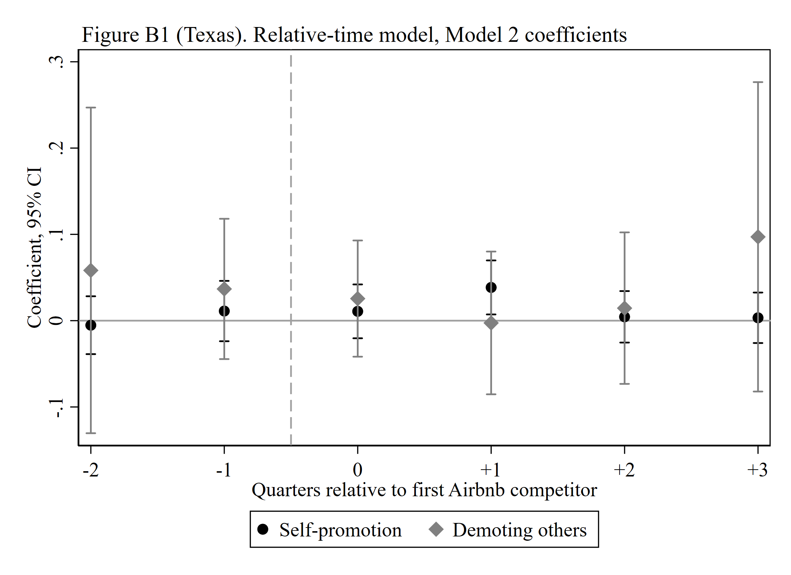
Table B1. Parallel trends, relative-time model, Texas
---------------------------------------------------------------------
(1) (2) (3) (4)
Promote 1 Promote 2 Demote 1 Demote 2
---------------------------------------------------------------------
Airbnb_Binary treat(-2) -0.007 -0.005 0.060 0.058
(0.017) (0.017) (0.096) (0.096)
Airbnb_Binary treat(-1) 0.007 0.011 0.039 0.037
(0.018) (0.018) (0.042) (0.041)
Airbnb_Binary treat(0) 0.009 0.011 0.026 0.026
(0.016) (0.016) (0.034) (0.034)
Airbnb_Binary treat(+1) 0.040* 0.039* -0.002 -0.003
(0.016) (0.016) (0.042) (0.042)
Airbnb_Binary treat(+2) 0.007 0.004 0.012 0.015
(0.015) (0.015) (0.044) (0.045)
Airbnb_Binary treat(+3) 0.004 0.003 0.097 0.097
(0.015) (0.015) (0.092) (0.091)
log(CompetingHotels) 0.026 0.020 -0.239** -0.240**
(0.024) (0.022) (0.085) (0.085)
Log(ReviewCount) 0.027*** 0.013
(0.005) (0.022)
---------------------------------------------------------------------
Observations 10,068 10,068 7,487 7,487
---------------------------------------------------------------------
Airbnb supply is turned into a 0/1 variable (any competing listing within 1 km, lagged) and dummies mark the quarters around each hotel’s first Airbnb competitor, as in Autor (2003). 351 hotels become treated and 98 never do. Neither lead (−2, −1) is significant for either outcome, so there is no pre-trend. Self-promotion rises one quarter after treatment (0.040, p < 0.05) and demoting others does not move. The paper finds the same pattern, no pre-trend and a significant treatment-period coefficient (0.060 for promotion, −0.108 for demoting others).
19
Notes:
Appendix B. The identification check the instructor is most likely to ask about. No pre-trend in either outcome, and the response arrives one quarter after the first listing.

Slide 20
Table F1. Same thresholds for every hotel, 2SLS, Texas
------------------------------------------------------------------------------------------
(1) (2) (3) (4) (5) (6)
Promote 1 Promote 2 Promote 3 Demote 1 Demote 2 Demote 3
------------------------------------------------------------------------------------------
log(Airbnb) 0.024 0.020 0.019 -0.161 -0.165 -0.162
(0.016) (0.015) (0.015) (0.097) (0.098) (0.098)
log(CompetingHotels) 0.008 0.004 0.006 -0.162 -0.159 -0.164
(0.024) (0.023) (0.023) (0.102) (0.102) (0.106)
Log(ReviewCount) 0.026*** 0.026*** 0.006 0.005
(0.005) (0.005) (0.025) (0.025)
log(Airbnb) x Low-end 0.005 -0.015
(0.019) (0.077)
------------------------------------------------------------------------------------------
Observations 10,068 10,068 10,068 7,487 7,487 7,487
Kleibergen-Paap F 85.7 86.0 41.1 69.7 69.9 34.6
------------------------------------------------------------------------------------------
The main tables count 4 and 5 stars as promotion and 1 star as demotion for low-end hotels, because their ratings are lower on average. Here every hotel uses 5 stars and 1 to 2 stars, the Mayzlin et al. (2014) operationalisation. Self-promotion 0.024, 0.020, 0.019 and demoting others −0.16, the same as Tables 2 and 3. Paper, same columns. 0.027***, 0.025***, 0.026*** and −0.036***, also unchanged from its main tables.
20
Notes:
Appendix F reproduces. The choice of thresholds does not drive anything.

Slide 21
Table H1. All neighbouring hotels as competitors, 2SLS, Texas
------------------------------------------------------------------------------------------
(1) (2) (3) (4) (5) (6)
Promote 1 Promote 2 Promote 3 Demote 1 Demote 2 Demote 3
------------------------------------------------------------------------------------------
log(Airbnb) 0.011 0.010 0.014 -0.076 -0.076 -0.076
(0.016) (0.014) (0.014) (0.054) (0.054) (0.055)
log(CompetingHotels) 0.009 0.003 -0.001 -0.207** -0.208** -0.208**
(0.027) (0.026) (0.026) (0.075) (0.076) (0.077)
Log(ReviewCount) 0.028*** 0.028*** 0.006 0.006
(0.005) (0.005) (0.014) (0.014)
log(Airbnb) x Low-end -0.019 0.001
(0.018) (0.040)
------------------------------------------------------------------------------------------
Observations 10,068 10,068 10,068 8,271 8,271 8,271
Kleibergen-Paap F 106.3 106.4 53.6 91.4 91.8 45.9
------------------------------------------------------------------------------------------
The main tables treat only same-tier hotels within 1 km as competitors. Here every hotel within 1 km counts, and the competitor count, the demoting-others measure and the instrument are rebuilt accordingly. All signs hold. Self-promotion is smaller (0.011 to 0.014) and demoting others is −0.076, while competing hotels stay negative and significant (−0.208**). First-stage F above 100. Paper, same columns. 0.022***, 0.020**, 0.021*** and −0.018*, which it also reports as consistent with its main findings.
21
Notes:
Appendix H reproduces in sign. Cross-tier competitors dilute the self-promotion response here more than in the paper.

Slide 22
Table C1. Mutual demotion within hotel triplets, 2SLS, Texas
--------------------------------------------------------
(1) (2) (3)
Model 1 Model 2 Model 3
--------------------------------------------------------
log(Airbnb) -0.423*** -0.386*** -0.347**
(0.108) (0.102) (0.108)
log(CompetingHotels) 0.246*** 0.164* 0.136
(0.075) (0.071) (0.073)
Log(ReviewCount) 0.178*** 0.177***
(0.021) (0.020)
log(Airbnb) x Low-end -0.127**
(0.043)
--------------------------------------------------------
Observations 24,966 24,966 24,966
Kleibergen-Paap F 127.4 126.5 55.8
--------------------------------------------------------
Appendix C repeats Table 4 with three hotels that all compete with each other. Mutual demotion is the sum of the six directed demotions, Airbnb supply and competing hotels are the intersections of the three sets, and the instrument is rebuilt from the shared competitors. 2,403 triplets and 24,966 triplet-quarters with triplet, quarter and city × season fixed effects, SEs clustered by triplet. log(Airbnb) −0.423***, −0.386***, −0.347**, the strongest estimate in the replication. Paper, same columns. −0.259***, −0.185***, −0.178*** on 437,695 triplet-quarters. The low-end interaction is −0.127** here and +1.667* in the paper, the same sign reversal as in Table 4.
22
Notes:
Appendix C reproduces with significance. The pair and triplet tests are where the Texas panel has the most power.

Slide 23
Table E1. Gaussian-kernel competition intensity, 2SLS, Texas
-------------------------------------------------------------------------------------------------
(1) (2) (3) (4) (5) (6)
Promote 1 Promote 2 Promote 3 Demote 1 Demote 2 Demote 3
-------------------------------------------------------------------------------------------------
log(Airbnb, kernel) 0.015 0.013 0.017 0.051 0.050 -0.028
(0.010) (0.009) (0.009) (0.095) (0.096) (0.065)
log(CompetingHotels, kernel) -0.005 -0.010 -0.020 -0.798* -0.797* -0.563*
(0.032) (0.030) (0.031) (0.381) (0.381) (0.250)
Log(ReviewCount) 0.028*** 0.027*** 0.080 0.089
(0.005) (0.005) (0.082) (0.080)
log(Airbnb) x Low-end -0.016 0.406
(0.011) (0.309)
-------------------------------------------------------------------------------------------------
Observations 10,068 10,068 10,068 9,099 9,099 9,099
Kleibergen-Paap F 589.9 591.8 271.5 548.1 548.8 270.8
-------------------------------------------------------------------------------------------------
Every listing and every hotel within 3 km counts, with weight exp(−d²/2h²) at bandwidth h = 1 km, so a listing at the hotel’s door contributes 1, at 1 km 0.61 and at 2 km 0.14. Demoting reviews are attributed in proportion to the same weights and the instrument is rebuilt the same way. Self-promotion stays positive but smaller (0.013 to 0.017, not significant), demoting others loses its sign across bandwidths (−0.26 at 0.5 km, in results/stata/tx_tableE1_05km.txt), and competing hotels stays negative and significant. The paper reports both bandwidths as consistent with its main results (not tabulated in the text). Here the hard 1 km cutoff gives the cleaner picture.
23
Notes:
Appendix E is where the replication is weakest among the robustness checks. The first stage is very strong, so this is about the outcome, not the instrument.

Slide 24
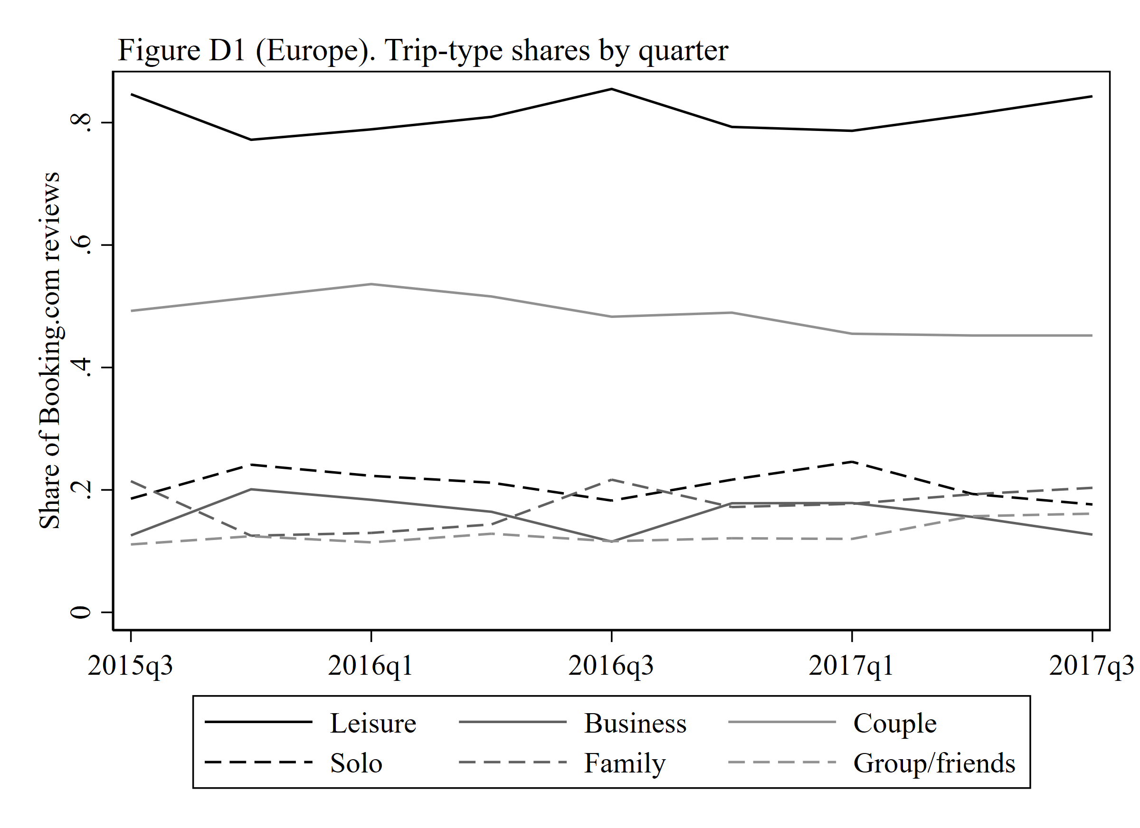
Figure D1. Trip-type shares by quarter, Europe
Built from Booking.com trip-type tags. The paper tests whether customer composition shifted as Airbnb grew and finds no change (repeated-measures ANOVA p close to 1, KPSS stationary). Here a Friedman test across quarters gives p = 1.00 and the KPSS p-values are 0.07 to 0.10, so every series is stationary. Trip type is not recorded in the TripAdvisor data, so this appendix is reproducible for Europe only.
24
Notes:
Appendix D reproduces. The customer-shift alternative explanation the paper rules out is also ruled out here.

Slide 25
Obstacles
Obstacle | What was done
Inside Airbnb no longer publishes host registration dates | Entry quarter rebuilt from host tenure (years and months as host). The earliest value is capped at January 2011, harmless since the paper reports almost no supply before 2011 Q4
Hotel coordinates not in any review file | Name-based geocoding placed about 30% of hotels at the wrong branch, so they were replaced by coordinates read from each hotel’s TripAdvisor page, 449 of 449
Booking.com has no hotel identifier | Fuzzy name matching to TripAdvisor within city, 1,125 of 1,492 at similarity ≥ 90, with 186 lacking coordinates dropped
No price tier (STR) for either market | Economy-class brand list for Texas (26% low-end, paper 24%). Europe’s “luxury” sample has 2 budget hotels, so the moderation is not estimable there
Only listings alive at crawl time are observed | Shared with the paper’s one-time crawl, and a longer horizon makes it worse. Treatment measured with error, likely attenuating toward zero
Competing-hotel counts need operating periods (tax filings) | First-to-last review window used instead, so the count varies over time and is not absorbed by hotel fixed effects
25
Notes:
Syllabus item four. The geocoding and the host_since change are the two a reader would not anticipate.

Slide 26
Overall reproducibility
Texas
Directionally reproduced, underpowered. Every main coefficient has the paper’s sign, the self-promotion estimate matches to the third decimal, the instrument is strong and the placebo pattern holds. Significance is reached only at the pair level.
Europe
The paper’s exact measure can be built, but the design does not identify in markets where every hotel is treated. A boundary condition the paper does not state.
Heterogeneity
The high-end versus low-end contrast depends on proprietary STR tiers and is the least robust claim, with the right sign for self-promotion, not significant, and reversed in the pair-level test.
26
Notes:
Syllabus item one, stated plainly. If there is one slide to remember, it is this one.

Slide 27
What the replication puts in question
Domain of the identification strategy. The competitors’-Airbnb instrument needs sparse, uneven supply. It works in 2011–2015 Texas and fails by construction where Airbnb is ubiquitous, which by now includes most large cities.
The 1 km radius. Meaningful in Texas, meaningless in Paris or London, so the kernel version of Appendix E would have to be the main specification there.
The headline heterogeneity. “High-end hotels self-promote more, low-end do not” rests on STR price tiers no one can obtain, and with brand-based tiers it is not significant and the pair-level sign reverses.
Survivorship in Airbnb supply. Both the paper and this replication date supply from listings alive at crawl time, and churn correlated with density means attenuation, so the Texas estimates are probably conservative.
Comparability of the two platforms. The Mayzlin gap assumes TripAdvisor and the verified site draw similar guests, and Booking.com’s trip-type tags make that testable, and in Europe the composition is stable (Appendix D).
27
Notes:
None of these overturn the paper. They narrow its scope and name the one claim that could not survive without proprietary data.

Slide 28
Extension 1. The effect belongs to Airbnb’s growth phase
-----------------------------------------------------------------------------------------------------------------------------
(1) (2) (3) (4) (5) (6)
Promote <=2011q4 Promote 2012-15 Promote >=2016 Demote <=2011q4 Demote 2012-15 Demote >=2016
-----------------------------------------------------------------------------------------------------------------------------
log(Airbnb) -0.061 0.107* 0.040 0.042 0.002 -0.418
(0.080) (0.045) (0.114) (0.057) (0.282) (0.585)
log(CompetingHotels) 0.245 0.006 -0.034 0.125 -0.184 0.177
(0.154) (0.054) (0.039) (0.068) (0.343) (0.109)
Log(ReviewCount) -0.004 0.020** 0.028*** 0.008 0.003 0.001
(0.024) (0.008) (0.008) (0.015) (0.030) (0.025)
-----------------------------------------------------------------------------------------------------------------------------
Observations 779 4,473 4,773 545 3,246 3,655
Kleibergen-Paap F 42.2 19.5 10.1 30.9 11.6 12.8
-----------------------------------------------------------------------------------------------------------------------------
Our Texas data run from 2011 to 2019, longer than the paper’s 2008 to 2015. We cut the sample into three periods and ran the same 2SLS model in each. Before 2012 Airbnb was tiny (under one listing near a typical hotel) and there is no effect, which matches the paper. From 2012 to 2015, the paper’s own period, Airbnb grew from 1 to 9 listings per hotel and self-promotion rises with it (0.107, significant). From 2016 on Airbnb is everywhere (12 to 34 listings per hotel) and the effect is gone again. So the paper’s result is real but belongs to the years when Airbnb was still spreading. That is the same reason the European cities, where Airbnb is already dense, show nothing.
28
Notes:
This is the slide that ties the two panels together. The design has a window of validity in time as well as in space.

Slide 29
Extension 2. A text-based manipulation measure, Texas
---------------------------------------------------------------------------------------------------------------------------
(1) (2) (3) (4) (5) (6)
Fake 5-star 1 Fake 5-star 2 Fake 5-star 3 Fake 1-2-star 1 Fake 1-2-star 2 Fake 1-2-star 3
---------------------------------------------------------------------------------------------------------------------------
log(Airbnb) 0.023* 0.022* 0.022* -0.007 -0.007 -0.006
(0.010) (0.010) (0.010) (0.007) (0.007) (0.007)
log(CompetingHotels) 0.017 0.015 0.014 0.007 0.008 0.005
(0.013) (0.013) (0.013) (0.013) (0.013) (0.012)
Log(ReviewCount) 0.012*** 0.012*** 0.002 0.002
(0.003) (0.003) (0.002) (0.002)
log(Airbnb) x Low-end -0.003 -0.007
(0.008) (0.009)
---------------------------------------------------------------------------------------------------------------------------
Observations 10,068 10,068 10,068 10,068 10,068 10,068
Kleibergen-Paap F 85.7 86.0 41.1 85.7 86.0 41.1
---------------------------------------------------------------------------------------------------------------------------
The paper infers fake reviews from a gap between two websites. We tried a more direct route. We trained a simple text classifier on 1,600 hotel reviews that are known to be real or fake (the Ott et al. corpus) and it tells them apart 88 percent of the time. We then ran it over all 2.5 million review texts and, for each hotel and quarter, counted the share of 5-star reviews that look fake. That share rises with Airbnb supply (0.023, significant), almost exactly the paper’s 0.021. Fake-looking negative reviews do not move, again as in the paper. The text measure also agrees with our reviewer-history measure (correlation 0.46). One caveat. The training reviews are about Chicago hotels from 2011, so we removed place and brand words before scoring.
29
Notes:
The strongest slide in the extension. Three different measures (platform gap, reviewer history, text) point the same way with the same magnitude. Say the training-corpus caveat out loud.

Slide 30
Extension 3. Validating the proxy on a verified platform, Europe
-----------------------------------------------------------------------------------------------
(1) (2) (3) (4)
Excess top, 2SLS Excess top, OLS Excess bottom,~S Excess bottom,~S
-----------------------------------------------------------------------------------------------
log(Airbnb) -0.102 -0.027 0.018 0.001
(0.062) (0.017) (0.040) (0.015)
log(CompetingHotels) -0.032 -0.042 0.011 0.013
(0.050) (0.044) (0.026) (0.024)
Log(ReviewCount) 0.004 0.003 -0.002 -0.002
(0.005) (0.005) (0.003) (0.004)
-----------------------------------------------------------------------------------------------
Observations 7,101 7,101 7,101 7,101
-----------------------------------------------------------------------------------------------
Texas has no verified site like Expedia, so we measured manipulation with a stand-in, the share of reviews from accounts that post only once. Europe lets us test it, since Booking.com reports each reviewer’s review count. One-time reviewers write 46.9 percent of 5-star and 1 to 2-star reviews on TripAdvisor but only 27.1 percent on Booking.com. This gap tracks the paper’s own manipulation measure closely (correlation 0.69), so the stand-in captures the same thing. As elsewhere in Europe, it does not respond to Airbnb supply because the instrument is weak.
30
Notes:
This closes the loop on the Texas proxy. It was chosen out of necessity and Europe shows it measures the same thing as the paper’s gap.

Slide 31
Conclusion
The paper’s Texas result survives a conceptual replication in direction, in magnitude and in its placebo logic, but not in statistical strength at the hotel level, and it reaches significance at the pair level and with a text-based measure.
Its identification strategy has a domain, sparse and uneven Airbnb supply. Outside it, in dense European cities or in Texas after 2016, the instrument has nothing to work with.
The high-end/low-end contrast is the claim most dependent on proprietary data and the least robust.
31
Notes:
Close on the three sentences on the left. Offer the code map if asked how the pipeline fits together.

