Slide 1






GAME CLUB
Presented by:
Alexander Leydon 12912857
Jorge Rodriguez Nocua 12997882
Xiang Xu 12834901
Gaoyi Liu 12652956

Slide 2
CONTENTS
Problem & Target Audience
01
Difference & Business Model
02
Process & Framework
03
Showing time
04

Slide 3

01
Problem
&
Target Audience

Slide 4
Problem
How quickly a game could be made on the iPhone

Slide 5
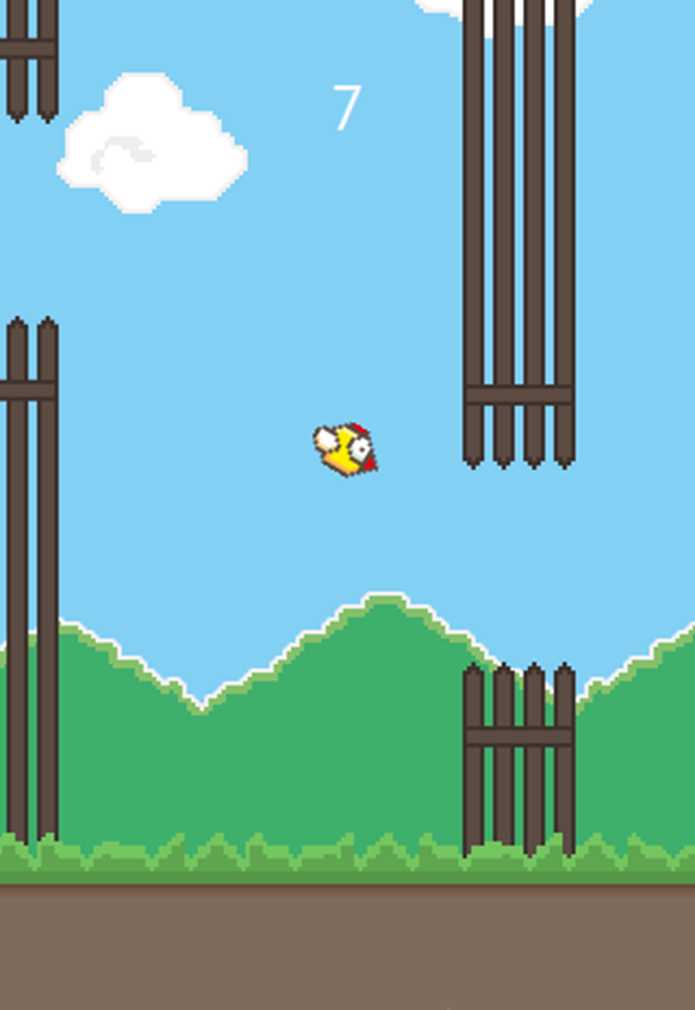
Target Audience
Target groups: Kids to teens
Solution: A game like Flappy-birds

Slide 6

Reasons
1
Flappy Birds is a simple game
2
It is a well known game
3
Players can finish one round in short time

Slide 7
02
Difference
&
Business Model

Slide 8

Difference
Unlike flappy bird our game uses different sprites
The player can customize their experience in the game as well as their avatar(sprite)

Slide 9

Business Model
This uses a Free Model
No cost for the game
No premiums in the game

Slide 10
03
Framework
&
Process

Slide 11
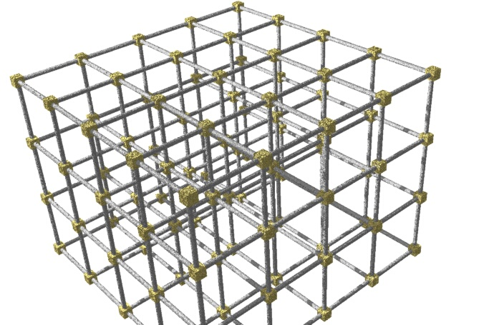
Framework
We used the SpriteKit framework
We were going to use GameKit, but …

Slide 12
Process
We used GitHub to share the work with each other
Created empty views and added basic navigation
Changed idea from Temple Run like to Flappy Bird like
Changed the layout of each scene so it is landscape
Got data to be passed between views
Each made prototypes of the game
Finalized game
Got high-scores working
Got customizable aspects working

Slide 13
04
Showing time

Slide 14

Questions

Slide 15
Thank you!

