Slide 1
GAME CLUB
By: Alexander Leydon 12912857
Jorge Rodriguez Nocua 12997882
Xiang Xu 12834901
Gaoyi Liu 12652956

Slide 2
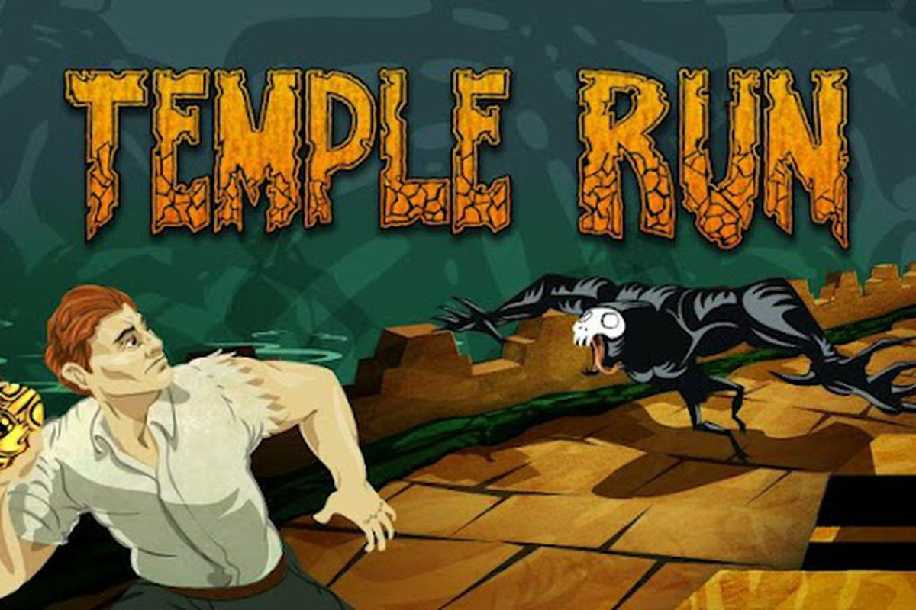
How many people have ever played a game called Temple Run?

Slide 3

Problem
Our group were hired by a new games developer who wanted to test how quickly a game could be made on the iPhone that was simple to learn, entertaining and popular

Slide 4
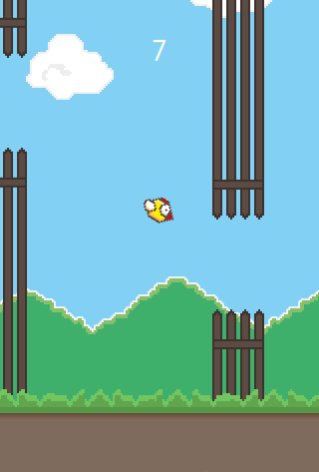
Target Audience
Target groups: Kids to teens
Solution: make a game like flappy-birds
Reasons:
Flappy birds is a simple game
It only has one control;
which is to tap the screen
a well known game
people will control the game in no time

Slide 5

Differences
Unlike flappy bird our game uses different sprites
The player can customize their experience in the game as well as their avatar(sprite)

Slide 6

Business Model
This uses a Free Model
No cost for the game
No premiums in the game

Slide 7
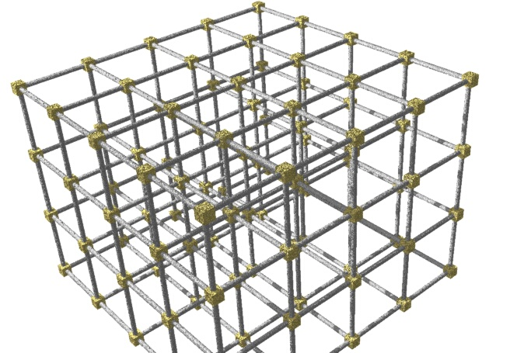
Frameworks
We used the SpriteKit framework
We were going to use GameKit, but …

Slide 8

Process
We used GitHub to share the work with each other
Created empty views and added basic navigation
Changed idea from Temple Run like to Flappy Bird like
Changed the layout of each scene so it is landscape
Got data to be passed between views
Each made prototypes of the game
Finalized game
Got high-scores working
Got customizable aspects working

Slide 9
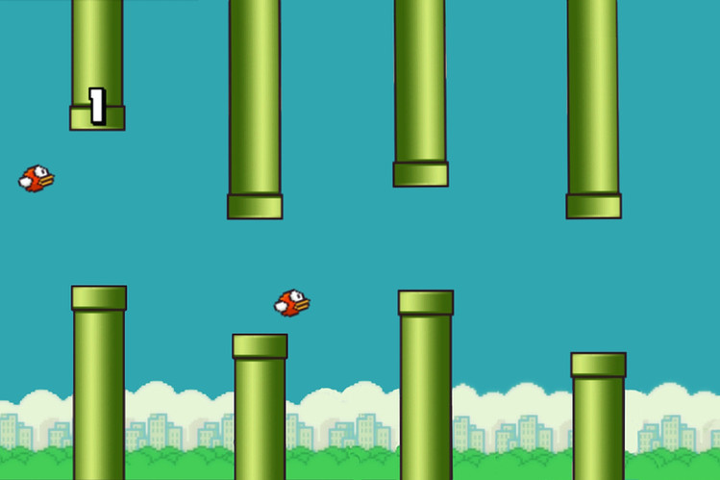
SHOWN TIME

Slide 10

Questions

