Slide 1
Software Process:
IDENTIFY A PROBLEM
DESIGN A SOLUTION
BUILD IT

Slide 2
Software Process:
IDENTIFY A PROBLEM
UNDERSTAND PROBLEM
DESIGN A SOLUTION
PLAN AND COMMUNITCATE THE SOLUTION
BUILD IT

Slide 3

Problem
Play is typically not seen as valuable or essential to learning. It’s more commonly viewed as an activity separate from learning rather than as one in which students learn.

Slide 4

Problem
KIDS consider learning as a boring subject.

Slide 5
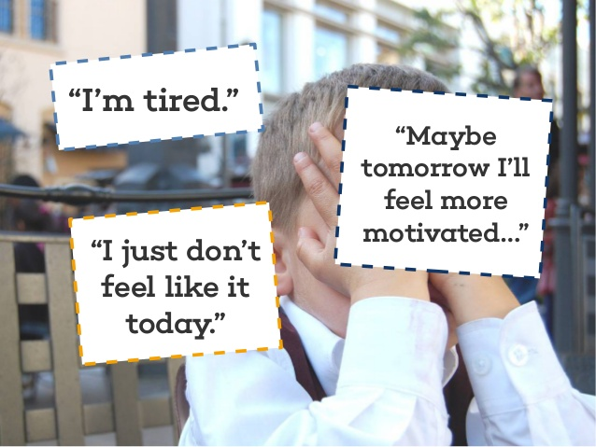
problem
KIDS are not motivated enough to involve themselves in positive learning activity.

Slide 6

problem
Given the incredible pressures and challenges schools face as they try to adequately prepare students to lead successful lives in the 21st century, animals often do not fit into the discussion.

Slide 7

Solution
Children all over the world play. They all know how to play, and no one has to teach them how.

Slide 8

Solution
Any time we see a human activity that is wired into the brain and accomplished by all children worldwide, we know it is critical to human development.

Slide 9

solution
Children learn concepts through play; they learn to cope and make sense of life experiences; and, they develop critical human capacities such as problem solving, imagination, self regulation and original thinking.

Slide 10
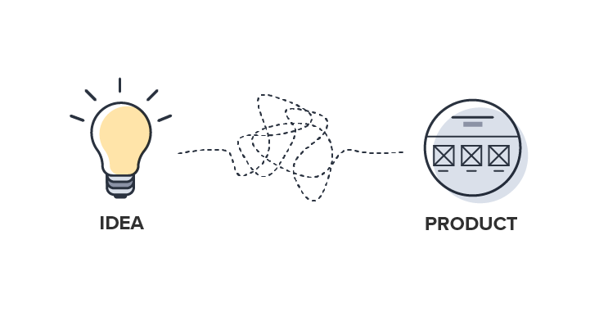

Slide 11
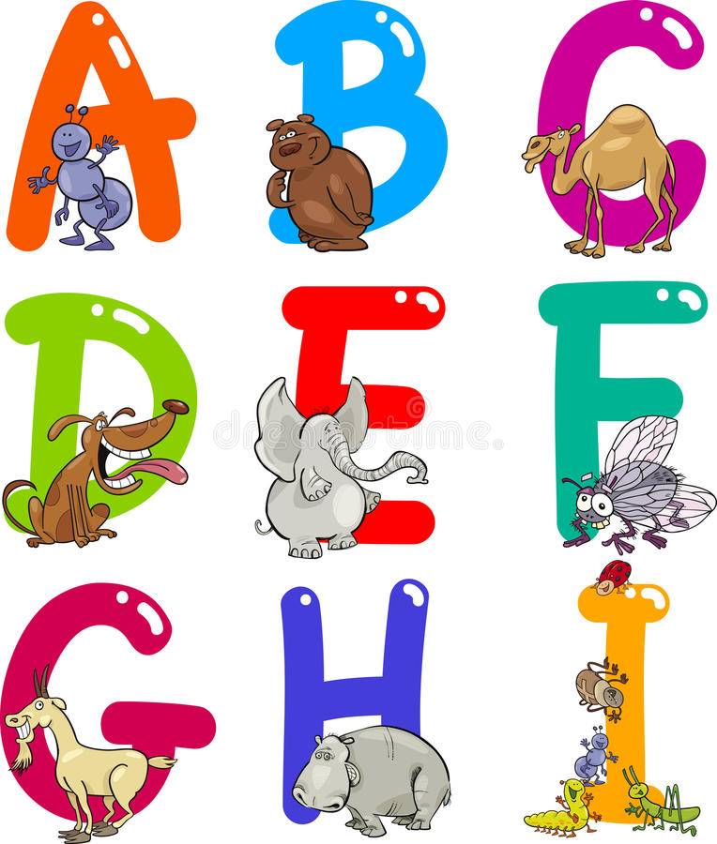
About abc kidz
How our app can solve problem?

Slide 12
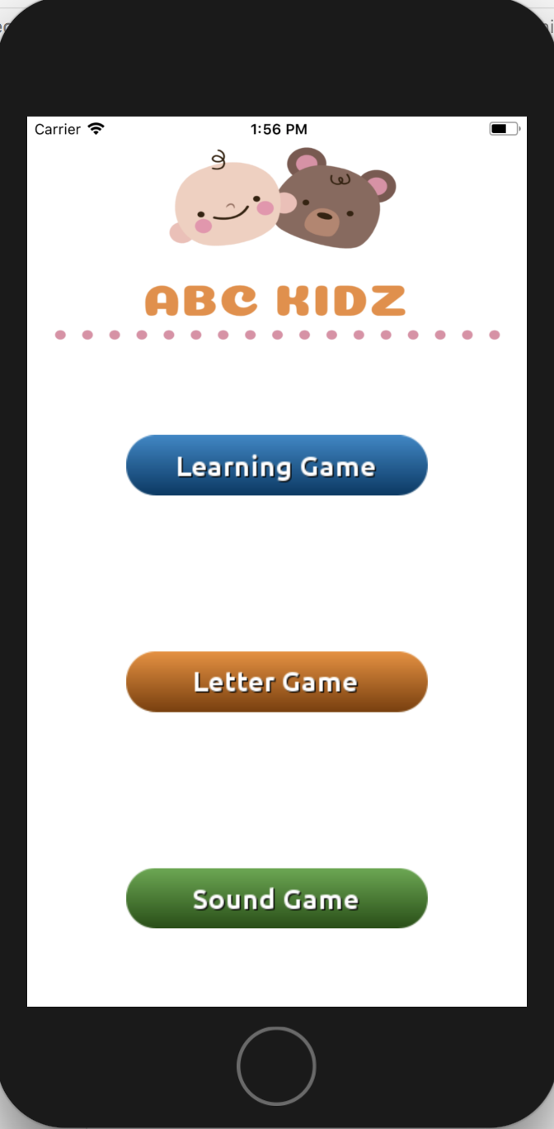
ABC KIDZ

Slide 13
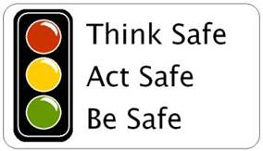
Conclusion:
Teach to be safe

Slide 14
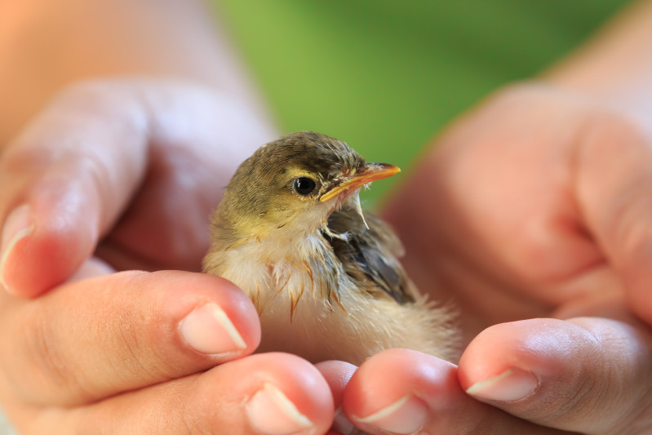
Conclusion:
Teach to be gentle

Slide 15

conclusion
Play Pretend

Slide 16
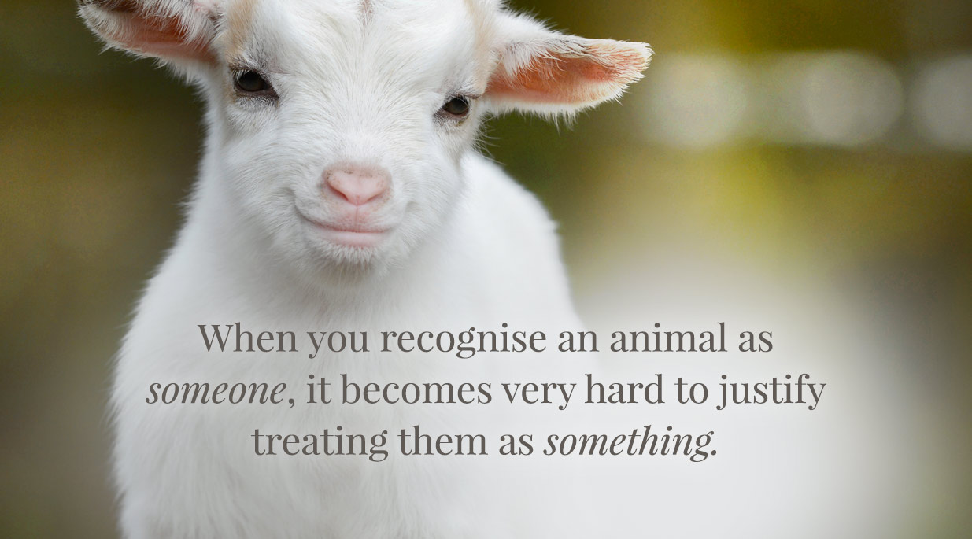
conclusion
Develop Empathy towards animals

