Slide 1
Bubble Fighter
Group 17

Slide 2
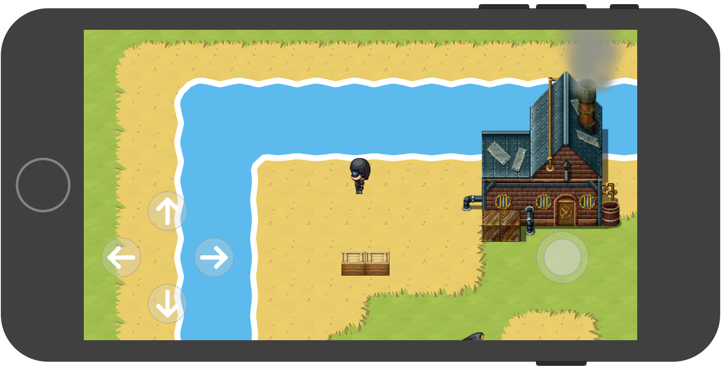

Slide 3
Demo

Slide 4
Framework Used
UIKit
SpriteKit
GamePlayKit

Slide 5
Spritekit
SKScene
SKNode
SKSpriteNode
SKPhysicsbody
SKEmitterNode

Slide 6
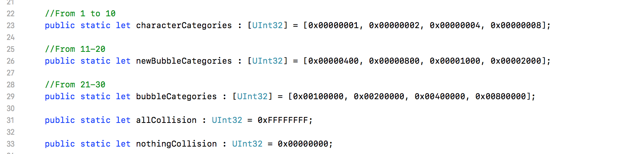
Collision - Physicsbody

Slide 7
GamePlayKit
Components System
State machine
Agent System

Slide 8
Architecture
Entity -> Components -> System

Slide 9
Architecture
GameScene | Player Entity | PlayerComponent
 |  | CharacterComponent | State Machine System | Walk
 |  |  |  | Idle
 | AI Entity |  |  | Dying
 |  |  |  | Dead
 |  |  | Animation System
 |  | AIComponent | AIAgent | Behaviour
 | Bubble Entity | BubbleComponent
 | Entities | HardWallComponent
 |  | SoftWallComponent
 |  | ItemComponent

Slide 10
GKAgent
GKGoal
GKBehaviour

Slide 11
Thank you

