Slide 1
A Productivity App
Chaoyi Shen - 12783876
Fanxing Meng - 13116746
Ying Luo - 13056559
Baishan Wang - 12830966

Slide 2
Target Audience
Student
Office worker
Report DDL
Submit assignment
Exam
Project
Business meeting

Slide 3




What can it do ?

Slide 4




Memorandum
+
Calendar
Compare with ……
·Combine memo & calendar
·Notification
·Import from Calendar
·Color tag

Slide 5


Demonstrate Video

Slide 6

Frameworks
CoreData
EventKit
Date&TimePicker
SnapKit

Slide 7
CoreData
Framework from apple
used for store data into the device

Slide 8
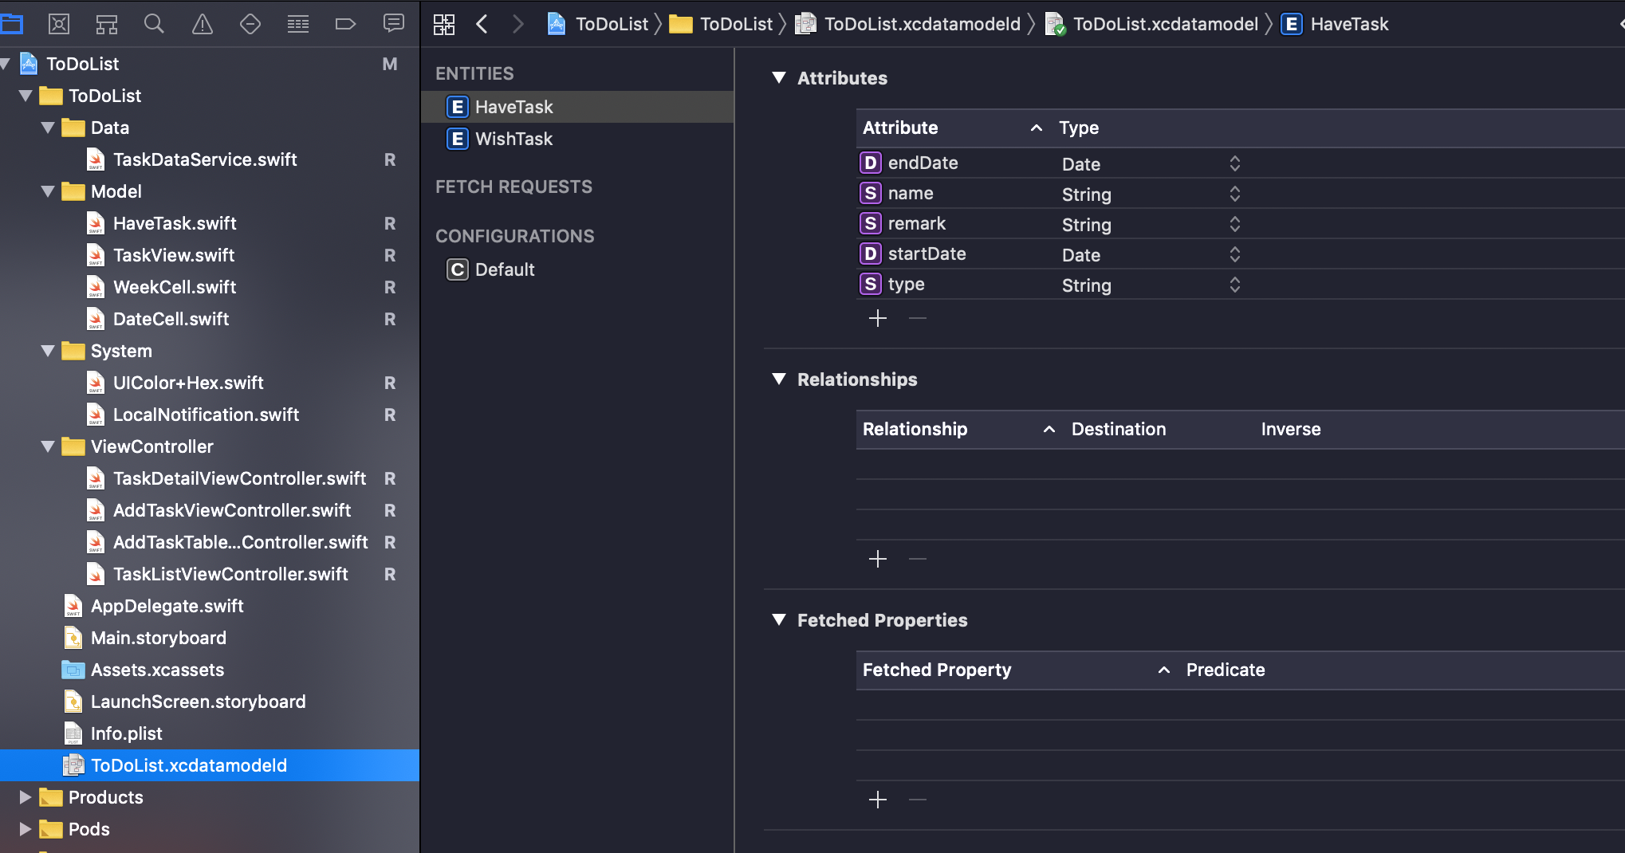
CoreData

Slide 9
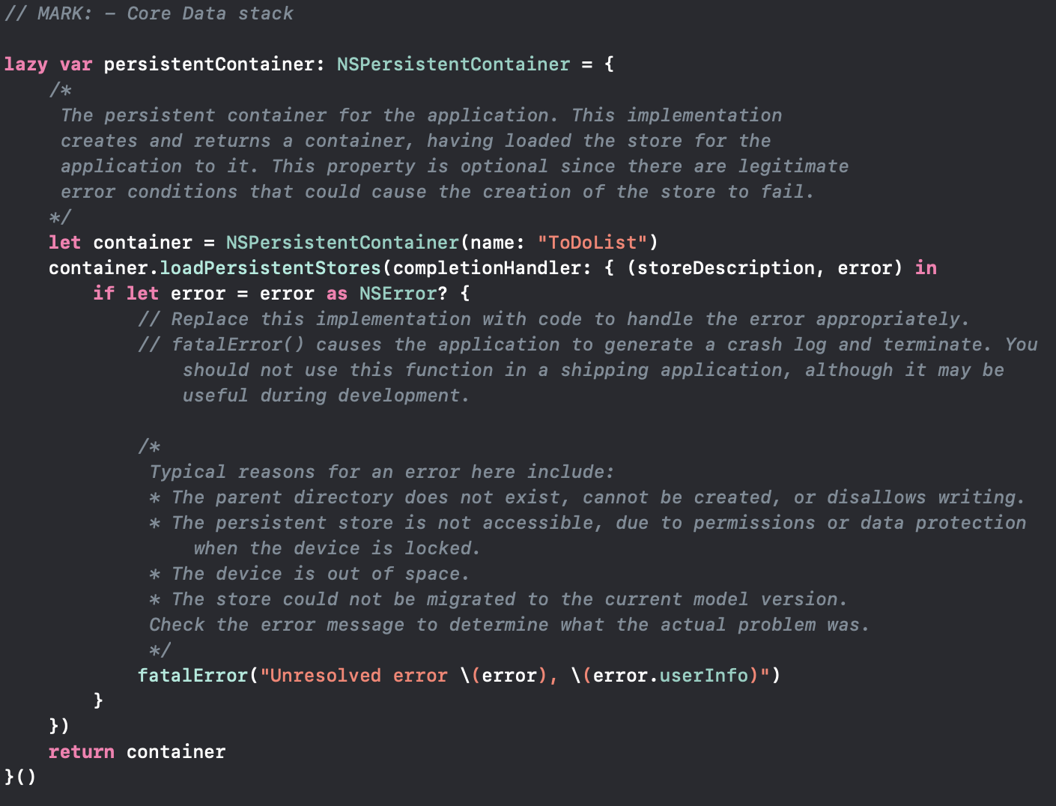
CoreData

Slide 10
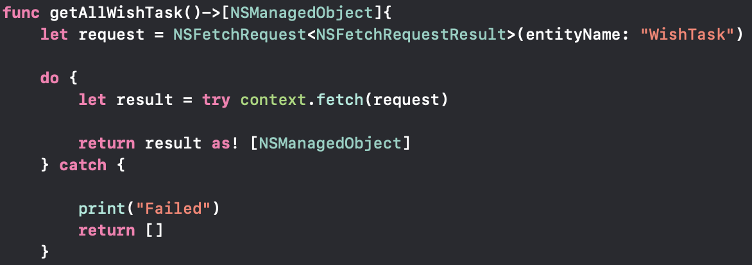
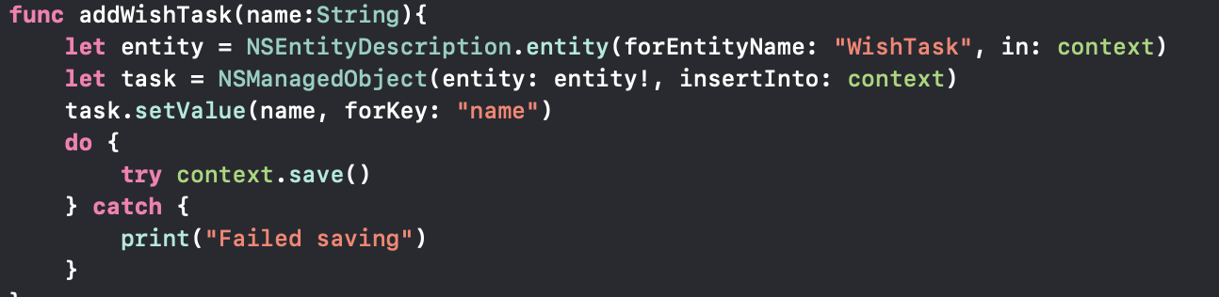
CoreData

Slide 11
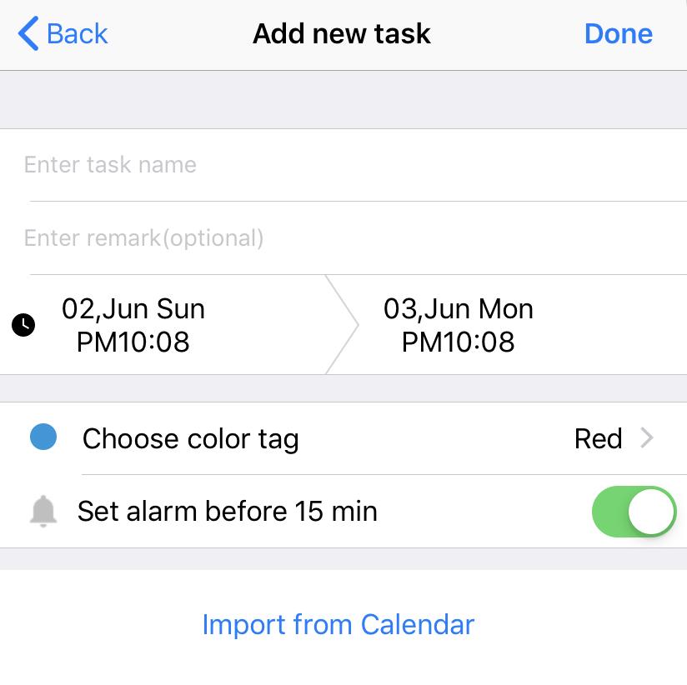
EventKit
A framework to read, write and create event on system calendar.
Import the existed events from system calendar and add them into our app.

Slide 12
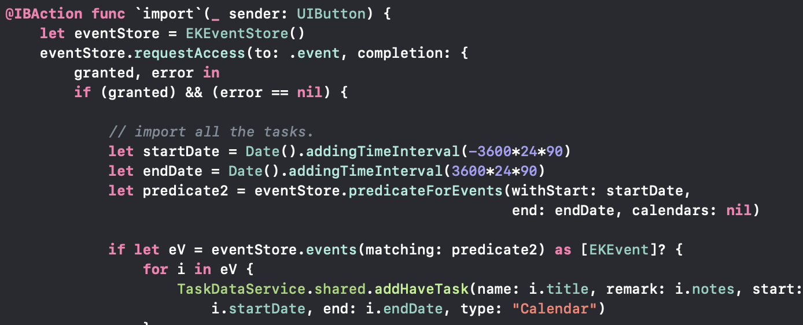
EventKit

Slide 13
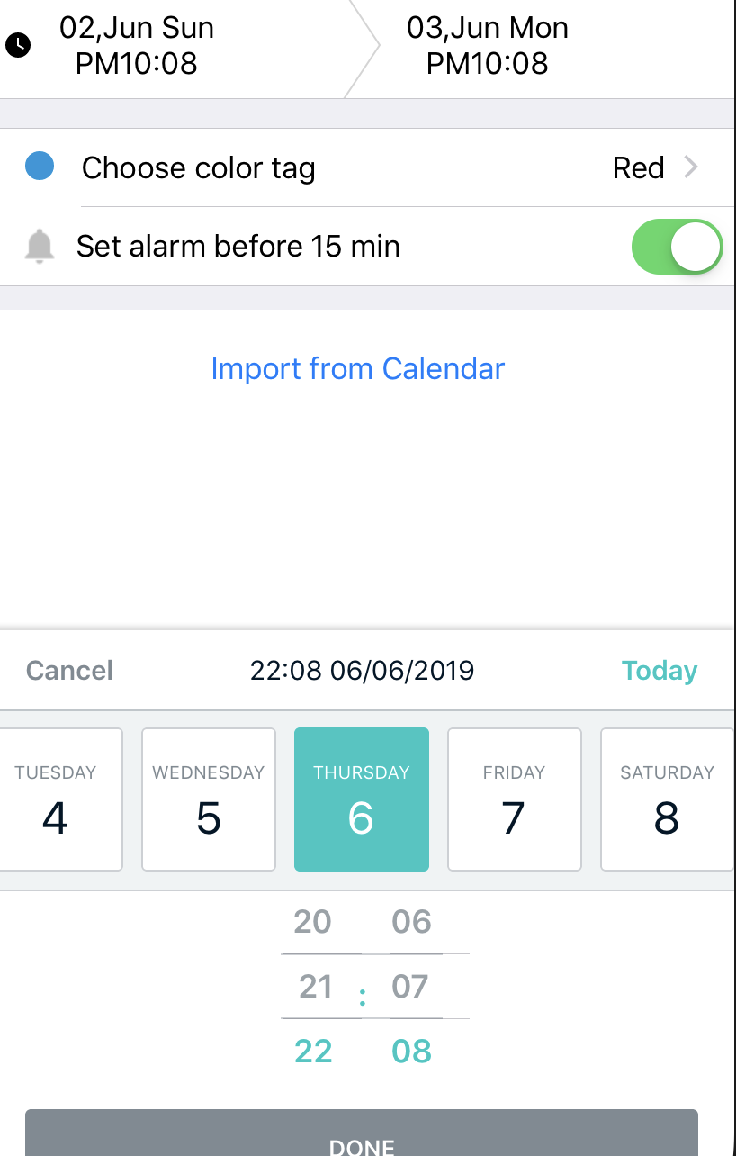
DateTimePicker
A third party library installed from cocoapod.
A nicer iOS UI component for picking date and time.

Slide 14
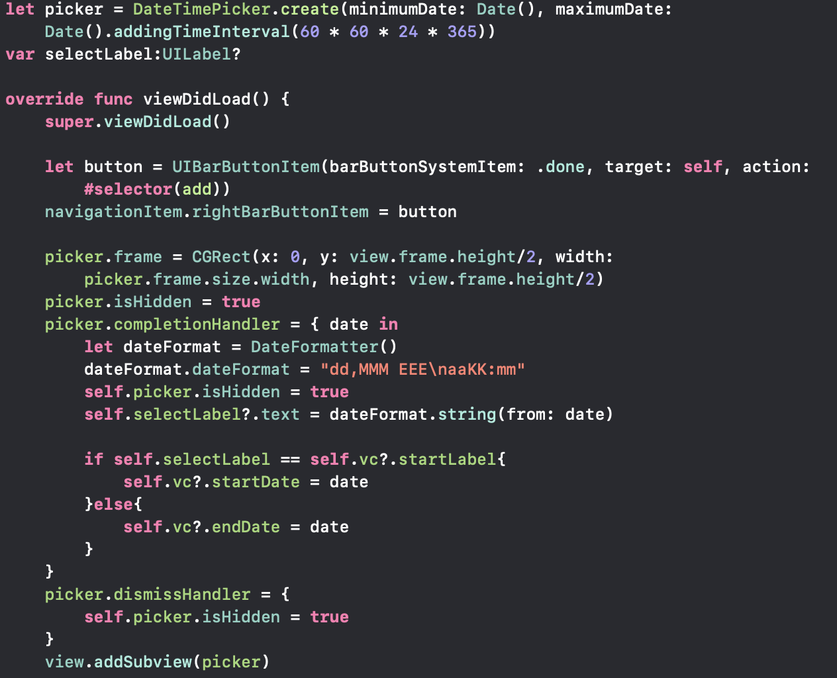
DateTimePicker

Slide 15
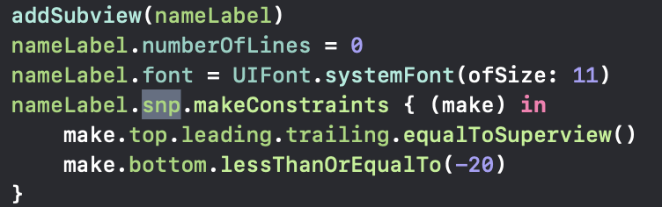
Snapkit
A third party library installed from cocoapod.
SnapKit is a DSL to make Auto Layout easy on both iOS and OS X.

Slide 16
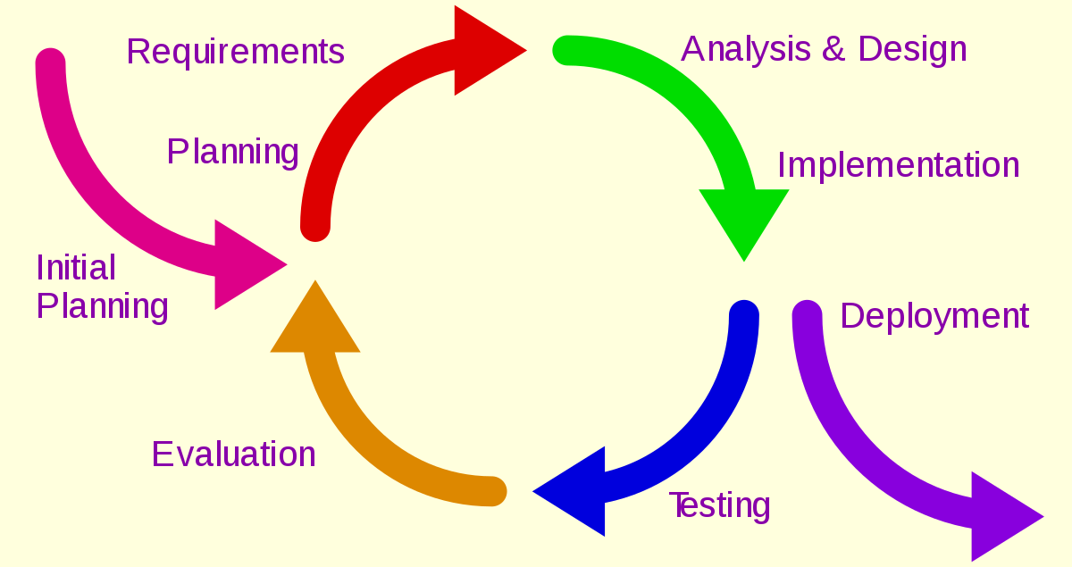

Slide 17


Initial planning
Brain storming
Have an idea to help ourselves manage our tasks in the semester.
Looking for the solution of our requirements.

Slide 18
Analysis & Design
Define our main users.
Students
People at work
Design the style and the prototype.
Ask for the advices from others.

Slide 19
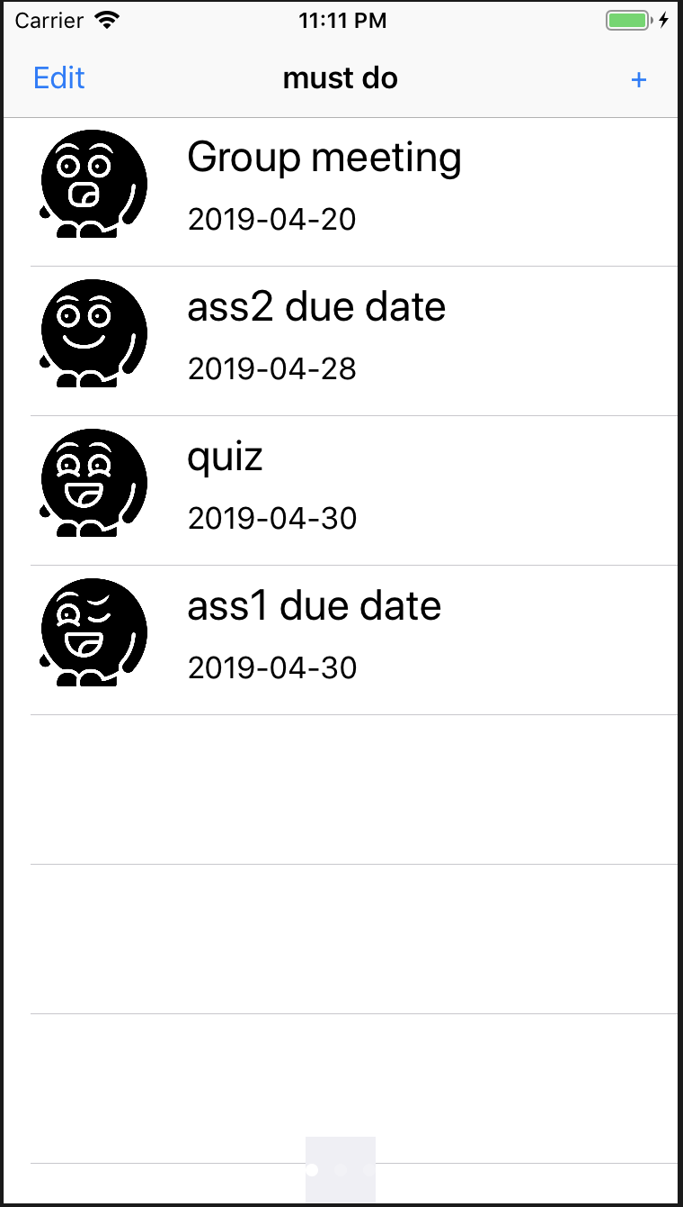
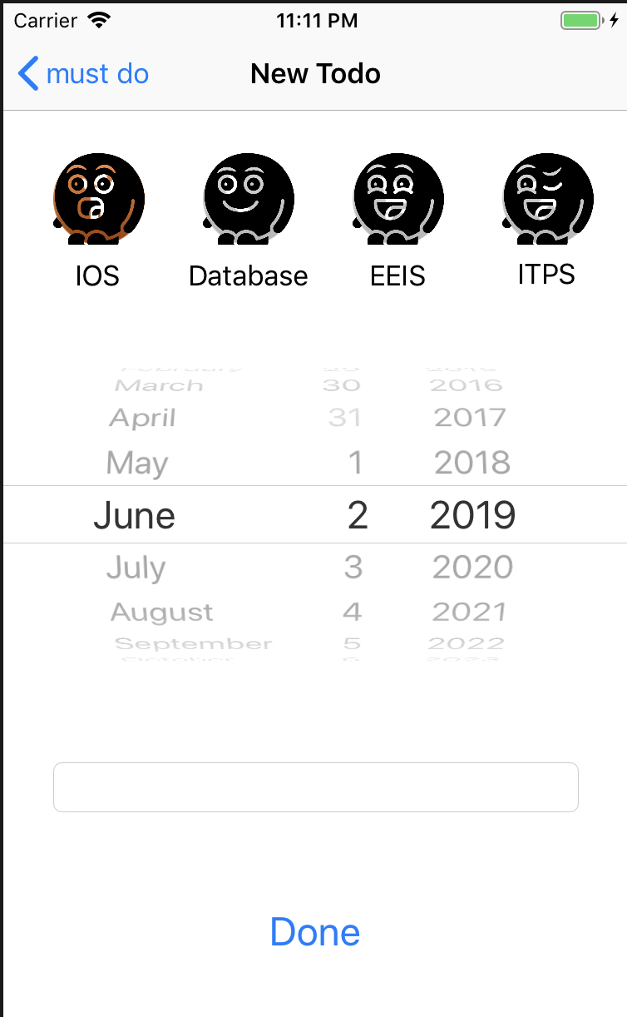
Prototype

Slide 20
Implementation
Make the final decision.
Make an app about improve productivity.
Use the calendar style.
Start developing our app.

Slide 21
Evaluation
Add some functions to improve our app.
Divide our app into two interfaces—have to do, wish to do.
One as the normal to-do list, another one as the calendar.
Remove some useless functions.
Using color tag to replace the specific description.
Make the interface of our app as simple as possible.
Alarm, notification and import from Calendar

Slide 22
THANK YOU

