Slide 1
FoodTinder

Slide 2
Introduction
Team
FoodTinder - What is it?
Exaplanation of the App

Slide 3
Target Audience
Anyone who eats
University Students
Parents
Working Professionals

Slide 4
What problem is being solved?
Food delivery revenue is growing at about 9.4% annually.
Australians are spending roughly $2.6 billion each year.
About $1,590 a year each.
Aim is to create a product that caters to people not knowing what to eat/cook without costing them money.

Slide 5
How does it compare to other solutions?
Other apps encourage users to order food from an external place (UberEats, Deliveroo, Menu Log)
Our app aims to continue the fun and convenience of selecting food while saving the user money.
Makes preparing and cooking food at home a little simpler.

Slide 6
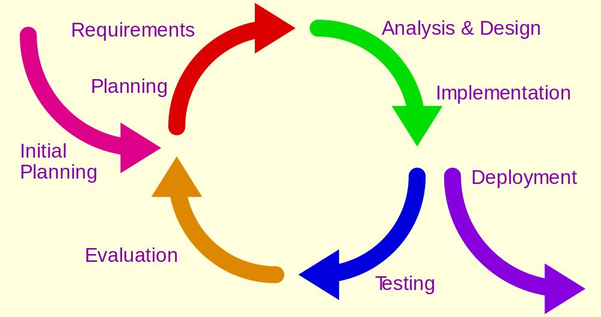
Iterative Design Process
Developed prototype based on the idea generated.
Tested the prototype, made changes, and began the process all over again until satisfied.
E.g. (function/element of the app that needed multiple iterations?)

Slide 7

Frameworks/Services Used
Food2Fork offers an API which exposes its powerful recipe discovery functions for your app to use.
The API gives you access to an ever-expanding recipe database, powerful ingredient search function, and social-media based ranking algorithm.
Give your users the recipes they are looking for.

Slide 8
App Demonstration

