Slide 1
To be decided
YAMIN KHIN 12626747
CHAORAN PEI
RICHARD
Notes:
A good presentation should:
Describe the target audience for this app. Explain what problem is being solved, and how this app compares to other possible solutions. Show the app being used. Decide whether you want to use a simulator or device, or record a video. You can display a device's screen using QuickTime Player. It is also possible to use a HDMI cable or the lectern document camera.
Depending on the nature of your app, you may also want to discuss:
What business model this app supports. What frameworks or services you used to implement it. How your design and development process worked, and whether you felt it was effective.

Slide 2
TARGET AUDIENCE
Young
Enthusiastic
Familiar with phone and new application
Good at accepting new things
Full of questions in mind
Like to communicate with peers
UNIVERSITY
STUDENTS

Slide 3
PROBLEM BEING SOLVED
Easy communication between students, anonymous or account
An interesting app to spend the spare time
Collect possible answers for all questions
Good help on both academic and entertainment

Slide 4


COMPARABLE SOLUTION
Quora
A question-and-answer website where questions are asked, answered, and edited by Internet users in the form of opinions.
A company founded in 2009, California.
Website first available in June 2010.
ZHIHU
A question-and-answer website where questions are asked, answered, and edited by Internet users in the form of opinions.
Launched January 2011.

Slide 5
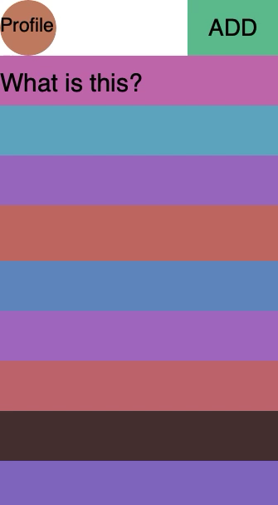
DEMONSTRATION
Actual screen shot add here

Slide 6
FIREBASE
Realtime Database
Authientication
cocoapods

Slide 7
PRODUCT DESIGN CYCLE
BRAINSTORMING
PROTOTYPING
TESTING
EVALUATING
ADDING FEATURES ONCE QUESTION ADDED TO APP

Slide 8

Q & A

