Slide 1
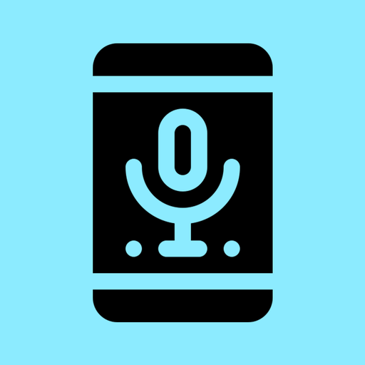
SpeechTranslatePal
Group 158 - Pouriya, Ashna, Krish

Slide 2
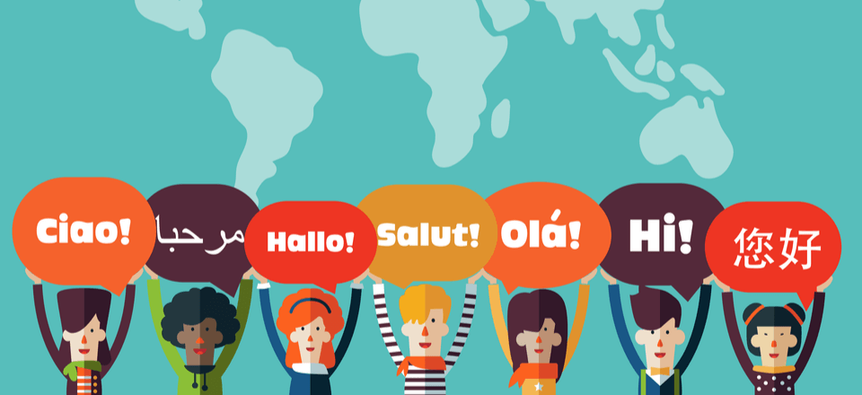
Purpose
Some people might have difficulties when others spoke in a different language
People from different backgrounds in different societies
“To create an app that can be helpful to people of any age, to communicate and use according to their need even without typing anything. ”

Slide 3

Demographic
Travellers (Specially for European Countries based on languages)
Can be helpful to old people especially they do not need a keyboard
International students or all STUDENTS!
Could also be fun for anyone using in different places
BASICALLY FOR ANYONE!!

Slide 4
Our Solution
SpeechTranslatePal a translation iOS app that can translate even big chunk of text to another language
Featuring:
Uses Voice Recognition: no need for a keyboard Recognizing voice in multiple languages
Uses Google Cloud Translation API: it supports mostly all the languages
UI design: designed for smoother use, User Friendly

Slide 5
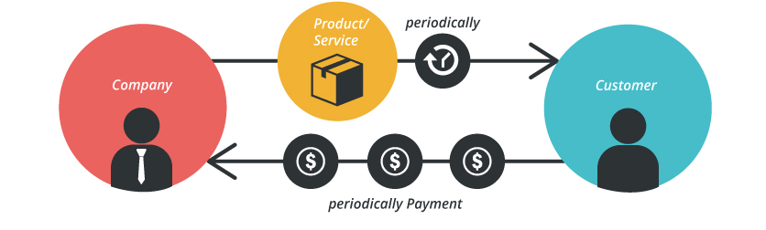
Business Model
Nickel and Dime
Basic product is cost-sensitive, therefore first version could be a 30-day trial free version, then for the further use the app is going to charge users a fair amount.
And then for the later versions, for additional services that come with it, an additional amount is charged.

Slide 6
Configurations
On Swift 5, Xcode 10.x
One UIViewController and UITableViewController
JSONSerialization class to convert information returned from the server (Google) to swift data type like string
API call in URL format
SFSpeechRecognizer class to request authorization and initiate the speech recognition process
Frameworks: UIKit, Speech and Foundation

Slide 7


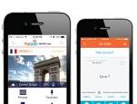

Other similar popular apps
Microsoft Translator
Google - web-based and mobile app
TripLingo
Oladas Inc.

Slide 8
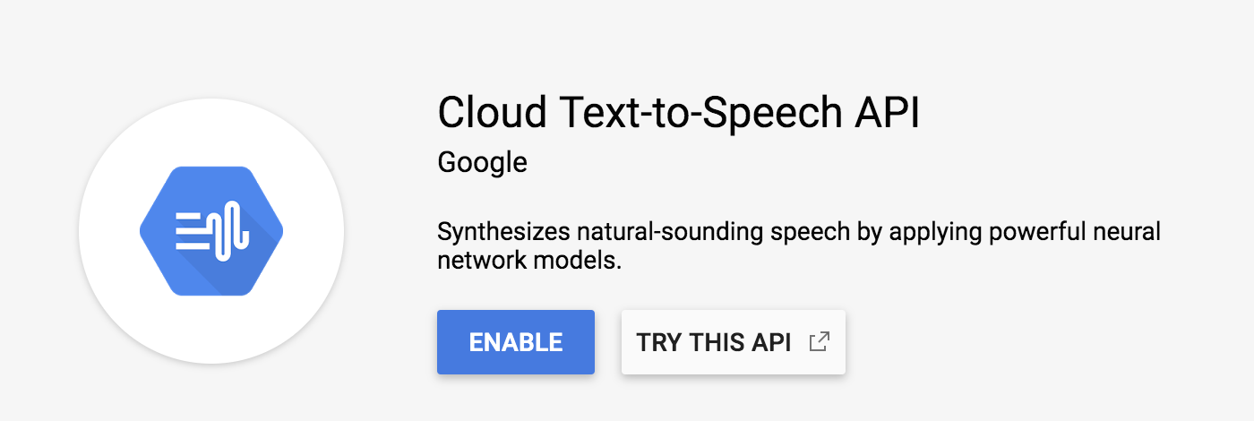

Future improvements
Text to speech: using Cloud Text-to-Speech Google API
More languages for voice recognition
Refined Interface

Slide 9
Thanks

