Slide 1
YOLOv8-Based Deep Learning Approach for Real-Time Skin Lesion Classification Using the HAM10000 Dataset presented by UTSHA SHAHA
Notes:
Good morning/afternoon, everyone. Today, I'm excited to present our research on a YOLOv8-based deep learning approach for real-time skin lesion classification using the HAM10000 dataset. This work represents a significant step forward in applying state-of-the-art object detection models to the critical field of dermatological diagnostics. Our goal was to develop a system that could accurately classify various types of skin lesions in real-time, potentially aiding in early skin cancer detection and improving patient outcomes.

Slide 2
Introduction
Skin cancer statistics
Importance of early detection
Challenges in traditional diagnostic methods
Notes:
Let's begin by understanding the context of our research. Skin cancer is the most prevalent form of cancer in the United States, with over 20% of Americans developing it in their lifetime. What's crucial to understand is that early detection can dramatically improve survival rates. For melanoma, the deadliest form of skin cancer, early detection leads to a 99% five-year survival rate.
However, traditional diagnostic methods face several challenges. They can be time-consuming, often requiring multiple visits to specialists. They're also subjective, relying heavily on the individual expertise of the dermatologist. This subjectivity can sometimes lead to misdiagnosis or delayed treatment.
This is where our research comes in. We aimed to develop an automated system that could quickly and accurately classify skin lesions. Such a system could serve as a valuable tool for dermatologists, potentially speeding up the diagnostic process and providing an objective second opinion. It could be particularly valuable in areas with limited access to dermatologists, serving as an initial screening tool.

Slide 3
Research Objectives
Utilize YOLOv8 for skin lesion detection and classification
Evaluate performance of different YOLOv8 variants
Achieve high accuracy and real-time performance
Notes:
Our primary objective was to harness the power of YOLOv8, an advanced object detection model, for skin lesion classification. We aimed to evaluate five different variants of YOLOv8 to determine which offers the best balance of accuracy and speed for this critical task. Our goal was to achieve high classification accuracy while maintaining real-time performance, which is crucial for practical clinical applications.

Slide 4
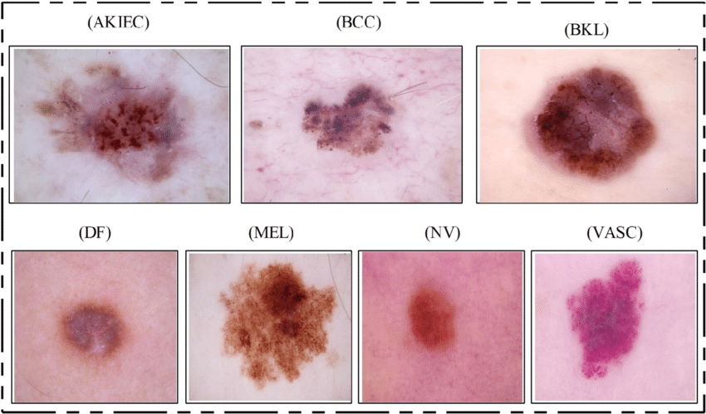
Dataset overview
Classes | Total Images
Melanocytic Nevus (NV) | 6705
Melanocytic Melanoma (MEL) | 1113
Benign Keratosis (BKL) | 1099
Basal Cell Carcinoma (BCC) | 514
Actinic Keratosis (AKIEC) | 327
Vascular Lesion (VASC) | 142
Dermatofibroma (DF) | 115
Combined | 10015
HAM10000 dataset details
10,015 dermatoscopic images
7 classes of skin lesions
Data distribution chart
Number of images per class
Sample dermoscopic image from HAM10000.
Notes:
For this study, we used the HAM10000 dataset, which is part of the ISIC 2018 Challenge. This dataset is a comprehensive collection of 10,015 high-resolution dermatoscopic images. What makes this dataset particularly valuable is its diversity - it includes seven different classes of skin lesions, ranging from benign conditions to malignant melanomas.
Let's look at the distribution of these classes as shown in this table. As you can see, there's a significant class imbalance. Melanocytic nevi, which are generally benign, make up the majority of the dataset with 6,705 images. On the other end of the spectrum, we have rarer lesions like dermatofibroma, with only 115 images.
This imbalance presents a challenge in machine learning. If not addressed, it could lead to a model that's very good at identifying common lesions but performs poorly on rarer, potentially more dangerous ones. We'll discuss how we addressed this challenge in our methodology.

Slide 5
Methodology - Data Preparation
Category | Augmentation | Value
Color | HSV-Hue Adjustment | ±0.015
 | HSV-Saturation Adjustment | ±0.7
 | HSV-Value Adjustment | ±0.4
Geometric | Translation | ±10%
 | Scaling | ±50%
 | Horizontal & Vertical Flip | 100%
 | Horizontal & Vertical Shear | ±10°
Advanced | Mosaic Augmentation | 100%
 | Auto Augmentation (RandAugment) | Enabled
 | Random Erasing | 40%
Dataset reorganization for YOLOv8
Data augmentation techniques
Table of augmentation methods
Data augmentation techniques
Notes:
Our methodology began with careful data preparation. The original HAM10000 dataset came with all images in a single folder and an Excel file indicating each image's cancer type. This format isn't directly compatible with the YOLOv8 classification model we planned to use.
To address this, we wrote a Python script to reorganize the dataset. This script sorted the images into subfolders based on their respective classes, creating a directory structure that YOLOv8 classification models require. This step was crucial in ensuring our data was in the right format for training.
Next, we addressed the class imbalance issue I mentioned earlier through data augmentation. Data augmentation is a technique where we create new training examples by applying various transformations to our existing images. This not only helps balance our classes but also makes our model more robust by exposing it to a wider variety of image variations.
As you can see in this table, we applied several augmentation techniques. We used image rotations, including 90-degree clockwise and counter-clockwise rotations, as well as 180-degree rotations. We also adjusted bounding boxes to match these rotations. Additionally, we applied horizontal and vertical shearing of up to 15 degrees.
These augmentations serve multiple purposes. They help balance our dataset by creating more examples of underrepresented classes. They also make our model more robust to variations in image orientation and perspective, which is crucial in real-world applications where skin lesion images might be captured from various angles

Slide 6
Methodology - YOLOv8 Model Variants
Model | Size | TOP-1 Acc. | TOP-5 Acc. | speed | PARAMS | FLOPS(B)
YOLOv8n-cls | 244 | 69.0 | 88.3 | 0.31 | 2.7 | 4.3
YOLOv8s-cls | 244 | 73.8 | 91.7 | 0.35 | 6.4 | 13.5
YOLOv8m-cls | 244 | 76.8 | 93.5 | 0.62 | 17.0 | 42.7
YOLOv8l-cls | 244 | 76.8 | 93.5 | 0.87 | 37.5 | 99.7
YOLOv8x-cls | 244 | 79.0 | 94.6 | 1.01 | 57.4 | 154.8
Table of YOLOv8 classification model variants
Characteristics: size, accuracy, speed, parameter, FLOPs
YOLOV8 CLASSIFICATION MODEL VARIANTS
Notes:
For our study, we chose to work with the YOLOv8 model, which is a state-of-the-art object detection and image classification model. YOLOv8 offers several pre-trained variants, each with different trade-offs between accuracy and computational requirements.
This table shows the characteristics of five YOLOv8 classification model variants we evaluated.
Look at the 'Parameters' and 'FLOPs' columns. Parameters refer to the number of learnable parameters in the model - more parameters generally mean a more complex model capable of learning more intricate patterns. FLOPs, or Floating Point Operations, give us an idea of the computational complexity of the model.
The choice of model variant is crucial and depends on the specific requirements of the application. In a clinical setting where accuracy is paramount and powerful hardware is available, the x or l variants might be preferable. For a mobile application designed for preliminary screening, the n or s variants could be more suitable due to their speed and lower resource requirements."

Slide 7
Methodology - Training Configuration
Parameter | value
Task | Classification
Epochs | 30
Batch Size | 16
Image Size | 640 pixels
Learning Rate | 0.01
Momentum | 0.937
Weight Decay | 0.0005
Training parameters
Hardware details
PERFORMANCE METRICS OF YOLOV8 MODEL VARIANTS
Notes:
Our training configuration involved 30 epochs with a batch size of 16 and an image size of 640 pixels. We used an NVIDIA A40 GPU with 48 GB memory, running CUDA version 12.2. This setup allowed us to train complex models efficiently and thoroughly evaluate their performance.

Slide 8
Methodology – model training process
Initial training on augmented dataset
Hyperparameter tuning over 30 epochs
Validation and testing wish diverse subsets
Notes:
Our model training process consisted of three main steps:
Initial training: We started by training each model variant on our augmented dataset. This gave the models a chance to learn the basic features and patterns in skin lesion images.
Hyperparameter tuning: Over the course of 30 epochs, we fine-tuned the hyperparameters of each model. This process involves adjusting parameters like learning rate and momentum to optimize the model's performance. It's a crucial step in achieving the best possible accuracy.
Validation and testing: Finally, we rigorously validated and tested each model using diverse subsets of our data. This step is critical to ensure that our models generalize well - in other words, that they perform well on new, unseen data, not just the data they were trained on.
This comprehensive approach allowed us to thoroughly evaluate each model variant and understand its strengths and weaknesses in the context of skin lesion classification

Slide 9
Performance Metrics
Key matrices : Precision, Recall, F1-Score, Accuracy, Inference Time
Importance of each metric in skin lesion classification
Notes:
To evaluate our models, we used several key performance metrics those are precision, recall, F1-score, accuracy and inference time. In the context of skin lesion classification, balancing these metrics is crucial. We need high precision to avoid unnecessary biopsies or treatments, high recall to ensure we don't miss any potential skin cancers, and low inference time for practical clinical application.
**** you can add the definitions of the matrices if you want**** Precision: This measures the accuracy of positive predictions. In our context, high precision means that when the model identifies a lesion as malignant, it's likely to be correct. It's calculated as the ratio of true positives to all positive predictions. Recall: Also known as sensitivity, recall measures the model's ability to find all positive instances. High recall in our case means the model is good at identifying all malignant lesions, which is crucial for not missing potential skin cancers. It's the ratio of true positives to all actual positives.
F1-Score: This is the harmonic mean of precision and recall, providing a single score that balances both metrics. It's particularly useful when you have an uneven class distribution, as we do in our dataset.
Accuracy: This is the ratio of correct predictions to total predictions. While useful, it can be misleading in imbalanced datasets, which is why we consider it alongside other metrics.
Inference Time: This measures how long it takes the model to make a prediction on a single image. It's crucial for assessing the model's suitability for real-time applications.

Slide 10
Results - Performance Comparison
MODELS | Accuracy | Precision | Recall | F1 | Inference
YOLOv8n-cls | 84.0% | 79.5% | 70.4% | 73.0% | 0.5 ms
YOLOv8s-cls | 85.6% | 81.7% | 72.2% | 75.8% | 0.9 ms
YOLOv8m-cls | 85.0% | 81.1% | 72.7% | 76.3% | 1.6 ms
YOLOv8l-cls | 86.1% | 84.3% | 72.7% | 77.0% | 2.7 ms
YOLOv8x-cls | 86.2% | 82.1% | 72.8% | 76.9% | 4.2 ms
Notes:
Now, let's dive into our results. This table compares the performance of each YOLOv8 variant across our key metrics.
Looking at accuracy, we see improvement as we move from smaller to larger models. The YOLOv8x-cls model achieved the highest accuracy at 86.2%, closely followed by the YOLOv8l-cls at 86.1%. This suggests that the additional complexity of these larger models allows them to capture more nuanced features in the skin lesion images.
In terms of precision, the YOLOv8l-cls model actually outperformed the x variant, with 84.3% versus 82.1%. This indicates that the large model was slightly better at avoiding false positives.
Recall was fairly consistent across all models, ranging from 70.4% for the nano variant to 72.8% for the extra-large variant. This suggests that even the smaller models were reasonably good at identifying positive cases.
The F1-score, which balances precision and recall, was highest for the YOLOv8l-cls model at 77.0%, indicating it had the best overall balance of precision and recall.
Now, looking at the inference time, we see a clear trade-off. The YOLOv8n-cls model was by far the fastest, with an inference time of just 0.5 milliseconds. In contrast, the YOLOv8x-cls model took 4.2 milliseconds per image. This speed difference could be crucial in real-time applications.

Slide 11
Results - Performance Comparison with Other Study
Our Study on HAM10000 Dataset
ELSLC Study on HAM1000 Dataset
Model | Accuracy | Precision | Recall | F1-Score | Inference
YOLOv8n-cls | 84.0% | 79.5% | 70.4% | 73.0% | 0.5 ms
YOLOv8s-cls | 85.6% | 81.7% | 72.2% | 75.8% | 0.9 ms
YOLOv8m-cls | 85.0% | 81.1% | 72.7% | 76.3% | 1.6 ms
YOLOv8l-cls | 86.1% | 84.3% | 72.7% | 77.0% | 2.7 ms
YOLOv8x-cls | 86.2% | 82.1% | 72.8% | 76.9% | 4.2 ms
Model | Accuracy | Precision | Recall | F1-Score
Combined | 81.3% | 82.57% | 80.1% | 81.31%
EfficientNetB0 | 79.58% | 78.69% | 79.48% | 79.54%
ResNet101 | 79.41% | 78.39% | 78.35% | 78.31%
ResNet50 | 75.21% | 74.32% | 74.46% | 75.45%
VGG16 | 69.77% | 68.55% | 68.31% | 68.56%
Notes:
Now, let's dive into our results. This table compares the performance of each YOLOv8 variant across our key metrics.
Looking at accuracy, we see improvement as we move from smaller to larger models. The YOLOv8x-cls model achieved the highest accuracy at 86.2%, closely followed by the YOLOv8l-cls at 86.1%. This suggests that the additional complexity of these larger models allows them to capture more nuanced features in the skin lesion images.
In terms of precision, the YOLOv8l-cls model actually outperformed the x variant, with 84.3% versus 82.1%. This indicates that the large model was slightly better at avoiding false positives.
Recall was fairly consistent across all models, ranging from 70.4% for the nano variant to 72.8% for the extra-large variant. This suggests that even the smaller models were reasonably good at identifying positive cases.
The F1-score, which balances precision and recall, was highest for the YOLOv8l-cls model at 77.0%, indicating it had the best overall balance of precision and recall.
Now, looking at the inference time, we see a clear trade-off. The YOLOv8n-cls model was by far the fastest, with an inference time of just 0.5 milliseconds. In contrast, the YOLOv8x-cls model took 4.2 milliseconds per image. This speed difference could be crucial in real-time applications.

Slide 12
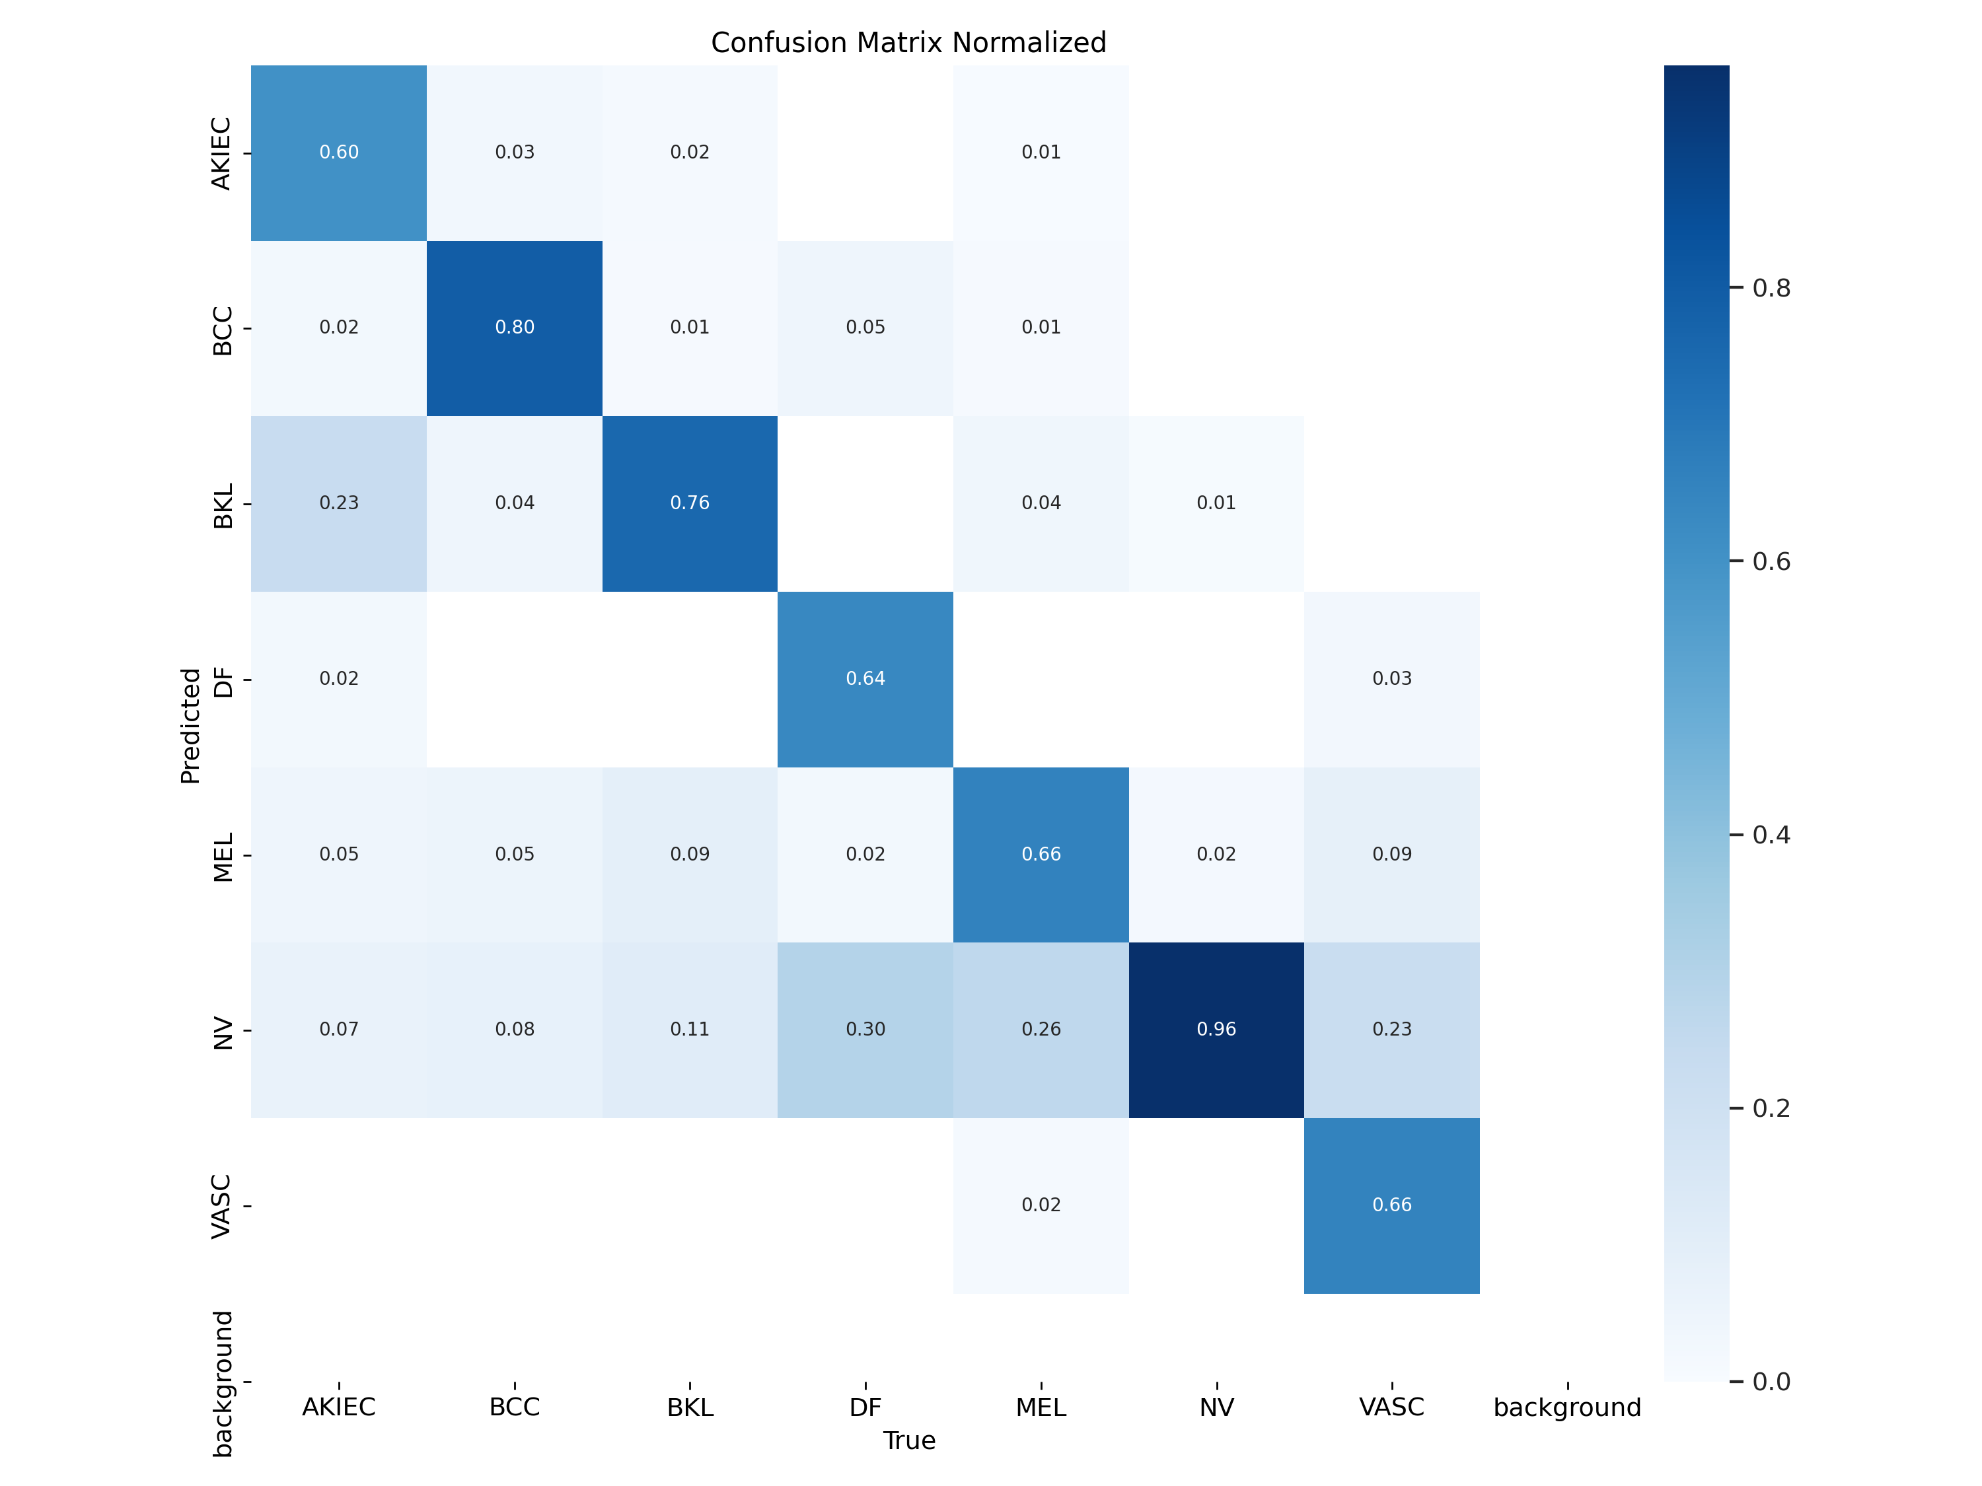
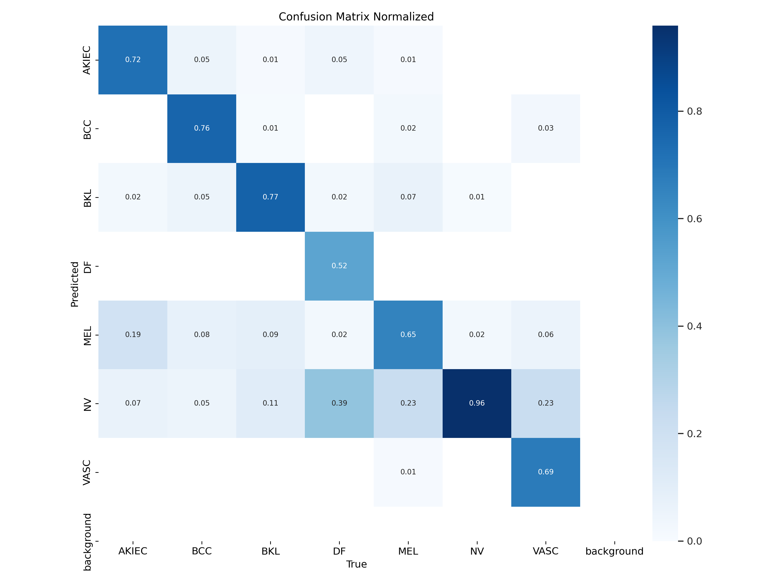
Results – Confusion Matrices
Confusion matrices of YOLOv8x-cls
Confusion matrices of YOLOv8l-cls
Notes:
These confusion matrices provide a more detailed look at each model's performance across different lesion types. The x-axis shows predicted classes, while the y-axis shows actual classes. Darker squares along the diagonal indicate better performance.
Looking at both the YOLOv8x-cls and YOLOv8l-cls matrices, we can see that all models performed exceptionally well on melanocytic nevi. This is not surprising given that this was the most common class in our dataset.
However, we can also see areas where the models struggled. For example, both models had some difficulty distinguishing between benign keratosis and solar lentigines. They also sometimes confused melanoma with benign nevi, which is a critical distinction in clinical practice.
Interestingly, despite its lower overall accuracy, the l variant showed slightly better performance on some of the rarer lesion types, such as dermatofibroma. This suggests that sometimes the relationship between model size and performance isn't straightforward, and careful evaluation is needed to choose the best model for a given task.

Slide 13
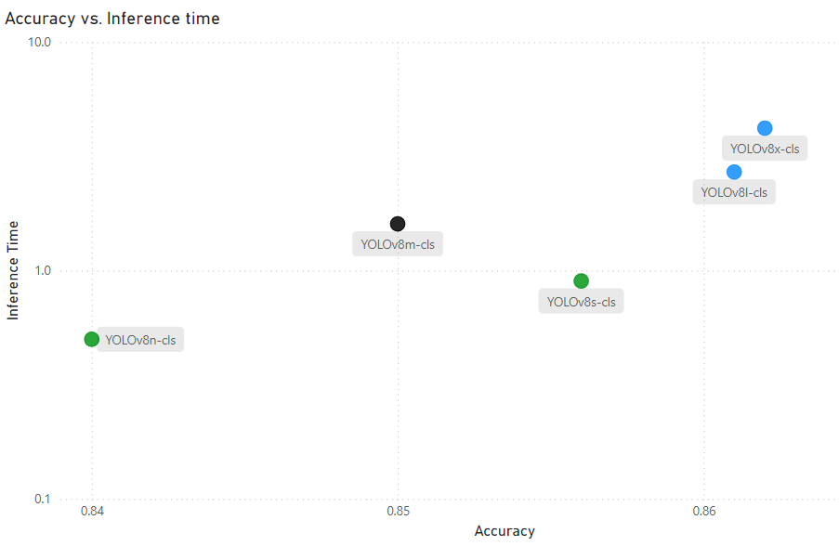
Discussion - Model Trade-offs
Notes:
This scatter plot visualizes the trade-off between accuracy and inference time for each of our models. It's a crucial tool for understanding how to balance performance and speed in real-world applications.
In the top-right corner, we see the YOLOv8x-cls and YOLOv8l-cls models. These offer the highest accuracy but at the cost of slower inference times. These models would be ideal in scenarios where accuracy is paramount and computational resources are readily available. For example, they could be used in a dermatology clinic for detailed analysis of suspicious lesions.
In the bottom-left corner, we find the YOLOv8n-cls and YOLOv8s-cls models. These models sacrifice some accuracy for extremely fast inference times. They could be perfect for real-time applications, such as a preliminary screening tool on a mobile device or in a general practitioner's office.
The YOLOv8m-cls model sits in the middle, offering a balance between accuracy and speed. This could be a good all-round choice for applications that need both reasonable accuracy and quick results.
It's important to note that the 'best' model depends entirely on the specific use case. In some scenarios, the slight accuracy gain of the x model over the l model might be worth the increased inference time. In others, the speed of the nano model might be critical, even if it means accepting a lower accuracy

Slide 14
Conclusion and Future Work
Summary of key findings
Potential impact on skin cancer diagnosis
Areas for future research (e.g., multi-task learning, attention mechanisms)
Notes:
In conclusion, our research demonstrates the potential of YOLOv8-based models for accurate and efficient skin lesion classification. We've achieved high accuracy, with our best model reaching 86.2%, while also offering variants capable of real-time performance.
These results suggest that YOLOv8 models could be valuable tools in dermatological practice. They could assist dermatologists by providing rapid, objective assessments of skin lesions, potentially speeding up the diagnostic process and improving early detection rates for skin cancers.
However, it's important to note that these models are not intended to replace dermatologists, but to augment their capabilities. The final diagnosis should always be made by a qualified healthcare professional.
Looking to the future, there are several exciting avenues for further research:
We could explore multi-task learning, combining classification with lesion segmentation. This could provide even more detailed information to clinicians.
Investigating attention mechanisms could potentially improve the model's performance on rarer lesion types.
Finally, we need to validate these models in diverse, real-world clinical settings to ensure their robustness across various patient populations and imaging conditions.

Slide 15
THANK YOU
utsha.saha@ndsu.edu
Notes:
Thank you for your attention. I'd be happy to take any questions about our research or discuss potential applications of this technology in dermatological practice.

