Slide 1

A Project Presentation
On
"Interconnected: A Social Media Platform"
Submitted By
Utsab Dangol(41002190)
A Project Presentation Submitted in partial fulfillment of the requirement of Bachelor of Computer Application (BCA) 4th Semester of Tribhuvan University, Nepal
February, 2026

Slide 2
Table of Content
Introduction
Problem Statement
Objectives
Functional Requirement
Data Modeling using ER
Process Modeling using DFD
Database Schema Design
Tools Implemented
Implemented Modules
Conclusion

Slide 3
Introduction
Interconnected is a community-based platform designed to replace addictive feeds with intentional, interest-driven filtering.
Users choose the content they want to focus on in the moment instead of being pulled into endless distraction.​

Slide 4
Problem Statement
Algorithm-Driven Distraction: Existing platforms prioritize engagement and trending content over relevance, leading to superficial interactions and reduced focus on meaningful topics.
Weak Community Emphasis: While some platforms offer community features, they are often secondary, hard to access, and fail to foster genuine, interest-based connections.
Information Overload: Constant content from multiple sources overwhelms users, hindering productive engagement and thoughtful discussion within focused communities.

Slide 5
Objectives
To create a community-driven social media platform that prioritizes meaningful
To balance social interaction with productivity by reducing algorithmic distractions
To give users greater control over what they see and how they engage with content.

Slide 6
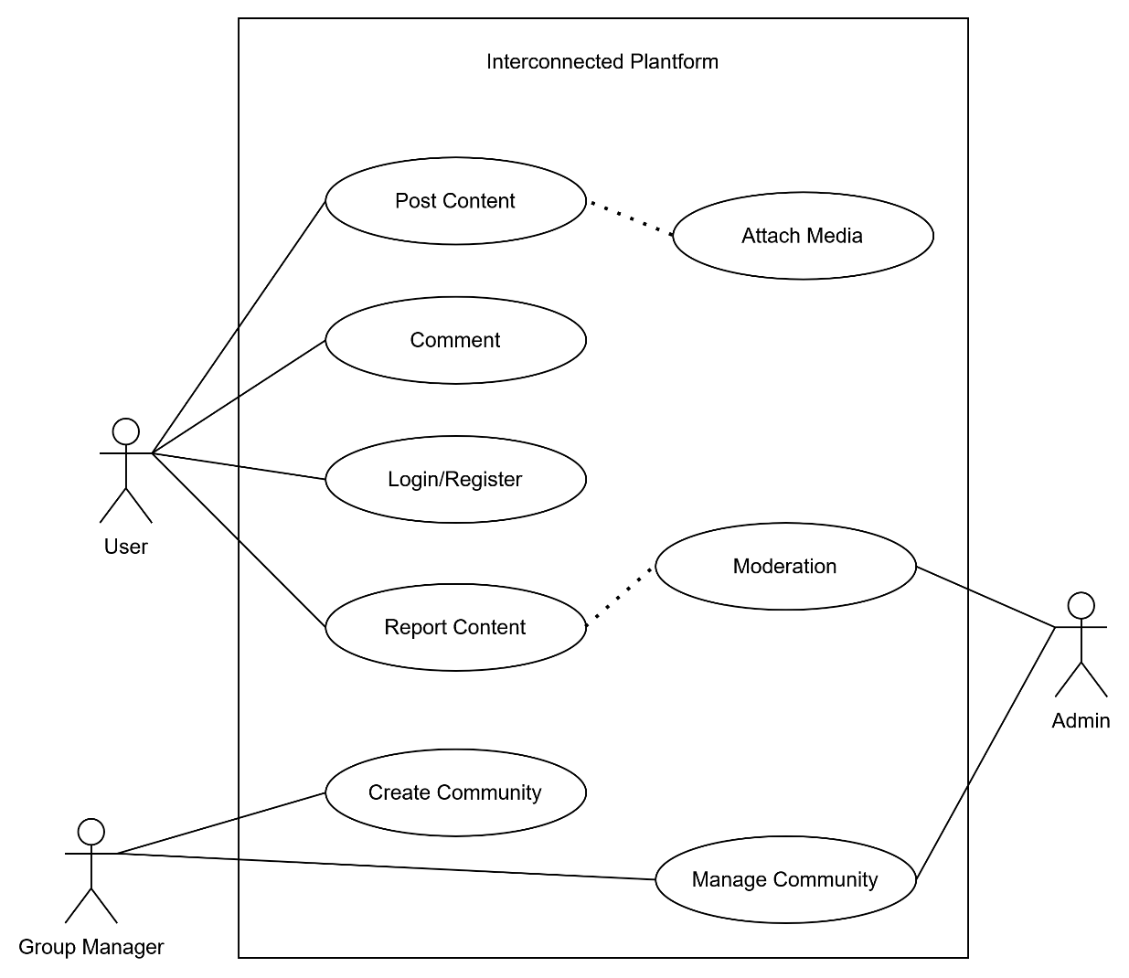
Functional Requirement

Slide 7
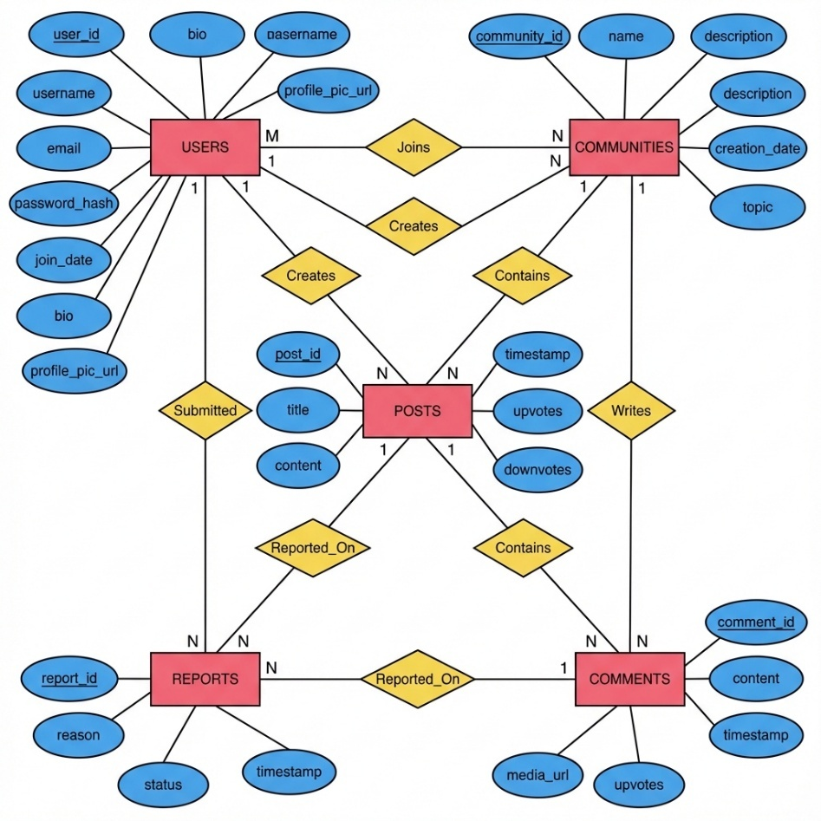
Data Modeling using ER

Slide 8
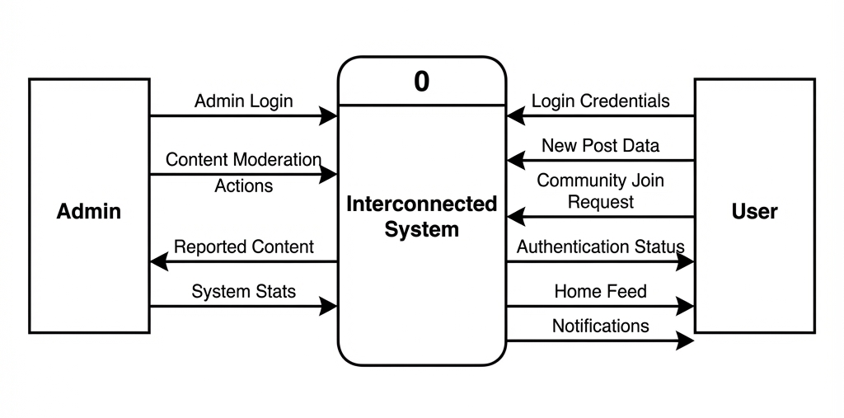
Level 0 DFD

Slide 9
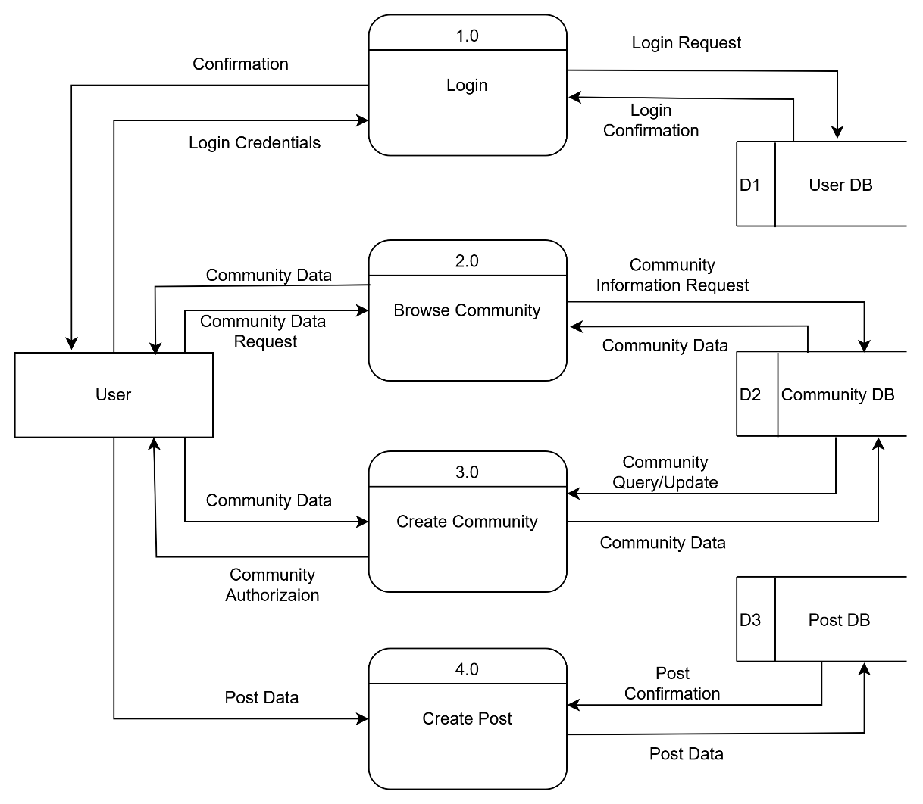
User Level 1 DFD

Slide 10

Admin Level 1 DFD

Slide 11
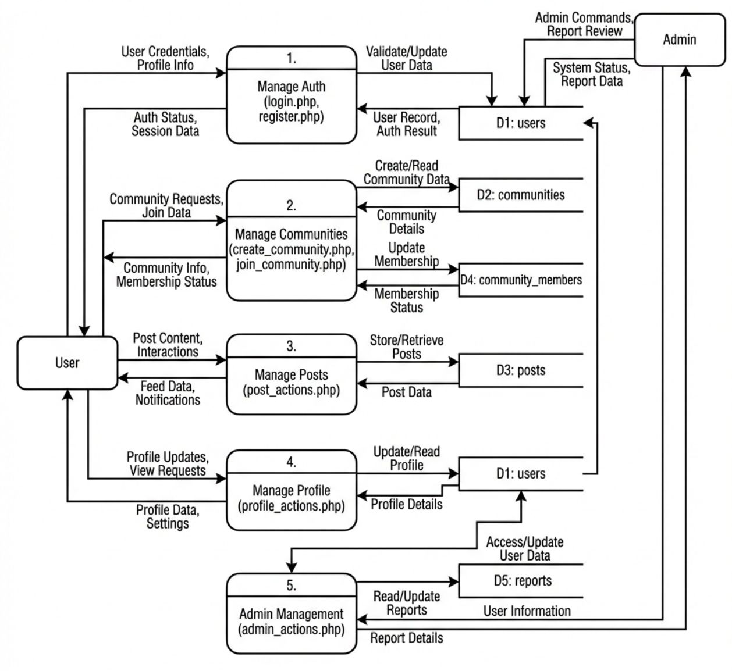
Physical DFD Diagram

Slide 12
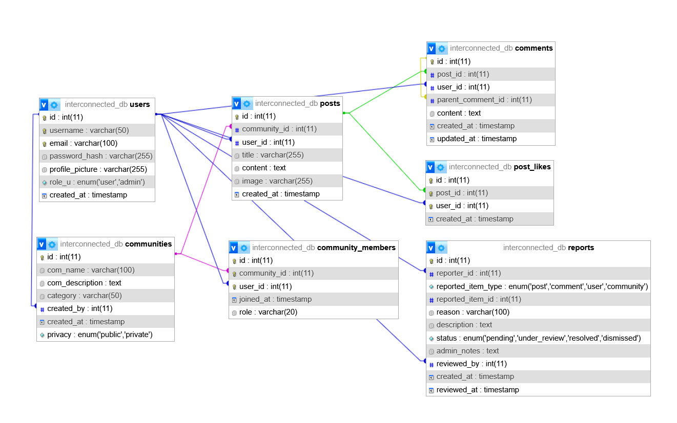
Database Schema Design

Slide 13
Tools Implemented
Software tools
HTML
CSS
React
PHP
MySQL.

Slide 14
Implemented Modules
User Authentication Module
Community Management Module
Content Creation and Management Module
Moderation Module
Administrative Module

Slide 15
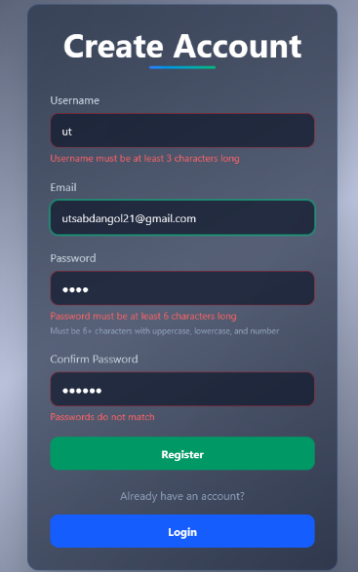
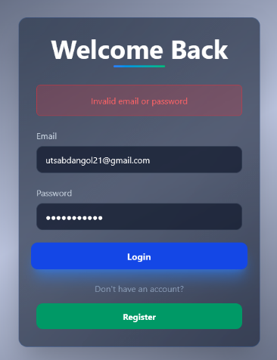
User Authentication Module: Provides secure registration, login, and session handling through input validation, unique user enforcement, password hashing, token generation, and controlled session lifecycle management.

Slide 16
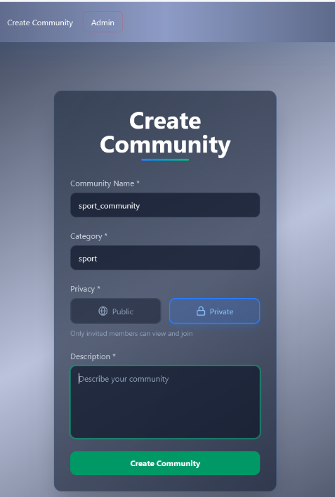
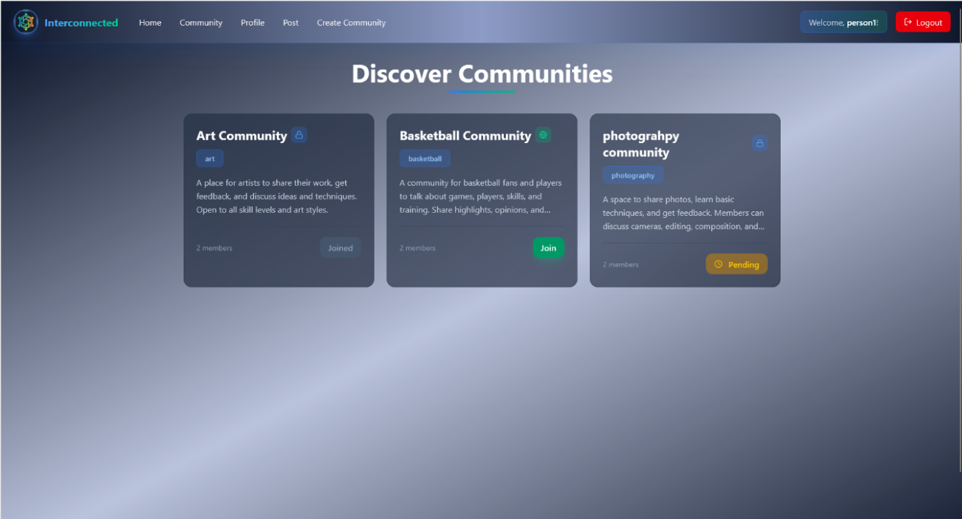
Community Management Module: Supports creation, discovery, and participation in communities, with structured membership handling, moderator assignment, search and filtering, and organized views of posts and guidelines.

Slide 17
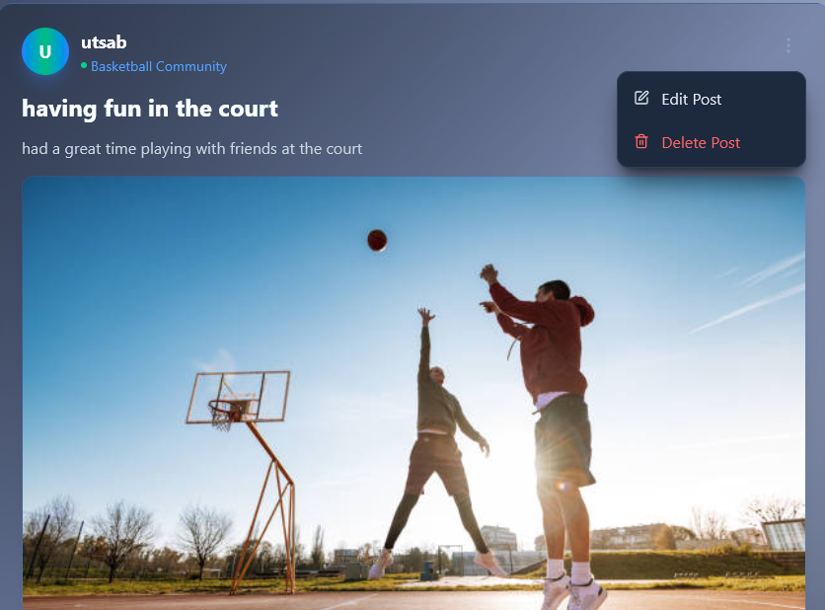
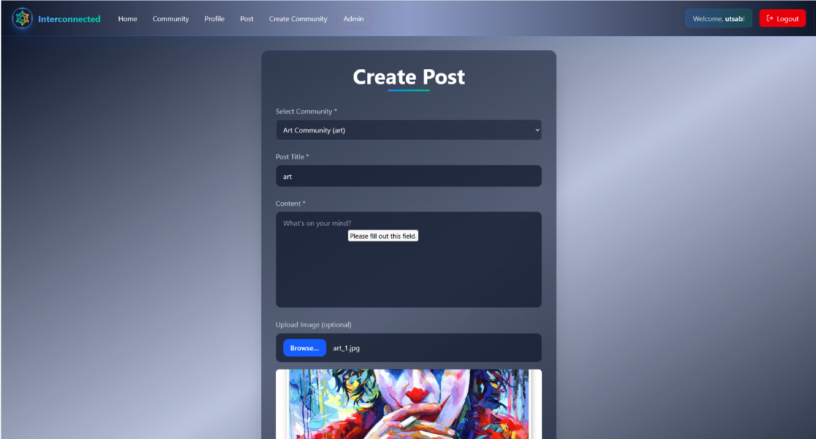
Content Creation and Management Module: Enables validated post and threaded comment creation, with author-based editing control and soft-deletion mechanisms to maintain data integrity and consistent UI responses.

Slide 18
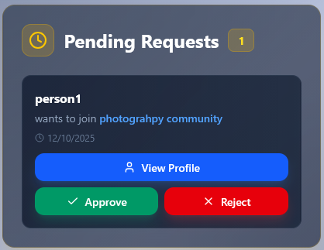
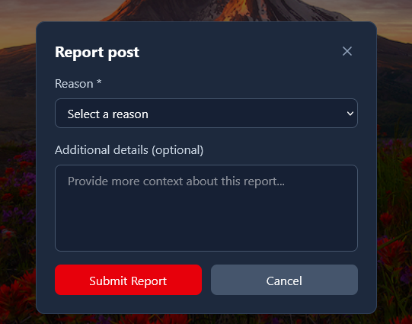
Moderation Module: Facilitates reporting and enforcement workflows, allowing moderators to review flagged content and apply actions such as warnings, removals, or bans with proper logging and status tracking.

Slide 19
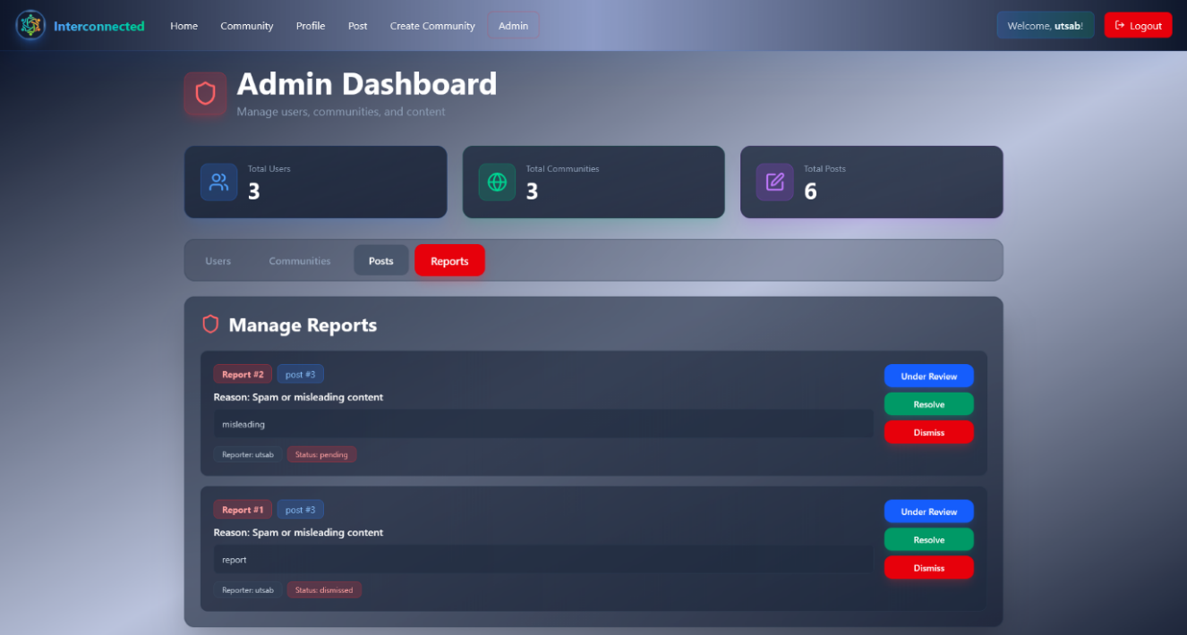
Administrative Module: Delivers system-wide governance through dashboards, analytics, user and community management, and oversight of activity trends and moderation processes.

Slide 20
Conclusion
Interconnected lets Users join communities aligned with their interests and share achievements, fostering meaningful interactions.
User-Controlled Content Consumption: The platform allows users to focus on topics of their choice, offering more control than algorithm-driven platforms.

Slide 21
DEMO

