Slide 1
Macrobiot Final Year Project On IoT Smart Home
Under the Supervision of
Mr. Saroj Shakya, Associate Professor
Presented By: Utsav Sapkota
University ID: 77190014

Slide 2
Contents
Introduction
Problem Statement
Objectives
Literature Review
Methodology
Design
Product Evaluation
Project Evaluation
Project Timeline
Work Plan
Gantt Chart
Conclusion
2

Slide 3
Introduction
Smart Home: Control Home Appliances Via Internet
AIM: Implement Low Cost IoT-based Smart Home System
Responsive Website
Control Appliances
Integrated Sensors
Real-time Information
3

Slide 4
Problem Statement
Energy consumption and wastage
Risk of intruders and burglary
Gas leak disaster and fire hazard
Infant death due to high temperature
Safety and comfort for the elderly and physically challenged
4

Slide 5
Objectives
Remotely Turn On/Off Appliances and Garage Door
Provide Safety By Preventing Burglary Attempt
Provide Real-time Atmospheric Information
Remotely Change Light Colour
Prevent Potential Fire Hazard
Reduce Energy Consumption
5

Slide 6
Literature Review
Emergence: With the advent of internet in the 1900s, the term IoT first coined in 1999, it truly flourished in 2010 along with smartphones
Benefits: Saves around 30% energy without compromising comfort, beneficial to elderly who require continuous monitoring, saves time and provides excellent home security as compared to traditional lock and key
Challenges: Internet reliance is its major drawback, potential information theft or leaks and misuse of information, and expensive installation and hardware maintenance
Related Works: Souza et al. (2018) proposed automated curtains and light control; Thakur & Joshi (2018) implemented smart room heater; Gupta et al. (2020) Designed an Automatic Garage Door Opener; using gas sensors and communication systems; Sahoo & Pati (2017) proposed and implemented an intrusion detection system using PIR.

Slide 7
Methodology
Prototype methodology was used because:
Specifications not well understood
Possible change in specification
Does not require high expertise
Less chances of complex error
Suitable for high-risk project
Product success guaranteed
Short time frame
7

Slide 8
Prototype Model
Requirements
Quick Design
Build Prototype
User Evaluation
Redefining Prototype
Implement and Maintain

Slide 9
Design
The Designs Include:
Overview Diagram
UI Design
9

Slide 10
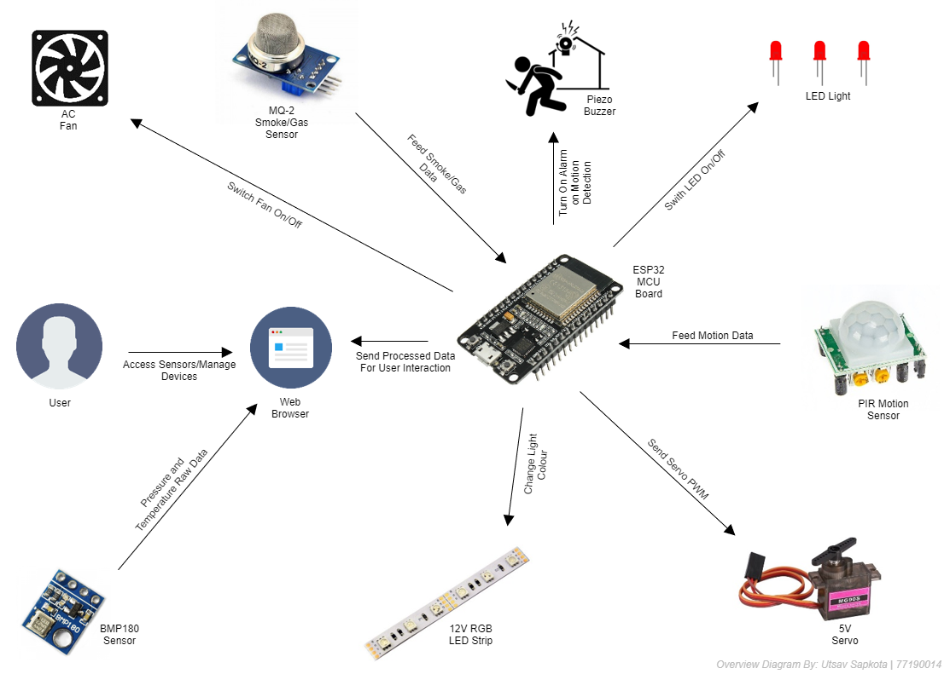
10

Slide 11
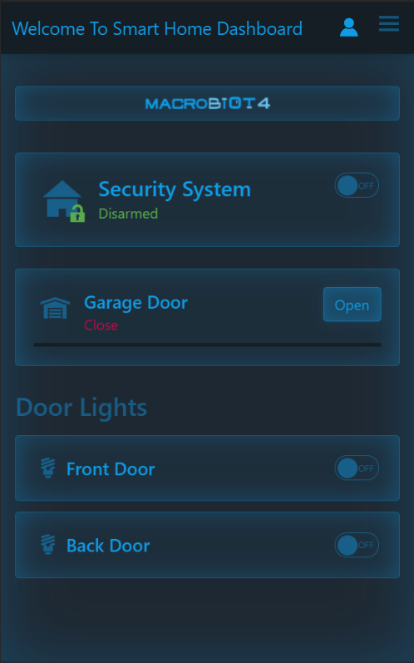
Mobile project Responsive design for mobile phones.

Slide 12
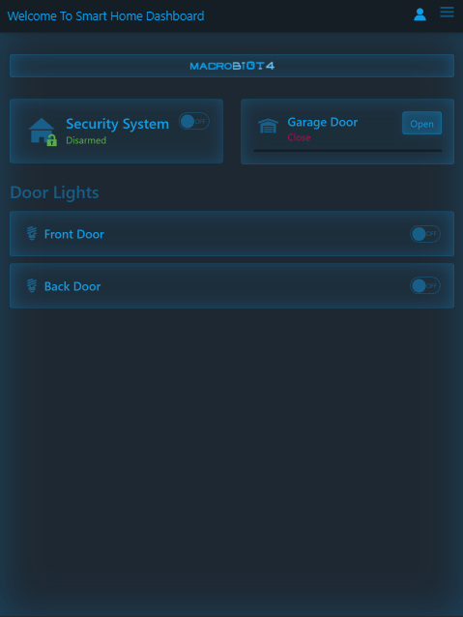
Tablet project
Responsive design for tablets.

Slide 13
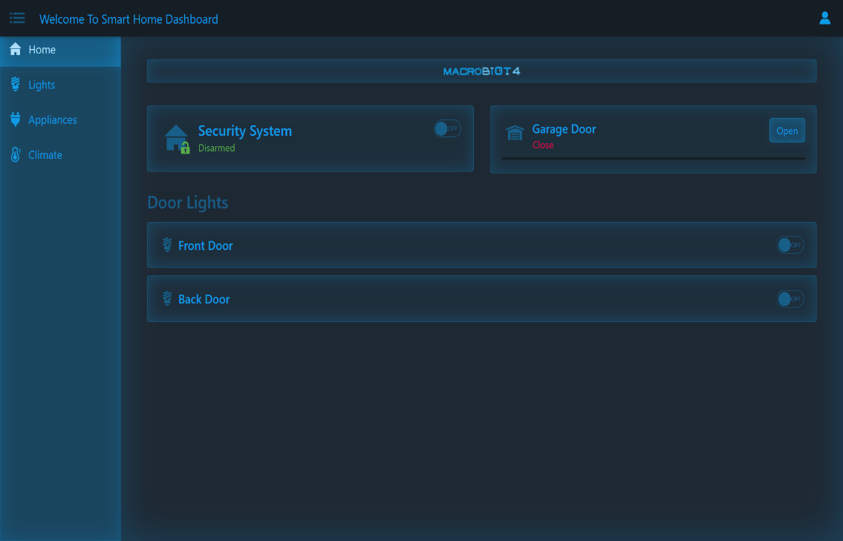
Desktop project
Responsive design for personal computers.

Slide 14
What Makes Smart Home Desirable?
Light Control
Security Camera
SOS Fire Update
An astounding 77.8% of total participants desired Light Control
66.7% participants desired SOS Fire Update
44.4% participants desired Live Security Camera

Slide 15
IoT Expenditure Survey
Outlay (NPR) | <5,000 (Less than five thousand) | >5,000 (More than five thousand) | >=100,000 (More or equal to hundred thousand)
Percentage of Participants | 22.2% | 55.6% | 22.2%

Slide 16
MCU Power Consumption
RATING | ESP32 WROOM | Raspberry Pi 4 Model B+
Current Consumption | 20 mA | 85 mA
Energy Consumption | 146.88 kWh / Mo | 34.56 kWh / Mo
Cost in a Month | NPR 1,762.56/- | NPR 414.72/-

Slide 17
Deployment Feasibility Survey
Nepal

Slide 18
SWOT Analysis
STRENGTHS
Cost Reduction
Public Interest
Ease of Use
Innovation
WEAKNESSES
Massive Investments
Data Challenges
Connectivity
Security
S
W
Exciting Investments
Infrastructure Management
OPPORTUNITIES
System Vulnerability
Lack of Demand
Not Meeting People’s Expectations
THREATS
O
T

Slide 19
Product Evaluation
Product was evaluated to determine fulfilment of initial project plan
The product was a success
Limitations were realized
Final product was economic, and efficient

Slide 20
Project Evaluation
The project was completed following the key aspects of the methodology
Each aspects of the methodology matches the project as prototype model was used
The project was completed in various stages
GitHub was used for version control
Procurement of specific hardware was especially challenging

Slide 21
Project Timeline
Submit Risk Register
Work in Progress
Ethical Consent Collection
Final Product Submission
Final Report Submission
Project Ends
JAN
FEB
MAR
APR
MAY
JUN
JUL
AUG
SEP
OCT
NOV
DEC
Project Starts Submit Project Plan
Prototype Complete
Monitoring and Controlling
Testing and Evaluation
TBC Graduation

Slide 22
Work Plan
Time Frame Allocated: 5 months
Project Initiation: 26/04/21
Project Completion: 08/07/21
Milestones
Light Toggle
Device Timer
Light Dimmer
Sensor Graph Plot
LED Colour Change
Garage Door Control
Motion Detection and Alarm
Gas Leakage Alert Notification

Slide 23
Gantt chart
Started: 26/04/21 Ends: 12/07/21 | Week 1 |  |  |  |  |  |  | Week 2
 | 1 | 2 | 3 | 4 | 5 | 6 | 7 | 8 | 9 | 10 | 11 | 12 | 13 | 14
Conception and Initiation |  |  |  | ◆
Definition and Planning |  |  |  |  |  |  |  |  |  |  |  |  |  | ◆
Executing |  |  |  |  |  |  |  | ◆
Monitoring and Controlling
Task 5
Closing
Task 6 |  |  |  |  |  | ◆ |  |  | ◆ |  | ◆

Slide 24
Conclusion
Project was deemed a success as it met criteria as promised
The product was energy efficient and was of low cost which was able to provide most demanded features as per the survey
Multiple drawbacks and limitations were encountered like the unavailability of storage space in the microprocessor that was used
Despite the challenges and limitations, hope for future extension of this product was realized

Slide 25

Thanks!
Utsav Sapkota STUDENT
The British College, Thapathali, Kathmandu
Let us view demonstration…

