Slide 1
Retail Analytics Project
Customer Shopping Behavior Analysis
Turning 3,900 transaction records into targeted commercial growth
End-to-End Analytics · Python · PostgreSQL · Power BI
Notes:
Welcome. Today we walk through the Customer Shopping Behavior project, showing how we converted 3,900 raw retail transactions into validated business strategies.

Slide 2
From raw transactions to a decision-ready story
PROJECT OUTPUT
BUSINESS ANGLE
PROJECT GOAL
Tooling
Action
Insight
A standardized database, reproducible SQL transformations, and an interactive executive Power BI dashboard.
Translate exploratory data science into concrete merchandising, discount optimization, and loyalty retention moves.
Uncover spending patterns, customer segments, product preferences, and subscription behavior across retail cohorts.
Project Architecture: Python Data Cleaning · PostgreSQL Modeling · Power BI Reporting
Notes:
This initiative bridges raw telemetry and executive decision-making. We structured the project across three key deliverables: pipeline cleaning, SQL modeling, and visual discovery.

Slide 3
The project starts with 3,900 purchases and 18 fields
3,900
18
$59.76
3.75
Customer, product, and shipping dimensions
Average review rating (37 missing imputed by median)
Total retail purchases analyzed
Average purchase amount across transactions
Dataset scope: Customer demographics, product catalog, fulfillment channels, and promotional redemption
Notes:
The foundation of the study is a multi-dimensional retail dataset capturing 3,900 discrete consumer orders with balanced transaction value and customer feedback.

Slide 4
Cleaning created a reliable base for analysis
01
02
03
04
05
Inspect
Standardize
Engineer
Prune
Load
Load raw transaction records and audit schema health with Python.
Clean column names and impute 37 missing ratings using category medians.
Derive structured age brackets and calculate purchase-frequency intervals.
Eliminate redundant promo-code attributes to ensure clean feature sets.
Migrate clean tables into PostgreSQL for high-speed relational queries.
ETL Pipeline: Python (Pandas) staging to PostgreSQL relational warehouse
Notes:
Data integrity was verified before running downstream analysis. We resolved missing survey data, engineered new behavioral features, and centralized the data into PostgreSQL.

Slide 5
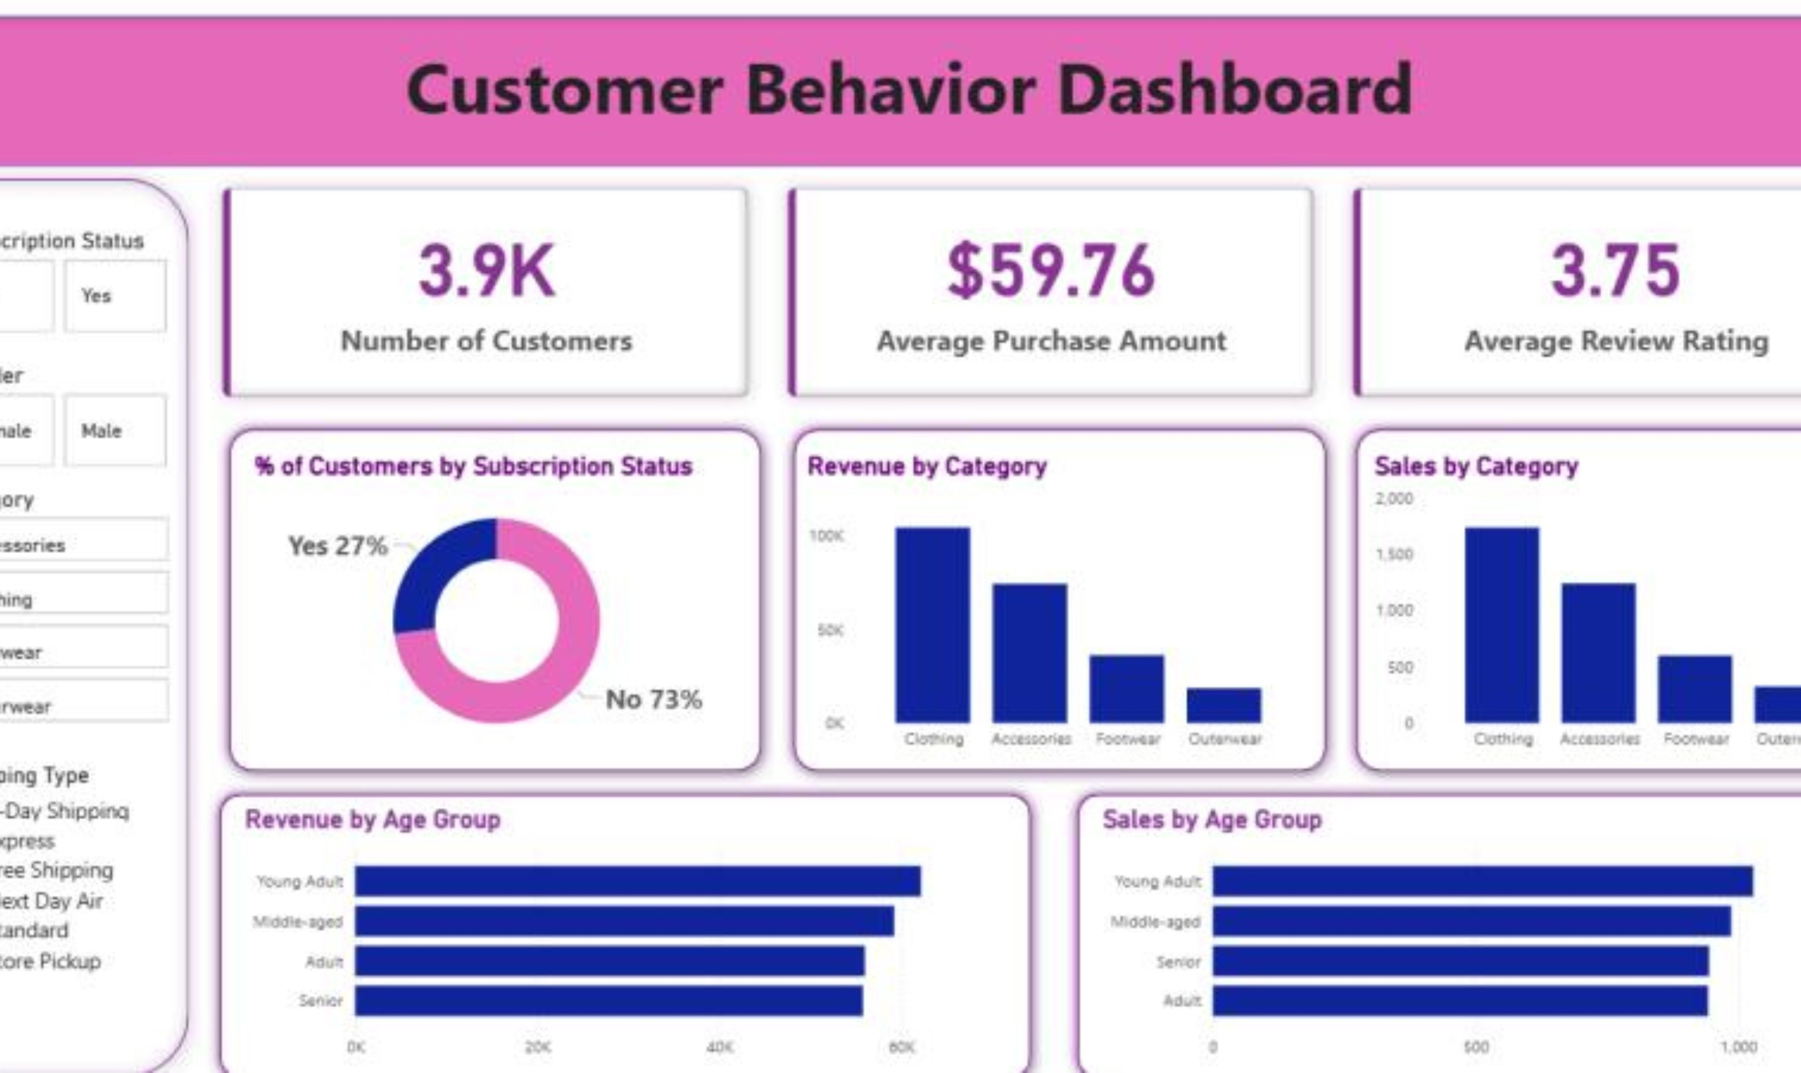
The dashboard turns ten business questions into one view
Power BI brings together customer counts, average spend, ratings, subscription mix, category performance, age-group revenue, shipping filters, and product views.

Slide 6
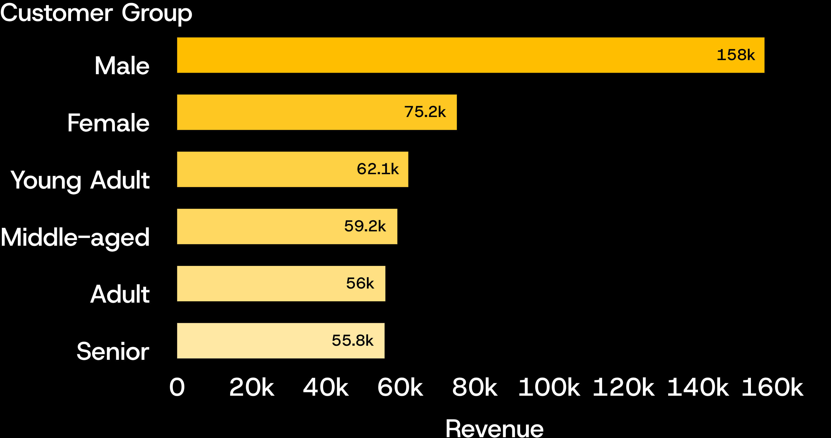
Revenue is concentrated in male customers and younger adults
DEMOGRAPHIC CONCENTRATION
68%
Male-driven revenue share ($157,890 vs $75,191 female).
$62,143
Generated by Young Adults, leading all four generational cohorts.
Source: PostgreSQL aggregation of transactional sales records
Notes:
Revenue distribution shows significant concentration. Male buyers account for more than double female spend, while Young Adults represent the most lucrative age segment.

Slide 7

Product performance points to clear campaign anchors
ANALYSIS DIMENSION | TOP ANCHOR | CATALOG LEADERS
Highest-Rated Items | Gloves (3.86) | Sandals (3.84), Boots (3.82), Hat (3.80), Skirt (3.78)
Category Leaders | Jewelry & Tops | Blouse, Sandals, and Jacket represent volume pillars
Discount Dependent | Footwear & Knit | Hat, Sneakers, Coat, Sweater, and Pants rely heavily on promos
Key takeaway: Pair top-rated organic performers with tighter margin controls on discount-dependent categories
Notes:
Product performance highlights high customer satisfaction in accessories and footwear, while identifying staple apparel that currently erodes margins through discount dependence.

Slide 8
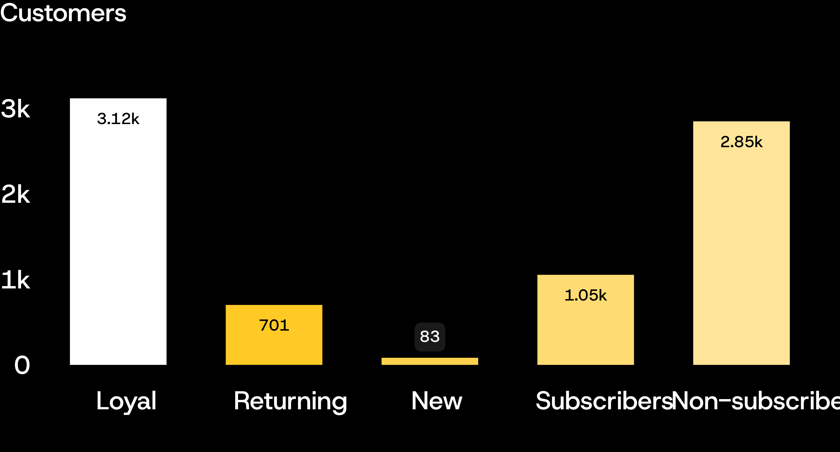
Loyalty is strong, but subscriptions lag behind
CONVERSION GAP
3,116
Loyal customers vs 83 new, showing exceptional repeat baseline.
2,518
Repeat buyers remain non-subscribers ($170k revenue uncaptured by programs).
Source: Customer segmentation audit; 958 subscribed repeat buyers vs 2,518 unsubscribed
Notes:
Our retention baseline is remarkably solid with over 3,100 loyal shoppers. However, subscription adoption is a major white space: 2,518 repeat purchasers have not joined the membership tier.

Slide 9
Five actions turn the analysis into a growth plan
Promote exclusive subscriber benefits.
Reward repeat buyers and move more of them into the Loyal segment.
Review discount policy to balance conversion with margin control.
Feature top-rated and best-selling products in campaigns.
Target high-revenue age groups and customers who value express shipping.
Notes:
These five strategic levers bridge the gap from exploratory metrics to operational revenue enhancement, targeting both loyalty monetization and discount discipline.

Slide 10
The project’s next step is activation
DASHBOARD
REUSABLE WORKFLOW
Monitor
TARGETED CAMPAIGNS
Reusable
Target
Use the dashboard to monitor subscription conversion, repeat buying, discount exposure, and category performance.
Keep the workflow reusable: clean in Python, query in PostgreSQL, communicate in Power BI.
Turn the strongest product and customer segments into targeted campaigns.

