Slide 1
NGO-Connect
Design & Architecture Overview
Connecting NGOs • Donors • Volunteers • Administrators
March 10, 2026 | Stakeholder Briefing

Slide 2
Agenda
1. Platform Overview & Value Proposition
2. System Architecture & Technology Stack
3. User Roles & Access Control
4. Core Feature Modules
5. Database Design
6. REST API Surface (149 Endpoints)
7. Key Workflows (Donations, Volunteering, Moderation)
8. AI & Recommendation Engine
9. Validation Evidence & Quality Metrics
10. Frontend Application Structure
11. Deployment & Configuration
NGO-Connect | Architecture, Delivery, and Validation
Slide 2/25

Slide 3
Executive Summary
NGO-Connect is a full-stack web platform bridging NGOs, donors, volunteers, and administrators. It enables transparent donations, volunteer management, AI-powered recommendations, and an Innovation Center for expanded community engagement.
149
REST API Endpoints
14
Route Modules
35
Database Tables
31+
Frontend Pages
✓ Real payment integration (Razorpay + Mock mode)
✓ Innovation Center: Giving Circles, Wishlists, Shifts, CRM
✓ AI chatbot powered by Google Gemini with RAG
✓ Role-based access: User, NGO, Admin
✓ Certificate generation for donations & volunteering
NGO-Connect | Architecture, Delivery, and Validation
Slide 3/25

Slide 4
System Architecture
Three-tier design with PostgreSQL backbone

Slide 5
High-Level Architecture
Presentation Tier
React 18 SPA • Tailwind CSS • Recharts • Leaflet Maps Axios + JWT Auth • React Router v6
▼
Application Tier
Node.js + Express • 14 Route Modules • JWT Middleware Payment Gateway • Gemini AI • Innovation Services
▼
Data Tier
PostgreSQL 14+ • 35 Relational Tables BIGSERIAL PK + External ID • JSONB source_doc • FKs for core + innovation
External Services: Razorpay Payment API • Google Gemini API • Webhook Delivery Service
NGO-Connect | Architecture, Delivery, and Validation
Slide 5/25

Slide 6
Technology Stack
Backend
Frontend
Node.js + Express
PostgreSQL 14+ (pg driver)
JWT Auth (jsonwebtoken)
bcryptjs (password hashing)
Multer (file uploads)
Google Generative AI (Gemini)
Razorpay / Mock payments
dotenv + CORS
React 18 + React Router v6
Axios (HTTP client)
Tailwind CSS
Recharts (data viz)
Leaflet + react-leaflet
leaflet-routing-machine
Heroicons (icons)
react-scripts (CRA toolchain)
NGO-Connect | Architecture, Delivery, and Validation
Slide 6/25

Slide 7
User Roles & Access Control
User (Donor / Volunteer)
NGO
Admin
Discover & donate to NGO campaigns
Apply for volunteer opportunities
Use Innovation Center (circles, wishlists)
View certificates & receipts
Message NGOs, get AI recommendations
Manage organization profile & verification docs
Create campaigns & volunteer opportunities
Manage Innovation Center modules
Review & approve certificate requests
Message users & manage volunteers
Verify / reject NGO registrations
Moderate flagged content & flag requests
Manage categories & broadcast notifications
Platform analytics & webhook dashboard
User management (delete users, enable/disable NGOs)
Auth: Stateless JWT (7-day expiry) • bcrypt password hashing • Role-checked middleware on every route
NGO-Connect | Architecture, Delivery, and Validation
Slide 7/25

Slide 8
Core Feature Modules
Donations • Volunteering • Innovation • Moderation • AI

Slide 9
Feature Modules Overview
Donations
Volunteering
Messaging
Campaign-based donations with Razorpay/mock payments, receipt generation, and NGO-approved certificates
Standalone opportunities + campaign volunteering, application lifecycle, activity completion & certificates
User-to-NGO and NGO-to-user messaging with conversation threads, unread counts, and broadcast
Innovation Center
Moderation
AI Intelligence
Giving circles, wishlists, volunteer shifts, CRM, corporate matching, impact updates, gamification
User flag requests for NGOs/campaigns, admin review & resolution, enable/disable NGOs
Personalized recommendations, LLM chatbot with RAG, campaign classification, fraud scoring, volunteer matching
NGO-Connect | Architecture, Delivery, and Validation
Slide 9/25

Slide 10
Database Design
Hybrid Document-Relational Pattern on PostgreSQL

Slide 11
Database Schema (35 Tables)
Design: BIGSERIAL PK + External ID + Typed relational columns + JSONB source_doc + Foreign Keys + Indexes
Core Table Groups
Innovation & Ops Tables
users_rel, ngos_rel, categories_rel
campaigns_rel, donations_rel
volunteer_opportunities_rel, volunteer_applications_rel
certificates_rel, messages_rel, notifications_rel
help_requests_rel, flag_requests_rel, ai_logs_rel
giving_circles_rel, circle_members_rel, circle_contributions_rel
wishlist_items_rel, in_kind_pledges_rel
volunteer_shifts_rel, volunteer_shift_signups_rel, volunteer_logs_rel
donor_notes_rel, donor_segments_rel, donor_segment_members_rel
impact_updates_rel, corporate_profiles_rel, corporate_matches_rel
volunteer_endorsements_rel
webhook_deliveries_rel (for outbound event reliability)
NGO-Connect | Architecture, Delivery, and Validation
Slide 11/25

Slide 12
REST API Surface
149 Endpoints across 14 Route Modules

Slide 13
API Endpoint Distribution
/api/innovation
/api/messages
44
7
/api/admin
25
/api/categories
5
/api/campaigns
14
/api/auth
4
/api/volunteering
12
/api/requests
4
/api/ngos
10
/api/certificates
3
/api/ai
8
/api/users
3
/api/donations
8
/api/notifications
2
Auth: Public | Any Authenticated | User | NGO | Admin • Content-Type: application/json • File uploads: multipart/form-data
NGO-Connect | Architecture, Delivery, and Validation
Slide 13/25

Slide 14
Key API Highlights
Authentication (4 endpoints)
POST /auth/register — User or NGO signup
POST /auth/login — JWT token (7-day expiry)
GET /auth/me — Current user profile
Donations (8 endpoints)
POST /donations/campaign/:id/initiate
POST /donations/:id/confirm
POST /donations/:id/certificate/decision
GET /donations/:id/receipt
Innovation Center (44 endpoints)
POST /innovation/giving-circles
POST /innovation/wishlists/items/:id/pledge
POST /innovation/volunteer/shifts
GET /innovation/crm/donors
Admin Dashboard (25 endpoints)
GET /admin/dashboard — KPI snapshot JSON
GET /admin/webhooks — Delivery logs
GET /admin/analytics — Charts data
NGO-Connect | Architecture, Delivery, and Validation
Slide 14/25

Slide 15
Key Workflows
Donation • Volunteer • Help Request • Moderation

Slide 16
Donation Workflow
1
→
2
→
3
→
4
→
5
→
6
User selects campaign & payment method
POST /initiate creates payment order
Payment gateway processes payment
POST /confirm verifies signature
Receipt generated campaign updated
NGO reviews & approves certificate
Payment Methods: UPI • Credit/Debit Card • Net Banking | Gateways: Razorpay (prod) • Mock (dev)
Volunteer Workflow
Browse opportunities / campaign volunteer roles →
Apply with contact details & motivation →
Complete activity & log hours →
Request certificate →
NGO approves → Certificate issued
NGO-Connect | Architecture, Delivery, and Validation
Slide 16/25

Slide 17
AI & Recommendation Engine
Gemini LLM • Rule-Based Scoring • RAG Pipeline

Slide 18
AI & Intelligence Features
Personalized Recommendations
LLM Chatbot with RAG
Rule-based scoring using user preferences (location, interests, causes, skills) matched against NGO sectors & campaigns. Top 10 each with scores + reasons.
Google Gemini + DB retrieval of relevant NGOs/campaigns + 13-article Knowledge Base + Role-aware prompts + fallback mode
Campaign Classification
Fraud Scoring
Keyword-based auto-categorization: Education, Health, Food, Disaster Relief, Environment, Other
Heuristic analysis: verification docs, account age, suspicious keywords, unrealistic goals. Flags if score ≥ 50.
NGO-Connect | Architecture, Delivery, and Validation
Slide 18/25

Slide 19
Validation & Delivery Confidence
Automated scenario coverage, moderation checks, and evidence artifacts

Slide 20
Validation Scorecard
35
Smoke Test Steps
21.69 ms
Avg Step Latency
375/375
Flood Scenario Pass
0
Flood Failures
Latest High-Volume Role Scenario Coverage
Flood scenario: 10 users, 4 NGOs, 9 campaigns, 10 donations, 3 endorsements
Role moderation scenario: verified NGOs = 2, rejected NGOs = 1
Flag moderation checks: submitted = 3, resolved = 3
Evidence files: flood_feature_report_20260309120914.json and role_workflow_report_20260309120955.json
NGO-Connect | Architecture, Delivery, and Validation
Slide 20/25

Slide 21
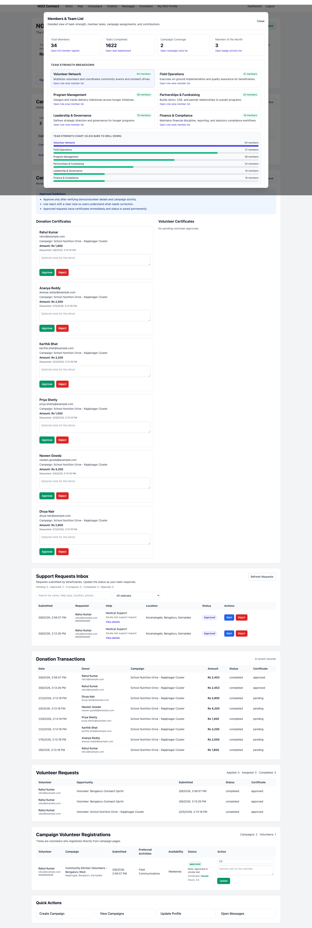
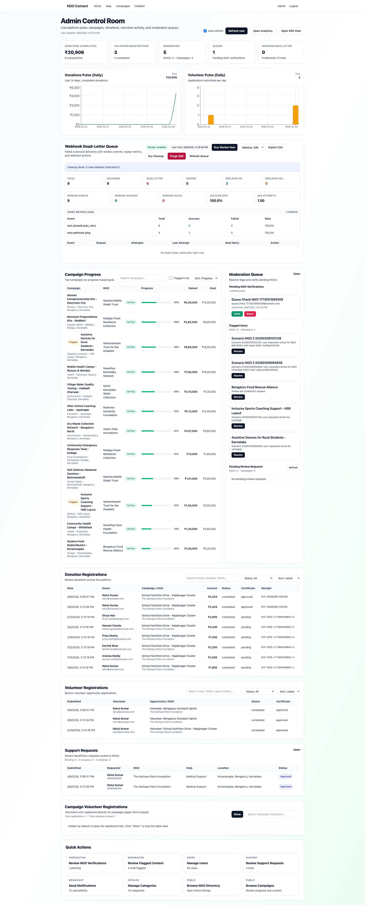
Visual Evidence Snapshot
Screens captured during functional validation runs
NGO dashboard interactive team insight checks
Admin webhook queue + controls validation
NGO-Connect | Architecture, Delivery, and Validation
Slide 21/25

Slide 22
Frontend Application
React 18 SPA with 31+ Pages & Role-Based Routing

Slide 23
Frontend Page Architecture
Public (8+)
User (12+)
Admin (8+)
Home — Landing with hero CTA, helplines, categories
Login / Register — Dual-mode (user + NGO)
NGO List & Profile — Search, filter, tabs, charts
Campaign List & Details — Donation + volunteer flows
Chatbot — AI support with suggested questions
Dashboard — Help requests, donations, volunteers, certs
Donate — Campaign selection, payment, receipts
Volunteer Opportunities — Apply, withdraw, complete
Recommendations — AI-powered with match scores
Innovation Center — Giving Circles, Wishlists, etc.
Dashboard — KPI cards, charts, auto-refresh, SSR viewer
Verifications — NGO approval/rejection queue
Flagged Content — Moderation & flag request review
Webhooks — Delivery logs, metrics, replay
Users / Notifications / Categories / Requests
Components: Navbar • ProtectedRoute • UserRoute • AdminRoute • ConfirmModal • PreferencesModal • RecommendedNgos
NGO-Connect | Architecture, Delivery, and Validation
Slide 23/25

Slide 24
Deployment & Configuration
Backend Environment
Setup Commands
PORT = 5001
POSTGRES_URL = postgresql://...
JWT_SECRET = <strong-secret>
GEMINI_API_KEY = <optional>
PAYMENT_GATEWAY_PROVIDER = mock | razorpay
MAIL_HOST / MAIL_USER / MAIL_PASS = <optional>
RAZORPAY_KEY_ID = <optional>
RAZORPAY_KEY_SECRET = <optional>
WEBHOOK_URL / WEBHOOK_SECRET = <optional>
npm install
npm run db:relational-schema
npm run seed
npm run dev (backend)
npm start (frontend, port 3000)
npm run smoke (API test)
npm run scenario:flood (full workflow)
npm run scenario:roles (moderation flow)
Seed Credentials
Admin: admin@ngoconnect.org / password123
User: rahul@example.com / password123
NGO: akshayapatra@ngo.org / password123
NGO-Connect | Architecture, Delivery, and Validation
Slide 24/25

Slide 25
Thank You
Questions & Discussion
149 Endpoints • 35 Tables • 31+ Pages • AI-Powered Full details: DESIGN_AND_ARCHITECTURE.md

