Slide 1

Social Media Engagement Analysis
Predicting Instagram Engagement Using CRISP-DM
Utsavi Sunil Patel

Slide 2
CRISP-DM Framework
Business Understanding
Data Understanding
Data Preparation
Modeling
Evaluation
Recommendations

Slide 3
Business Understanding
Customer: Instagram followers
Problem: Engagement varies across posts
Why it matters: Engagement = visibility
Goal: Improve engagement strategy

Slide 4
Data Understanding
Dataset: instagram_reach.csv
Features: captions, hashtags, likes, followers
Issues: missing text + time in words

Slide 5
Data Preparation
Cleaned text
Converted time to hours
Created new features:
- caption_length
- hashtag_count
- engagement_rate
- hours_since_posted

Slide 6
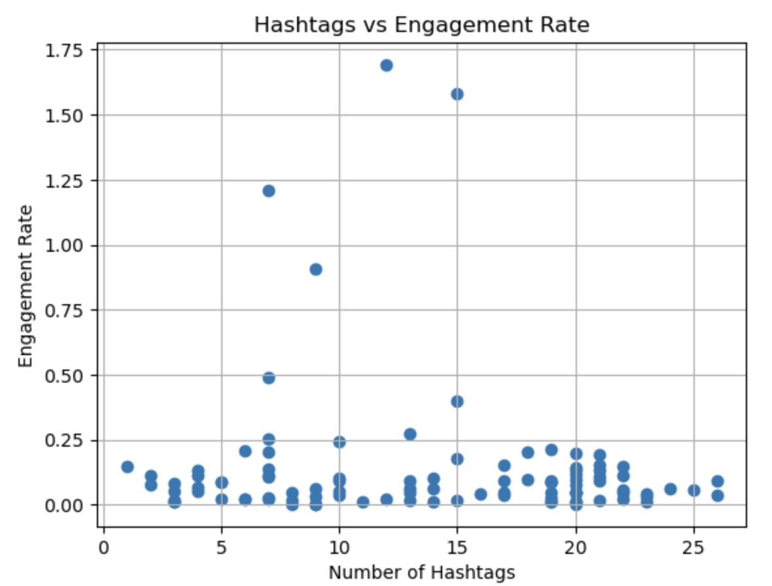
EDA Insight 1 — Hashtags
Weak relationship with engagement
Most posts show low engagement
Some outliers exist

Slide 7
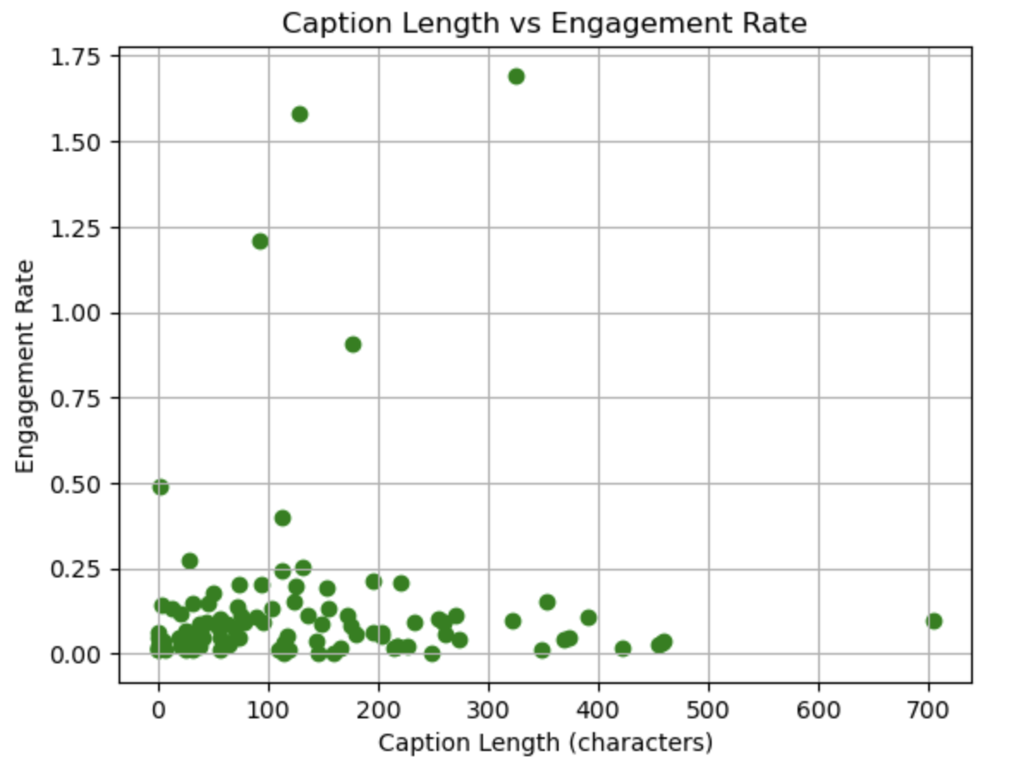
EDA Insight 2 — Caption Length
Very long captions underperform
Weak relationship overall

Slide 8
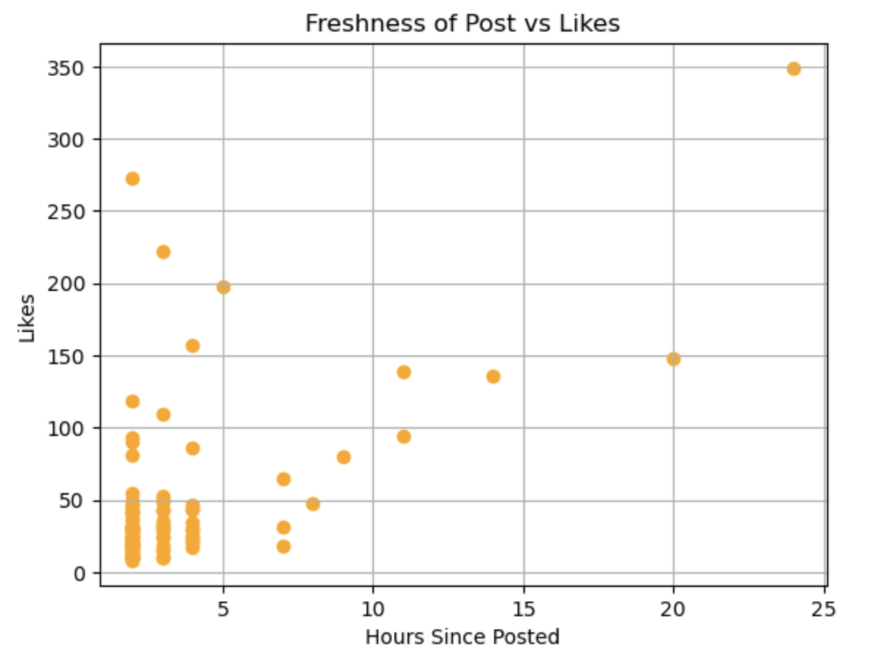
EDA Insight 3 — Timing
Posts in first 0–5 hours get highest likes
Engagement drops after 10 hours

Slide 9
Modeling Approach
Target: High vs Low Engagement
Baseline: Logistic Regression
Improved: Decision Tree
Features: Followers, Hashtag Count, Caption Length, Time

Slide 10
Model Results
Logistic Regression Accuracy: 85%
Decision Tree Accuracy: 70%
Top Predictors:
1. Followers
2. Hours Since Posted
3. Hashtag Count
4. Caption Length

Slide 11
Recommendations
Post during high-activity hours
Grow followers
Use simple captions
Use moderate hashtags

Slide 12
Next Steps
Add post type
Sentiment analysis
Image analysis
Use larger dataset

Slide 13
Conclusion
Engagement mainly driven by timing & followers
Hashtags & captions have limited effect
Clear posting strategy delivered

Slide 14
Thank You

