Slide 1
Trader Performance vs. Bitcoin Market Sentiment
Objective: discover whether sentiment regimes explain trader performance and identify patterns that can improve trading strategy.
July 2026
Notes:
Open with the business question: can market sentiment help explain trader behavior and performance? Explain that the output uses daily sentiment labels joined to intraday trade records.

Slide 2
Executive summary
211K
32
246
Trades analyzed
Accounts
Symbols
$10.30M
$1.19B
104K
99.997%
6
Total Closed PnL
Total Volume
Realized Trades
Sentiment Coverage
Missing Sentiment Rows
Decision-ready interpretation
• Sentiment alone is not enough to predict PnL; account, symbol, side, and trade size explain more variation.
• Greed drives higher activity and better PnL efficiency, but also a lower win rate than Fear.
• Very large trades dominate total PnL; risk controls should focus on size, not only frequency.
• Short/SELL activity performed especially well during Greed; BUY activity performed better during Fear. `
01
Notes:
Use this slide as the main story: Greed is not simply better. It has more PnL and efficiency, while Fear has a higher win rate.

Slide 3
Data understanding
Dataset
Rows
Date range
Key fields
Historical Trader Data
211,224
2023-05-01 to 2025-05-01
account, coin, execution_price, size_usd, side, timestamp_ist, direction, closed_pnl, fee
Fear & Greed Index
2,644
2018-02-01 to 2025-05-02
date, value, classification
Column interpretation
Data quality findings
• Closed PnL is realized profit/loss; many opening trades have zero PnL and should not be treated as losing trades.
• Direction indicates open/close and long/short behavior; Side captures BUY/SELL execution.
• Fear & Greed classification is daily, so it must be joined to trade-level data using trade date.
• No nulls or full duplicate rows in either raw file.
• Date parsing successful for all trader timestamps and sentiment dates.
• Only 6 joined rows were missing sentiment, due to boundary/date coverage mismatch.
• Leverage column was not present in the provided trader file, so leverage analysis is marked as unavailable.
02
Notes:
Emphasize that sentiment is daily while trades are intraday, so the correct join is date-level. Also mention the leverage column missing in the actual input file.

Slide 4
Data cleaning & join methodology
Raw trader trades
Parse timestamp IST
Create trade_date
Left join on date
Final analytical base
Join key: trader_df[Timestamp IST] → trade_date and sentiment_df[date] → sentiment_date. A left join keeps every trade even if sentiment is missing.
Cleaning steps used in Python
• Standardized column names to snake_case.
• Converted Timestamp IST and date into datetime format.
• Mapped 5 sentiment classes into Fear, Greed, and Neutral business groups.
• Converted numeric fields such as size_usd, closed_pnl, fee, and execution_price.
• Created event/position flags from Direction: Open, Close, Long, Short, Other.
03
Notes:
Walk through why a left join is used: trader data is the primary fact table and sentiment is an explanatory dimension.

Slide 5
Feature engineering
Feature family
Features created
Business purpose
PnL performance
total_closed_pnl, avg_pnl, net_pnl, realized_trades
Measure profitability and fee-adjusted performance
Win/loss
is_profit, is_loss, win_rate, loss_rate
Identify quality of outcomes, not only total PnL
Trading behavior
trade_count, buy_share, side, event_type, position_type
Understand how traders behave in sentiment regimes
Risk/scale
size_usd, trade_size_bucket, pnl_per_1k_volume, avg_fee
Separate profitable skill from large notional exposure
Granularity
account, coin, trade_date, week, hour
Enable account, symbol, and time-period segmentation
Important modeling choice: profitability metrics are interpreted on realized trades because opening trades frequently have Closed PnL = 0. Trading frequency and volume use all trades.
04
Notes:
Explain the difference between all trades and realized trades; this avoids calling zero-PnL opening trades losses.

Slide 6
Bitcoin Sentiment vs Trader Performance
Extreme Greed shows the strongest trading edge: highest win rate, highest average PnL, and best efficiency per volume.
211K
total trades
$10.0M
total net PnL
$1.19B
traded volume
Extreme Greed
best efficiency regime
Sr.No | CLASSIFICATION | TOTAL_TRADES | UNIQUE_ACCOUNTS | UNIQUE_SYMBOLS | TOTAL_PNL | TOTAL_NET_PNL | AVG_PNL | MAX_PROFIT | MAX_LOSS | TOTAL_VOLUME_USD | AVG_TRADE_SIZE_USD | PROFIT_TRADES | LOSS_TRADES | ZERO_PNL_TRADES | WIN_RATE_% | LOSS_RATE_% | AVG_PNL_PER_1000_USD_VOLUME
1 | Extreme Fear | 21400 | 32 | 85 | 739110 | 715222 | 35 | 115287 | -31037 | 114484261 | 5350 | 7931 | 2475 | 10994 | 37 | 12 | 6
2 | Extreme Greed | 39992 | 30 | 165 | 2715171 | 2688141 | 68 | 44223 | -10259 | 124465165 | 3112 | 18594 | 2259 | 19139 | 46 | 6 | 22
3 | Fear | 61837 | 32 | 134 | 3357155 | 3264698 | 54 | 135329 | -35682 | 483324790 | 7816 | 26019 | 3789 | 32029 | 42 | 6 | 7
4 | Greed | 50303 | 31 | 193 | 2150129 | 2087031 | 43 | 74531 | -117990 | 288582495 | 5737 | 19358 | 5818 | 25127 | 38 | 12 | 7
5 | Neutral | 37686 | 31 | 147 | 1292921 | 1253546 | 34 | 48504 | -24500 | 180242063 | 4783 | 14961 | 3198 | 19527 | 40 | 8 | 7
Interpretation 1. Extreme Greed is the best quality regime: $2.69M net PnL, 46.49% win rate, and $21.81 PnL per $1k volume. 2. Fear creates the largest absolute profit pool: $3.26M net PnL on the highest volume ($483.3M), but efficiency is only $6.95 per $1k. 3. Greed needs tighter risk control: worst max loss (-$118.0K) and higher loss rate (11.57%). 4. Extreme Fear is the weakest signal: lowest win rate (37.06%) and low efficiency ($6.46 per $1k).
Performance rank: Extreme Greed > Fear > Greed ≈ Neutral > Extreme Fear
05
Strategy takeaway: Increase allocation during Extreme Greed, use Fear for volume-driven opportunities with strict sizing, and reduce exposure/stop-loss limits during Greed and Extreme Fear.
Notes:
Emphasize the trade-off: Greed has more PnL, slightly higher mean realized PnL, and better efficiency, but Fear has a better win rate.

Slide 7
Symbol-level patterns
Top symbols by total PnL within each sentiment regime
Fear: top symbols
Total PnL
Win rate
Greed: top symbols
Total PnL
Win rate
HYPE
$1.32M
88.6%
@107
$2.71M
85.2%
ETH
$0.95M
88.8%
SOL
$0.49M
72.9%
SOL
$0.85M
87.0%
HYPE
$0.33M
93.7%
BTC
$0.49M
86.8%
ETH
$0.31M
63.6%
MELANIA
$0.29M
99.7%
BTC
$0.22M
77.2%
Interpretation
• HYPE is consistently important in both Fear and Greed, but the biggest Greed-period winner is @107.
• BTC had very high volume but not the highest PnL efficiency, suggesting scale without proportional profitability.
• Smaller/meme-style symbols can dominate PnL during specific regimes, so symbol-level controls are essential.
07
Notes:
Discuss how strategy should not treat Bitcoin sentiment as BTC-only. Altcoins had material contribution to PnL.

Slide 8
Account-level patterns
A small number of accounts drive a meaningful share of profit
Sentiment
Account abbreviated
Total PnL
Avg realized PnL
Win rate
Fear
0x0833...9012
$1.24M
$1,138
89.4%
Fear
0xbaaa...7864
$0.88M
$111
98.9%
Fear
0x4acb...b9f4
$0.46M
$509
96.3%
Greed
0xb123...ed23
$1.64M
$488
72.9%
Greed
0xbee1...7aab
$0.72M
$81
82.9%
Greed
0x7274...afbd
$0.45M
$1,686
69.9%
Pattern: some accounts produce high PnL through high average realized profit but lower win rate, while others produce steadier outcomes with very high win rate and smaller average gain.
Strategy use
• Segment accounts into high-alpha / high-volatility vs stable-consistency groups.
• Use account-level historical behavior to set risk limits and sizing recommendations.
• Do not copy strategy from high-PnL accounts without also checking drawdown and loss-tail behavior.
08
Notes:
Explain account segmentation as a trading intelligence layer. Account behavior is likely stronger than sentiment alone.

Slide 9
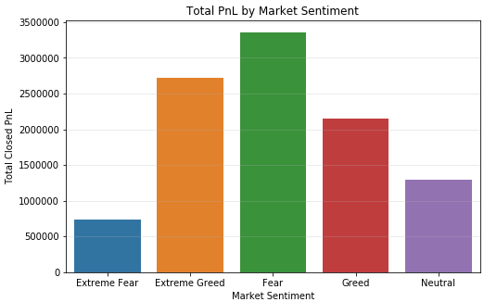
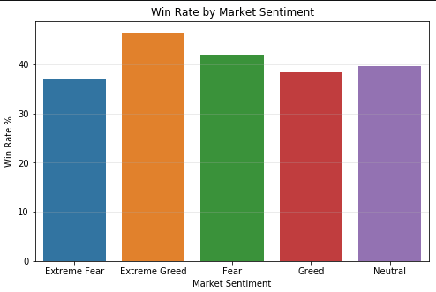
Total PnL and Win Rate by Market Sentiment
Total PnL and Win Rate by Market Sentiment
Fear sentiment generated the highest total PnL, indicating traders earned maximum profit during fearful market conditions. Extreme Fear had the lowest PnL, showing weaker performance in highly uncertain markets
Extreme Greed shows the highest win rate, meaning trades were more successful during strong bullish sentiment. Extreme Fear has the lowest win rate, suggesting higher uncertainty and poor trade accuracy.
Notes:
Mention that the p-values are based on realized non-zero PnL trades to avoid opening trades diluting profitability analysis.

Slide 10
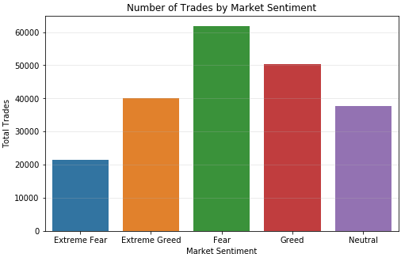
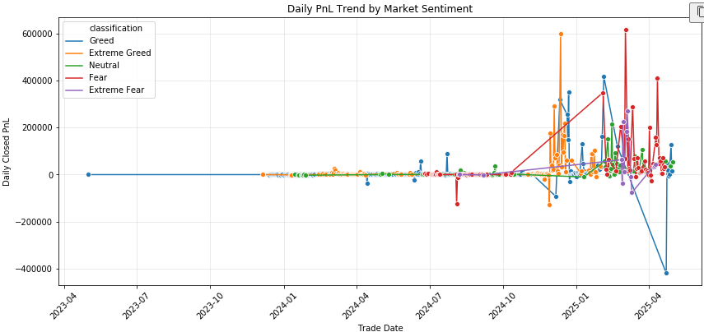
Number of Trades and Daily PnL by Market Sentiment
Fear has the highest number of trades, showing traders were most active during fearful market phases.Extreme Fear has the least trading activity, indicating reduced participation during panic periods.
Daily PnL became highly volatile from late 2024 onward, with large profit and loss spikes across sentiments.Fear and Extreme Greed show strong upside spikes, while Greed also shows a major downside loss, highlighting risk.
Notes:
Use this slide to show that sentiment interacts with execution side. In Greed, SELL/short-side behavior did especially well.

Slide 11
Final conclusion
Conclusion in simple language
• Greed periods delivered more total PnL and better efficiency, but Fear periods delivered a higher realized win rate.
• The average PnL difference between Fear and Greed is not statistically meaningful; the win-rate difference is meaningful.
• A smarter trading strategy should use sentiment as a regime filter, not a direct buy/sell rule.
Deliverable
Included
Clean analytical base
Date-level left join with sentiment labels
EDA + features
PnL, win rate, volume, side, account, symbol, size bucket
Strategy insights
Risk sizing, account segmentation, symbol regime playbooks
13
Notes:
End by making the final message crisp: sentiment is a useful context variable, but strategy needs a multivariate view.

