Slide 1
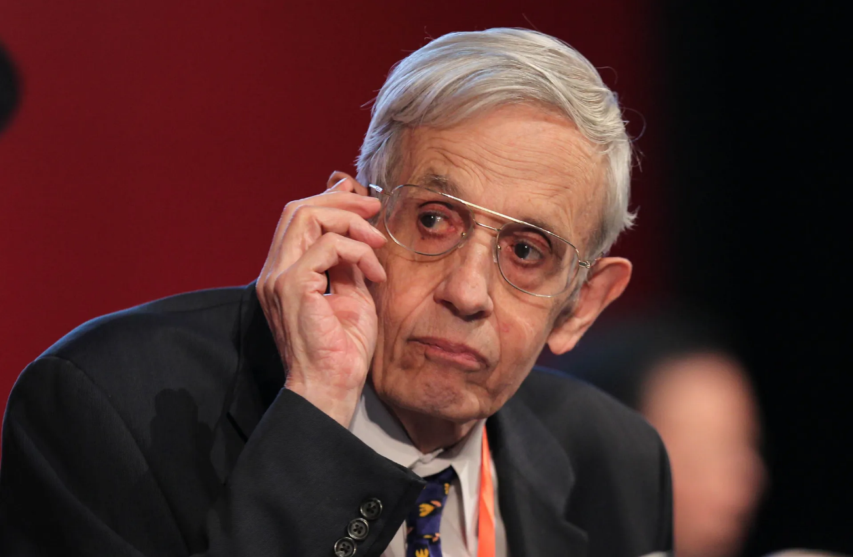
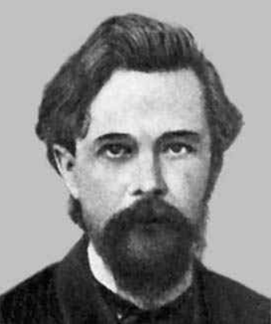
CSCD84: Artificial Intelligence
Tutorial Week 6: Simultaneous Games and MDP
John Forbes Nash Jr.
Andrei Andreyevich Markov
Erfan Meskar
Winter 2024, University of Toronto, Scarborough
[These slides were adapted from Dan Klein and Pieter Abbeel (ai.berkeley.edu), Francisco Estrada, Bahar Aameri and Sonya Allin, Fahiem Bacchus, David Poole and Alan Mackworth, Percy Liang and Dorsa Sadigh, Lisa Jing Yan, Cesare Tinelli, Dieter Fox, and Dan Weld.]

Slide 2
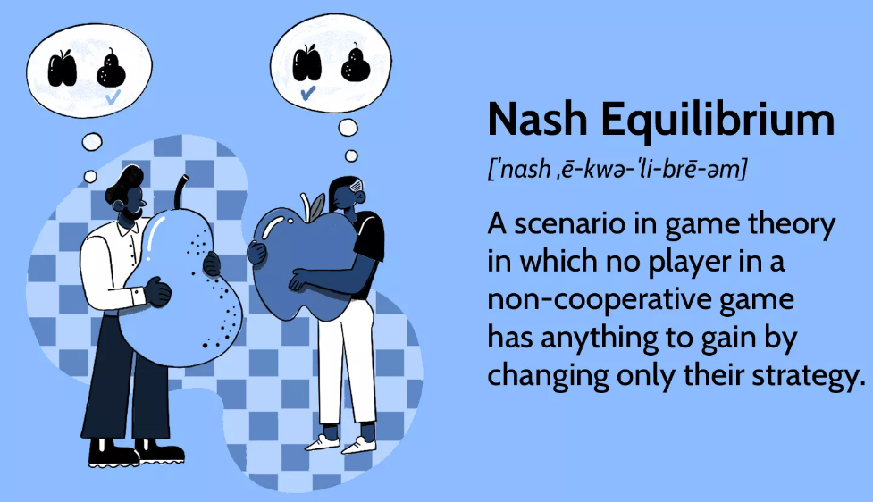
Today
Finding Pure and Mixed Nash Equilibrium
Solving MDPs

Slide 3
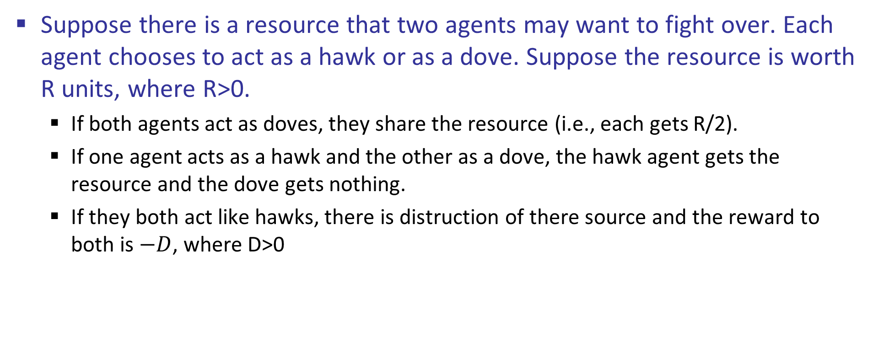
Example: Dove Hawk Game
Suppose there is a resource that two agents may want to fight over. Each agent chooses to act as a hawk or as a dove. Suppose the resource is worth R units, where R>0.
If both agents act as doves, they share the resource (i.e., each gets R/2).
If one agent acts as a hawk and the other as a dove, the hawk agent gets the resource and the dove gets nothing.
If they both act like hawks, there is distruction of there source and the reward to both is $−D$, where D>0

Slide 4
Example: Dove Hawk Game
Show the payoff matrix for this dove hawk game.
 |  | Agent 2
 |  | Dove | Hawk
Agent 1 | Dove | R/2, R/2 | 0, R
 | Hawk | R, 0 | -D, -D

Slide 5

Example: Dove Hawk Game – Pure NEs
Is there any Pure Nash Equilibrium (NE) in this game? If yes, specify them.
One Pure NE is agent 1 acts as Hawk and agent 2 acts as Dove. Nobody has any incentive to deviate
$π_{A}^{NE}=(1, 0)$ and $π_{B}^{NE}=(0, 1)$
Another Pure NE is agent 1 acts as Dove and agent 2 acts as Hawk.
$π_{A}^{NE}=(0, 1)$ and $π_{B}^{NE}=(1, 0)$
 |  | Agent 2
 |  | Dove | Hawk
Agent 1 | Dove | R/2, R/2 | 0, R
 | Hawk | R, 0 | -D, -D
Agent 2 wants to deviate
Agent 1 wants to deviate
Agent 1 wants to deviate
Agent 2 wants to deviate

Slide 6
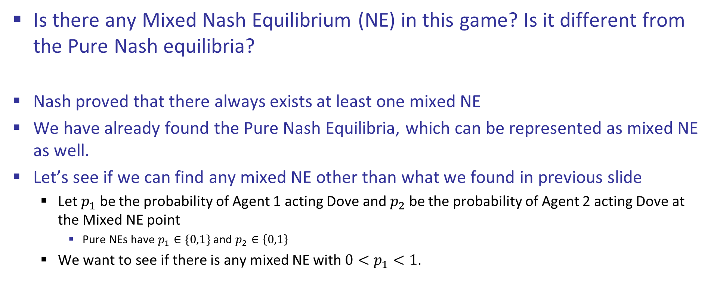
Example: Dove Hawk Game – Mixed NEs
Is there any Mixed Nash Equilibrium (NE) in this game? Is it different from the Pure Nash equilibria?
Nash proved that there always exists at least one mixed NE
We have already found the Pure Nash Equilibria, which can be represented as mixed NE as well.
Let’s see if we can find any mixed NE other than what we found in previous slide
Let $p_{1}$ be the probability of Agent 1 acting Dove and $p_{2}$ be the probability of Agent 2 acting Dove at the Mixed NE point
Pure NEs have $p_{1}∈\{0,1\}$ and $p_{2}∈\left\{0,1\right\}$
We want to see if there is any mixed NE with ${0<p}_{1}<1$.
 |  | Agent 2
 |  | Dove | Hawk
Agent 1 | Dove | R/2, R/2 | 0, R
 | Hawk | R, 0 | -D, -D

Slide 7
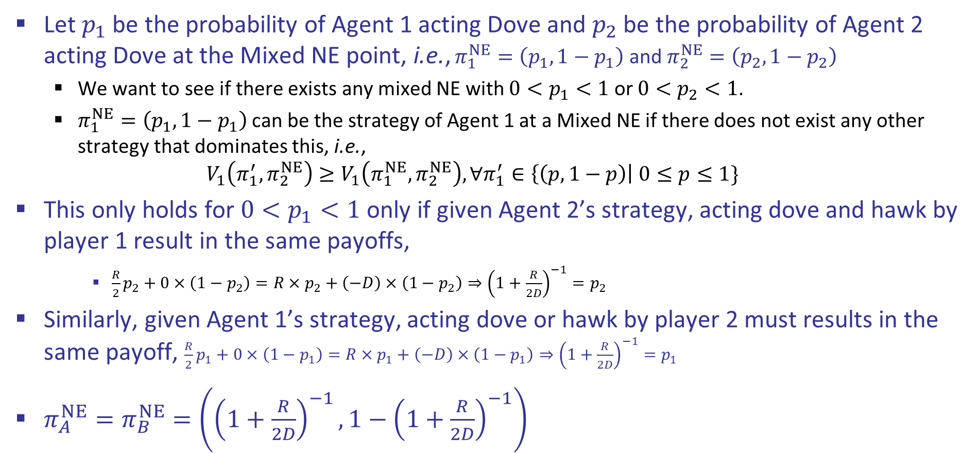
Example: Dove Hawk Game – Mixed NEs
Let $p_{1}$ be the probability of Agent 1 acting Dove and $p_{2}$ be the probability of Agent 2 acting Dove at the Mixed NE point, i.e., $π_{1}^{NE}=\left(p_{1}, 1−p_{1}\right)$ and $π_{2}^{NE}=\left(p_{2}, 1−p_{2}\right)$
We want to see if there exists any mixed NE with ${0<p}_{1}<1$ or ${0<p}_{2}<1$.
$π_{1}^{NE}=\left(p_{1}, 1−p_{1}\right)$can be the strategy of Agent 1 at a Mixed NE if there does not exist any other strategy that dominates this, i.e.,
$$V_{1}\left(π_{1}^{′},π_{2}^{NE}\right)≥V_{1}\left(π_{1}^{NE},π_{2}^{NE}\right), ∀π_{1}^{′}∈\left\{\left(p, 1−p\right)\right| 0≤p≤1\}$$
This only holds for ${0<p}_{1}<1$ only if given Agent 2’s strategy, acting dove and hawk by player 1 result in the same payoffs,
$\frac{R}{2}p_{2}+0×\left(1−p_{2}\right)=R×p_{2}+\left(−D\right)×\left(1−p_{2}\right)⇒{\left(1+\frac{R}{2D}\right)}^{−1}=p_{2}$
Similarly, given Agent 1’s strategy, acting dove or hawk by player 2 must results in the same payoff, $\frac{R}{2}p_{1}+0×\left(1−p_{1}\right)=R×p_{1}+\left(−D\right)×\left(1−p_{1}\right)⇒{\left(1+\frac{R}{2D}\right)}^{−1}=p_{1}$
$π_{A}^{NE}=π_{B}^{NE}=\left({\left(1+\frac{R}{2D}\right)}^{−1}, 1−{\left(1+\frac{R}{2D}\right)}^{−1}\right)$

Slide 8
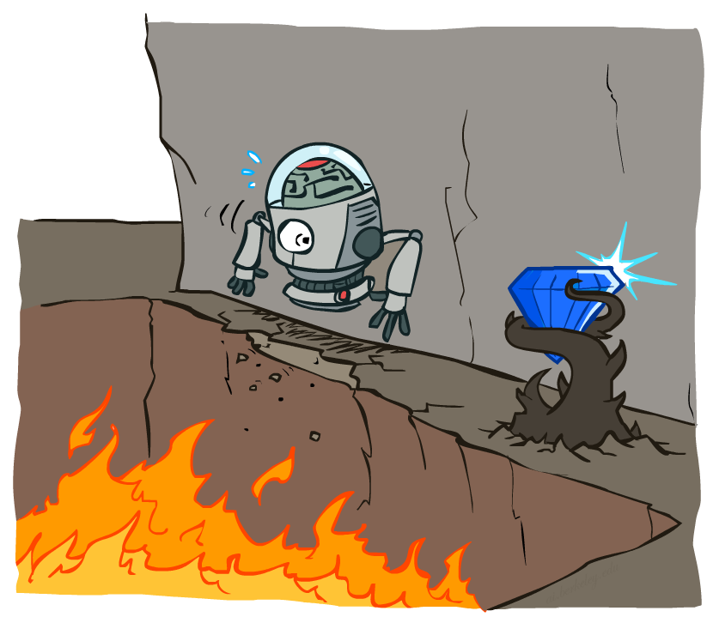
Today
Finding Pure and Mixed Nash Equilibrium
Solving MDPs

Slide 9
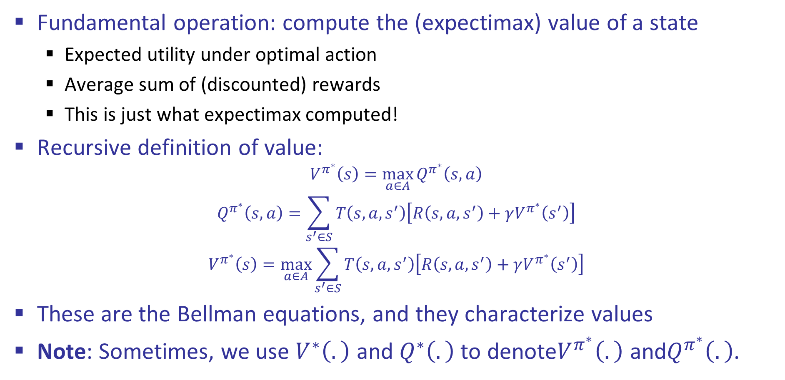
Values of States
Fundamental operation: compute the (expectimax) value of a state
Expected utility under optimal action
Average sum of (discounted) rewards
This is just what expectimax computed!
Recursive definition of value:
$$V^{π^{∗}}\left(s\right)=\max_{a∈A}{Q^{π^{∗}}\left(s,a\right)}$$
$$Q^{π^{∗}}\left(s,a\right)=\sum_{s^{′}∈S}{T\left(s,a,s^{′}\right)\left[R\left(s,a,s^{′}\right)+γV^{π^{∗}}\left(s^{′}\right)\right]}$$
$$V^{π^{∗}}\left(s\right)=\max_{a∈A}{\sum_{s^{′}∈S}{T\left(s,a,s^{′}\right)\left[R\left(s,a,s^{′}\right)+γV^{π^{∗}}\left(s^{′}\right)\right]}}$$
These are the Bellman equations, and they characterize values
Note: Sometimes, we use $V^{∗}\left(.\right)$ and $Q^{∗}\left(.\right)$ to denote$V^{π^{∗}}\left(.\right)$ and$Q^{π^{∗}}\left(.\right)$.
s
a
s, a
s,a,s’
s’

Slide 10
Value Iteration
Start with V₀(s) = 0: no time steps left means an expected reward sum of zero
Given vector of V_{k}(s) values, do one ply of expectimax from each state:
Repeat until convergence
Value iteration is just a fixed point solution method
… though the V_{k} vectors are also interpretable as time-limited values
Complexity of each iteration: O(S²A)
Theorem: will converge to unique optimal values
Basic idea: approximations get refined towards optimal values
Policy may converge long before values do
V_{k+1}(s)
a
s, a
s,a,s’
V_{k}(s’)

Slide 11

Example: Discounting
Given:
Actions:
States b, c, and: East, West
States a and e: Exit
Transitions: deterministic
The values above show the reward for the exit action
Zero rewards for West or East
Q1: For γ = 1, what is the optimal policy?
Q2: For γ = 0.1, what is the optimal policy?
Q3: For which γ are West and East equally good when in state d?

Slide 12

Example: Discounting
Q1: For γ = 1, what is the optimal policy?
0+10
0+0+10
0+0+0+10

Slide 13
Example: Discounting
Q2: For γ = 0.1, what is the optimal policy?
0.1x10
0.01x10
0.001x10

Slide 14

Example: Discounting
Q3: For which γ are West and East equally good when in state d?
$${10γ}^{3}=γ⇒γ=\sqrt{0.1}$$

Slide 15
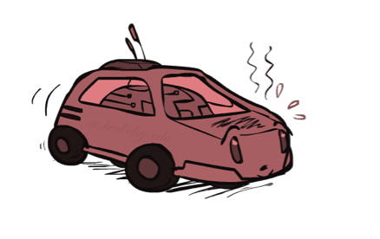
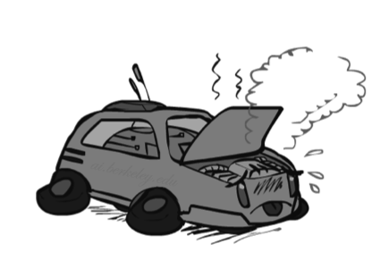
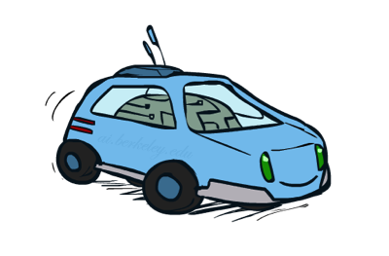
Example: Racing
A robot car wants to travel far, quickly
Three states: Cool, Warm, Overheated
Two actions: Slow, Fast
Going faster gets double reward
0.5
+1
1.0
Fast
Slow
-10
+1
0.5
Warm
Slow
Fast
0.5
+2
Cool
0.5
Overheated
+1
1.0
+2

Slide 16

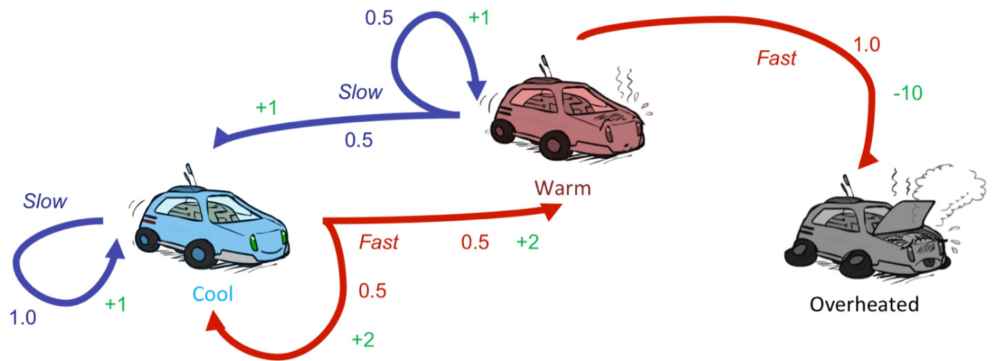
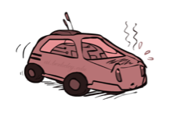
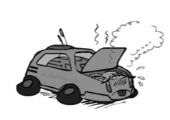
Example: Racing MDP
s | a | s' | T(s,a,s’) | R(s,a,s’)
 | Slow |  | 1.0 | +1
 | Fast |  | 0.5 | +2
 | Fast |  | 0.5 | +2
 | Slow |  | 0.5 | +1
 | Slow |  | 0.5 | +1
 | Fast |  | 1.0 | –10
 | (end) |  | 1.0 | 0

Slide 17

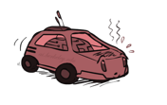
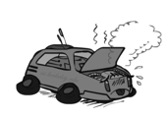

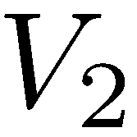
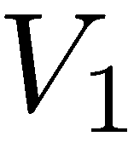
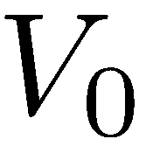

Example: Racing MDP Value Iteration
$$V_{3}$$
5 3.5 0
3.5 2.5 0
Assume no discount!
2 1 0
0 0 0

