Slide 1
Independence in a Bayes Net
Another piece of information we can obtain from a Bayes net is the “structure” of relationships in the domain.
The structure of the BN means: every X_{i} is conditionally independent of all of its nondescendants given it parents:
Pr(X_{i} | S ∪ Par(X_{i})) = Pr(X_{i} | Par(X_{i}))
for any subset S ⊆ NonDescendents(X_{i})
1

Slide 2
More generally
Many conditional independencies hold in a given BN.
These independencies are useful in computation, explanation, etc.
Some of these independencies can be detected using a graphical condition called D-Separation.
2

Slide 3
More generally…
How do we determine if two variables X, Y are independent given a set of variables E?
Simple graphical property: D-separation
A set of variables E d-separates X and Y if it blocks every undirected path in the BN between X and Y. (We'll define blocks next.)
X and Y are conditionally independent given evidence E
if E d-separates X and Y
Thus, BN gives us an easy way to tell if two variables are independent (set E = ∅) or cond. independent given E.
3

Slide 4
Blocking in D-Separation
Let P be an undirected path from X to Y in a BN. Let E (evidence) be a set of variables.
We say E blocks path P
iff there is some node Z on the path P such that:
Case 1: Z∊E and one arc on P enters (goes into)
Z and one leaves (goes out of) Z; or
Case 2: Z∊E and both arcs on P leave Z; or
Case 3: both arcs on P enter Z and
neither Z, nor any of its descendents, are in E.
4

Slide 5
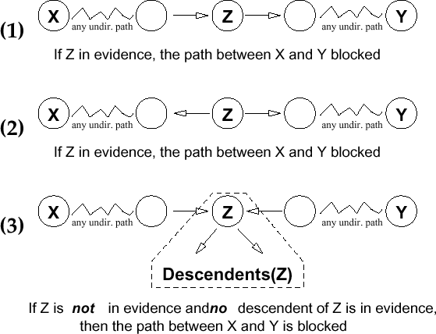
Blocking: Graphical View
5

Slide 6
Recall: D-Separation
D-separation:
A set of variables E d-separates X and Y if it blocks every undirected path
in the BN between X and Y.
6

Slide 7
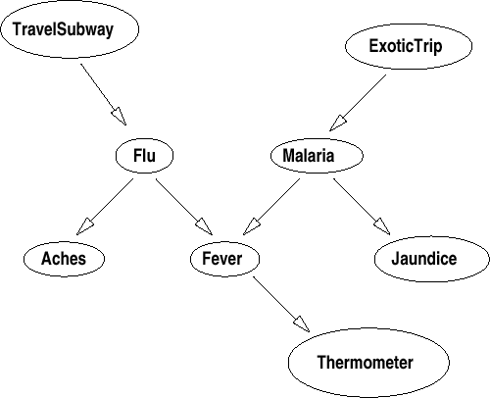
D-Separation: Intuitions
Subway and
Thermometer are dependent;
but are independent given Flu (since
Flu blocks the only path)
7

Slide 8
D-Separation: Intuitions
Aches and Fever
are dependent; but are independent
given Flu (since Flu blocks the only path). Similarly, for
Aches and Therm (dependent, but
indep. given Flu).
8

Slide 9
D-Separation: Intuitions
Flu and Mal are
independent (given no evidence): Fever
blocks the path, since it is not in evidence, nor is its decsendant Therm.
Flu and Mal are dependent given Fever (or given
Therm): nothing blocks path now.
What’s the intuition?
9

Slide 10
D-Separation: Intuitions
Subway, ExoticTrip are independent;
They are dependent given Therm;
They are independent given Therm and Malaria. This for exactly the same reasons for Flu/Mal above.
10

Slide 11
D-Separation Example
In the following network determine if A and E are independent given the evidence:
A
A and E given no evidence?
A and E given {C}?
A and E given {G,C}?
A and E given {G,C,H}?
A and E given {G,F}?
A and E given {F,D}?
A and E given {F,D,H}?
A and E given {B}?
G
C
H
D
F
9. A and E given {H,B}?
B
10. A and E given {G,C,D,H,D,F,B}?
E
11

Slide 12
D-Separation Example
In the following network determine if A and E are independent given the evidence:
A
A and E given no evidence? No
A and E given {C}? No
A and E given {G,C}? Yes
A and E given {G,C,H}? Yes
A and E given {G,F}? No
A and E given {F,D}? Yes
A and E given {F,D,H}? No
A and E given {B}? Yes
A and E given {H,B}? Yes
G
C
H
D
F
B
10. A and E given {G,C,D,H,D,F,B}? Yes
E
12

