Slide 1
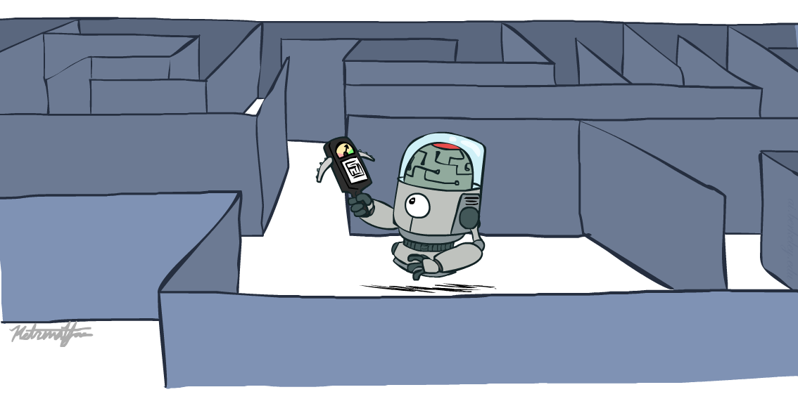
CSCD84: Artificial Intelligence
Tutorial Week 3: Search – Complementary Material
[P&M, 3.5.3, 3.8.1, 3.8.2]
Erfan Meskar
Winter 2024, University of Toronto, Scarborough
[These slides were adapted from Dan Klein and Pieter Abbeel (ai.berkeley.edu), Francisco Estrada, Bahar Aameri and Sonya Allin, Fahiem Bacchus, David Poole and Alan Mackworth, Percy Liang and Dorsa Sadigh, Lisa Jing Yan, Cesare Tinelli, Dieter Fox, and Dan Weld.]

Slide 2

🧑 Who am I?
Aditya Kulkarni (Adi)
4th Year CS – Entrepreneurship
Co-Pres @ DS3
Previously
PM @ TribalScale x McCain
QA Automation @ theScore
APM @ CMS UTSC
Tutor @ Varsity Tutors
What else?
Music Enthusiast – Indian Classical Music
Love Cooking
Started Watching Anime – OP @ 960, JJK @ 14, AOT, DS, SpyXFam

Slide 3
📅 Today
Part 1: Complementary Material
Iterative-deepening Complexity
Search Refinements:
Direction of Search and Bidirectional Search
Island Driven Search
Part 2: BFS, DFS, UCS, and A* Extra Examples

Slide 4
🔎 Iterative-deepening Search
Iterative-deepening search:
Start with a bound k = 0
Do a bounded depth-first search with bound k.
If a solution is found return that solution
Otherwise increment k and repeat
This will find the same first solution as what other method?
BFS
How much space is used?
O(bd)
Surely recomputing paths is wasteful!!!
Let’s see …
Notes:
For any search problem, you know the goal. Now, you have an idea of how far away you are from the goal.

Slide 5
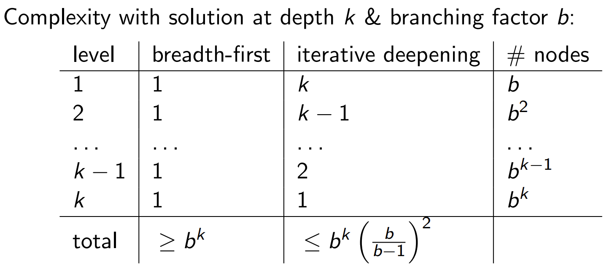

🧮 Iterative-deepening Complexity
Thus, Iterative Deepening has an asymptotic overhead of $\frac{b}{b−1}$ times the cost of expanding the paths at depth k using BFS.
Notes:
For any search problem, you know the goal. Now, you have an idea of how far away you are from the goal.

Slide 6
📅 Today
Part 1: Complementary Material
Iterative Deepening Complexity
Search Refinements:
Direction of Search and Bidirectional Search
Island Driven Search
Part 2: BFS, DFS, UCS, and A* Extra Examples

Slide 7
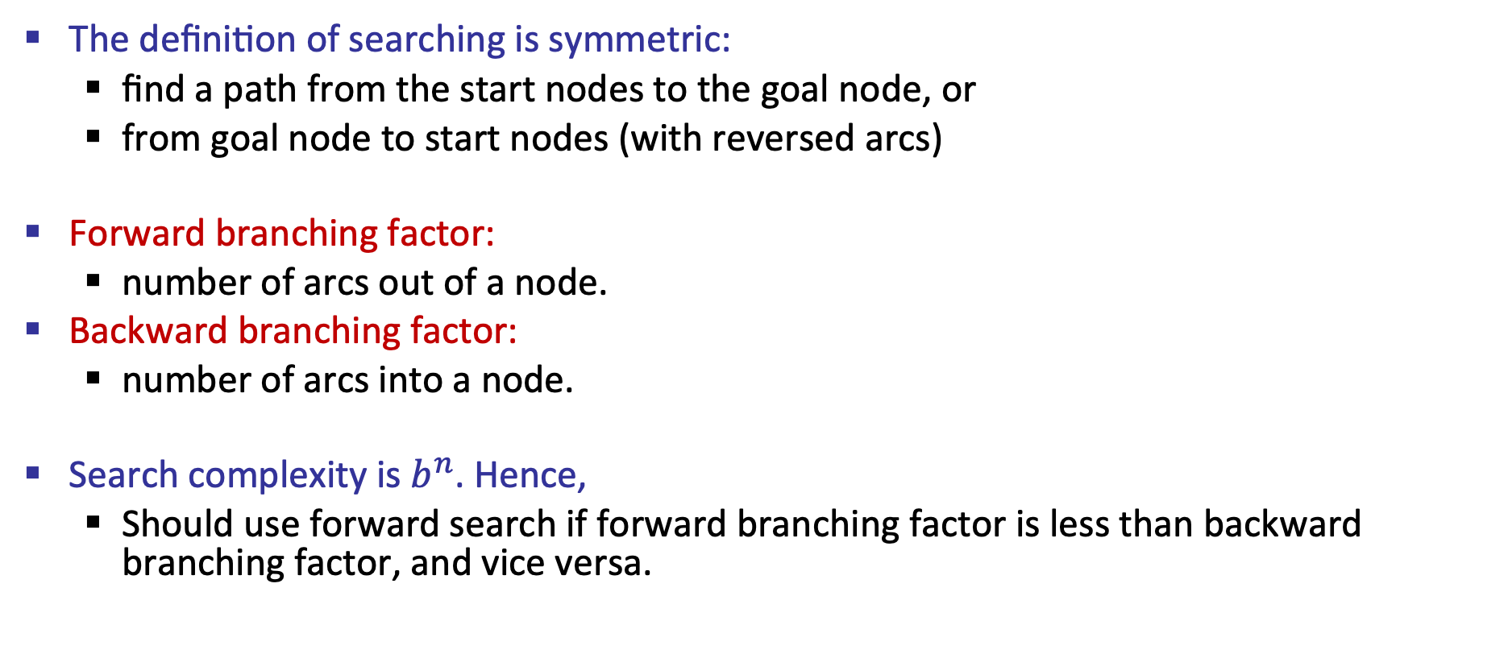
⬆️ Direction of Search
The definition of searching is symmetric:
find a path from the start nodes to the goal node, or
from goal node to start nodes (with reversed arcs)
Forward branching factor:
number of arcs out of a node.
Backward branching factor:
number of arcs into a node.
Search complexity is $b^{n}$. Hence,
Should use forward search if forward branching factor is less than backward branching factor, and vice versa.
Notes:
For any search problem, you know the goal. Now, you have an idea of how far away you are from the goal.

Slide 8
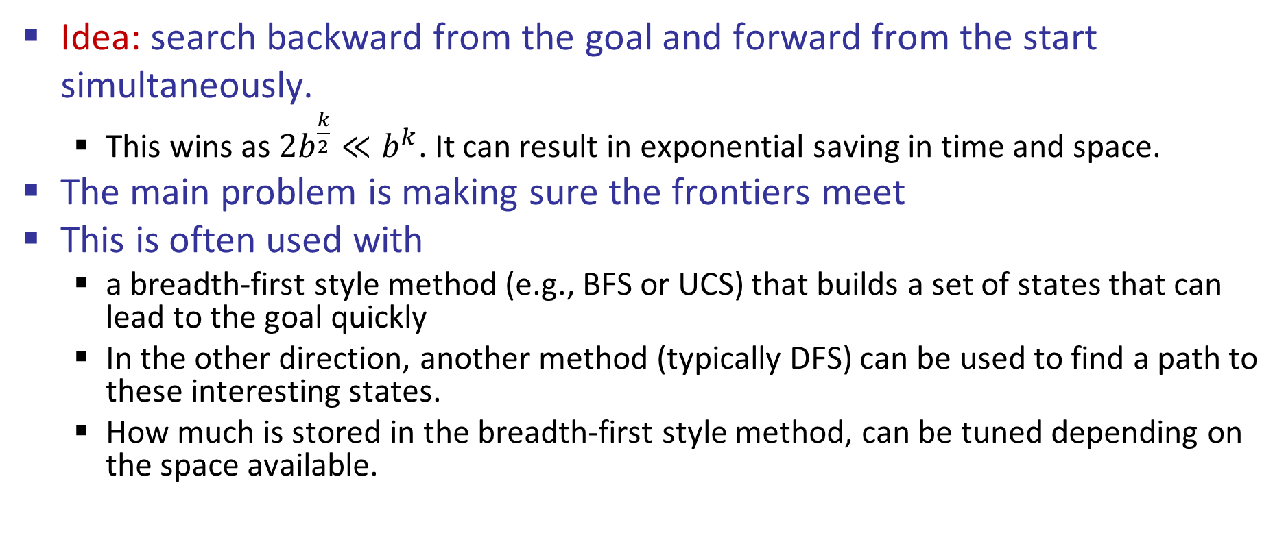
🔎 Bidirectional Search
Idea: search backward from the goal and forward from the start simultaneously.
This wins as $2b^{\frac{k}{2}}≪b^{k}$. It can result in exponential saving in time and space.
The main problem is making sure the frontiers meet
This is often used with
a breadth-first style method (e.g., BFS or UCS) that builds a set of states that can lead to the goal quickly
In the other direction, another method (typically DFS) can be used to find a path to these interesting states.
How much is stored in the breadth-first style method, can be tuned depending on the space available.
Notes:
For any search problem, you know the goal. Now, you have an idea of how far away you are from the goal.

Slide 9
📅 Today
Part 1: Complementary Material
Iterative Deepening Complexity
Search Refinements:
Direction of Search and Bidirectional Search
Island Driven Search
Part 2: BFS, DFS, UCS, and A* Extra Examples

Slide 10
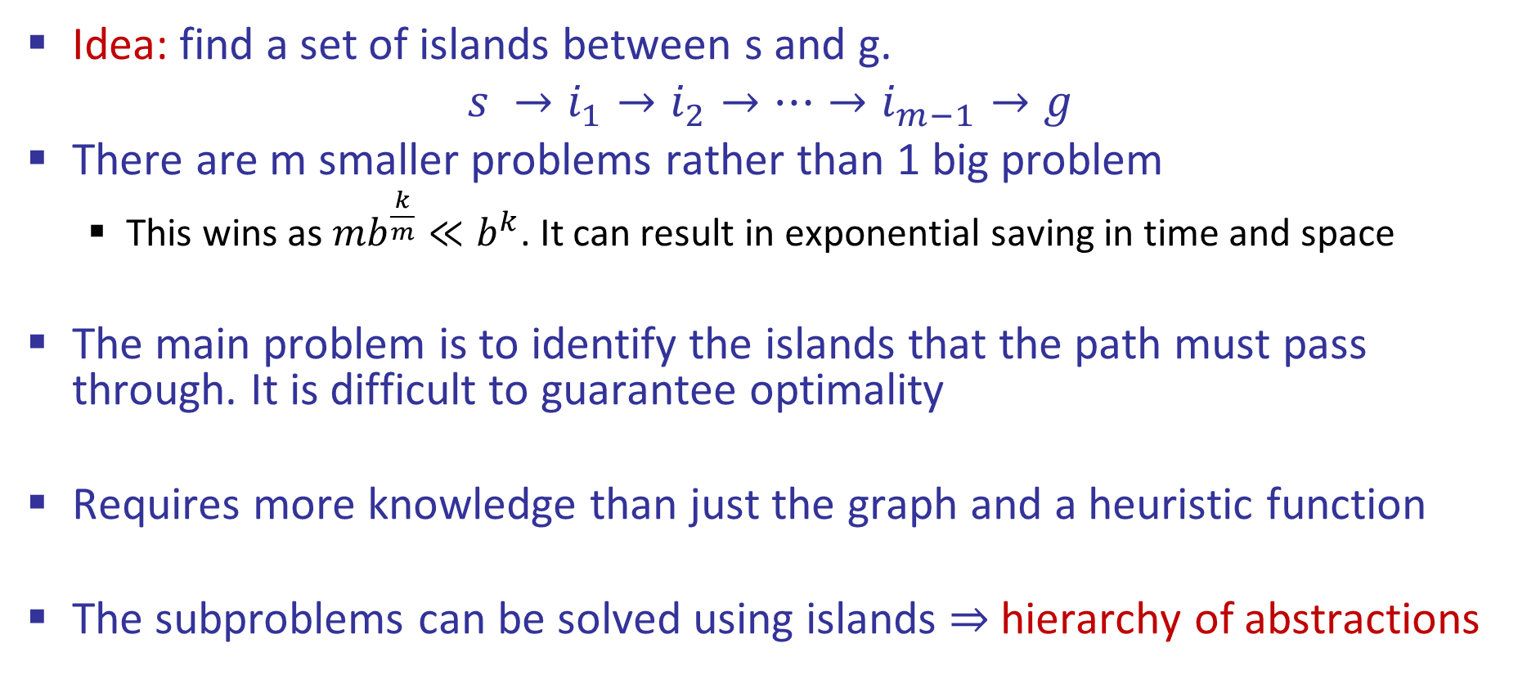
🔎 Island Driven Search
Idea: find a set of islands between s and g.
$$s →i_{1}→i_{2}→…→i_{m−1}→g$$
There are m smaller problems rather than 1 big problem
This wins as $mb^{\frac{k}{m}}≪b^{k}$. It can result in exponential saving in time and space
The main problem is to identify the islands that the path must pass through. It is difficult to guarantee optimality
Requires more knowledge than just the graph and a heuristic function
The subproblems can be solved using islands $⇒$hierarchy of abstractions
Notes:
For any search problem, you know the goal. Now, you have an idea of how far away you are from the goal.

Slide 11
📅 Today
Part 1: Complementary Material
Iterative Deepening Complexity
Search Refinements:
Direction of Search and Bidirectional Search
Island Driven Search
Part 2: BFS, DFS, UCS, and A* Extra Examples

Slide 12
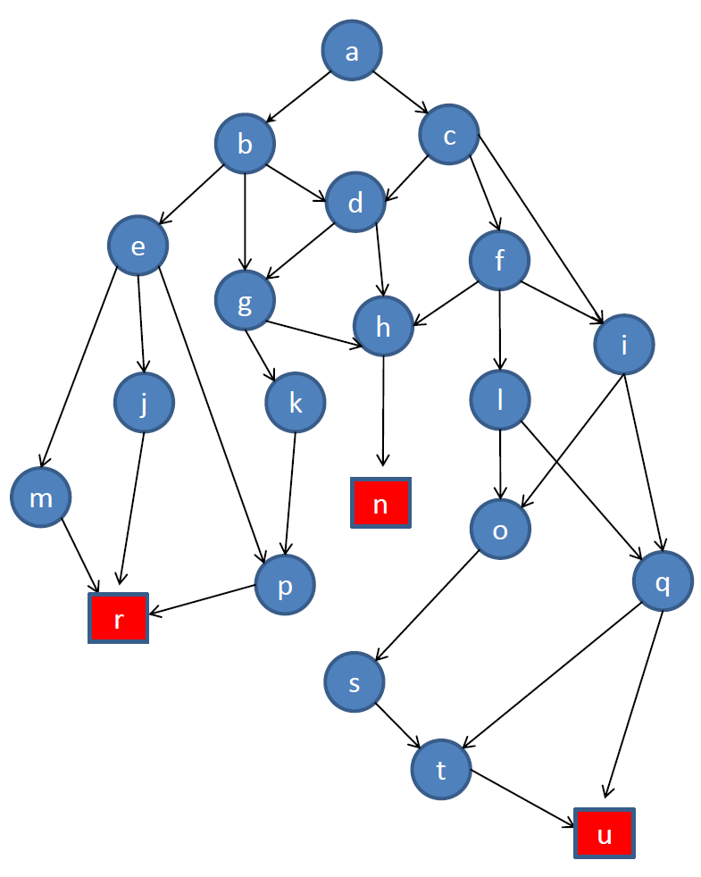
🏋️‍♂️ Extra Examples
In what order are the nodes in this search tree expanded by BFS? (assume a node’s children are expanded left-to-right)
Which goal node is returned by BFS?
In what order are nodes expanded by DFS? (for nodes at the same level assume left-to-right order)
Which goal node is returned by DFS
Goal nodes are red squares. Show the queue (BFS) or stack (DFS) of nodes to be expanded at each step
Notes:
For any search problem, you know the goal. Now, you have an idea of how far away you are from the goal.

Slide 13
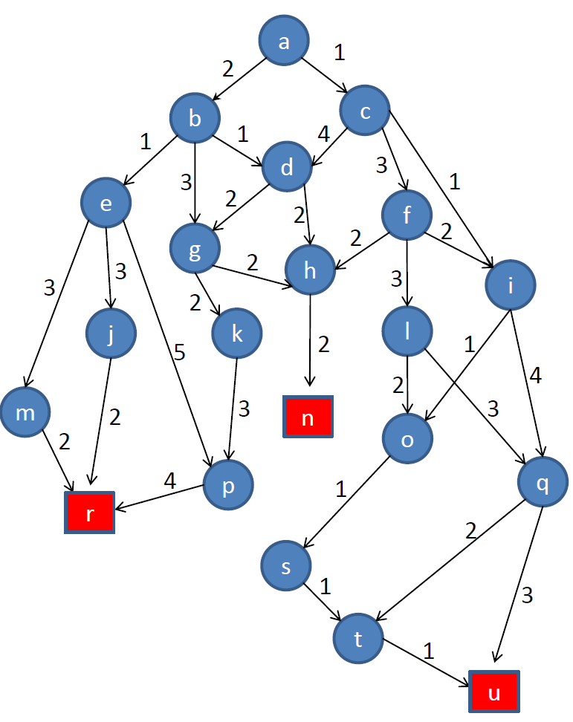
🏋️‍♂️ Extra Examples
In what order are the nodes in this search tree expanded by UCS?
List the path from a to the optimal goal found by UCS.
Goal nodes are red squares. Keep track of known shortest distances from node a at each step.
Notes:
For any search problem, you know the goal. Now, you have an idea of how far away you are from the goal.

Slide 14

🏋️‍♂️ Extra Examples
In what order are the nodes in this search tree expanded by A*?
List the path from a to the optimal goal found by A*.
Is this the optimal goal?
Is the heuristic admissible?
Goal nodes are red squares.
Notes:
For any search problem, you know the goal. Now, you have an idea of how far away you are from the goal.

Slide 15

🎥 Movie Recommendation
The Imitation Game (2014)
- Adapted from the book
Alan Turing: The Enigma (1983)
- Name of his paper
Can Machines Think? (1950)
- Setting
End of WWII (Application of Cryptography)

