Slide 1

Canadian Bank Risk Credit Analysis
Presented: Chris Cao

Slide 2
Background
Around 41% of surveyed Canadians took out a personal loan to buy a car.
13% of Canadians get personal loans to pay off their credit cards.
More than three million Canadians have home equity lines of credit.
73% of Canadians had some type of outstanding debt.
Around 15% of Canadians use personal loans for debt consolidation.

Slide 3
Problem
Solution
How capable each loan applicant
is of repaying a loan?
Build machine learning models
to predict probability of default (POD)

Slide 4
Datasets
01
02
03
04
05
06
Application
Bureau Credit
Installment
Credit Card
Point of Sale
Previous Application

Slide 5
Analysis Workflow
Model Development/
Testing
Feature Engineering
Exploratory Data Analysis
Data Preprocessing

Slide 6
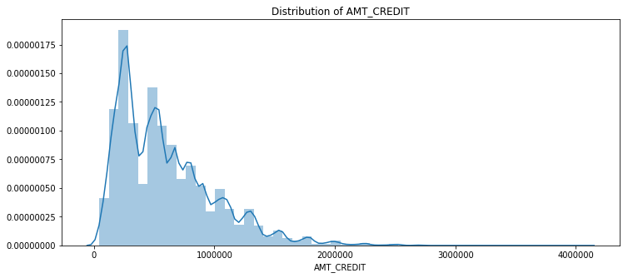
Exploratory Data Analysis

Slide 7
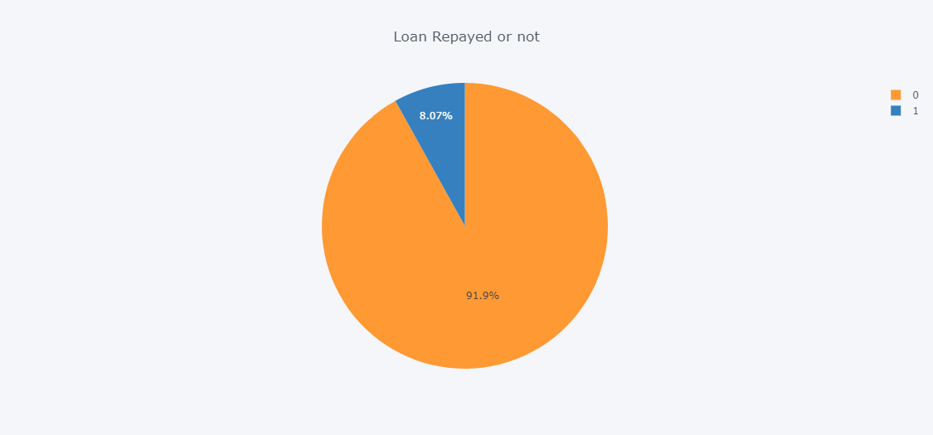
Exploratory Data Analysis
8.1%

Slide 8
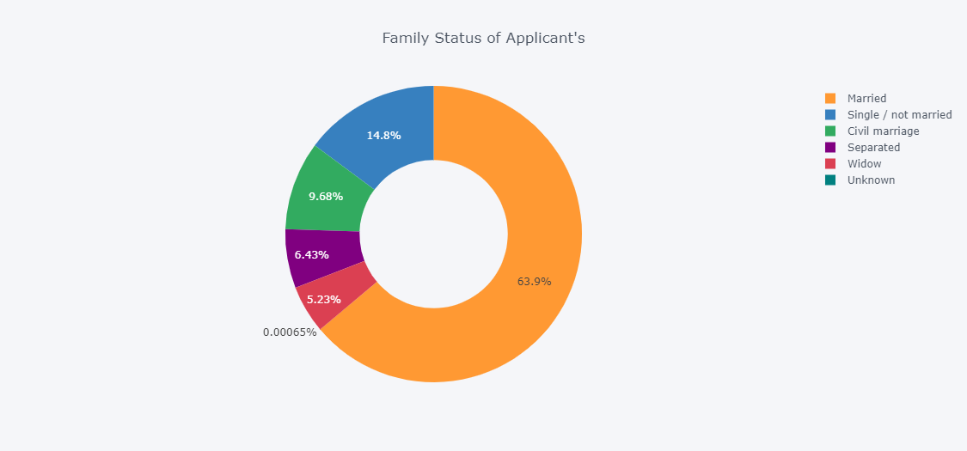
Exploratory Data Analysis

Slide 9
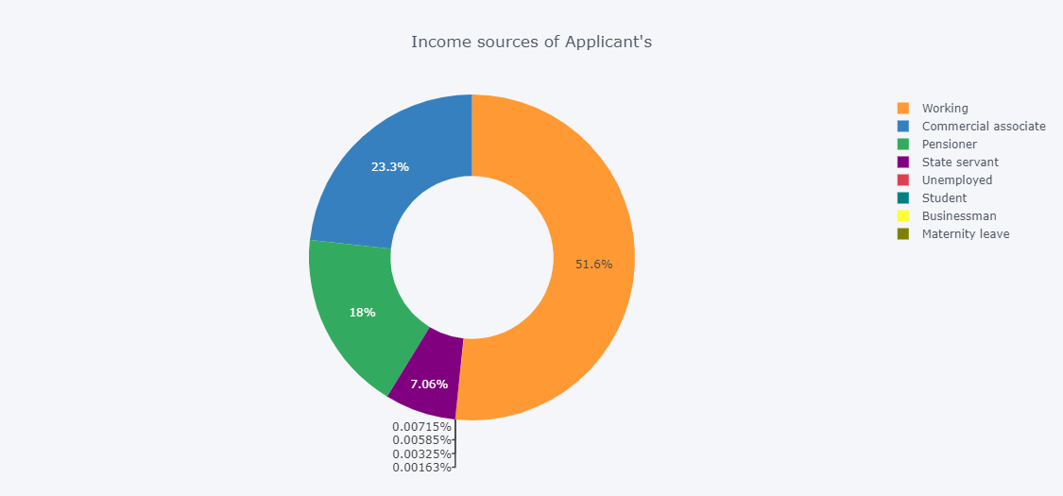
Exploratory Data Analysis

Slide 10
Data Pre-processing / Feature Engineering
Outlier/Missing Data/Correlation Analysis
Calculate New Features & Data Aggregation
One-hot encoder/label encoder
Data Integration (307511 rows, 947 features)

Slide 11
ML Model
Model – LightGBM with 5-fold CV
Why? – Speed, Memory Usage, Accuracy
Class Imbalance problem: Down-sampling (75:25)
Hyperparameter Tuning: Bayesian Optimization

Slide 12
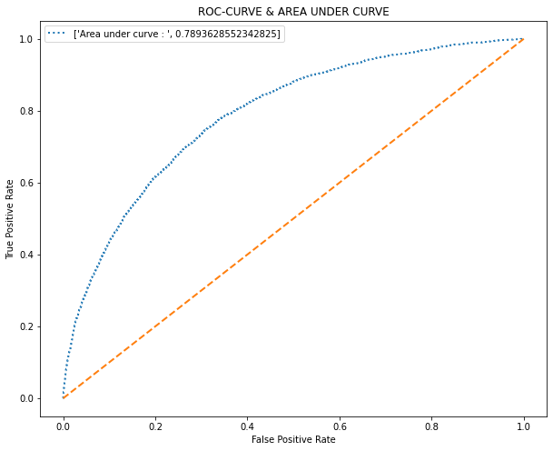
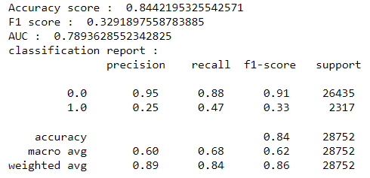
Model Result

Slide 13
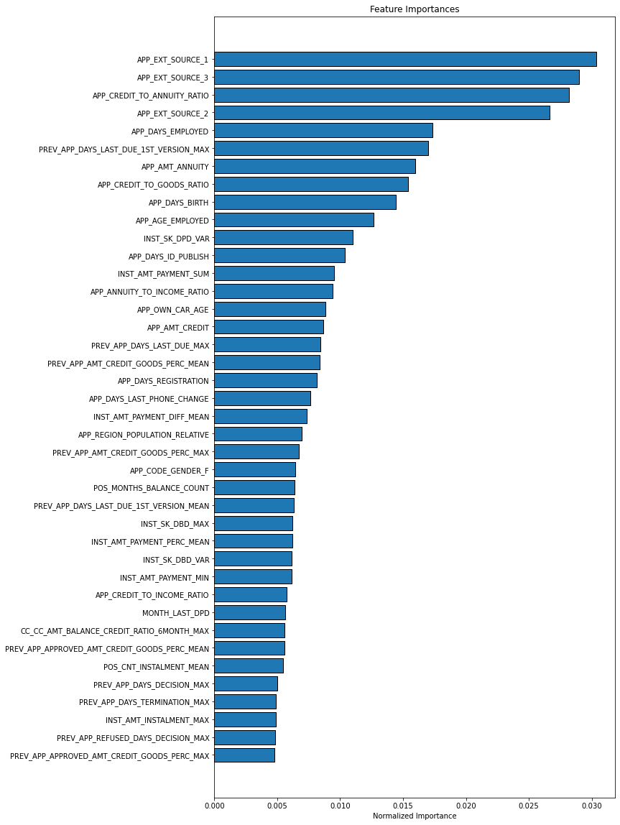
Feature Importance

Slide 14
What’s next?
Train GRU/LSTM models on pos-cash, credit card, bureau, installment to calculate credit scores
Try out and build multiple classification models and apply bagging method to prevent
Gather more data – for example macroeconomics data

Slide 15

Thank you! Q&A

Slide 16

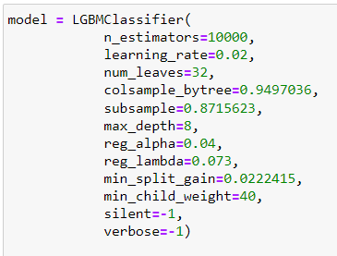
Appendix - LightGBM

Slide 17
Appendix – Features Engineering
Application: calculated credit to annuity ratio, credit to goods price ratio, annuity to income, credit to income, age employed, percentage of adult in the household etc.
Bureau: calculated overall loan payment performance over different period (last 1 month, 6 months, 12 months) etc.
Credit Card: calculated Balance to Credit Ratio, Credit Usage Ratio and similar to Bureau, calculate overall credit card payment performance over different period etc.
Installment: calculated last time the client paid late and underpaid, overall performance on installment etc.
POS Cash: last DPD date, overall pos/cash loan payment performance over (6,12,18 months) periods.
Previous Application: separate analysis on approved and rejected applications

