Slide 1












CSC358: Principles of Computer Networks
Lecture 0: Logistics
mobile network
4G
national or global ISP
Streaming
video
Skype
IP
local or regional ISP
home network
content
provider
network
HTTP
datacenter
network
Ethernet
TCP
enterprise
network
Erfan Meskar
Winter 2025, University of Toronto, Mississauga

Slide 2
Self-introduction
Course Instructor:
Erfan Meskar
Since 2022: Postdoc and Course Instructor at UofT
Ph.D. at UofT ECE
Research interest: Algorithmic Fairness, Fair Resource Allocation, Mechanism Design, Fair ML, Game Theory
Office Hour:
Thursdays,11:30 AM - 12:30 PM and 03:30 PM - 04:30 PM, DH-3019
Email: e.meskar@utoronto.ca

Slide 3
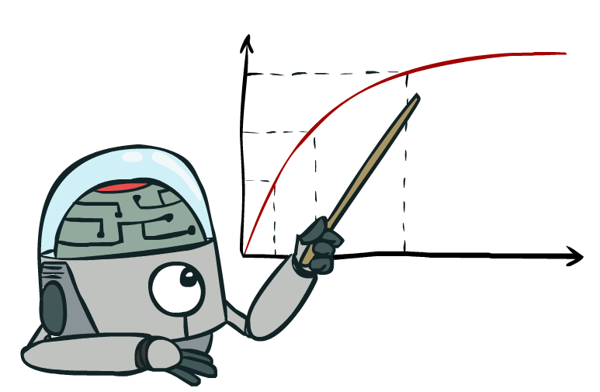
Course Logistics

Slide 4
Lectures/Tutorials
Two sections:
LEC0101: Thu, 01:00 PM - 03:00 PM MN 2110
LEC0102: Thu, 05:00 PM - 07:00 PM MN 1210
Tutorials: Tuesdays, Room DH
PRA101: 9 AM – 10 AM
PRA103: 11 AM – noon
Lectures and tutorials will be in-person. The tutorials are scheduled to begin in the second week.
Note: You are responsible for all material covered in either tutorials or lectures (unless otherwise specified)
PRA102: 10 AM – 11 AM
PRA106: 4 PM – 5 PM

Slide 5
Live Streaming and Recording
Lectures will be live-streamed on Zoom. However, we use the blackboard sometimes, which won’t be captured by camera.
Lecture slides will be uploaded
Lectures will be recorded (probably just LEC0102)
Lectures uploaded to the course page.
Tutorials: In-person,
Tutorial slides will be uploaded
Tutorials will NOT be live-streamed
Tutorials will NOT be recorded

Slide 6
Textbook
“Computer Networks: A Systems Approach”,
Peterson and Davie, 6th Edition
Recommended books:
“Computer Networking: A Top Down Approach”,
Kurose and Ross, 8th Edition
Also, check out the textbook website for some extra questions and practice
“UNIX Network Programming, Volume I: The Sockets Networking API”,
Stevens, Fenner, and Rudoff, 3rd edition
“TCP/IP Illustrated, Volume 1: The Protocols”,
Stevens, 1993

Slide 7
Prerequisites and Readings
Prerequisites:
Algorithms
Basic probability theory
Strong backgroung in C++ and Python programming and Unix environment
Readings:
On Syllabus

Slide 8
Tentative Schedule
 | Lectures | Deliverables
 |  | Programming Assignment | Problem Set | Wireshark Labs | Midterm
 |  | due 11:59pm on MarkUs | due 11:59pm on Crowdmark | due 11:59 pm on Quercus | 6:25 - 8:00 PM, at KN 137
Week 1 (Jan 6-12) | Course Overview; Circuits and Packets; How does the Internet work? Architectural Principles and Goals;
Week 2 (Jan 13-19) | Physical Layer: Encoding; Link Layer: Ethernet and CSMA/CD; Error Detection/Correction;
Week 3 (Jan 20-26) | "Frames" & Scalability Issues with Broadcast Ethernet; | PA0 – Warmup, Sunday, Jan. 26
Week 4 (Jan 27-Feb 2) | Switched Ethernet; Spanning Tree Protocol; Why do we need Network Layer;
Week 5 (Feb 3-9) | Fundamentals of Routing; Internet Addressing; The Internet Protocol;
Week 6 (Feb 10-16) | Intradomain Routing Protocols; DNS; DHCP; ARP; |  | PS1, Sunday, Feb 16
(Feb 17-22) | Reading Week
The Missing Sunday (Feb 23) |  | PA1 - ARP, Sunday, Feb 23 |  | WL1 - DNS, Sunday, Feb 23
Week 7 (Feb 24-March 2) | Midterm Review; |  |  |  | Midterm, Friday, Feb 28
Week 8 (March 3-9) | Internet Topology and Interdomain Routing; Path Vector (BGP)
Week 9 (March 10-16) | Putting All the Pieces Together; Host Network Stack; Socket Programming; | PA2 - IP routing, Friday, March 14 |  | WL2 - DHCP, Friday, March 14
Week 10 (March 17-23) | Application Layer; Transport Layer;
Week 11 (March 24-30) | Reliable Transport; Congestion Control 1; |  | PS2, Friday, March 28
Week 12 (March 31-April 4) | Congestion Control 2; Queueing Mechanisms; Middleboxes; | PA3 - Web Proxy, Friday, April 04 |  | WL3 - TCP, Friday, April 04

Slide 9
Important Dates
Feb 17 – 22: Reading week
Note: Feb 23 is the due date for PA1 and WL1
Feb 28: Midterm
Date, time, and Location: Friday, 6:25 - 8:00 PM, at KN 137.
Covers Weeks before the midterm, i.e., lectures and tutorials up to and including week 6, and PS1, and WL1
No C++/Python programming question will be on the midterm
Non-programmable Calculator: ALLOWED
Aid sheet: NOT ALLOWED

Slide 10
Important Dates
April 9 – 26: Final exam period, 2-hour exam
Date, time, and location will be announced by the Office of the Registrar.
Covers everything, i.e., lectures and tutorials up to and including the last week, PS1, PS2, WL1, WL2, and WL3
No C++/Python programming question will be on the Final
Non-programmable Calculator: ALLOWED
Aid sheet: NOT ALLOWED

Slide 11
Course Website/Discussion Board/MarkUs
Course Website/Discussion Board/MarkUs:
Quercus for course website
Piazza for discussion site
MarkUs, Crowdmark, and Quercus for submission:
https://markus.teach.cs.toronto.edu/utm-2025-01/main/login_remote_auth
https://app.crowdmark.com/sign-in/utoronto
All course announcements will be posted on Quercus/Piazza.
You are responsible for reading all postings made by the instructor or the TAs on Quercus and Piazza.
Lecture slides, tutorial materials, problem sets, programming assignments, and Wireshark handouts will be posted on Quercus.

Slide 12
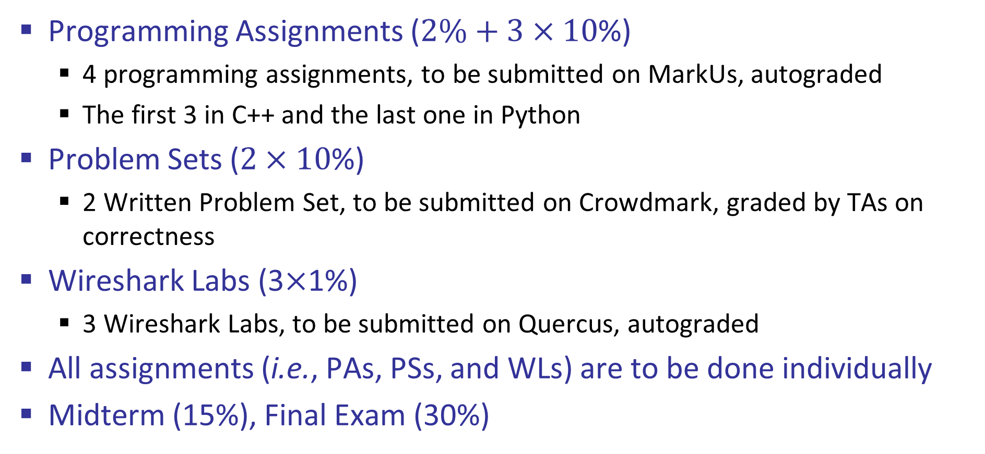
Grading Structure
Programming Assignments ($2\%+3×10$%)
4 programming assignments, to be submitted on MarkUs, autograded
The first 3 in C++ and the last one in Python
Problem Sets ($2×10$%)
2 Written Problem Set, to be submitted on Crowdmark, graded by TAs on correctness
Wireshark Labs (3$×$1%)
3 Wireshark Labs, to be submitted on Quercus, autograded
All assignments (i.e., PAs, PSs, and WLs) are to be done individually
Midterm (15%), Final Exam (30%)

Slide 13
Lateness Policy
Lateness policy: 6 Grace Days in total
These 6 days can be distributed across all assignments
Note: Maximum of 2 days can be used for each PA, PS, WL.
You get 0 If the assignment is submitted after the grace period
We keep track of your remaining Grace Days on Quercus.
Look under the grade section to see your remaining grace days
It will be updated after we release the grades for an assignment

Slide 14
How to Use the Grace Days?
You do NOT need to notify us before submitting your work
We simply compare your submission date with the due date.
Consider the following examples:
Alice has
Note: Maximum of 2 days can be used for each PA, PS, WL.
You get 0 If the assignment is submitted after the grace period
We keep track of your remaining Grace Days on Quercus.
Look under the grade section to see your remaining grace days
It will be updated after we release the grades for an assignment

Slide 15
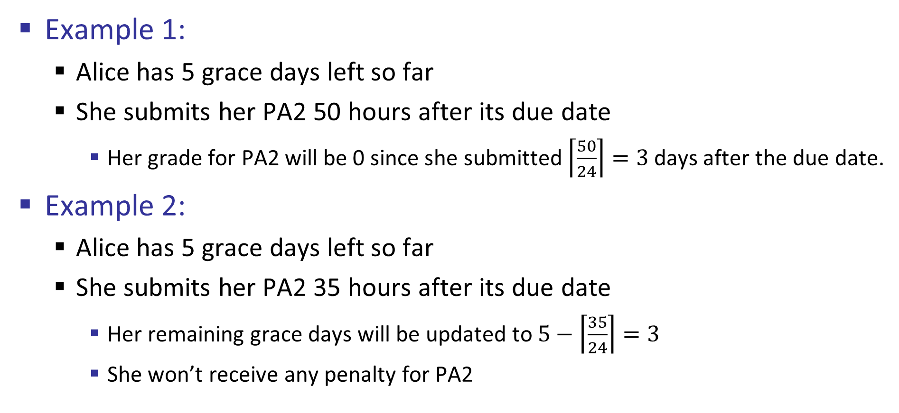
How to Use the Grace Days?
Example 1:
Alice has 5 grace days left so far
She submits her PA2 50 hours after its due date
Her grade for PA2 will be 0 since she submitted $\left\lceil \frac{50}{24}\right\rceil =3$days after the due date.
Example 2:
Alice has 5 grace days left so far
She submits her PA2 35 hours after its due date
Her remaining grace days will be updated to $5−\left\lceil \frac{35}{24}\right\rceil =3$
She won’t receive any penalty for PA2

Slide 16

How to Use the Grace Days?
Example 3:
Alice has 1 grace days left so far
She submits her PA2 35 hours after its due date
Her grade for PA2 will be 0 since she submitted $\left\lceil \frac{50}{24}\right\rceil =2$days after the due date, but she has only 1 grace day left.

Slide 17
Remark Request
Remark requests for PAs, PSs, WLs, and Midterm:
Due within 1 week of receiving the graded work
Must be submitted by posting a private note on Piazza
Carefully review your assignments, reflect, and write a short explanation justifying the reasons for a regrading request
If a grade is contested and we realize that the marker made a mistake in the student's favour, the mark for that assignment may be lowered when the mistake is found. This would otherwise create a situation which is unfair to other students.
Please include your full name, UTORid, and student number in the body of the private note

Slide 18
Email Policy
Email Policy:
Questions clarifying the course material cannot be answered by email.
Come to my office hours or to TA office hours instead.
TAs: concepts, programming assignments, problem sets
Erfan: concepts, high level guidance
Instructor’s email can be used for questions of a personal nature (e.g., accommodations for illness).

Slide 19
Piazza Policy
When and how:
For all questions of general interest, e.g.,
about the course material, problem sets, programming assignments, general questions about course logistics and administration
Respect the academic integrity of the course.
Do not reveal any idea or part of a solution to a course assessment.
Feel free to answer questions from other students
Helping someone else learn is one of the most effective ways to master a subject

Slide 20
Response Rate
We aim to respond to all email and Piazza postings within two business days.
Note: we do not monitor Piazza/email on weekends and holidays.

Slide 21
Extensions and Accommodations
If you ever need a special accommodation, please request one!
We’re here to support you, and we understand that life happens
Email your request to the instructor

Slide 22
Plagiarism
What is plagiarism?
See http://www.cs.toronto.edu/~fpitt/documents/plagiarism.html for the meaning of plagiarism, how to avoid it, and the U of T policies about it.
You can discuss the assignments with other students,
but you should not give your code/solution (or parts of your code/solution) to other students.
You should not look at another student’s code until after you have handed in your assignment (and the due date is past).
Plagiarism has occurred in the past in this class, and it has had very negative consequences for the students involved.

Slide 23
Accessibility Needs
The University of Toronto is committed to accessibility.
If you require accommodations or have any accessibility concerns, please visit https://www.utm.utoronto.ca/accessibility/ as soon as possible.
Feel free to discuss it with me. I will be happy to help.

Slide 24
Volunteer Note‐taker Position
UTM Accessibility Services is looking for note-taker volunteers in all sections of CSC358.
Benefits of Volunteering:
Receive a Co-Curricular Record (CCR) notation
Develop and enhance your organizational and note-taking skills
Contribute towards an accessible and inclusive community
Receive a reference letter upon request
For more information, visit https://aims.utm.utoronto.ca/user/NotetakingNotetakers/default.aspx

Slide 25
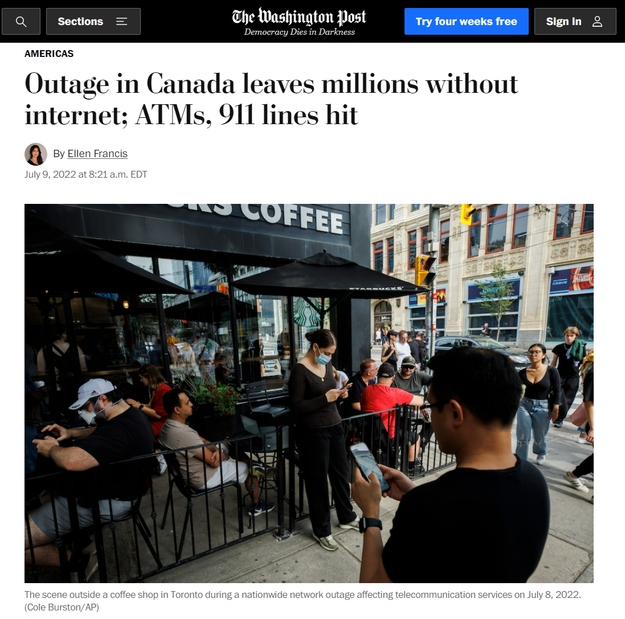
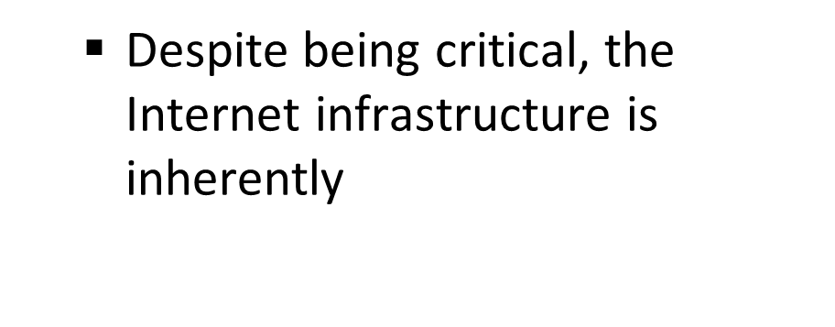
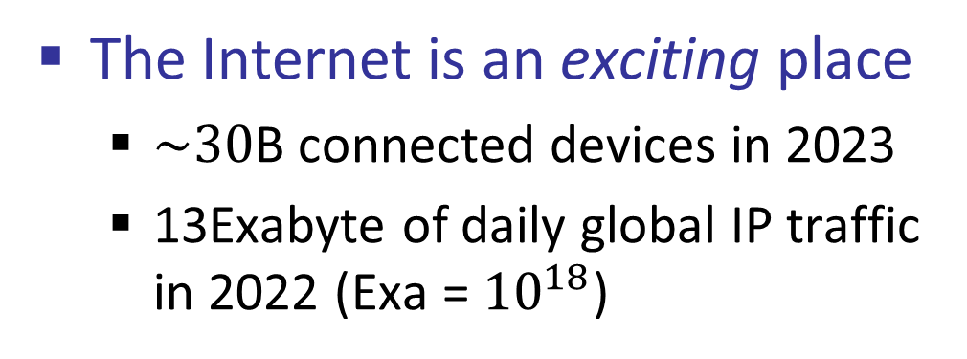
What is This Course, anyway?
It is all about how the Internet works
The Internet is an exciting place
$\sim 30$B connected devices in 2023
13Exabyte of daily global IP traffic in 2022 (Exa = ${10}^{18}$)
The Internet is a fragile place
Despite being critical, the Internet infrastructure is inherently
“An update in our [Rogers] core IP [internet protocol] network …
caused our IP routing network to malfunction,"

Slide 26
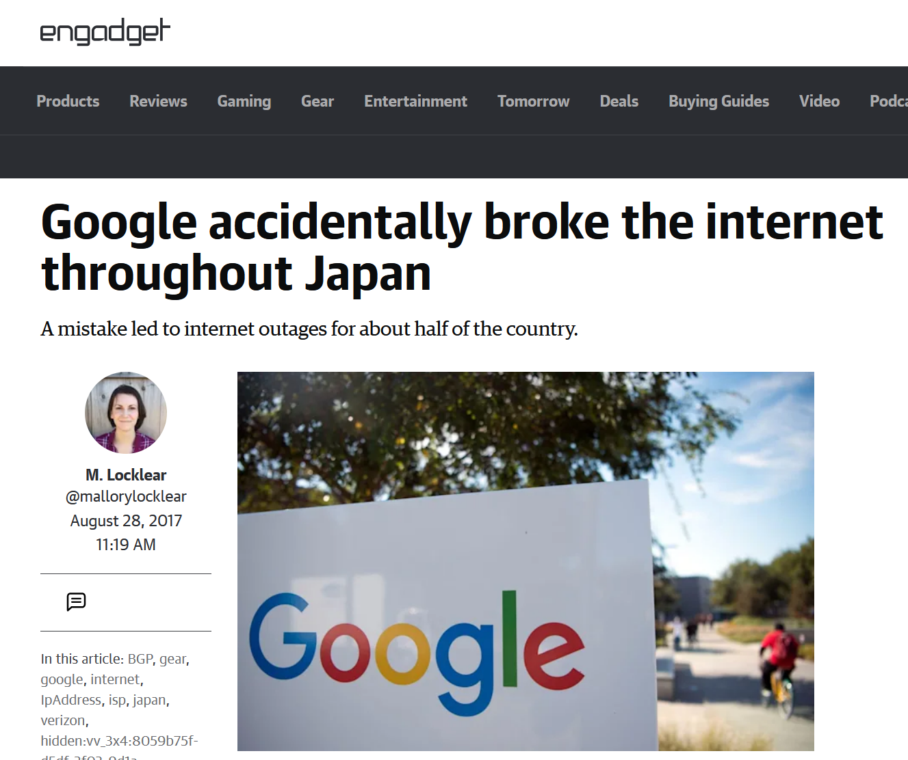

What is This Course, anyway?
It is all about how the Internet works
The Internet is an exciting place
$\sim 30$B connected devices in 2023
13Exabyte of daily global IP traffic in 2022 (Exa = ${10}^{18}$)
The Internet is a fragile place
Despite being critical, the Internet infrastructure is inherently
“Someone in Google fat-thumbed a Border Gateway Protocol (BGP) advertisement and sent Japanese Internet traffic into a black hole.”

Slide 27
What is This Course, anyway?
In CSC358, we study how the Internet works
With the focus on Key intuitions and design ideas
From Basics:
Naming, Layering, Socket Programming, Packet Switching, Reliability, Sharing, etc.
To Advance Networking:
Routers and Switches, Congestion Control, Security, Software Defined Networking, etc.

Slide 28
Acknowledgements
Special thanks to Yashar Ganjali, Peter Marbach, Sajad Shirali-Shahreza, and Michael Liut from UofT, and
Nick McKeown from Stanford University
Jennifer Rexford from Princeton University
David Wetherall from University of Washington
Nick Feamster from Georgia Tech
Rachit Agarwal from Cornell University
Sylvia Ratnasamy from UC Berkeley

