Slide 1












CSC358: Principles of Computer Networks
Lecture 2-Part 1: Network Sharing
mobile network
4G
national or global ISP
Streaming
video
Skype
IP
local or regional ISP
home network
content
provider
network
HTTP
datacenter
network
Ethernet
TCP
enterprise
network
Erfan Meskar
Winter 2025, University of Toronto, Mississauga

Slide 2
Today’s Outline
Part 1: How is a network shared?
Circuit switching
Packet switching
Statistical Multiplexing
Parts 2-4: Physical/Link layer
Different types of media
Encoding bits with signals
Framing

Slide 3
Circuit Switching
It’s the method used used to be used by the telephone network.
A call has three phases:
Establish circuit from end-to-end (“dialing”),
Communicate,
Close circuit (“tear down”).
Originally, a circuit was an end-to-end physical wire.
Nowadays Previously, a circuit was like a virtual private wire:
each call has its own private, guaranteed data rate from end-to-end.
A
B
Source
Destination

Slide 4
Circuit Switching
Reservation establishes a “circuit” within a switch
switch
src
dst

Slide 5
Circuit Switching – Telephone Network
Each phone call is allocated 64kb/s. So, a 10Gb/s trunk line can carry about 156,000 calls.
Destination
“Callee”
Source
“Caller”
Central
Office
“C.O.”
Central
Office
“C.O.”
Trunk
Exchange

Slide 6

Timing in Circuit Switching
Data
Circuit establishment
Data transfer
time
Circuit teardown

Slide 7
Poor Efficiency in Circuit Switching
The circuit is mostly idle due to traffic bursts
Circuit establishment
Data transfer
time
Circuit teardown

Slide 8
Poor Efficiency in Circuit Switching
The circuit is used for a short amount of time
Information
time

Slide 9

Circuit switching doesn’t “route around trouble”
Once a circuit is established, all data follows that fixed path.
If a problem arises, the communication is disrupted because the circuit cannot dynamically reroute around the issue.
circuit-switched networks lack mechanisms to automatically find alternative paths to bypass the trouble.
A
B

Slide 10
Circuit Switching, Pros and Cons
Pros:
Predictable performance
Once circuit is established, it provides simple/fast switching
Cons:
Complexity of circuit setup/teardown
Inefficient when traffic is bursty
Circuit setup adds delay
Switch fails --> its circuit(s) fails

Slide 11
Packet Switching
It’s the method used by the Internet
Each packet is individually routed,
using the router’s local routing table
The routers maintain no per-flow state
Different packets with the same source and destination address may take different paths
Several packets may arrive for the same output link at the same time,
Therefore, a packet switch has buffers

Slide 12
Packet Switching
A
B
R2
Source
R1
R3
Destination
R4
C
switch
dst
Each packet contains destination (dst)
Each packet treated independently

Slide 13
Packet Switching
A
B
R2
Source
R1
R3
Destination
R4
C
switch
dst
Each packet contains destination (dst)
Each packet treated independently
With buffers to absorb transient overloads

Slide 14
Packet Switching – Simple Switch Model
“4”
Link 1, ingress
Choose
Egress
Link 1, egress
Link 2
Link 2, ingress
Choose
Egress
Link 2, egress
R1
“4”
Link 1
Link 3
Link 3, ingress
Choose
Egress
Link 3, egress
Link 4
Link 4, ingress
Choose
Egress
Link 4, egress

Slide 15
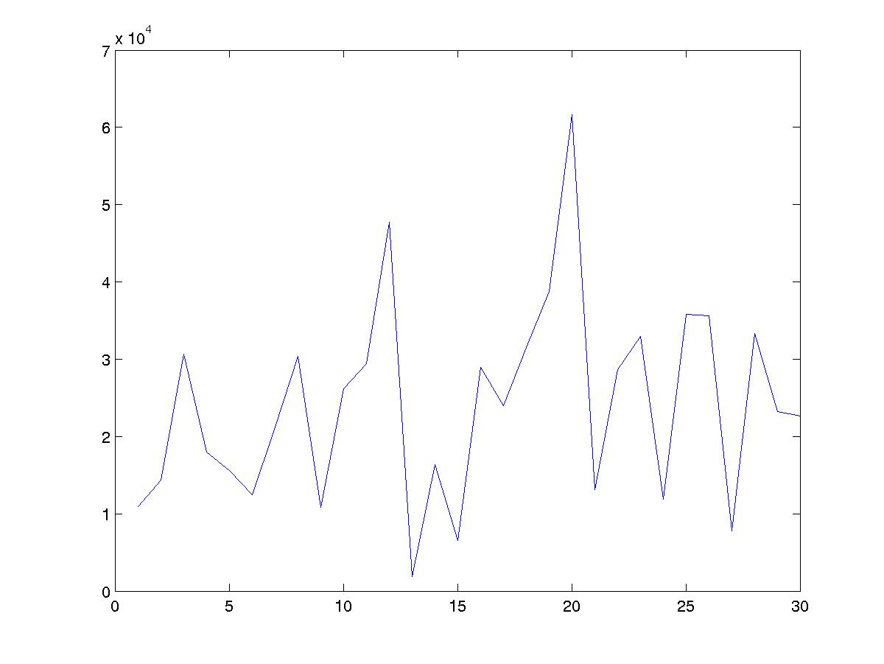
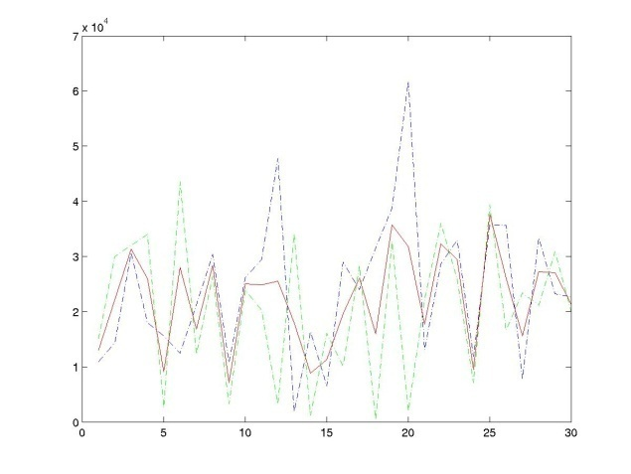
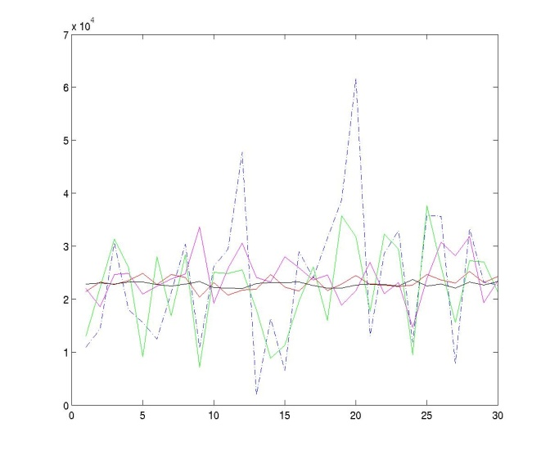
Statistical Multiplexing – Basic Idea
Network traffic is bursty, i.e., the rate changes frequently
Peaks from independent flows generally occur at different times
Conclusion: The more flows we have, the smoother the aggregate traffic.
One flow
Two flows
Many flows
Average rate
Arrival rate
Average rates of: 1, 2, 10, 100, 1000 flows.
time
time
time

Slide 16
Statistical Multiplexing Gain (SMG)
Packet arrival Rate
A
C
A
C
time
Packet arrival Rate
B
C
B
C
time
Notes:
Statistical multiplexing
Important if traffic is bursty
Less expensive
Contention requires buffering
Variable delay => no QoS guarantees

Slide 17
Statistical Multiplexing Gain (SMG)
Packet arrival Rate
2C
R < 2C
A
R
A+B
B
B
A
time
Statistical multiplexing gain = 2C/R
Other possible definitions of SMG:
The ratio of rates that give rise to a particular queue occupancy,
The ratio of buffer size that give rise to a particular loss probability.
Notes:
Statistical multiplexing
Important if traffic is bursty
Less expensive
Contention requires buffering
Variable delay => no QoS guarantees

Slide 18
Why Packet Switching in The Internet
Efficient use of expensive links:
The links are assumed to be expensive and scarce.
Packet switching allows many, bursty flows to share the same link efficiently.
“Circuit switching is rarely used for data networks, ... because of very inefficient use of the links” - Gallager
Resilience to failure of links & routers:
“For high reliability, ... [the Internet] was to be a datagram subnet, so if some lines and [routers] were destroyed, messages could be … rerouted” - Tanenbaum

Slide 19
Questions for the rest of the semester
Is layering the best approach?
Simplifies design
Yet, limited and inflexible
Best effort service
Made the rapid growth of the Internet possible
Makes providing any guarantees very difficult
Packet switching
Enables statistical multiplexing
We need extremely fast routers
Routing: How does a router know which output port to send the packet to?

