Slide 1












CSC358: Principles of Computer Networks
Lecture 2-Part 2: Communication Channel Media
mobile network
4G
national or global ISP
Streaming
video
Skype
IP
local or regional ISP
home network
content
provider
network
HTTP
datacenter
network
Ethernet
TCP
enterprise
network
Erfan Meskar
Winter 2025, University of Toronto, Mississauga

Slide 2
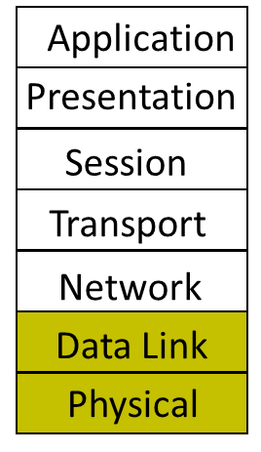
Outline
Part 1: How is a network shared?
Circuit switching
Packet switching
Statistical Multiplexing
Physical/Link layer
Part 2: Different types of media
Part 3: Encoding bits with signals
Part 4: Framing

Slide 3
Last Time …
So far:
How do we make sense of the Internet?
4-layer, 5-layer, 7-layer model
Packet switching vs. Circuit Switching and Statistical Multiplexing Gain

Slide 4
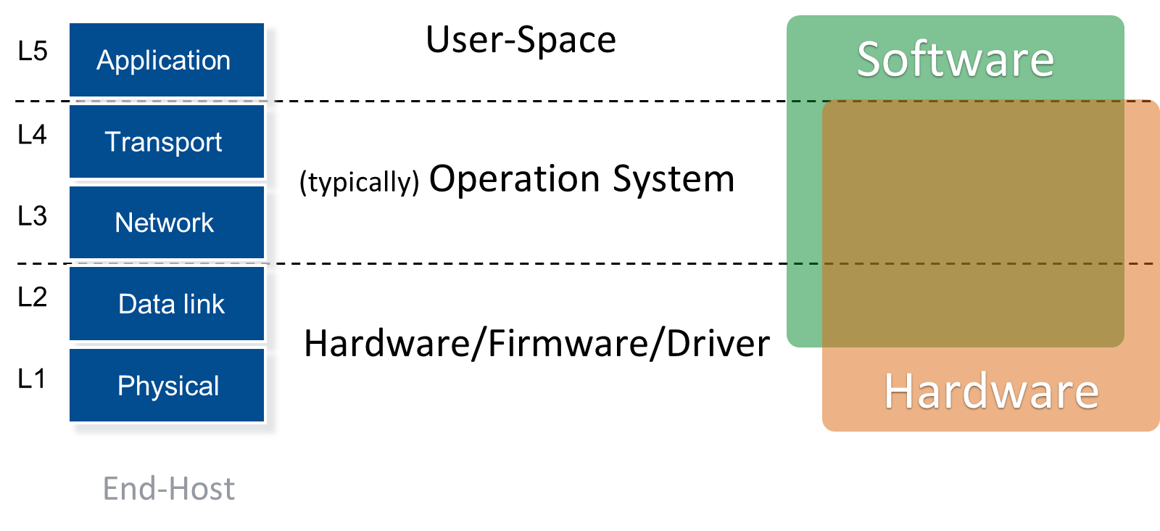
Where is Each Layer Implemented
Throughout the semester, we will study these layers and their specific responsibilities
First layer to study: Physical/Link layer

Slide 5
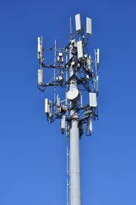
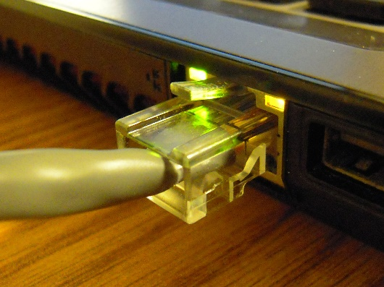
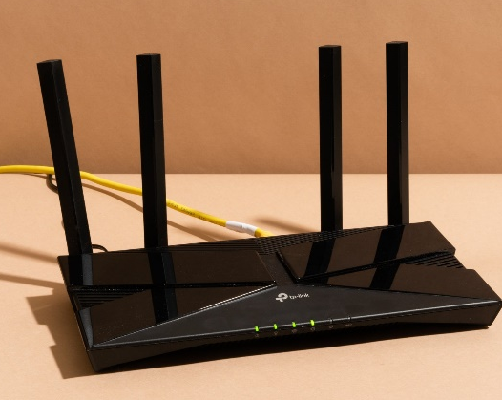
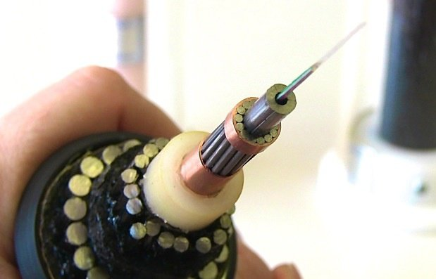
Physical Layer
Physical layer specifies:
Physical medium: cable, fiber, wireless frequency
Encoding: how to represent binary data and signal and transmit/receive it.
Modulation*: It involves modifying the signals in terms of their frequency, amplitude, and phase.
* Leave modulation to Electrical Engineers (EE). As Computer Scientist (CS), you are NOT responsible for modulation (won’t be covered in your exams).

Slide 6
Types of Communication Media (Physical Channels)
All practical links propagate electromagnetic radiation through a medium
One way to characterize links is by the medium they use
Wire:
Twisted pair, e.g., CAT5 UTP, 10 to 100Mbps, 100m*
Coaxial cable, e.g., thin-net, 10 to 100Mbps, 200m*
Fiber:
Multi-mode, e.g., 100Mbp/s, 600m*
Single-mode, e.g., 100 to 2400 Mbps, 40km*
Wireless:
Infra-red, e.g., IRDA, 1Mbps*
RF, e.g., 802.11 wireless LANs, Bluetooth*
Microwave, satellite, cell phones
* You do not need to memorize the green text for exams.

Slide 7
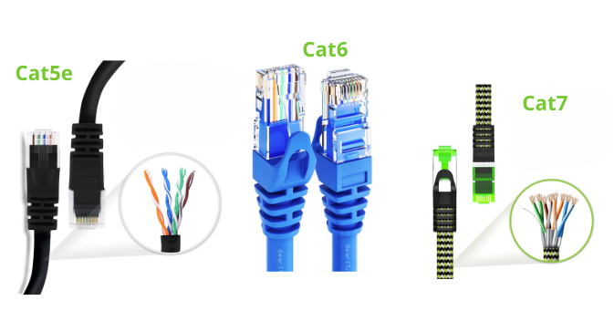
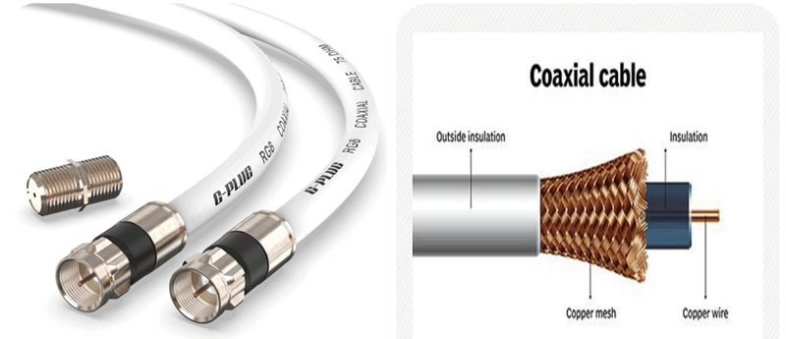
Wire
There are mainly two categories of wire physical channel
Twisted Pair Cables: Consists of pairs of wires twisted together
Examples: Cat 5e, Cat 6, Cat 7.
Good for Local Area Networks (LANs)
Coaxial Cable:
Common in cable TV, broadband Internet, and older networking systems.
Image credit: GEARit: https://www.gearit.com/blogs/news/ethernet-cable-wiring-diagram
Image credit: www.techtarget.com

Slide 8
Fiber
Long, thin, pure strand of glass
Light propagated with total internal reflection
Enormous bandwidth available (terabits)
Light source
(LED, laser)
Light detector
(photodiode)

Slide 9
Fiber
Based on the way light travels through the fiber, we have two primary categories for:
Single-mode fiber
Multi-mode fiber
Jacket
Jacket
Cladding
Cladding
Core glass
Core glass
Single-mode Fiber
Multi-mode Fiber

Slide 10
Single-mode Fiber
Single-mode fiber: Allows only a single light mode (or path) to propagate.
Has a small core diameter, typically 8-10 microns*
Designed to minimize signal distortion caused by overlapping light modes
Provides long-distance communication range, up to 40 km or more*
Offers higher bandwidth
Use case:
Suitable for long-distance, high-bandwidth applications.
Submarine communication cables.
Long-distance telecom and Wide Area Networks (WANs).
Jacket
Cladding
Core glass
* You do not need to memorize the green text for exams.

Slide 11
Multi-mode Fiber
Single-mode fiber: Allows multiple light modes (or paths) to propagate simultaneously.
Has a larger core diameter, typically 50-62.5 microns*.
leads to more modal dispersion.
Suitable for short-distance communication range, up to 550 meters*
Offers Lower bandwidth
Use case:
Suitable for short-distance, cost-effective solutions
Data centers and enterprise networks.
Local Area Networks (LANs).
Jacket
Cladding
Core glass
* You do not need to memorize the green text for exams.

Slide 12
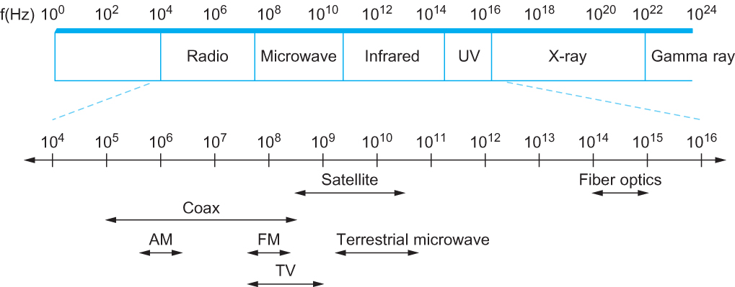
Wireless
Different frequencies have different properties
Signals subject to atmospheric/environmental effects
Electromagnetic spectrum*
* You do NOT need to memorize these ranges, numbers, and names for your exams.

Slide 13
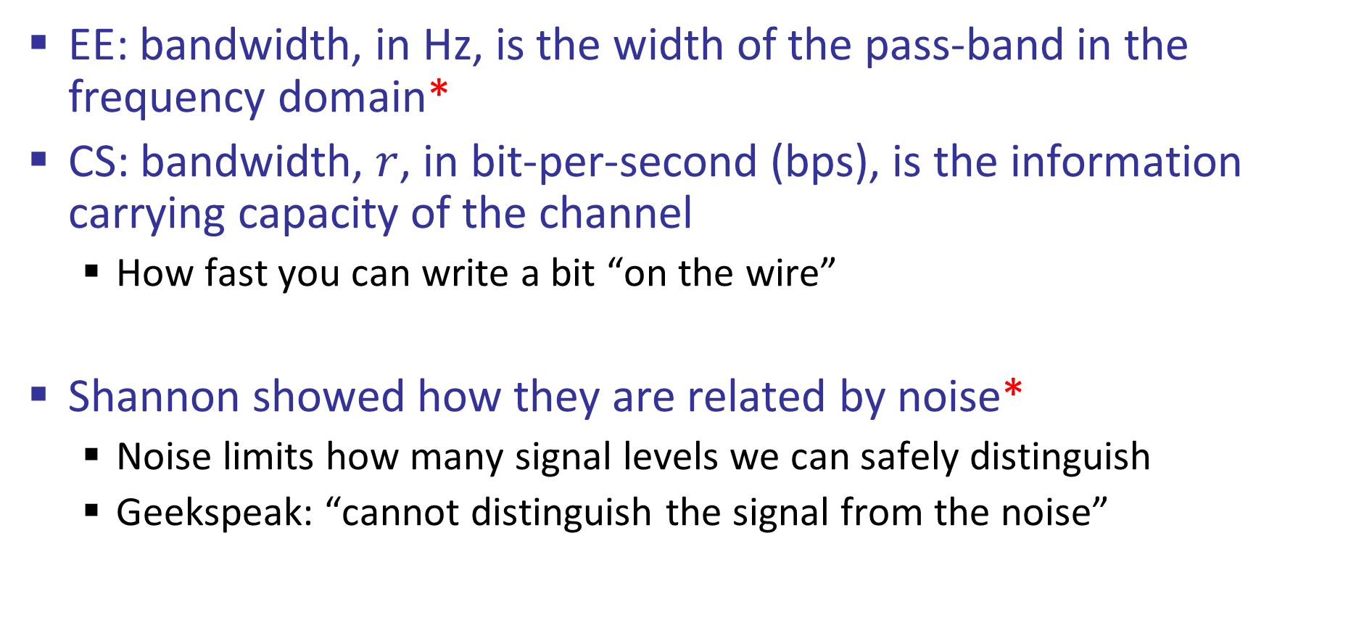
Bandwidth of a Channel
EE: bandwidth, in Hz, is the width of the pass-band in the frequency domain*
CS: bandwidth, $r$, in bit-per-second (bps), is the information carrying capacity of the channel
How fast you can write a bit “on the wire”
Shannon showed how they are related by noise*
Noise limits how many signal levels we can safely distinguish
Geekspeak: “cannot distinguish the signal from the noise”
* Beyond the scope of the course. You are CS students, so you are not expected to know what EE mean by bandwidth or Shannon Theorem

