Slide 1












CSC358: Principles of Computer Networks
Lecture 2-Part 3: Encoding
mobile network
4G
national or global ISP
Streaming
video
Skype
IP
local or regional ISP
home network
content
provider
network
HTTP
datacenter
network
Ethernet
TCP
enterprise
network
Erfan Meskar
Winter 2025, University of Toronto, Mississauga

Slide 2
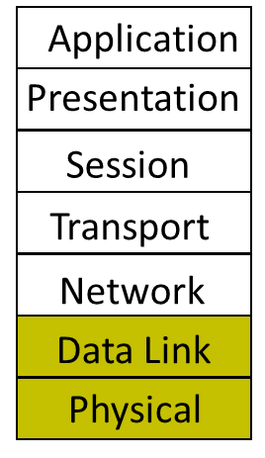
Today’s Outline
Part 1: How is a network shared?
Circuit switching
Packet switching
Statistical Multiplexing
Physical/Link layer
Part 2: Different types of media
Part 3: Encoding bits with signals
Part 4: Framing

Slide 3
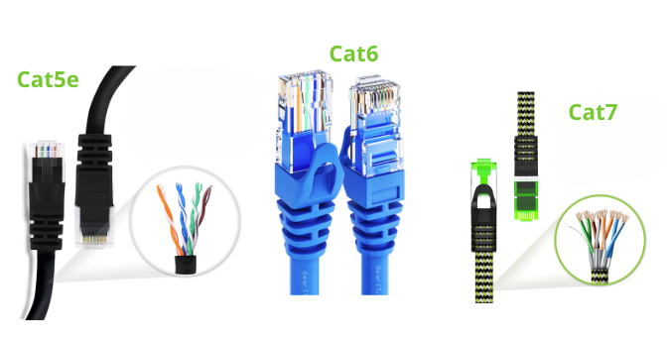
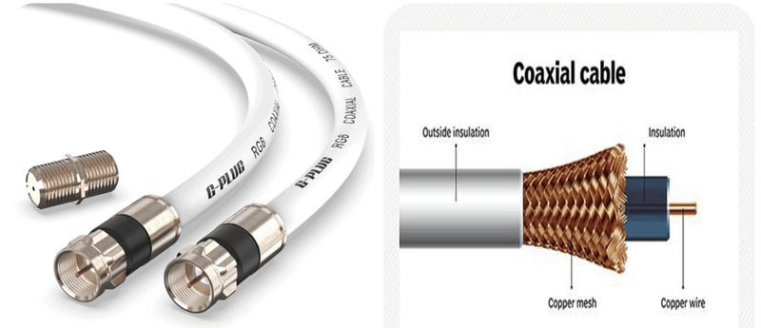
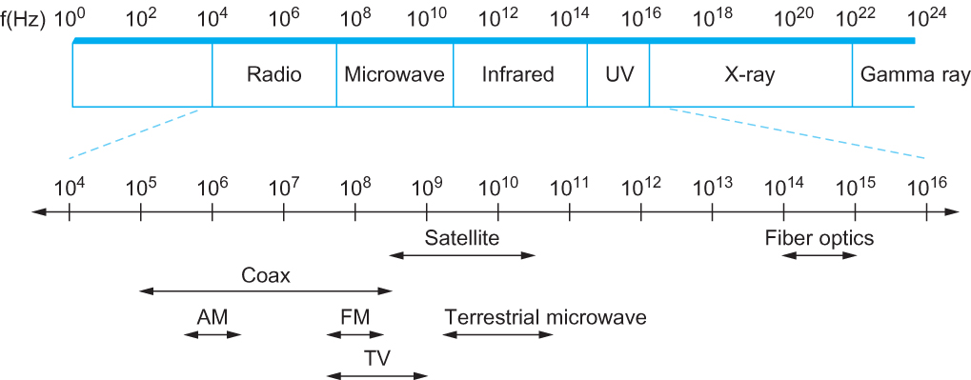
So Far …
We saw how electromagnetic signals travel through different media
Next, we’ll see how digital data is transformed into electromagnetic signal, i.e., Encoding
Image credit: GEARit: https://www.gearit.com/blogs/news/ethernet-cable-wiring-diagram
Jacket
Jacket
Cladding
Cladding
Core glass
Core glass
Image credit: www.techtarget.com
Single-mode Fiber
Multi-mode Fiber

Slide 4
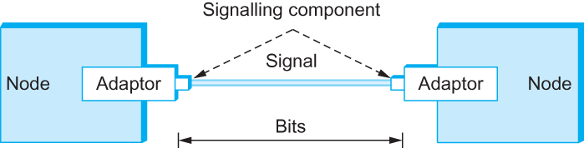
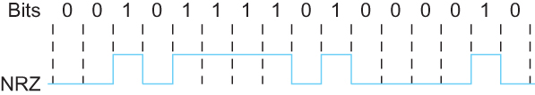
Encoding Bits with Signals
Encoding/Decoding:
Generate analog waveform (e.g., voltage) from digital data at the transmitter
Recover the digital data from analog waveform at the receiver
In this course, we study 4 simple Encoding techniques
NRZ
NRZI
Manchester
4B/5B
Digital Data:
Analog Waveform:
Signals travel between signaling components; bits flow between adaptors
An Example of How Digital Data can be Encoded as Analog Waveform

Slide 5

NRZ Encoding
1 as high, 0 as low!
Called Non-return to Zero (NRZ)
Low is not necessarily 0V. For example, it could be -1V.
For example:
Digital data to be transmitted: 001010110
Use the clock cycle to generate analog waveform
Clock is an internal signal that alternates from low to high, a low/high pair is considered as one clock cycle
0
0
1
0
1
0
1
1
0
Received Waveform
Clock
Clock
Encoded
Waveform
Decoded data
0
0
1
0
1
0
1
1
0
Transmitter generates analog waveform from digital data, using its clock
Receiver generates digital data from the received (noisy) analog waveform, using its clock

Slide 6
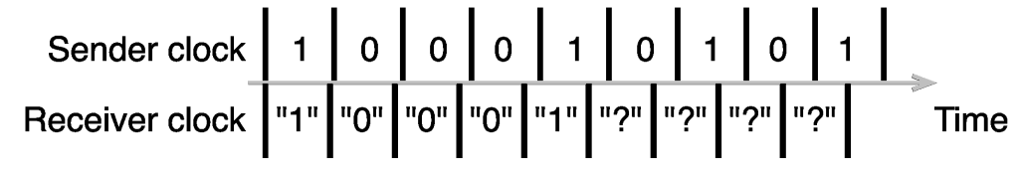
Issues with NRZ
Baseline Wander: Too many consecutive 0’s and 1’s makes detection difficult
The receiver keeps an average of the signals it has seen so far
Uses the average to distinguish between low and high signal
When a signal is significantly lower than the average, it is 0, else it is 1
Bit Slip: if sender and receiver clocks are not perfectly aligned the receiver may lose track of bit boundaries over time.

Slide 7
Non-return to Zero Inverted (NRZI) Encoding
Encode 1 with transition from current signal
Encode 0 by staying at same level
NRZI at least solves the issue with consecutive 1s
Also, it makes clock recovery a bit easier than NRZ
0
0
1
0
1
0
1
1
0
Clock
NRZI

Slide 8
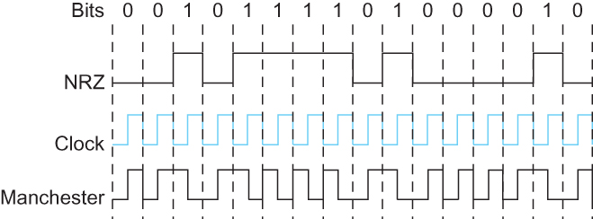
Manchester Encoding
Merges the clock with signal by transmitting X-OR of the NRZ encoded data and the clock
For a 0 bit: send a low-to-high waveform
For a 1 bit: send a high-to-low waveform
Benefits:
Self-clocking: the embedded clock makes synchronization and clock recovery easier
Resolves the issue with consecutive 0s and 1s
Disadvantage:
Bandwidth inefficient:
Compared to NRZ and NRZI, provides half bandwidth (in bps)
Low-to-high
waveform
High-to-low
waveform

Slide 9
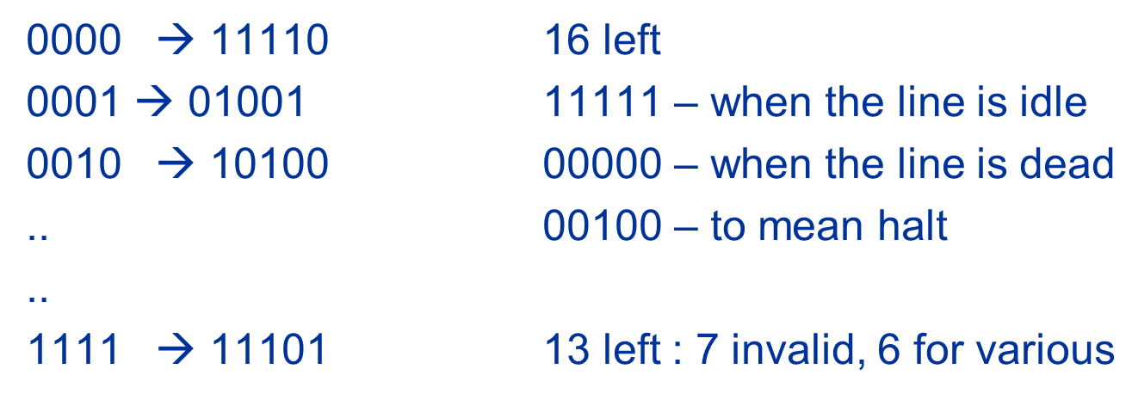

4B/5B Encoding
Every 4 bits is first encoded as 5 bits. Then, the transformed digital data is transmitted with NRZI.
Carefully select 16 5-bit chips such that
No more than one leading 0 and no more than two trailing 0s in each 5-bit
Hence, no pair of 5-bit codes results in more than three consecutive 0’s
* No need to memorize this table

Slide 10
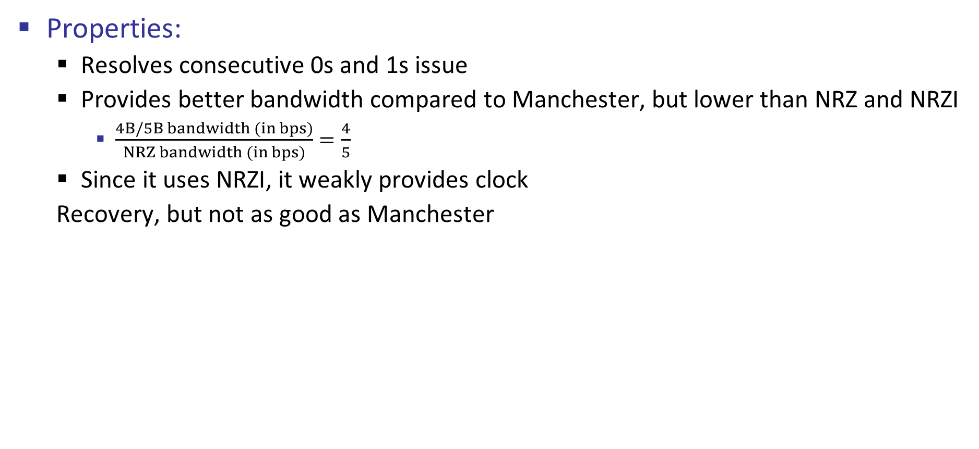
4B/5B Encoding
Properties:
Resolves consecutive 0s and 1s issue
Provides better bandwidth compared to Manchester, but lower than NRZ and NRZI
$\frac{4B/5B bandwidth (in bps)}{NRZ bandwidth (in bps)}=\frac{4}{5}$
Since it uses NRZI, it weakly provides clock
Recovery, but not as good as Manchester

Slide 11
NRZ, NRZI, Manchester, 4B/5B Applications
Encoding Technique | Applications
NRZ | Legacy systems
NRZI | USB
Manchester | Ethernet (10BASE-T), RFID, IR Communication
4B/5B | Fast Ethernet (100BASE-TX, 1000BASE-SX), Fiber Channel

