Slide 1












CSC358: Principles of Computer Networks
Lecture 2-Part4: Framing
mobile network
4G
national or global ISP
Streaming
video
Skype
IP
local or regional ISP
home network
content
provider
network
HTTP
datacenter
network
Ethernet
TCP
enterprise
network
Erfan Meskar
Winter 2025, University of Toronto, Mississauga

Slide 2
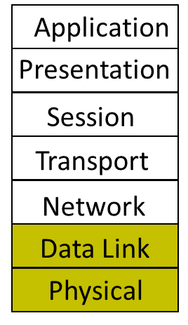
Outline
Part 1: How is a network shared?
Circuit switching
Packet switching
Statistical Multiplexing
Physical/Link layer
Part 2: Different types of media
Part 3: Encoding bits with signals
Part 4: Framing

Slide 3
The Story So Far
So far, we learned how to send bits on links!
Encode digital data as analog waveform
Send analog waveform over the communication channel
Sending stream of bits on link is fun! But not all we want.
On the sender side, the link layer wants to send stream of frames in a way that the receiver would be able to recover the stream of frames.
That’s because Internet uses packet switching

Slide 4





Remember the Russian Dolls?
We must come up with a way to send stream of frames such that the receiver would be able to recover the stream of frames.
application
message
M
M
application
Transport
segment
H_{t}
M
H_{t}
M
Transport
Network
datagram
H_{n}
H_{t}
M
H_{n}
H_{t}
M
Network
Link
frame
H_{l}
H_{n}
H_{t}
M
H_{l}
H_{n}
H_{t}
M
Link
Physical
Physical
source
destination

Slide 5
Framing
Node A tells its adaptor to transmit a frame from the node’s memory.
This results in a sequence of bits being sent over the link.
The adaptor on node B then collects the sequence of bits arriving on the link, and
deposits the corresponding frame in B’s memory.
Central challenge faced by the adaptor:
Recognizing exactly what set of bits constitute a frame, i.e.,
determining where the frame begins and ends
packet
Data link layer protocol
packet
frame
frame
adapter
adapter
Bits flow between adaptors, frames between hosts

Slide 6
How to Separate Bits into Frames
Sentinel is a common* solution to framing challenge
Look for special control codes that mark start and end of frames
Recent Point-to-Point Protocol (PPP) and High-level Data Link Control (HDLC) use sentinel approach with special “flag” code 01111110 (i.e., 0x7e*)
What if this “flag” code appears in the main message?
01111110
Frame contents
01111110
*Using sentinels is only one possible solution. Later in the course, we’ll see another solution (i.e., using preamble, frame length, and interframe gaps in Ethernet).
*Please take some time to review hexadecimal notation. It will be used a lot in this course.

Slide 7
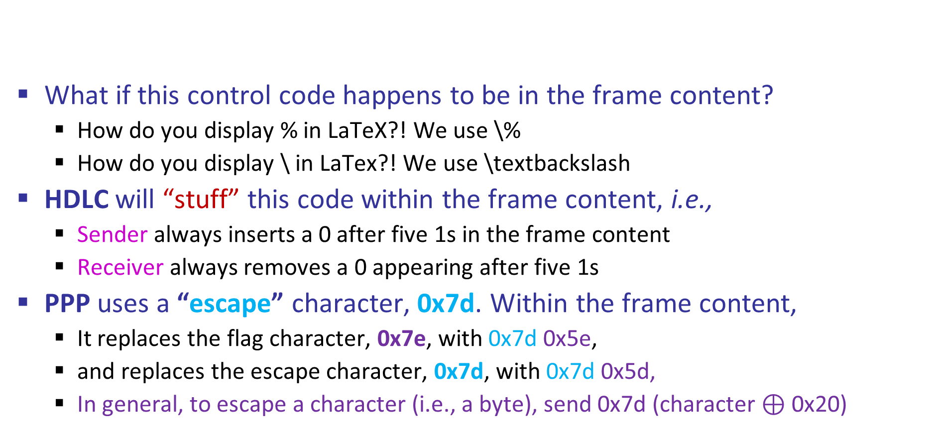
How to Separate Bits into Frames
What if this control code happens to be in the frame content?
How do you display % in LaTeX?! We use \%
How do you display \ in LaTex?! We use \textbackslash
HDLC will “stuff” this code within the frame content, i.e.,
Sender always inserts a 0 after five 1s in the frame content
Receiver always removes a 0 appearing after five 1s
PPP uses a “escape” character, 0x7d. Within the frame content,
It replaces the flag character, 0x7e, with 0x7d 0x5e,
and replaces the escape character, 0x7d, with 0x7d 0x5d,
In general, to escape a character (i.e., a byte), send 0x7d (character $⊕$ 0x20)
01111110
Frame contents
01111110
0x7e
0x7e
XOR

Slide 8
Point-to-Point Protocol (PPP)
It’s Link layer (L2) protocol
It can be used for point-to-point byte-oriented physical layers.
That’s why it uses “escape” character (i.e., a byte, not a bit)
Often used for data links that were not designed for packet transmission, e.g.,
dial-up and DSL internet connecting a customer’s modem to Internet Service Provider (ISP) via a phone line.
Satellite communication links for point-to-point communication.

Slide 9
High-level Data Link Control (HDLC)
It’s Link layer (L2) protocol
It can be used for point-to-point or point-to-multipoint bit-oriented physical layers.
That’s why it can use “bit stuffing” (i.e., it does not have to add a byte. It can add a single bit.)
Often used to provide framing on links that do not have byte framing.
Satellite communication where one satellite communicates with multiple ground stations.

