Slide 1












CSC358: Principles of Computer Networks
Lecture 3-Part 1: Abstract Model of Link
mobile network
4G
national or global ISP
Streaming
video
Skype
IP
local or regional ISP
home network
content
provider
network
HTTP
datacenter
network
Ethernet
TCP
enterprise
network
Erfan Meskar
Winter 2025, University of Toronto, Mississauga

Slide 2
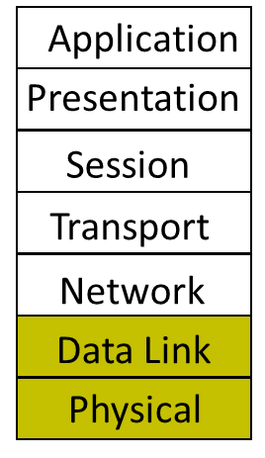
Outline
Abstract Model of Link

Slide 3
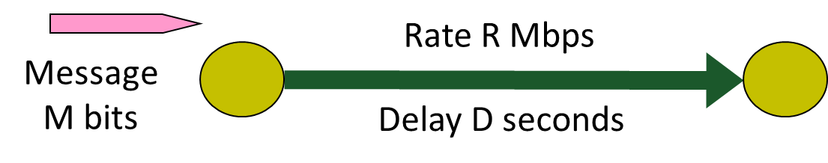
Abstract Model of a Link
Abstract model is typically all we will need
What goes in comes out altered by the model
Other parameters that are important:
The kind and frequency of errors*
Whether the media is broadcast or not*
* We will discuss frequency of error (e.g., bit-error-rate) and broadcast media later in the course.

Slide 4

Packet Latency
Packet Latency: Total time to send a packet across a link
The time from when the sender starts sending the first bit until the last bit arrives at the receiver.
Last bit of packet
First bit of packet
r bits/s

Slide 5

Packet Latency
Packet Latency, $d$, depends on:
Propagation Delay
Transmission delay (or Packetization Delay)
$d$ = $d$^{prop} + $d$^{tran}
p
r bits/s
l

Slide 6

Propagation Delay
Propagation Delay, $d$^{prop}:
It depends on:
Length of the link, $l$
Propagation speed of the analog waveform in the link, $c$
$d$^{prop} $=\frac{l}{c}$
The encoded analog waveform of the bit
l
1

Slide 7
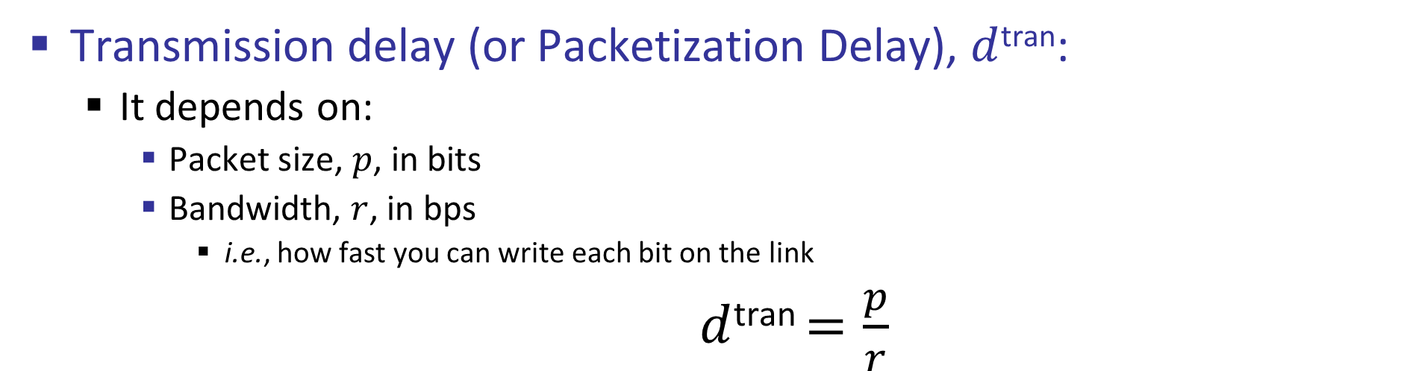
Transmission Delay
Transmission delay (or Packetization Delay), $d$^{tran}:
It depends on:
Packet size, $p$, in bits
Bandwidth, $r$, in bps
i.e., how fast you can write each bit on the link
$d$^{tran} $=\frac{p}{r}$
The encoded analog waveform of the packet
p
r bits/s
1
0
0
1
1
1
0
0
1
1
0
0
1
1
1
0
0
1

Slide 8
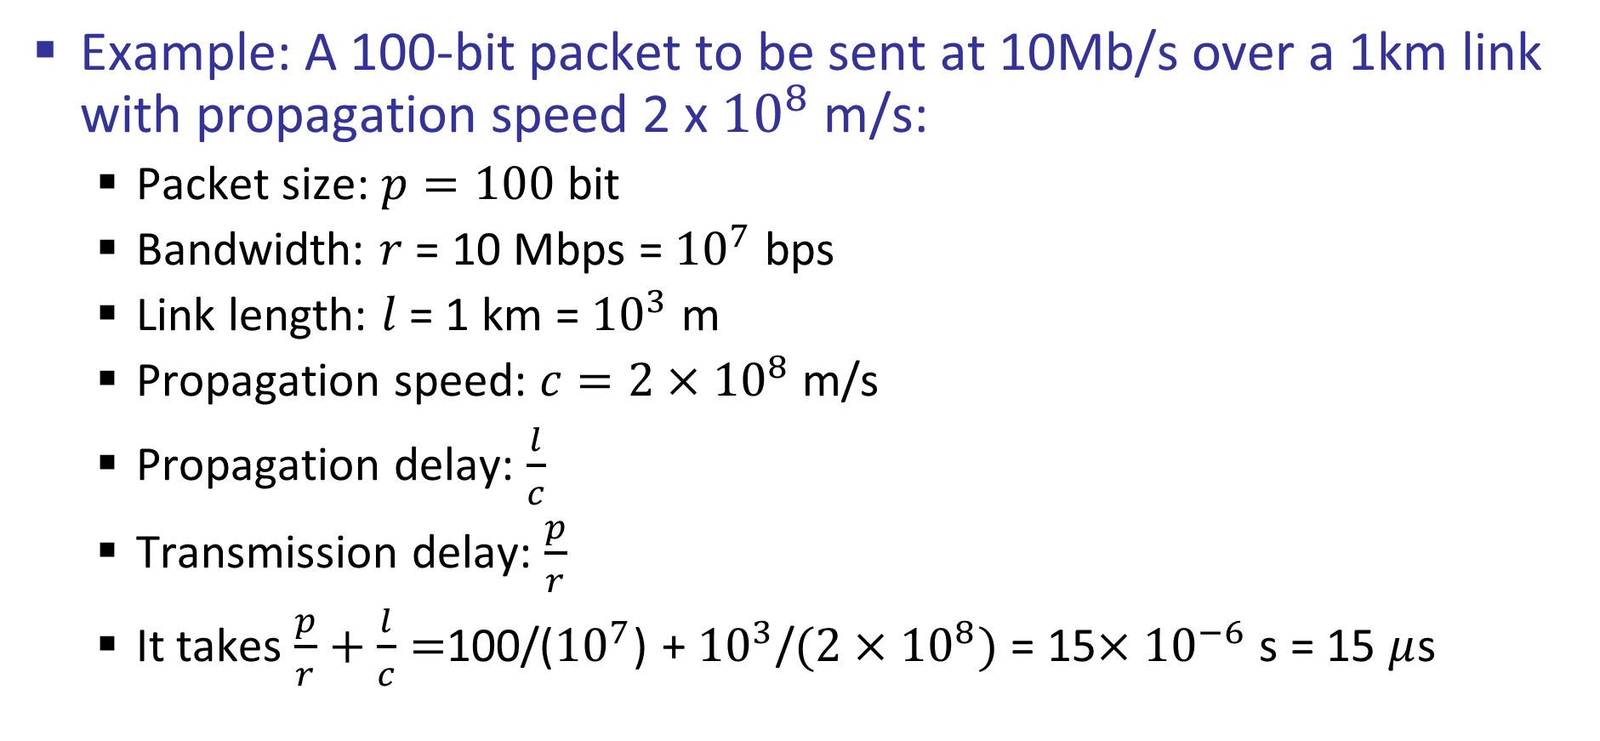
Packet Latency
Example: A 100-bit packet to be sent at 10Mb/s over a 1km link with propagation speed 2 x ${10}^{8}$ m/s:
Packet size: $p=100$ bit
Bandwidth: $r$ = 10 Mbps = ${10}^{7}$ bps
Link length: $l$ = 1 km = ${10}^{3}$ m
Propagation speed: $c=2×{10}^{8}$ m/s
Propagation delay: $\frac{l}{c}$
Transmission delay: $\frac{p}{r}$
It takes $\frac{p}{r}+\frac{l}{c}=$100/(${10}^{7}$) + ${10}^{3}$/$(2×{10}^{8})$ = 15$×{10}^{−6}$ s = 15 $μ$s

Slide 9
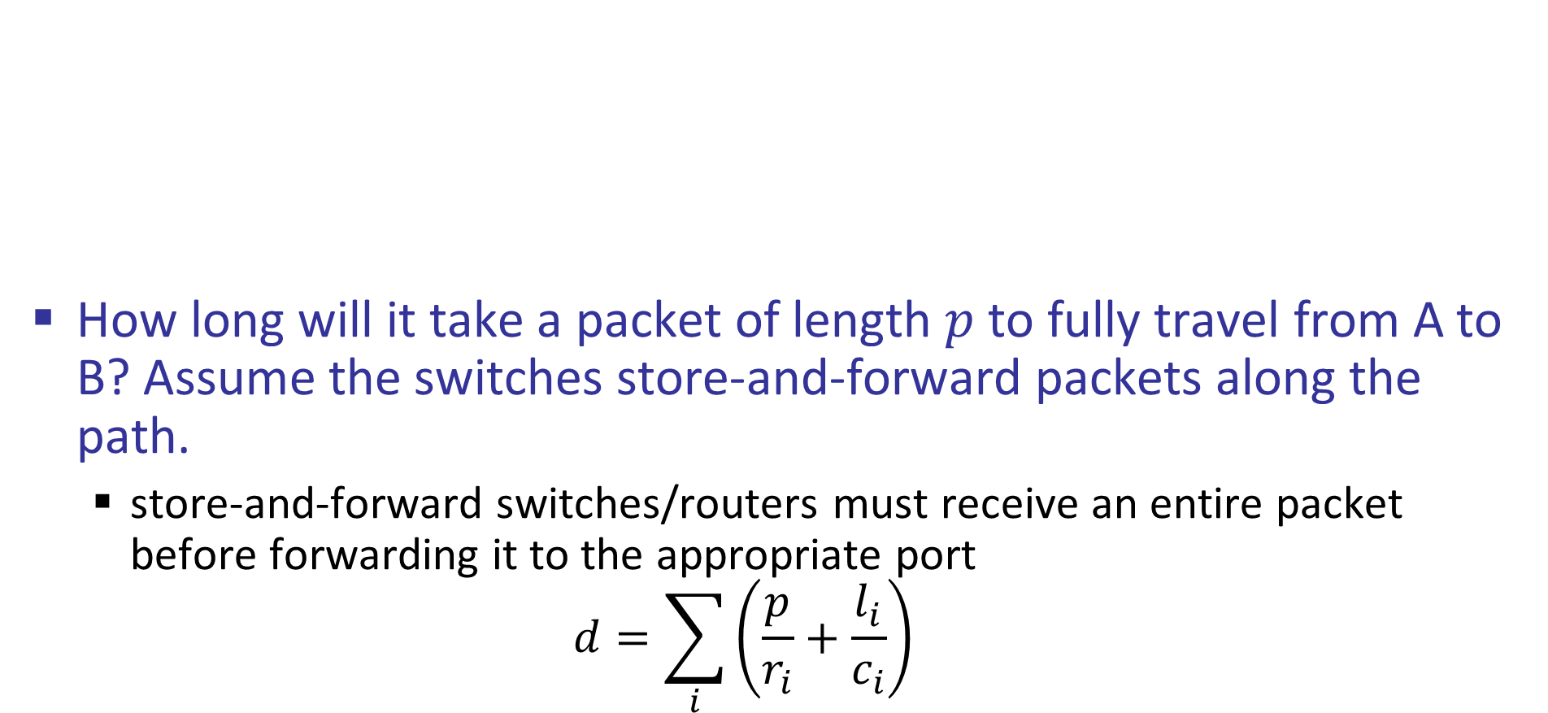
Packet End-to-end Delay
How long will it take a packet of length $p$ to fully travel from A to B? Assume the switches store-and-forward packets along the path.
store-and-forward switches/routers must receive an entire packet before forwarding it to the appropriate port
$$d=\sum_{i}{\left(\frac{p}{r_{i}}+\frac{l_{i}}{c_{i}}\right)}$$
l₁, c_{1,} r₁
l₂ , c₂, r₂
A
l₃ , c₃, r₃
l₄ , c₄, r₄
B

Slide 10
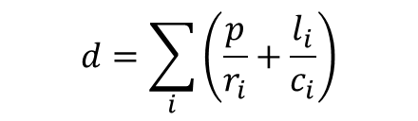
Packet End-to-end Delay – Timeline
A
l₁ , c₁, r₁
B
l₂ , c₂, r₂
l₃ , c₃, r₃
l₄ , c₄, r₄
S1
S2
S3
A
p/r₁
time
p/r₂
S1
l₁/c₁
p/r₁
$$d=\sum_{i}{\left(\frac{p}{r_{i}}+\frac{l_{i}}{c_{i}}\right)}$$
p/r₃
S2
l₂/c₂
p/r₂
p/r₄
S3
l₃/c₃
p/r₃
B
time
l₄/c₄
p/r₄

Slide 11
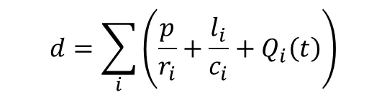
Queueing Delay
Data
H
Other packets
A
l₁, r₁
l₂, r₂
l₃, r₃
l₄, r₄
B
S1
S2
Q₂(t)
S3
A
p/r₁
p/r₂
$$d=\sum_{i}{\left(\frac{p}{r_{i}}+\frac{l_{i}}{c_{i}}+Q_{i}\left(t\right)\right)}$$
S1
l₁/c
Q₂(t)
p/r₃
S2
l₂/c
p/r₄
S3
l₃/c
B
time
l₄/c

Slide 12
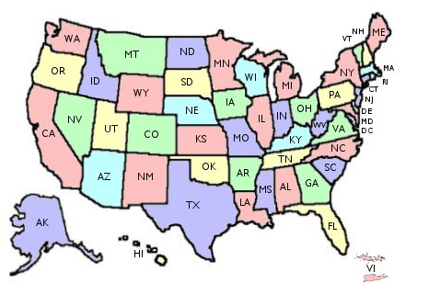
One-way delay and RTT
Link one-way delay is :
(Arrival Time of the last bit) – (Departure Time of the last bit)
Note: In a point-to-point connection:
One-way delay = propagation delay
Departure
Time
Arrival
Time

Slide 13
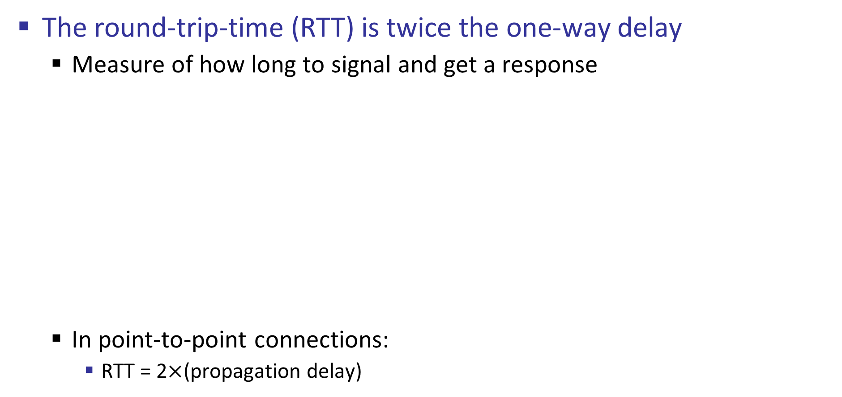
One-way delay and RTT
The round-trip-time (RTT) is twice the one-way delay
Measure of how long to signal and get a response
In point-to-point connections:
RTT = 2$×$(propagation delay)
Signal Departure Time
Response arrival Time

Slide 14
Throughput and Goodput
Throughput measures how fast the sender sends data during the Transfer Time
Goodput measures how fast the receiver receives useful data during the Transfer Time
Note that these measures are different from bandwidth
Transfer Time = Time to get started shipping the bits +
Time to get to ship the bits +
Time to get to get stopped shipping the bits

Slide 15
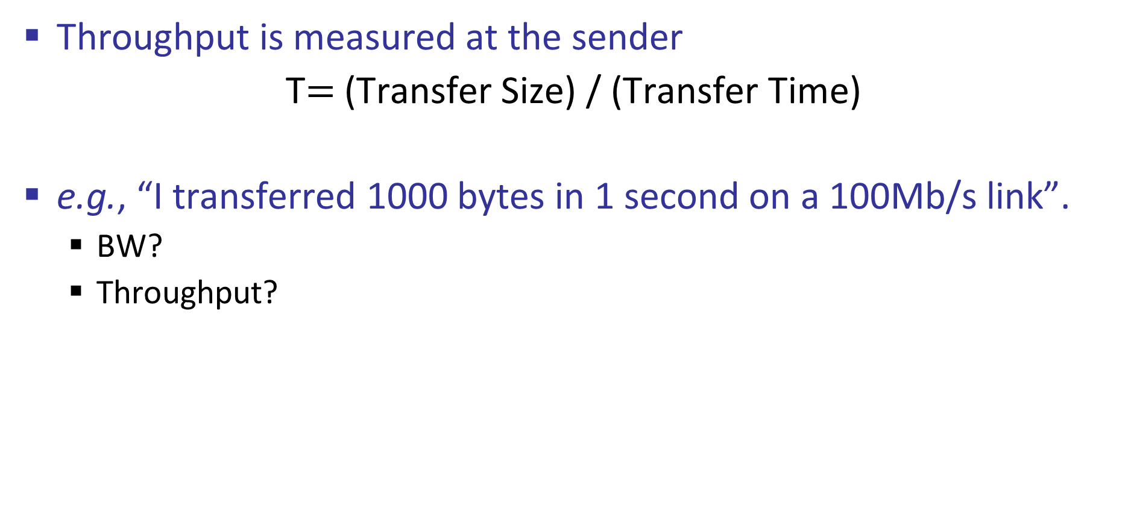
Throughput
Throughput is measured at the sender
T$=$(Transfer Size) / (Transfer Time)
e.g., “I transferred 1000 bytes in 1 second on a 100Mb/s link”.
BW?
Throughput?

Slide 16
Throughput and Goodput
Goodput is measured at receiver
T_{goodput}=(Useful application data Size ) / (Transfer Time)
Goodput is the rate in bits per second of useful traffic received.
Goodput excludes:
duplicate packets
packets dropped along the path
protocol overhead (e.g., headers and acknowledgement),
control messages (e.g., keep-alive signals, handshake messages)

Slide 17
Bandwidth-Delay Product (BDP)
What is Bandwidth-Delay Product (BDP)?
Before seeing its definition, let’s first study the example below to motivate the importance of BDP:
Consider a connections between Hosts A and B with one-way delay of 250-msec and a bandwidth of 50-kbps.
A simple method for reliable transmission is to send a packet, wait to receive its acknowledgment, then send the next packet.
Not efficient
Ack received
Host A
1
2
3
4
Host B
time

Slide 18
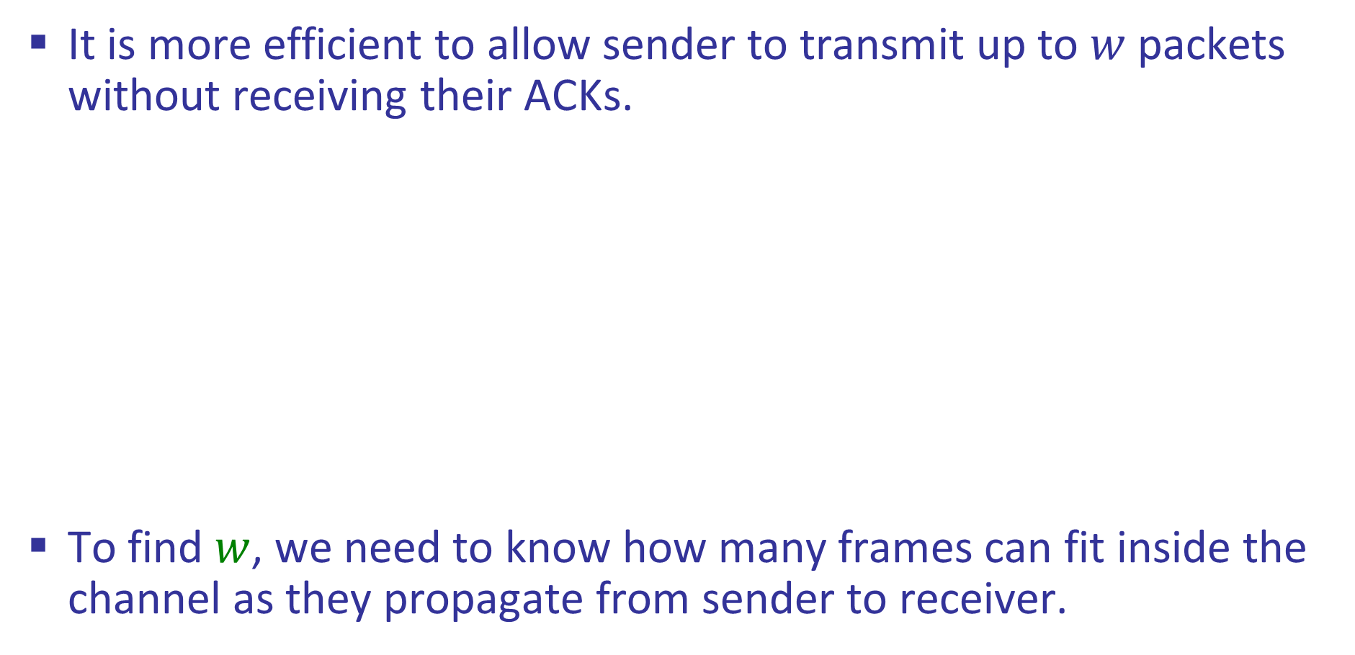
Bandwidth-Delay Product (BDP)
It is more efficient to allow sender to transmit up to $w$ packets without receiving their ACKs.
To find $w$, we need to know how many frames can fit inside the channel as they propagate from sender to receiver.
Ack received
Host A
1
2
3
4
Host B
Ack received
Host A
2
4
1
3
More efficient
Host B
time

Slide 19
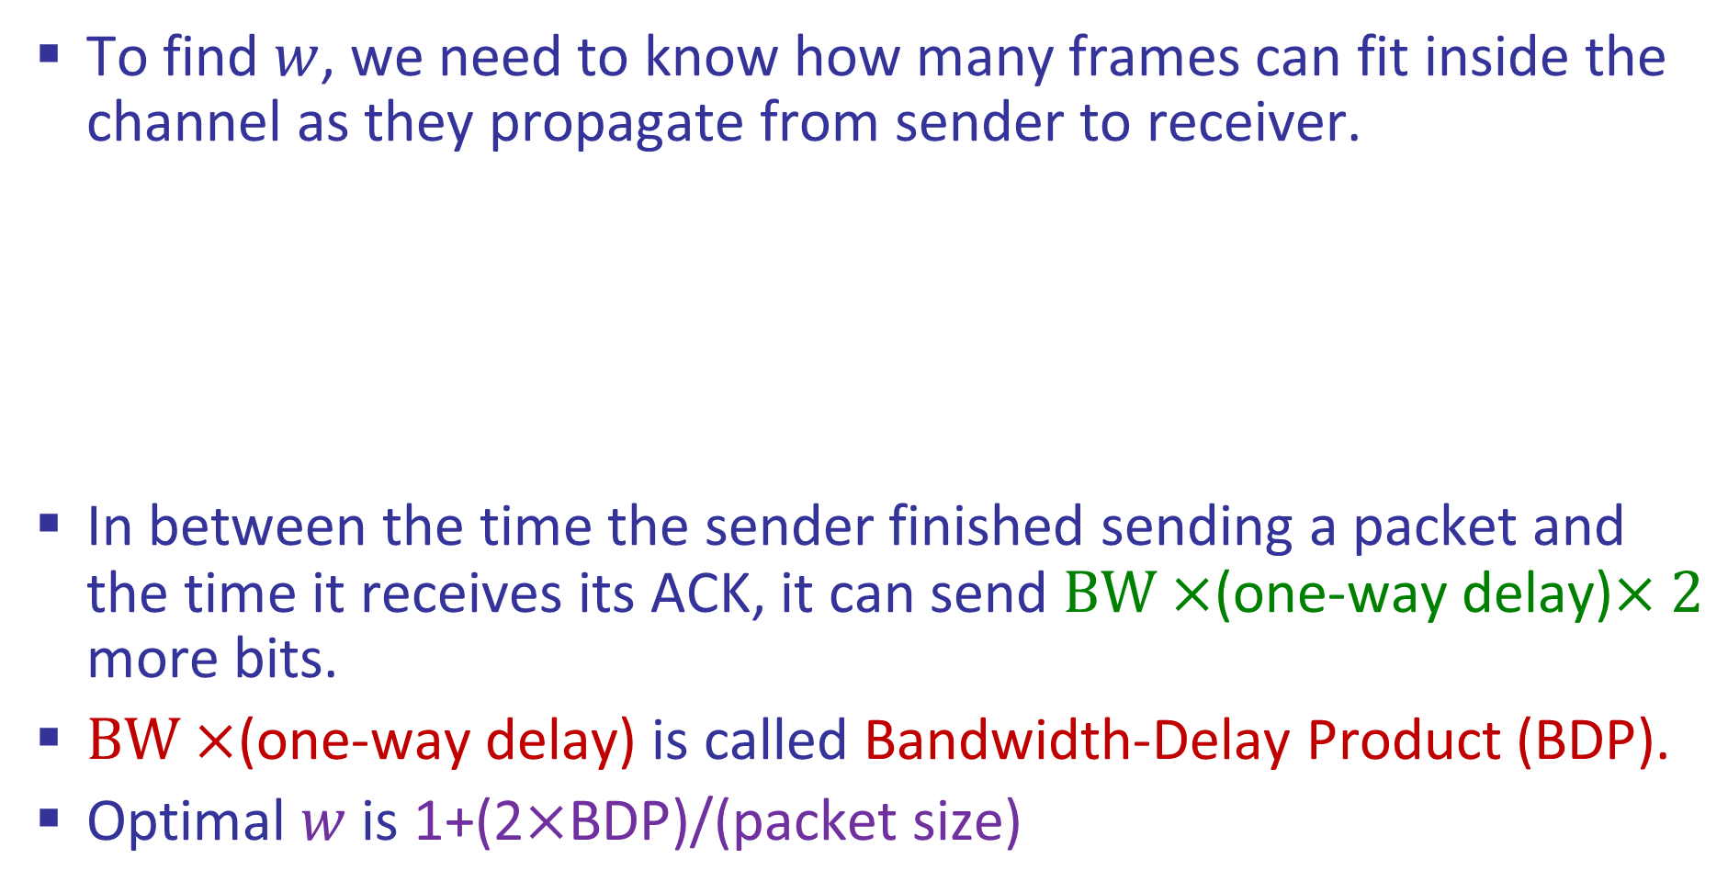

Bandwidth-Delay Product (BDP)
To find $w$, we need to know how many frames can fit inside the channel as they propagate from sender to receiver.
In between the time the sender finished sending a packet and the time it receives its ACK, it can send $BW×$(one-way delay)$×2$ more bits.
$BW×$(one-way delay) is called Bandwidth-Delay Product (BDP).
Optimal $w$ is 1+(2$×$BDP)/(packet size)
2$×$(one-way delay)
Ack received
Host A
2
4
1
3
Host B
time

Slide 20
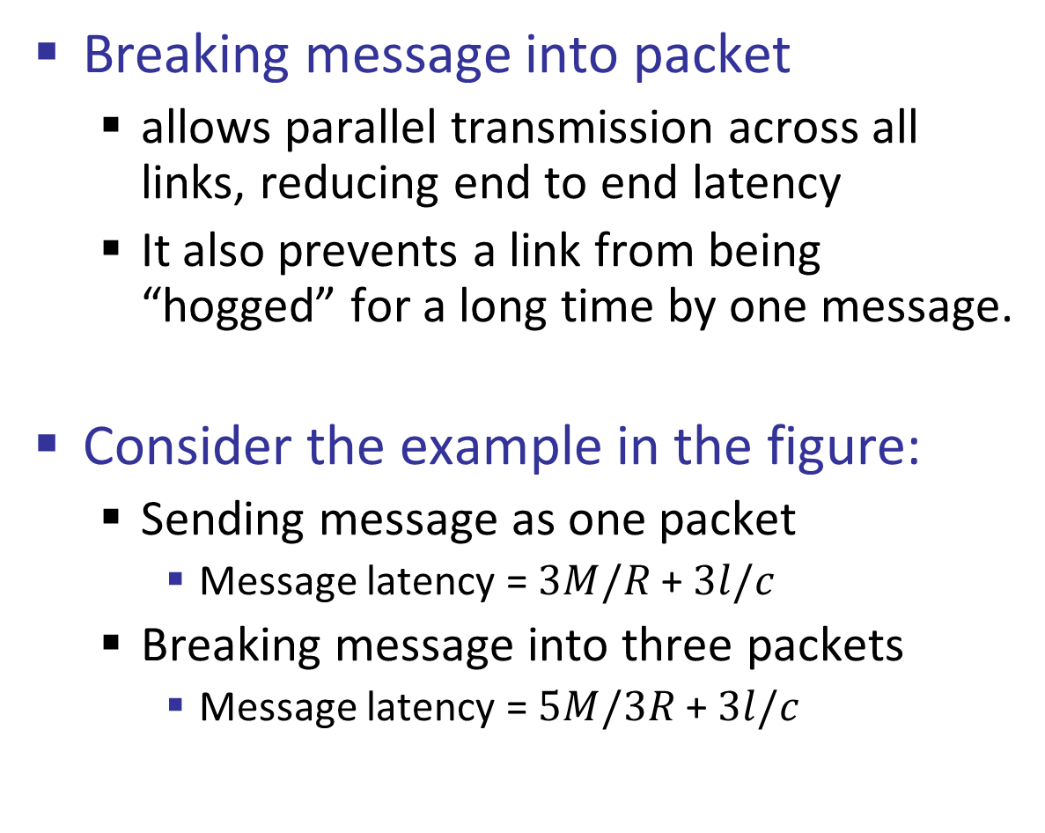
Transmission of Multiple Packets Across All Links
Breaking message into packet
allows parallel transmission across all links, reducing end to end latency
It also prevents a link from being “hogged” for a long time by one message.
Consider the example in the figure:
Sending message as one packet
Message latency = $3M/R$ + $3l/c$
Breaking message into three packets
Message latency = $5M/3R$ + $3l/c$
M/R
Host A
R1
R2
Host B
M/R
Host A
R1
R2
Host B

Slide 21
What We’ve Learned
Abstract Model of Link:
Packet Latency, Transmission Delay, and Propagation Delay
Queueing Delay
Packet End-to-end Delay
How to draw its timeline
Message End-to-end Delay
How to draw its timeline
Throughput and Goodput
Link One-way Delay, RTT, and BDP

Slide 22
The story So Far
We typically model links in terms of bandwidth and delay,
from which we can calculate message latency.
Framing allows complete frames to be recovered at the far end of the link.
Thus, framing makes it possible to recover complete frames at the receiver.
We need to encode bits into waveform signals so that we can recover them at the other end of the channel.
Different media have different properties that affect their performance as links.

