Slide 1












CSC358: Principles of Computer Networks
Lecture 3-Part 2: Error Detection and Correction
mobile network
4G
national or global ISP
Streaming
video
Skype
IP
local or regional ISP
home network
content
provider
network
HTTP
datacenter
network
Ethernet
TCP
enterprise
network
Erfan Meskar
Winter 2025, University of Toronto, Mississauga

Slide 2
Errors
Bit errors are introduced into frames
Electrical interference and noises are inevitable
They can cause some of the bits to be flipped in the frame we receive
i.e., changing a bit of 0 into 1 or vice versa.
We must be able to detect/correct when this occurs! Why?
Otherwise, the received message could be garbled and useless
Who needs to do it? (links, routers, OSs, or apps?)
Links, routers, and OSs

Slide 3
Error Detection and Correction
In this part, we’ll introduce two techniques:
Error Detection Codes
Error Correction Codes
Why do we need to implement these techniques?
To detect or correct messages that are garbled during transmission.

Slide 4
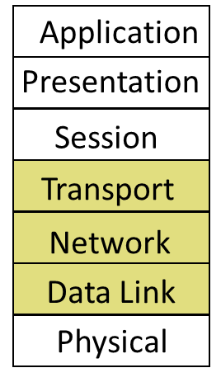
Error Detection and Correction
Which layer implements these techniques?
The responsibility for doing this cuts across the different layers, namely Link, Network, and Transport Layer
Why not just the link layer?
Error detection at link layer:
can detect and possibly correct errors for data transmitted over a single link (e.g., between a device and a router or access point).
Wouldn’t that be enough?
No. Error detection at link layer does not account for errors introduced beyond that specific link.
Errors can be introduced at other points, too.
in routers and switches (e.g., when storing packets in buffer or processing them),
In end-hosts (e.g., during reassembly from receiver’s buffer),

Slide 5
Outline
Error detection and correction
(N,K) block coding
Hamming distance
Parity,
2D-Parity
Checksums,
CRC, …

Slide 6
Detection vs. Correction
Error detection mechanisms* allow errors to be recognized
How? Add redundant data.
We want to be overcome errors.
Two strategies to correct errors:
Use error detection codes. If error is detected, request retransmition, or Automatic Repeat reQuest (ARQ)
Error correcting codes, or Forward Error Correction (FEC)
How? Add redundant data. Similar idea to error correction codes, but more complicated.
Error correction codes allow errors to be repaired, too.
* Also known as error detection codes or error detection scheme

Slide 7
Detection vs. Correction, cont’d
Error Detection Codes:
Requires smaller number of bits/overhead
Requires less/simpler processing
But require retransmission which increases the traffic in the network.
Error Correction Codes:
Reduce the number of retransmissions.
But need more bits/overhead and requires more/complex processing.

Slide 8
Retransmissions vs. FEC
Question: Which one should we choose? Retransmissions or FEC?
Depends on the type of error, cost of recovery, and application.
Example: Message with 1000 bits, bit error rate 0.001
Case 1: random errors → FEC
Case 2: bursts of 1000 errors → ARQ
Case 3: real-time application (teleconference) → FEC
FEC tends to be most useful when
(1) errors are quite probable, as they may be, for example, in a wireless environment, or
(2) the cost of retransmission is too high, for example, because of the latency involved retransmitting a packet over a satellite link.

Slide 9
A Naïve Coding Scheme: Copycat Coding Scheme
Let’s start by studying a naïve coding scheme. We call it Copycat
Sender sends two copies. Receiver looks for differences.
Example:
Sender:
Assume we are asked to send 0110100.
We send 00111100110000 instead.
Receiver:
On the receiving end, we compare 1st bit with 2nd bit, 3rd bit with 4th bit, etc.
If we notice any difference between them, it means that there is an error.
For instance:
E.g. 1: if we receive 00111101110000, we know that 7th or 8th bit was flipped.
i.e., we detected error.
E.g. 2: 00111100110000, we do not detect any error and return 0110100 as the sent message.

Slide 10
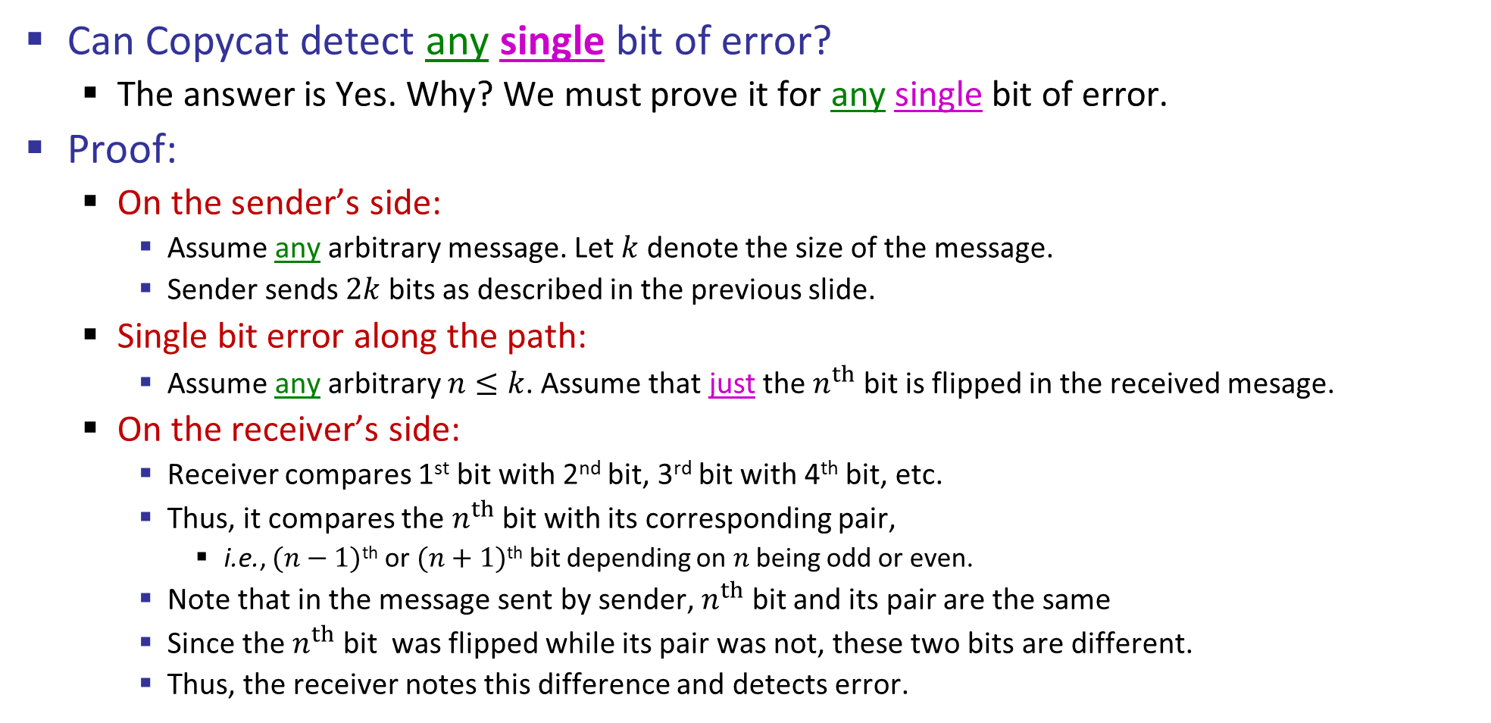
Copycat Coding Scheme
Can Copycat detect any single bit of error?
The answer is Yes. Why? We must prove it for any single bit of error.
Proof:
On the sender’s side:
Assume any arbitrary message. Let $k$ denote the size of the message.
Sender sends $2k$ bits as described in the previous slide.
Single bit error along the path:
Assume any arbitrary $n≤k$. Assume that just the $n^{th}$ bit is flipped in the received mesage.
On the receiver’s side:
Receiver compares 1st bit with 2nd bit, 3rd bit with 4th bit, etc.
Thus, it compares the $n^{th}$ bit with its corresponding pair,
i.e., $(n−1)$^{th} or $(n+1)$^{th} bit depending on $n$ being odd or even.
Note that in the message sent by sender, $n^{th}$ bit and its pair are the same
Since the $n^{th}$ bit was flipped while its pair was not, these two bits are different.
Thus, the receiver notes this difference and detects error.

Slide 11
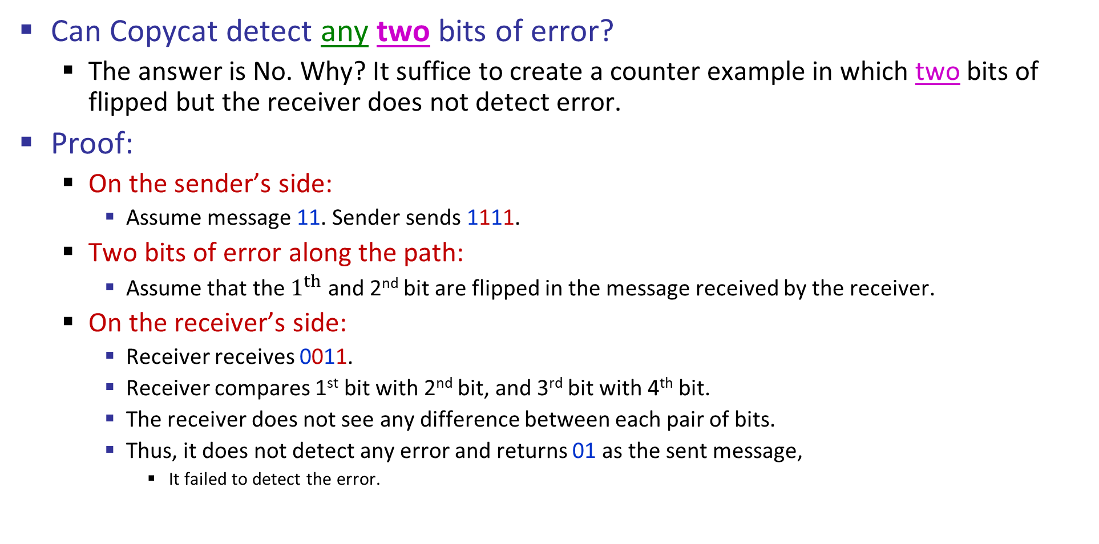
Copycat Coding Scheme
Can Copycat detect any two bits of error?
The answer is No. Why? It suffice to create a counter example in which two bits of flipped but the receiver does not detect error.
Proof:
On the sender’s side:
Assume message 11. Sender sends 1111.
Two bits of error along the path:
Assume that the $1^{th}$ and 2nd bit are flipped in the message received by the receiver.
On the receiver’s side:
Receiver receives 0011.
Receiver compares 1st bit with 2nd bit, and 3rd bit with 4th bit.
The receiver does not see any difference between each pair of bits.
Thus, it does not detect any error and returns 01 as the sent message,
It failed to detect the error.

Slide 12
Copycat Coding Scheme Properties
What is the maximum number of flip of bits that Copycat is guaranteed to detect? → 1
What is the overhead of Copycat? → 100%
Question: Can we do any better? Catching more kinds of errors with less overhead?
Answer: Yes – stronger protection with fewer bits is possible
But we can’t catch all inadvertent errors, nor malicious ones
We will look at basic block codes
K bits in, N bits out is a (N, K) block code.
k-information bits and (n-k) redundant error detection/correction bits.
They are simple, memoryless mapping

Slide 13
Outline
Error detection and correction
(N,K) block coding
Hamming distance
Parity,
2D-Parity
Checksums,
CRC, …

Slide 14
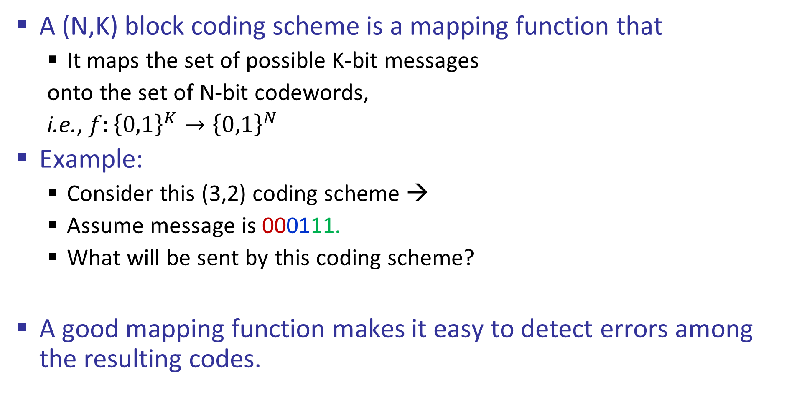
(N,K) Block Coding
A (N,K) block coding scheme is a mapping function that
It maps the set of possible K-bit messages
onto the set of N-bit codewords,
i.e., $f:{\left\{0,1\right\}}^{K}→{\left\{0,1\right\}}^{N}$
Example:
Consider this (3,2) coding scheme →
Assume message is 000111.
What will be sent by this coding scheme?
A good mapping function makes it easy to detect errors among the resulting codes.
The set of 2-bit messages
The set of 3-bit codewords
00
010
01
110
10
111
11
000

Slide 15
Copycat as (N,K) Block Coding
Example: Consider the Copycat coding scheme. Can you represent it as a (N,K) block coding scheme?
What are N and K? N=2, K=1
What is the mapping function?
The set of codewords
The set of messages
1
0
11
00

Slide 16
Outline
Error detection and correction
(N,K) block coding
Hamming distance
Parity,
2D-Parity
Checksums,
CRC, …

Slide 17
The Hamming Distance
The Hamming distance of two codewords:
The number of bits that are different between two codewords
e.g., HD(00001010, 01000110) = 3
The Hamming distance of a coding scheme:
Minimum HD between any pair of mapped codewords of that coding scheme
Example: Consider a (3, 2) coding scheme with this mapping function
What is this coding scheme’s Hamming distance?
1
00
010
110
01
10
111
11
000

Slide 18





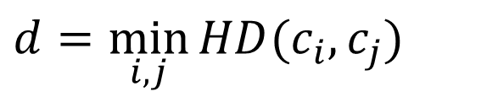

The Hamming Distance, cont’d
Let $d$ be the Hamming distance of a coding scheme:
The coding scheme can detect up to any $(d−1)$ bits of error. Why?
How? if what received is not any of the codewords, you detect error
Upon detecting an error, set the closest codeword to be the corrected version. This approach can correct up to any $\left\lfloor \frac{d−1}{2}\right\rfloor$ bits of error. Why?
Set of Codewords
$$c_{4}$$
$$c_{3}$$
$$HD(c_{2},c_{3})$$
$d=\min_{i,j}{HD(c_{i}, c_{j})}$
$$c_{1}$$
$$c_{2}$$

Slide 19
Next Week
Error detection and correction
(N,K) block coding
Hamming distance
Parity,
2D-Parity
Checksums,
CRC, …

