Slide 1












CSC358: Principles of Computer Networks
Lecture 4-Part 1: Error Detection and Correction
mobile network
4G
national or global ISP
Streaming
video
Skype
IP
local or regional ISP
home network
content
provider
network
HTTP
datacenter
network
Ethernet
TCP
enterprise
network
Erfan Meskar
Winter 2025, University of Toronto, Mississauga

Slide 2
So Far …
So far:
We studied why and where we need error detection and correction codes.
We saw two strategies to correct errors:
Request retransmition, or Automatic Repeat reQuest (ARQ)
Error correcting codes, or Forward Error Correction (FEC)
Now:
We study some basic idea behind coding.
Then, we briefly review some well-known coding scheme in internet.
First, let’s study a naïve coding scheme.

Slide 3
A Naïve Coding Scheme: Copycat Coding Scheme
Let’s start by studying a naïve coding scheme. We call it Copycat
Sender sends two copies. Receiver looks for differences.
Example:
Sender:
Assume we are asked to send 0110100.
We send 00111100110000 instead.
Receiver:
On the receiving end, we compare 1st bit with 2nd bit, 3rd bit with 4th bit, etc.
If we notice any difference between them, it means that there is an error.
For instance:
if we receive 00111101110000, we know that 7th or 8th bit was flipped.
i.e., we detected error.
00111100110000, we do not detect any error and return 0110100 as the sent message.

Slide 4
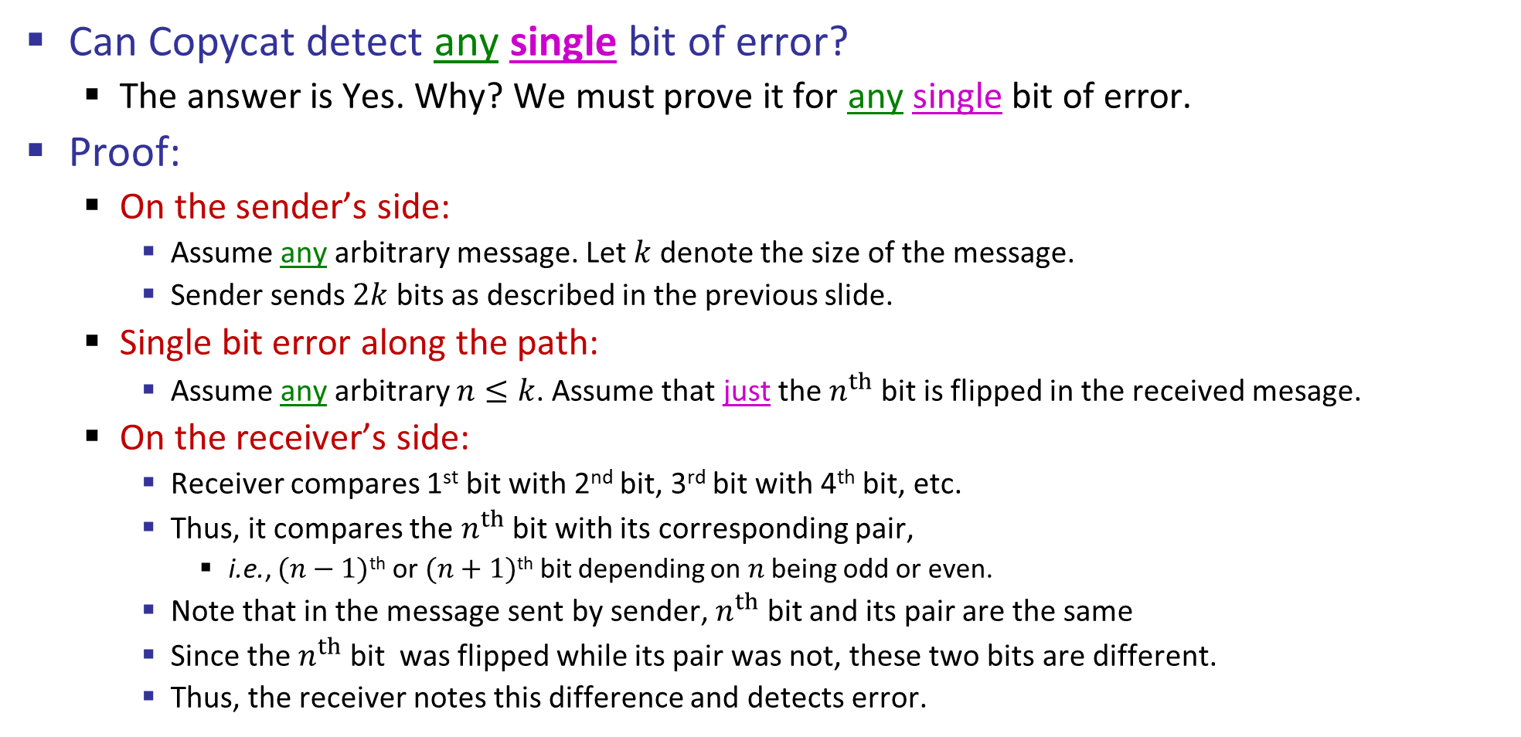
Copycat Coding Scheme
Can Copycat detect any single bit of error?
The answer is Yes. Why? We must prove it for any single bit of error.
Proof:
On the sender’s side:
Assume any arbitrary message. Let $k$ denote the size of the message.
Sender sends $2k$ bits as described in the previous slide.
Single bit error along the path:
Assume any arbitrary $n≤k$. Assume that just the $n^{th}$ bit is flipped in the received mesage.
On the receiver’s side:
Receiver compares 1st bit with 2nd bit, 3rd bit with 4th bit, etc.
Thus, it compares the $n^{th}$ bit with its corresponding pair,
i.e., $(n−1)$^{th} or $(n+1)$^{th} bit depending on $n$ being odd or even.
Note that in the message sent by sender, $n^{th}$ bit and its pair are the same
Since the $n^{th}$ bit was flipped while its pair was not, these two bits are different.
Thus, the receiver notes this difference and detects error.

Slide 5
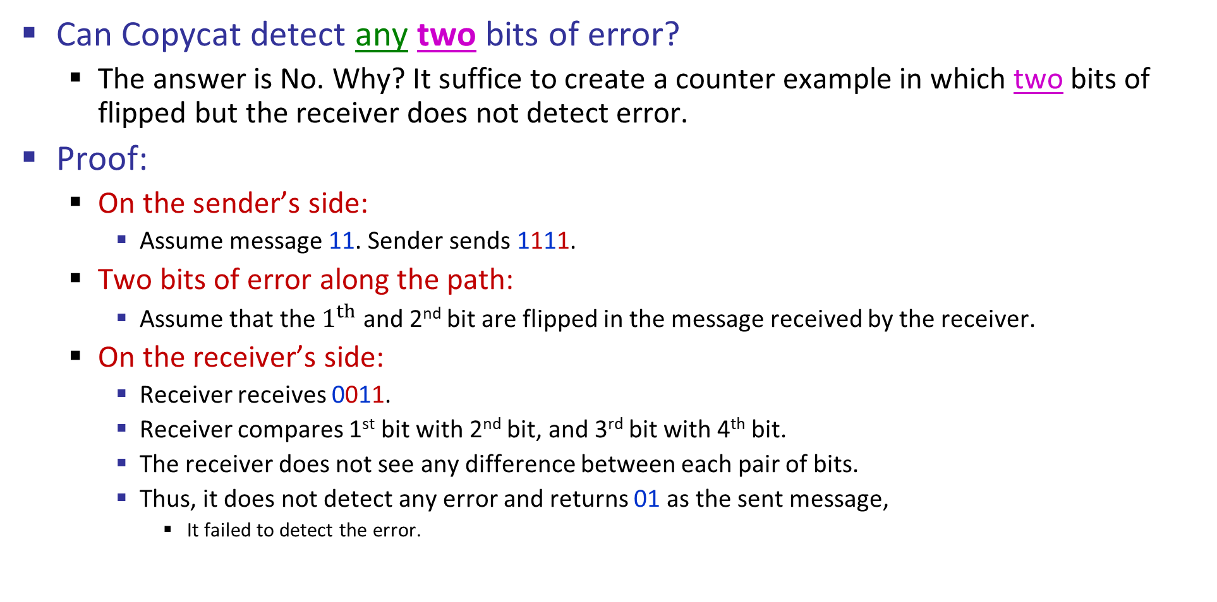
Copycat Coding Scheme
Can Copycat detect any two bits of error?
The answer is No. Why? It suffice to create a counter example in which two bits of flipped but the receiver does not detect error.
Proof:
On the sender’s side:
Assume message 11. Sender sends 1111.
Two bits of error along the path:
Assume that the $1^{th}$ and 2nd bit are flipped in the message received by the receiver.
On the receiver’s side:
Receiver receives 0011.
Receiver compares 1st bit with 2nd bit, and 3rd bit with 4th bit.
The receiver does not see any difference between each pair of bits.
Thus, it does not detect any error and returns 01 as the sent message,
It failed to detect the error.

Slide 6
Copycat Coding Scheme Properties
What is the maximum number of flip of bits that Copycat is guaranteed to detect? →
What is the overhead of Copycat? →
Question: Can we do any better? Catching more kinds of errors with less overhead?
Answer: Yes – stronger protection with fewer bits is possible
But we can’t catch all inadvertent errors, nor malicious ones
We will look at basic block codes
K bits in, N bits out is a (N, K) block code.
k-information bits and (n-k) redundant error detection/correction bits.
They are simple, memoryless mapping

Slide 7
Outline
Error detection and correction
(N,K) block coding
Hamming distance
Parity,
2D-Parity
Checksums,
CRC, …

Slide 8
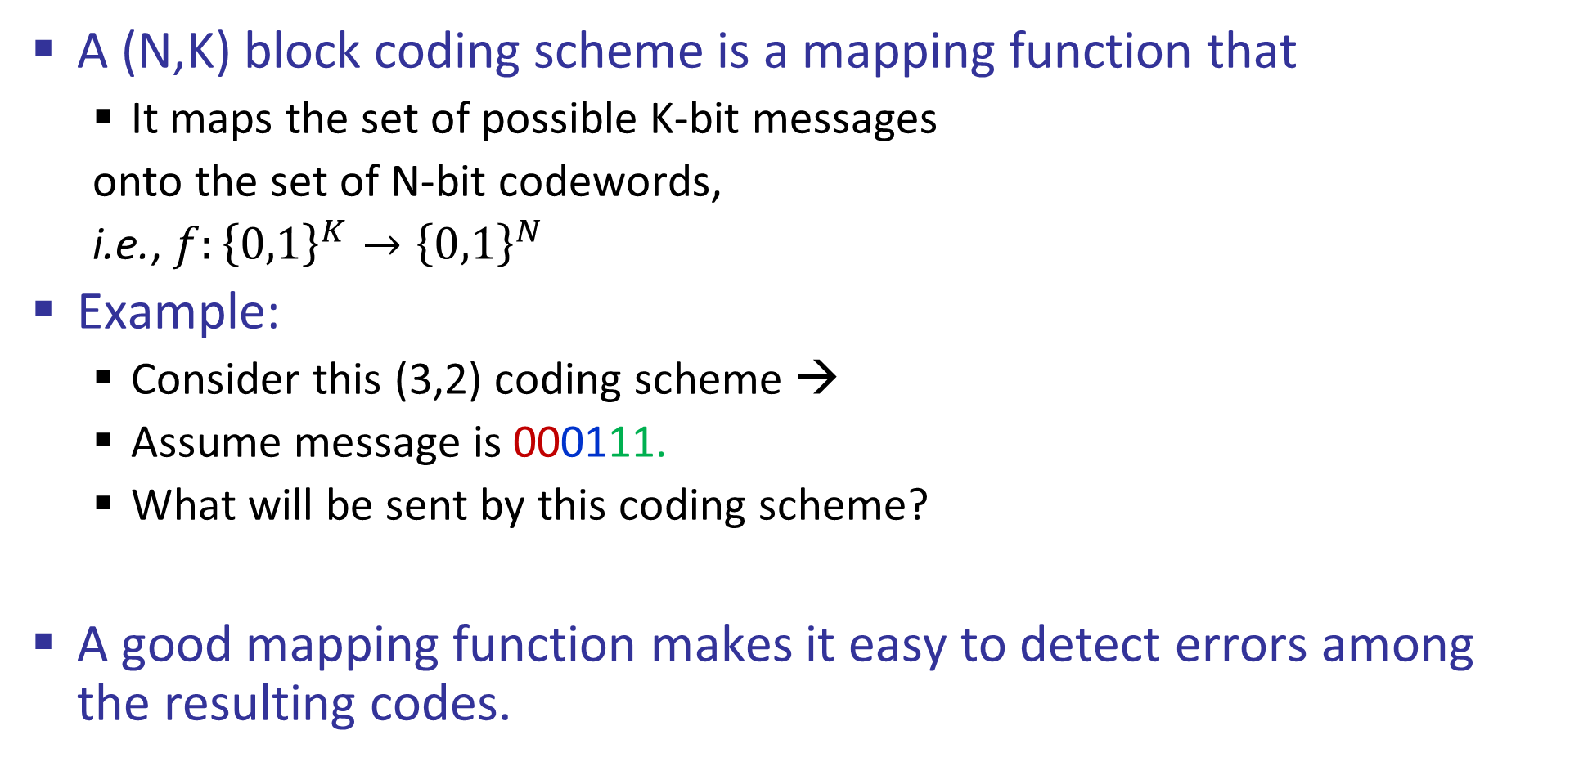
(N,K) Block Coding
A (N,K) block coding scheme is a mapping function that
It maps the set of possible K-bit messages
onto the set of N-bit codewords,
i.e., $f:{\left\{0,1\right\}}^{K}→{\left\{0,1\right\}}^{N}$
Example:
Consider this (3,2) coding scheme →
Assume message is 000111.
What will be sent by this coding scheme?
A good mapping function makes it easy to detect errors among the resulting codes.
The set of 2-bit messages
The set of 3-bit codewords
00
010
01
110
10
111
11
000

Slide 9
Copycat as (N,K) Block Coding
Example: Consider the Copycat coding scheme. Can you represent it as a (N,K) block coding scheme?
What are N and K?
What is the mapping function?
The set of codewords
The set of messages

Slide 10
Outline
Error detection and correction
(N,K) block coding
Hamming distance
Parity,
2D-Parity
Checksums,
CRC, …

Slide 11
The Hamming Distance
The Hamming distance between two codewords:
The number of bits that are different between two codewords
e.g., HD(00001010, 01000110) = 3
The Hamming distance of a coding scheme:
Minimum hamming distance between any pair of mapped codewords of that coding scheme
Example: Consider a (3, 2) coding scheme with this mapping function
What is this coding scheme’s
Hamming distance?
00
010
110
01
10
111
11
000

Slide 12





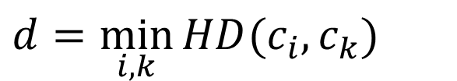

The Hamming Distance, cont’d
Let $d$ be the Hamming distance of a coding scheme:
The coding scheme can detect up to any $(d−1)$ bits of error. Why?
Upon detecting an error, set the closest codeword to be the corrected version. This approach can correct up to any $\left\lfloor \frac{d−1}{2}\right\rfloor$ bits of error. Why?
Set of Codewords
$$c_{4}$$
$$c_{3}$$
$$HD(c_{2},c_{3})$$
$d=\min_{i,k}{HD(c_{i}, c_{k})}$
$$c_{1}$$
$$c_{2}$$

Slide 13
Outline
Error detection and correction
(N,K) block coding
Hamming distance
Parity,
2D-Parity
Checksums,
CRC, …

Slide 14
1D-Parity – Error Detection
Start with n bits and add another so that the total number of 1s is even (even parity)
e.g., 0110010 → 01100101
Easy to compute as XOR of all input bits
Will detect an odd number of bit errors. Why?
But not an even number of bit errors. Why?
Cannot be used to correct any errors. Why?

Slide 15
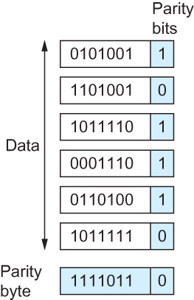
2D Parity – Error Correction
Add parity row/column to array of bits
Detects up to any three bits of errors,
and many errors with more than 3 bits (but not all of them).
Can successfully correct any 1 bit of errors
2D Parity

Slide 16
Checksums – Error Detection
Used in Internet protocols (IP, ICMP, TCP, UDP)
A simplified explanation of Internet Checksum Algorithm:
Add up the data and send it along with sum
An accurate explanation of the “Internet Checksum”:
Divide the data into 16-bit chunks.
Add the chunks together using “16-bit ones complement summation” (explained in the next slide).
Take the ones complement of the result from step 2. That 16-bit number is the checksum.

Slide 17
1’s Complement Summation
When adding numbers in ones complement summation,
a carryout (i.e., overflow) from the most significant bit needs to be added to the result
e.g., 1’s complement summation of 0xAB12 and 0xA933 is:
0x A B 1 2
+
0x A 9 3 3
----------------
0x 1 5 4 4 5
Add back the overflow
0x 1 5 4 4 5
+
1
------------------
0x 5 4 4 6
overflow
Thus, 1’s complement summation of 0xAB12 and 0xA933 is 0x5446.

Slide 18
Internet Checksum (at Sender)
Consider the message 0xAB12, 0xA933, 0xB001
Adding 0xAB12, 0xA933, and 0xB001 in 1’s complement summation:
Checksum is 1’s complement of 0x0448 = 0xFBB7
Sender sends 0xAB12, 0xA933, 0xB001, 0xFBB7
Words | 1’s complement summation | Sum | Overflow Wraparound
0xAB12 |  | 0x0000 + 0xAB12 = 0xAB12
0xA933 |  | 0xAB12 + 0xA933 = 0x15445 | Overflow: Add 1 (i.e., 0x5445 + 0x0001=0x5446)
 | 0x5446
0xB001 |  | 0x5446 + 0xB001 = 0x10447 | Overflow: Add 1 (i.e., 0x0447 + 0x0001=0x0448)
 | 0x0448

Slide 19
Internet Checksum (at Receiver)
Consider receiving 0xAB12, 0xA933, 0xB001, 0xFBB7
Add 0xAB12, 0xA933, 0xB001, and 0xFBB7 in 1’s complement summation. If the result is NOT 0xFFFF, then an error is detected.
If the result is 0xFFFF, the receiver accepts the message and removes the checksum
Words | 1’s complement summation | Sum (Hexadecimal) | Overflow Wraparound
0xAB12 |  | 0x0000 + 0xAB12 = 0xAB12
0xA933 |  | 0xAB12 + 0xA933 = 0x15445 | Overflow: Add 1
 | 0x5446
0xB001 |  | 0x5446 + 0xB001 = 0x10447 | Overflow: Add 1
 | 0x0448
0xFBB7 |  | 0xFFFF
 | 0xFFFF

Slide 20
CRCs (Cyclic Redundancy Check)
CRC Reduces the number of extra bits and maximizes protection
It is Stronger protection than checksums
Used widely in practice, e.g., Ethernet CRC-32
Implemented in hardware (XORs and shifts)
Mathematically more involved …*
* Details of CRC process is beyond the scope of the course. You do not need to know how it works.

Slide 21
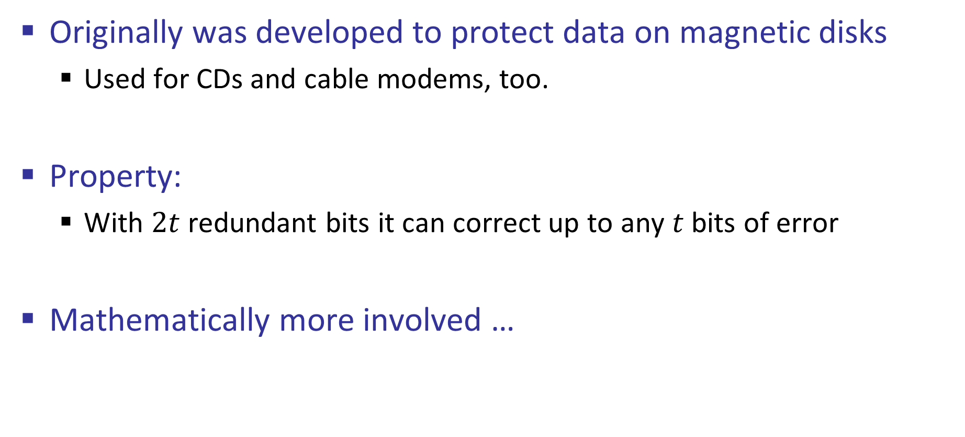
Reed-Solomon / BCH Codes*
Originally was developed to protect data on magnetic disks
Used for CDs and cable modems, too.
Property:
With $2t$ redundant bits it can correct up to any $t$ bits of error
Mathematically more involved …
* The content of this page is beyond the scope of the course and won’t be covered in your exams. Feel free to skip it.

Slide 22
Summary
Why do we need to detect and correct messages that are garbled during transmission.
The responsibility for doing this cuts across the different layers, namely Link, Network, and Transport Layer. We discussed why.
We saw two different techniques to overcome bit error, and where and when each one should be used.
We studied (N,K) block coding, hamming distance, and its relation to the number of bit errors that are guaranteed to be detected or corrected.
We studies 1D Parity, 2D Parity, and Internet Checksum

