Slide 1












CSC358: Principles of Computer Networks
Lecture 4 – Part 2: Multiple Access Links
mobile network
4G
national or global ISP
Streaming
video
Skype
IP
local or regional ISP
home network
content
provider
network
HTTP
datacenter
network
Ethernet
TCP
enterprise
network
Erfan Meskar
Winter 2025, University of Toronto, Mississauga

Slide 2
Warning
In the following slides, we use animations to better illustrates the ideas in this part of the lecture.
Quercus in unable to show these animations.
Please download the slides and use proper Powerpoint slide viewer to see the animations.

Slide 3
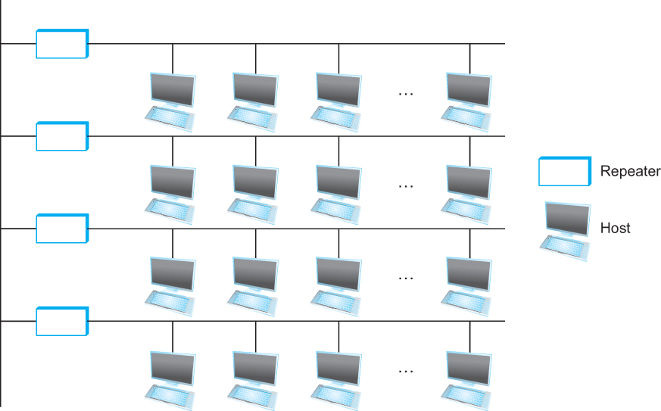
So Far …
So far:
We saw how to connect two hosts and send frames
Link layer protocols specify how to talk to your “neighbors”
Now:
How do we build a “small” network with this?
Within a building, campus
Local Area Network (LAN)
packet
Data link layer protocol
packet
frame
frame
adapter
adapter
Bits flow between adaptors, frames between hosts

Slide 4
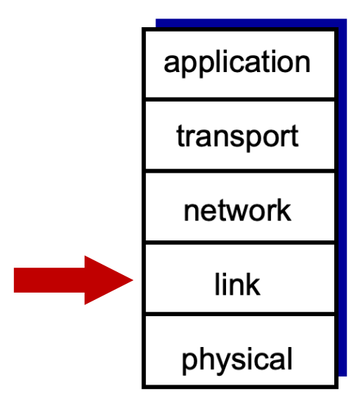

Outline
Shared Medium and Collision
MAC Approaches

Slide 5
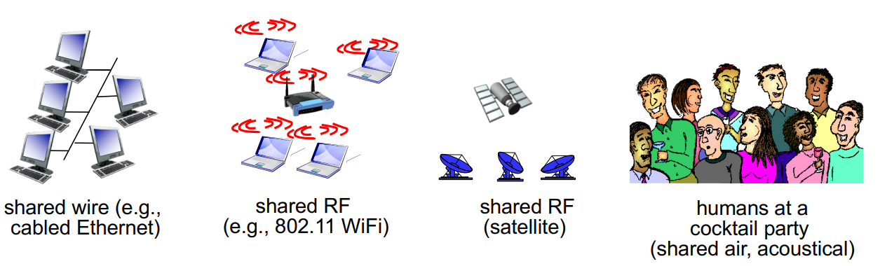
Two Types of Network Mediums
Point-to-Point
PPP for dial-up access
1000BASE-T (Gigabit Ethernet) for point-to-point link between Ethernet switch and host (with CAT5 cable)
10GBASE-ER (10 Gigabit Ethernet) for long-distance fiber link
Shared Medium
The channel may be shared among multiple hosts!
Traditional Ethernet (pre ~2000)
802.11 wireless LAN
Cellular network

Slide 6
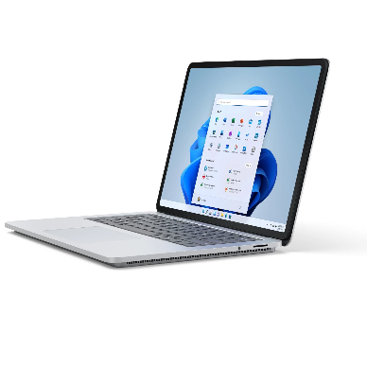

Collisions on Shared Medium
When only one host transmits, there’s no collision:
Host C
Host D
time
Host A wants to send this signal to Host D
Host B
Host A

Slide 7
Collisions on Shared Broadcast Medium
When more than one host transmits, we may have collision:
Host C wants to send this signal to Host B
Host D
Host C
time
Host A wants to send this signal to Host D
Host B
Host A

Slide 8
Collisions on Shared Broadcast Medium
When more than one host transmits, we may have collision:
What does host B receive?
The signals from hosts A and C collide
Thus, host B received signal is the superposition of those two signals.
Host C wants to send this signal to Host B
Host B receives this signal
time
Host D
Host C
time
time
Host A wants to send this signal to Host D
Host B
Host A

Slide 9

Collisions on Shared Broadcast Medium
For a single shared broadcast channel
We need to avoid having multiple nodes speaking at once. Otherwise, collisions lead to garbled data
We need Medium Access Control (MAC) algorithms to determine how nodes sould share channel, i.e., determine when a node can transmit.

Slide 10
Outline
Types of Network Mediums
Point-to-point
Broadcast
Shared Broadcast Medium and Collision
MAC Approaches
Channel partitioning
Turn taking
Random access

Slide 11
Why Are There Different Types of MAC Approaches?
Different types of links solve these problems differently
Ethernet (wired) vs. Wifi (wireless)
In wired Ethernet, it is easier to detect that something is going wrong
However, in wireless links, it is difficult to detect trouble.
Thus, they need different MAC approaches.
We will study the wired case.
Different MAC approaches provide different throughput, reliability, etc.
They also rely on physical layer characteristics (encoding, modulation, etc.)

Slide 12
Types of MAC Approaches: 1. Channel Partitioning
In channel partitioning approach:
We divide channel into smaller “pieces” (e.g., time slots, frequency, code), and allocate each piece to a node for exclusive use.
Examples of channel partitioning techniques:
Time Division Multiple Access (TDMA)→ cable internet access
Frequency Division Multiple Access (FDMA) →cable internet access
Code Division Multiple Access (CDMA) →cellular telephony

Slide 13
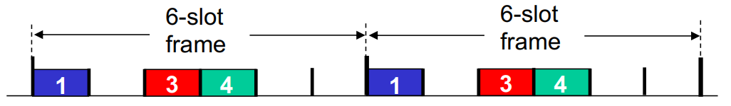
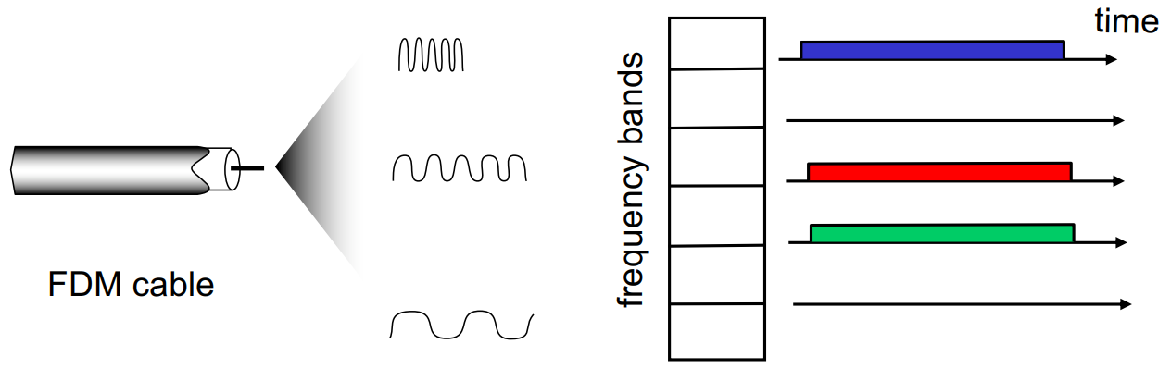
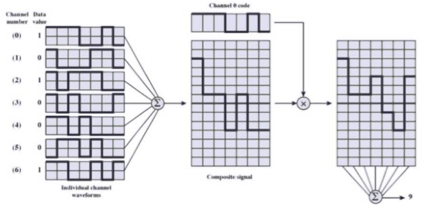
Channel Partitioning MAC Protocols
TDMA: each station gets fixed length slot in each round
FDMA: channel spectrum divided into frequency bands
CDMA: Encode with a set of vectors that are mutually orthogonal

Slide 14
Types of MAC Approaches: 2. Taking Turns
Taking turns:
Nodes take turns, but nodes with more to send can take longer turns
Examples of taking turns techniques:
Token-passing protocol, Polling protocol → Bluetooth

Slide 15
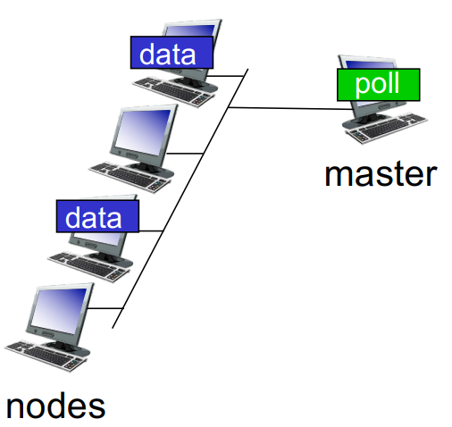
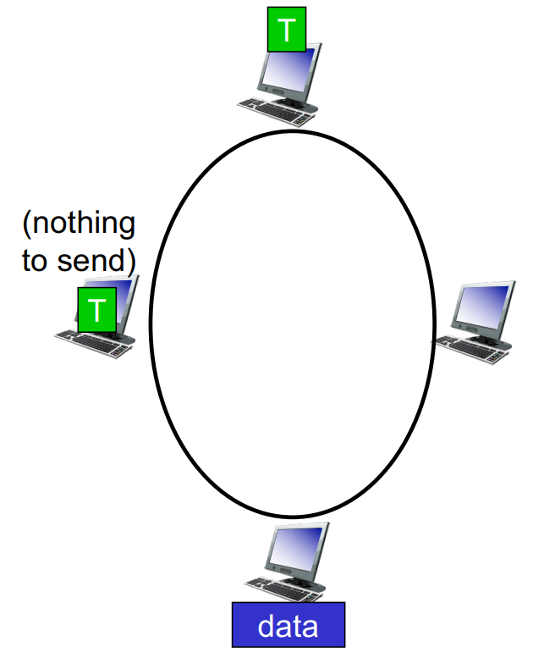
“Taking Turns” MAC Protocols
Polling:
Master “invites” nodes to transmit in turn
Typically used with “dumb” nodes
Concerns:
Polling overhead, latency, single point of failure (master)
Token passing:
A special frame, known as token passed from one node to next sequentially.
When you have the token, send up to the maximum number of frames (if you have any), then pass the token
Concerns:
Token overhead, latency, failure of one node can crash entire network

Slide 16
Types of MAC Approaches: 3. Random Access
Random access:
Channel not divided, allow collisions
“Recover” from collisions
Examples of random access techniques:
ALOHA/ Slotted ALOHA
Carrier Sense Multiple Access / Collision Detection (CSMA/CD)→Ethernet
Carrier Sense Multiple Access / Collision Avoidance (CSMA/CA)→Wifi
We will study CSMA/CD

Slide 17
Random Access MAC Protocols
When node has packet to send
Transmit at full channel data rate R
No a priori coordination among nodes
If two or more nodes are transmitting simultaneously → collision
Random access MAC protocol specifies:
How to detect collisions
How to recover from collisions (e.g., via delayed retransmissions)

Slide 18
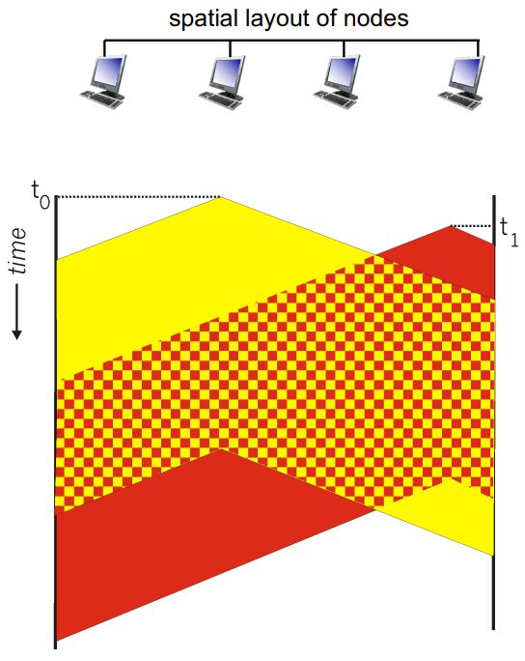
Carrier Sense Multiple Access (CSMA)
CSMA:
listen before transmit,
If channel is sensed idle, transmit entire frame
If channel is sensed busy, defer transmission
CSMA collisions:
propagation delay means two nodes may not hear each other’s transmission
Collision makes the entire packet transmission time wasted
distance & propagation delay play role in determining collision probability

Slide 19
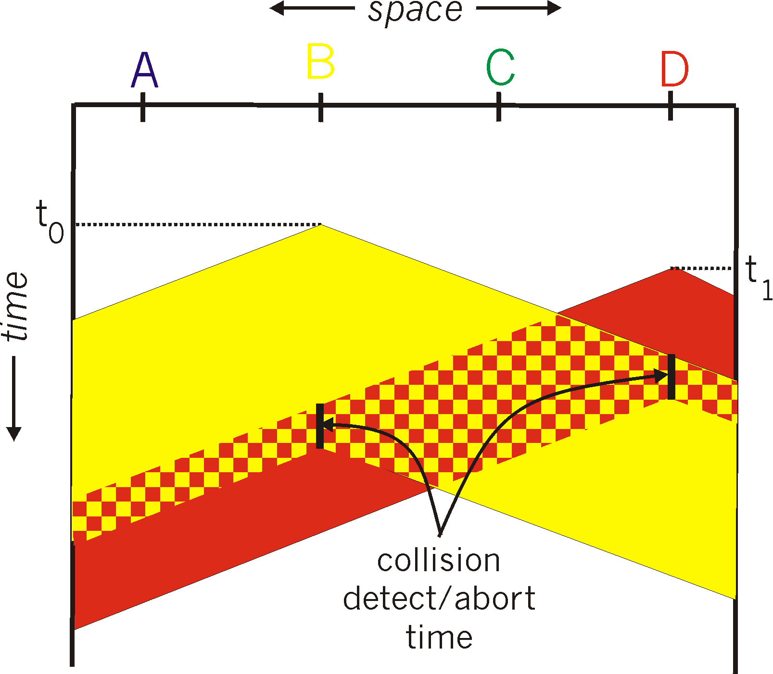
CSMA/CD (Collision Detection)
Collision detection:
Easy in wired LANs: measure signal strengths, compare transmitted and received signals
How does CSMA/CD work?
If channel is sensed busy, defer transmission (CSMA)
When you’re transmitting, if a collision is detected, abort transmission and wait for a random period before retransmitting (CD)

Slide 20
Limits on CSMA/CD Network Length
For this to work, we need restrictions on minimum frame size or maximum distance.
Consider this example →
Would Host B realize that its frame collided with Host D’s frame?
Would Host D realize that its frame collided with Host B’s frame?
Why?

Slide 21
Limits on CSMA/CD Network Length
In the example below, will host A and C ever realize that they caused a collision?
Host C wants to send this signal to Host B
Host D
Host C
time
Host A wants to send this signal to Host D
Host B
Host A

Slide 22
Limits on CSMA/CD Network Length
How about now?
Host A’s frame is larger now (i.e., longer waveform signal).
Would A realize that it caused a collision?
Host C wants to send this signal to Host B
Host D
Host C
Host B
Host A
time
Host A wants to send this signal to Host D

Slide 23
Limits on CSMA/CD Network Length
Latency depends on physical length of link
Time to propagate a packet from one end to the other
Suppose A and B are two host on the two ends of the network.
Suppose A sends a packet at time t
And B sees an idle line at a time just before t+d
So, B happily starts transmitting a packet
B detects a collision and aborts
But A won’t receive B’s signal until t+2d
A
B
latency d

Slide 24

Limits on CSMA/CD Network Length
In the worst-case, Host A receives B’s signal that collided with its own signal after 2$d$^{prop}.
For Host A to be able to detect the collision, its frame must be large enough to keep Host A transmitting during this period
Otherwise, when A receives B’s signal, A is quiet and won’t realize that its frame was collided.

Slide 25
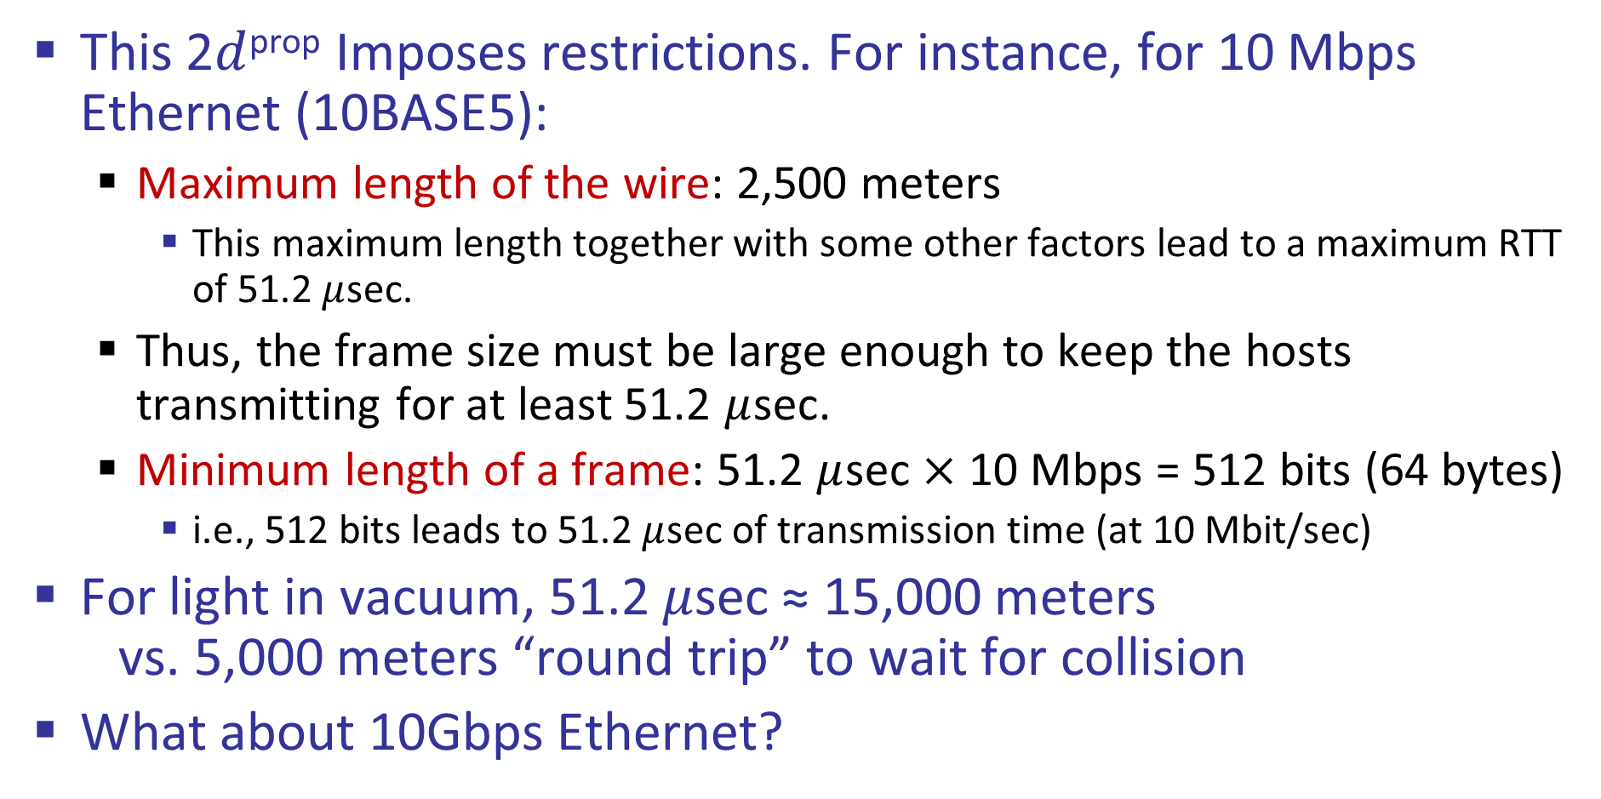
Limits on CSMA/CD Network Length
This 2$d$^{prop} Imposes restrictions. For instance, for 10 Mbps Ethernet (10BASE5):
Maximum length of the wire: 2,500 meters
This maximum length together with some other factors lead to a maximum RTT of 51.2 $μ$sec.
Thus, the frame size must be large enough to keep the hosts transmitting for at least 51.2 $μ$sec.
Minimum length of a frame: 51.2 $μ$sec $×$ 10 Mbps = 512 bits (64 bytes)
i.e., 512 bits leads to 51.2 $μ$sec of transmission time (at 10 Mbit/sec)
For light in vacuum, 51.2 $μ$sec ≈ 15,000 meters vs. 5,000 meters “round trip” to wait for collision
What about 10Gbps Ethernet?

Slide 26
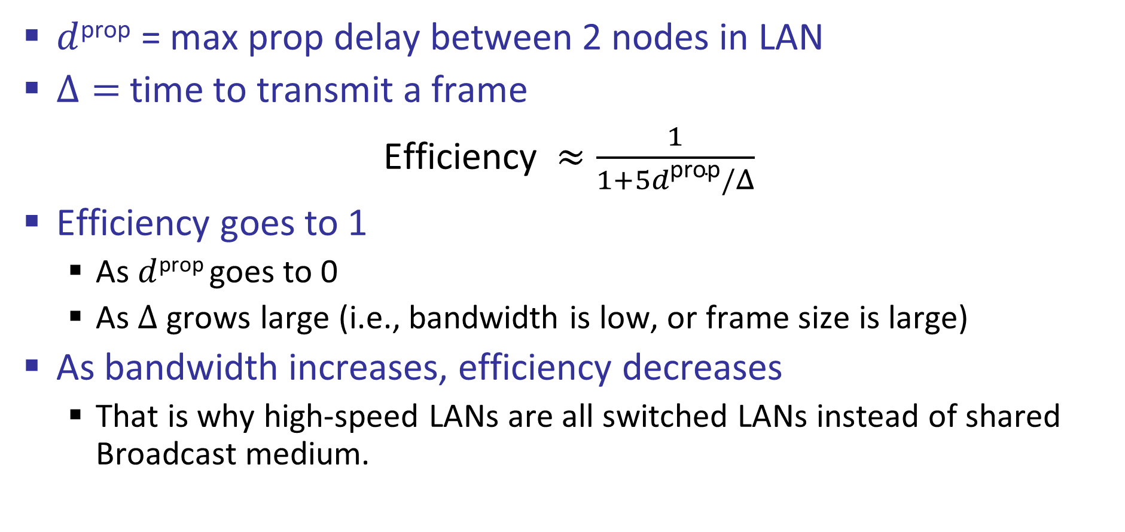
CSMA/CD Efficiency
$d$^{prop} = max prop delay between 2 nodes in LAN
$Δ=$ time to transmit a frame
Efficiency $≈\frac{1}{1+5d\text{prop}/Δ}$
Efficiency goes to 1
As $d$^{prop} goes to 0
As $Δ$ grows large (i.e., bandwidth is low, or frame size is large)
As bandwidth increases, efficiency decreases
That is why high-speed LANs are all switched LANs instead of shared Broadcast medium.
You do not need to memorize this equation in your exams. If needed, we will provide it.

Slide 27
Collision Detection Is Not Always Easy
Collision detection:
Easy in wired LANs: measure signal strengths, compare transmitted and received signals
Difficult in wireless LANs: received signal strength overwhelmed by local transmission strength
It uses a different technique: CSMA/CA (collision avoidance)→If time permits, we may discuss it later in the course.

