Slide 1












CSC358: Principles of Computer Networks
Lecture 5 – Part 2: Switched LANs
mobile network
4G
national or global ISP
Streaming
video
Skype
IP
local or regional ISP
home network
content
provider
network
HTTP
datacenter
network
Ethernet
TCP
enterprise
network
Erfan Meskar
Winter 2025, University of Toronto, Mississauga

Slide 2
So Far …
So far:
Network Interface Cards (NICs) send frame
They have an “address”:
MAC (Medium Access Control) address
48 bits
Assigned by manufacturer
permanently hard-coded (“burned in”) on a device
Nodes write their own MAC address and next hop MAC address as the source and destination MAC address in L2 header
We saw how shared Ethernet, e.g., 10BASE5 works
Today:
Interconnecting LANs
Interconnect in Physical Layer
Interconnect in Link Layer
Why Are Modern Ethernet “Switched”?
Cut-through switching
Self-learning switches
Spanning tree

Slide 3
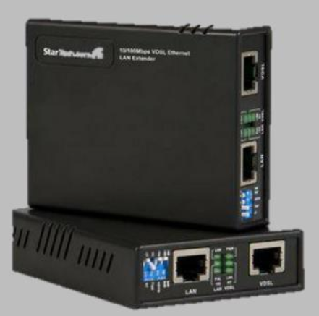
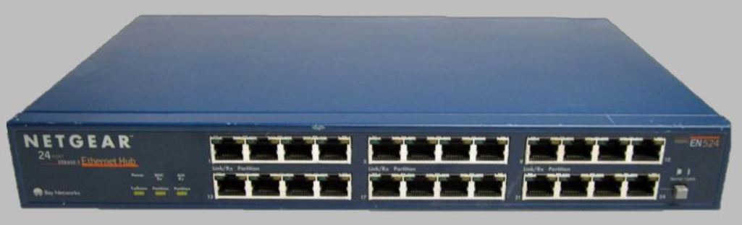
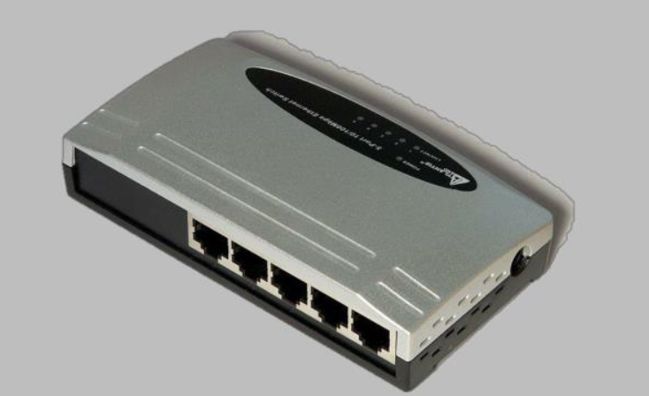
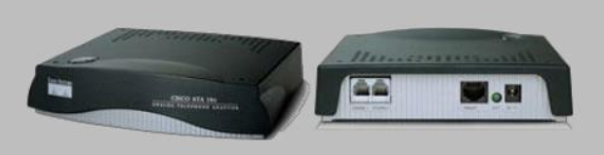
Interconnecting LANs
How to interconnect several LANs
Technology:
Physical Layer: Repeaters and Hubs
Data Link Layer: Bridges and Switches
Repeater
Hub
Switch
Bridge

Slide 4

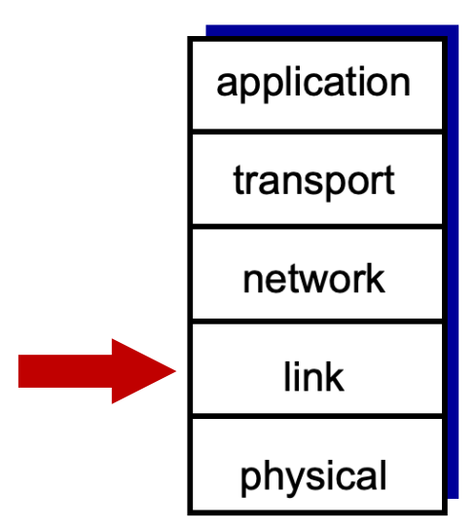
Today
Interconnecting LANs
Interconnect in Physical Layer
Interconnect in Link Layer
Why Are Modern Ethernet “Switched”?

Slide 5
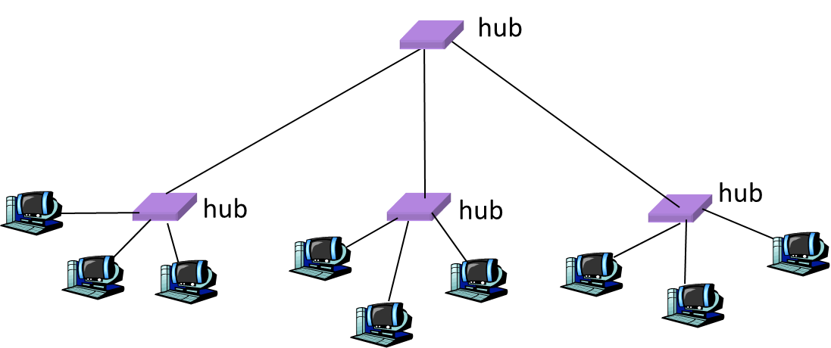
Interconnect LANs in L1: Repeater and Hub
Repeaters and hubs join LANs together in Physical Layer.
Upon receiving a signal on a port, they send it out on all other ports.
They are dumb analog devices operating in L1.
They don’t operate in L2. Thus, they don’t understand frames.
Repeater has two ports.
Best used for connecting two bus segments
Repeater transmits an amplified copy
Hubs have multiple ports
Best used for connecting multiple nodes
Hubs do not necessarily amplify the signal

Slide 6
Limitations of Repeaters and Hubs
All connected nodes are in one large collision domain
All hosts are competing for access to the same link
Hence, they are said to be in the same collision domain
Every bit is sent everywhere
So, aggregate throughput is limited
Cannot support multiple LAN technologies
Does not buffer or interpret frames
So, can’t interconnect between different rates or formats
e.g., 10 Mbps Ethernet and 100 Mbps Ethernet
Limitations on distances
e.g., still cannot go beyond 2500 meters on Ethernet

Slide 7
Today
Interconnecting LANs
Interconnect in Physical Layer
Interconnect in Link Layer
Why Are Modern Ethernet “Switched”?

Slide 8
Interconnecting LANs in L2: Bridges
Intelligent device that connects two or more bus segments at the link layer (L2)
Extracts destination address from the frame
Looks up the destination in its forwarding table
Forwards the frame to the appropriate LAN segment
Each segment is its own collision domain
Nodes in the same segment cannot send frames simultaneously
Nodes on different segments can send frames simultaneously
host
host
host
host
host
host
Bridge
host
host
host
host
host
host

Slide 9
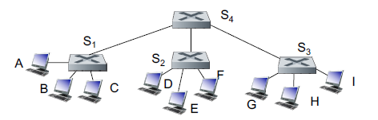
Interconnecting LANs in L2: Switches
A switch is essentially the same as a bridge, though typically used to connect hosts, not LANs segments
Each connection is a bidirectional point-to-point link
Host has direct, full duplex* connection to the switch rather than a shared LAN connection
Like bridges, switches support concurrent communication
In the figure below, Host A can talk to C, while B talks to D
* Full duplex: Both host and switch can send and receive data at the same time.

Slide 10
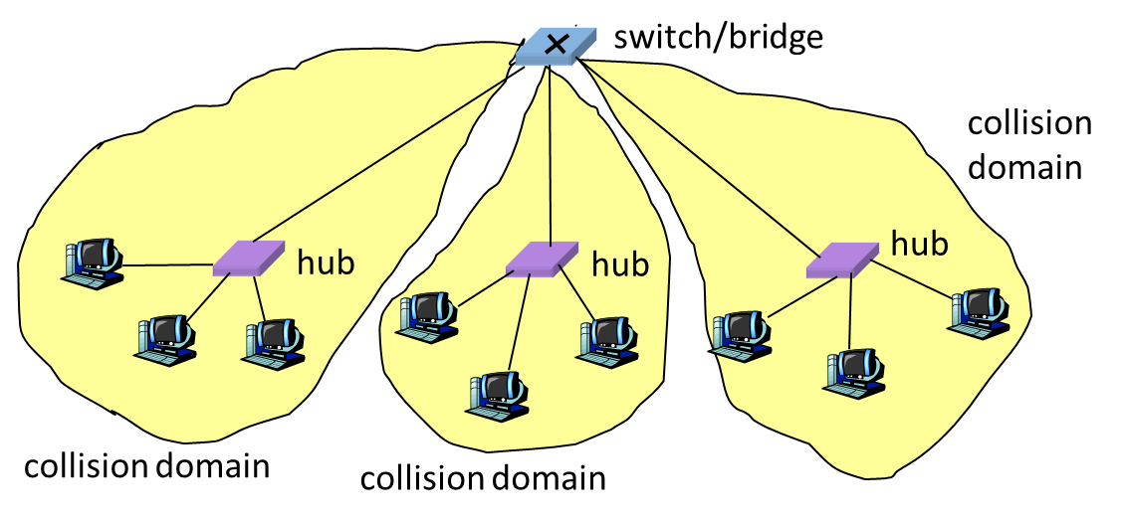
Bridges and Switches – Traffic Isolation
Switch and bridge forward a frame only to the necessary port
Lookup the destination MAC address of the frame in their forwarding table
Thus, segments become separate collision domains
This allows longer distances, i.e., extended geographic span of the network
This improves privacy by limiting the scope of frames
They apply carrier sense and collision detection
Does not transmit when the link is busy.
Applies exponential back-off after a collision
They can join segments that use different technologies (e.g., different transmission rate)

Slide 11
Today
Interconnecting LANs
Interconnect in Physical Layer
Interconnect in Link Layer
Why Are Modern Ethernet “Switched”?

Slide 12
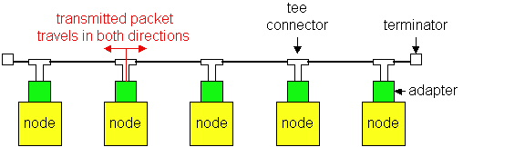
Why Are Modern Ethernet “Switched”?
Ethernet was invented as a broadcast technology
Hosts share channel
Each packet received by all attached hosts
CSMA/CD for access control
Current Ethernets are “switched”
bidirectional point-to-point link
Why Are Modern Ethernet “Switched”?

Slide 13
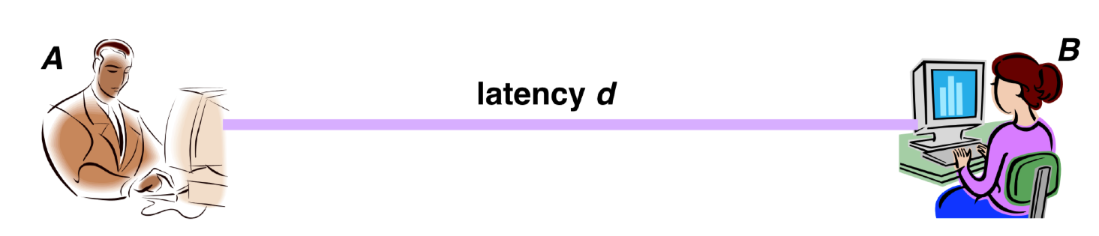
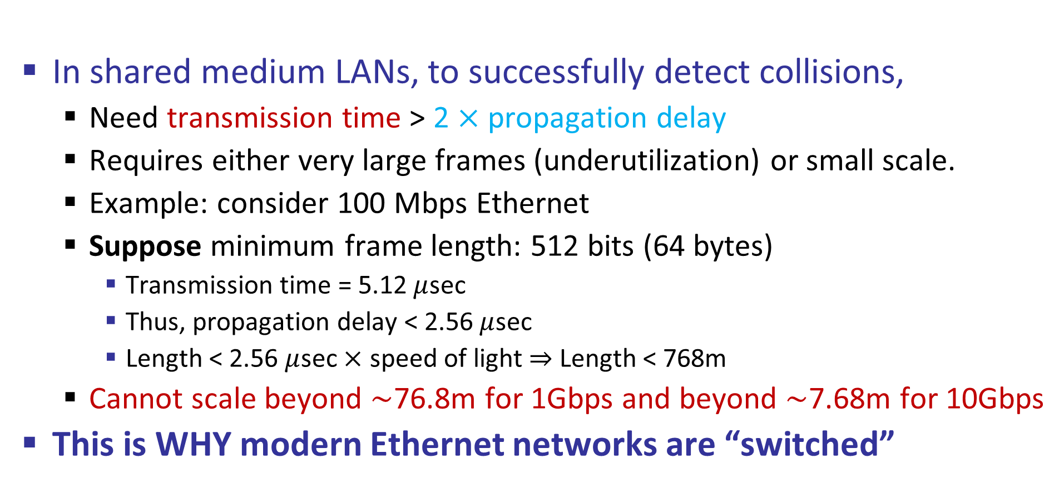
Limits on Traditional Ethernet Scalability
In shared medium LANs, to successfully detect collisions,
Need transmission time > 2 $×$ propagation delay
Requires either very large frames (underutilization) or small scale.
Example: consider 100 Mbps Ethernet
Suppose minimum frame length: 512 bits (64 bytes)
Transmission time = 5.12 $μ$sec
Thus, propagation delay < 2.56 $μ$sec
Length < 2.56 $μ$sec $×$ speed of light $⇒$ Length < 768m
Cannot scale beyond $\sim$76.8m for 1Gbps and beyond $\sim$7.68m for 10Gbps
This is WHY modern Ethernet networks are “switched”

Slide 14
Disadvantages Over Hubs/Repeaters
More expensive compared to hub/repeater
Delay in forwarding frames
Bridge/switch must receive and parse the frame and perform a look-up to decide where to forward
Storing and forwarding the packet introduces delay
Solution: cut-through switching → We’ll study this in the next slide
Need to learn where to forward frames
Bridge/switch needs to construct a forwarding table
Ideally, this must be done without intervention from network administrators
Solution: learning switches→ We’ll study this in the next part

Slide 15
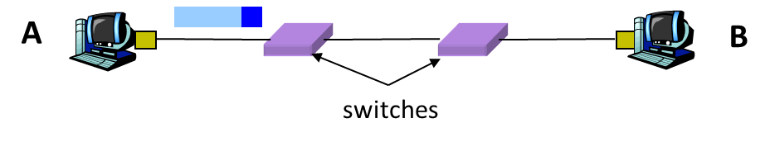
Store-and-forward vs. Cut-through Switching
Store-and-forward switching
Buffering a frame takes time
Suppose L is the length of the frame and R is the transmission rate
It takes L/R to receive the frame
This buffering delay can be a high fraction of total delay
Propagation delay is small over short distances
Thus, buffering delay is a large fraction of total delay
Cut-through switching
Starts transmitting as soon as possible
Inspects the frame header and do the look-up in the forwarding table
If outgoing link is idle, starts forwarding the frame
It allows overlapping transmissions
Transmits the head of the packet via the outgoing link, while still receiving the tail via the incoming link

