Slide 1












CSC358: Principles of Computer Networks
Lecture 5 – Part 3: L2 Switches Forwarding
mobile network
4G
national or global ISP
Streaming
video
Skype
IP
local or regional ISP
home network
content
provider
network
HTTP
datacenter
network
Ethernet
TCP
enterprise
network
Erfan Meskar
Winter 2025, University of Toronto, Mississauga

Slide 2

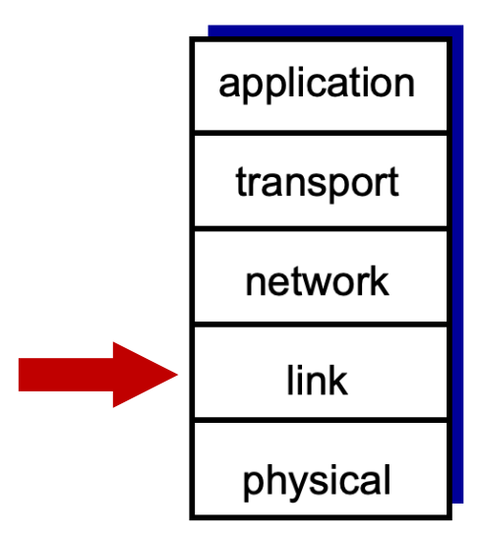
Today
Forwarding in Switched Ethernet
Populating The Forwarding Table
Using Spanning Tree Protocol to Remove Loops

Slide 3
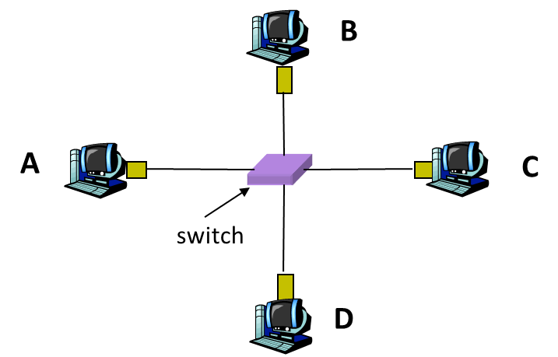
Forwarding Table
Switch forwarding table
Maps destination MAC address to outgoing interface
Goal: construct the switch table automatically
Key idea:
When you receive a frame, you get a clue about where the sender is
Use this idea to add a table entry for the sender. As more packets get sent, more table entries get added.
Note: The packet only helps you learn about the sender, not the receiver.
Forwarding is destination-based: Use the destination to decide the next-hop.
If the destination exists in the table: Forward to corresponding next-hop.
If not: Flood out of all ports (except incoming port).

Slide 4
Learning Switches: Populating the Forwarding Table
When a frame arrives
Inspect the source MAC address
Associate the address with the incoming interface (port number) and store the mapping in the forwarding table
Each table entry is associated with a Time-To-Live (TTL), typically 5 minutes.
If the TTL reaches 0, the entry is deleted.
This allows invalid routes (e.g., link goes down) to eventually expire.
If a frame is received from the same MAC address, reset the TTL for that entry in the table.
When frame arrives
If the destination exists in the table, forward to corresponding next-hop.
If it is unfamiliar destination, forward it out on every interface, except for the ingress one
Don’t have this destination address in my table. So, I’ll flood it
When in doubt, shout!

Slide 5
Learning Switches: Example
All tables start empty. Nobody has an entry for B, so the packet gets flooded.
Along the way, everyone gets a clue about A's location, and adds a table entry for A.
S2's Table
To: | Next-hop:
A | S1
S3's Table
To: | Next-hop:
A | S2
S2's Table
To: | Next-hop:
S3's Table
To: | Next-hop:
S1's Table
To: | Next-hop:
A | A
S1's Table
To: | Next-hop:
S2
S3
B
From: A, To: B
From: A, To: B
From: A, To: B
A
S1
From: A, To: B
From: A, To: B
From: A, To: B
From: A, To: B
From: A, To: B
S4
S5
C
S4's Table
To: | Next-hop:
S5's Table
To: | Next-hop:
S4's Table
To: | Next-hop:
A | S1
S5's Table
To: | Next-hop:
A | S4

Slide 6
Learning Switches: Example
This frame can get directly forwarded to A (no flooding) using the forwarding tables.
Routers along the B-to-A path get a clue about B's location, and add a table entry for B.
S2's Table
To: | Next-hop:
A | R1
B | S3
S3's Table
To: | Next-hop:
A | R2
B | B
S2's Table
To: | Next-hop:
A | R1
S3's Table
To: | Next-hop:
A | R2
S1's Table
To: | Next-hop:
A | Direct
B | S2
S1's Table
To: | Next-hop:
A | Direct
S2
S3
B
From: B, To: A
From: B, To: A
From: B, To: A
A
S1
From: B, To: A
From: B, To: A
S4
S5
C
S4's Table
To: | Next-hop:
A | S1
S5's Table
To: | Next-hop:
A | S4

Slide 7
A Very Important Note
A switch will process any frame that it receives on their active links, regardless of the source and destination MAC addresses in the frame.
Hosts and routers are different. A host or a router only process a frame if the destination MAC address of the frame is
equal to their MAC address (i.e., unicast)
equal to the its multicast group (i.e., multicast)
equal to FF:FF:FF:FF:FF:FF (i.e., broadcast)
Note that switches DON’T change the source MAC and destination MAC of the frame as they forward it.
We’ll see that routers change the source and destination MAC address in the frame.
S2's Table
To: | Next-hop:
A | R1
B | S3
S3's Table
To: | Next-hop:
A | R2
B | B
S2's Table
To: | Next-hop:
A | R1
S3's Table
To: | Next-hop:
A | R2
A
S2
S3
B
From: B, To: A
From: B, To: A
(it is NOT changed to:
From: B, To: S2, or
From:S3, To: A)
From: B, To: A

Slide 8
Today
Forwarding in Switched Ethernet
Populating The Forwarding Table
Using Spanning Tree Protocol to Remove Loops

Slide 9
Flooding Can Lead to Loops
Switches sometimes need to broadcast frames
Upon receiving a frame with an unfamiliar destination
Upon receiving a frame sent to the broadcast address
Broadcasting is implemented by flooding
Transmitting frame out every interface, except the one where the frame arrived
Flooding can lead to forwarding loops
e.g., if the network contains a cycle of switches
Either accidentally, or by design for higher reliability

Slide 10
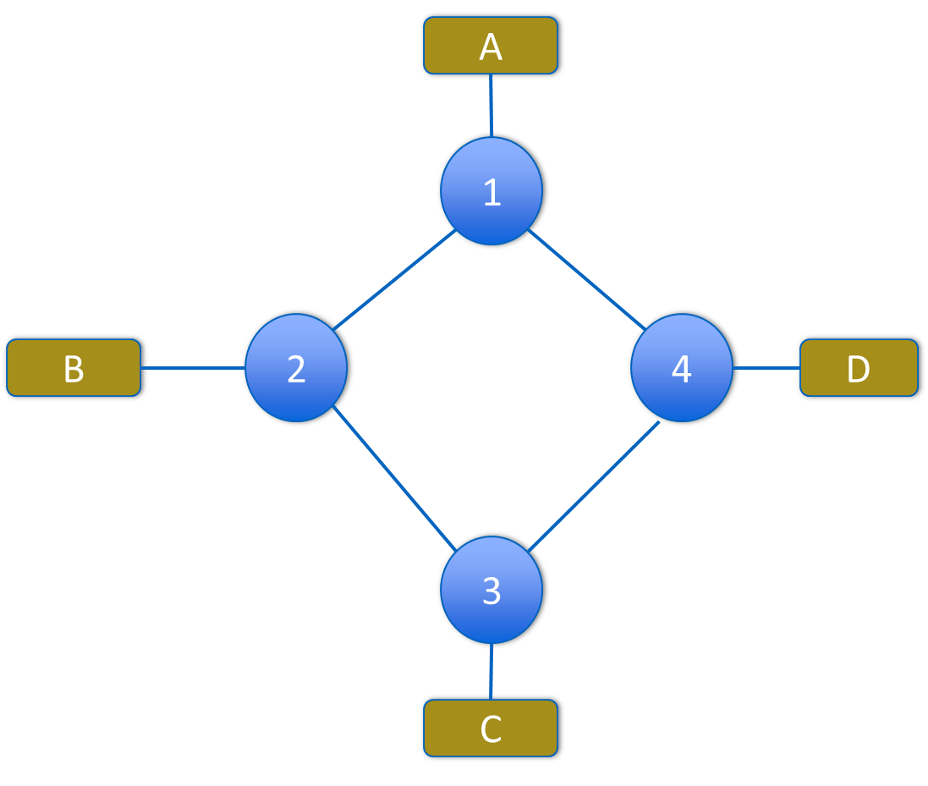
Flooding Can Lead to Loops
Example: A wants to broadcast a message
A sends packet to 1
1 Floods to 2 and 4
2 Floods to B and 3
4 Floods to D and 3
3 Floods packet from 2 to C and 4
3 Floods packet from 4 to C and 2
4 Floods packet from 3 to D and 1
2 Floods packet from 3 to B and 1
1 Floods packet from 2 to A and 4
1 Floods packet from 4 to B and 2
…
I want to Broadcast a message
OMG
what have I done??

Slide 11
Dealing with Loops
Enters Radia Perlman
“we have designed an algorithm that allows the extended network to consist of an arbitrary topology. The algorithm computes a subset of the topology that connects all LANs yet is loop-free (a spanning tree).”
Perlman, Radia (1985). "An Algorithm for Distributed Computation of a Spanning Tree in an Extended LAN“, ACM SIGCOMM

Slide 12
Easiest Way to Avoid Loops
Ensure the topology has no loops
Avoid using some of the links when flooding to avoid forming a loop
How can we ensure that the topology has no loops?
By build spanning tree*
Links not in the spanning tree are not used in forwarding frames, i.e., will be blocked.
Graph Has Cycles!
Don’t forward on these links
Graph Has No Cycles!
* A spanning tree is a sub-graph that covers all vertices but contains no cycles

Slide 13
Spanning Tree Protocol (STP)
STP is the protocol by which switches construct a spanning tree
It has nice properties and is still being used by switches
Zero configuration (by operators or users)
Self healing: when the network changes, switches will find another spanning tree for the new network
Key ingredients of STP:
Switches need to elect a “root”
Each switch must identify the interfaces that are on the shortest path from the root and exclude the interfaces that are not on the shortest path
root

Slide 14
Key Challenges That STP is Faced with
When you know the network topology, it is easy to construct a spanning tree.
However, switches don’t know the network topology. They just know their neighbors.
Thus, STP is faced with two fundamental challenges:
All switches must agree on (i.e., converge to) the same root*, WITHOUT KNOWING THE NETWROK TOPOLOGY
All switches must agree on (i.e., converge to) consistent shortest paths to the root WITHOUT KNOWING THE NETWROK TOPOLOGY
STP achieves both goals at the same time by switches sending each other STP messages
* The root in a spanning tree is the node which the shortest paths go

Slide 15
Switches Send STP Messages to Their Neighbors
STP Message structure: (Y, d, X)
STP wants all switches to eventually choose the switch with the smallest ID*as the root
Y in the message is used to achieve this
Each switch determines if its link is on its shortest path to the root
If not, it will be blocked (i.e., excluded from the tree)
d to Y, and X in the message is used to determine this
I currently believe that the switch with ID Y is the root
I currently believe that my distance to the root is d
My ID is X
* A switch’s ID is a combination of its priority and its MAC address. The priority can be set by the network administrator.

Slide 16
Steps in Spanning Tree Protocol
Initially each switch proposes itself as the root
i.e., switch X announces (X, 0, X) to its neighbors
Over time, switches update their view of root, distance to root, and next-hop
Whenever switch Z receives a message (Y, d, X) from its neighbor X
IF Y’s id < Z’s current view of root id:
Z updates: root = Y; next-hop = X; shortest-distance-to-root = d + distance-between-Z-and-X
ELSE IF Y’s id = Z’s current view of root id:
IF d + distance-between-Z-and-X < current shortest-distance-to-root:
Z updates: root = Y; next-hop = X; shortest-distance-to-root = d + distance-between-Z-and-X
ELSE IF d + distance-between-Z-and-X = current shortest-distance-to-root:
IF X’s id < current next-hop id:
Z updates: root = Y; next-hop = X; shortest-distance-to-root = d + distance-between-Z-and-X
IF root changed OR shortest-distance-to-root changed:
Send all neighbors the updated message (Y, shortest-distance-to-root, Z)

Slide 17
STP Example
Let’s run STP on this example
Assume all links have “distance” 1
1
3
5
2
6
4
7

Slide 18
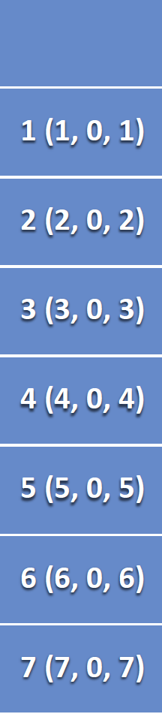
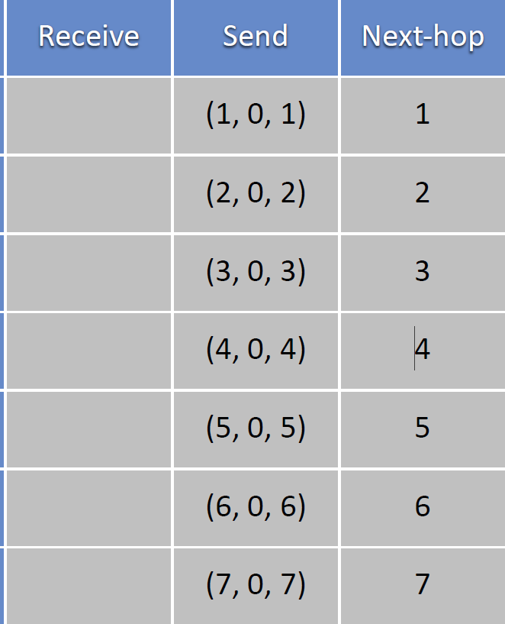
STP Example, Round 1
Current
view
1
3
5
2
6
4
7

Slide 19
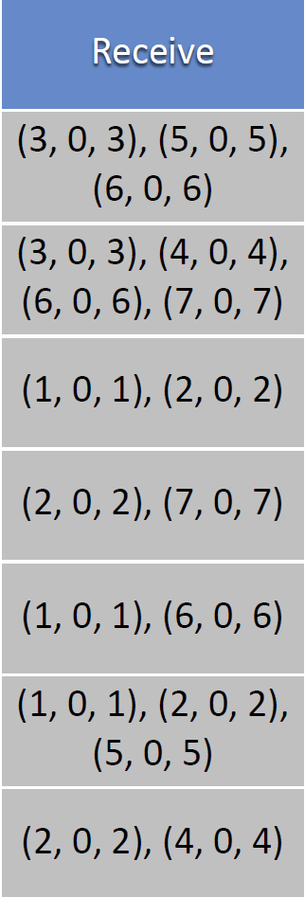
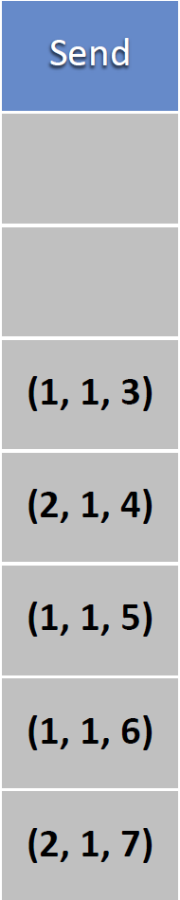
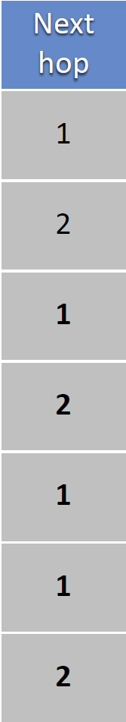
STP Example, Round 2
Current
view
1
3
5
2
6
4
7

Slide 20
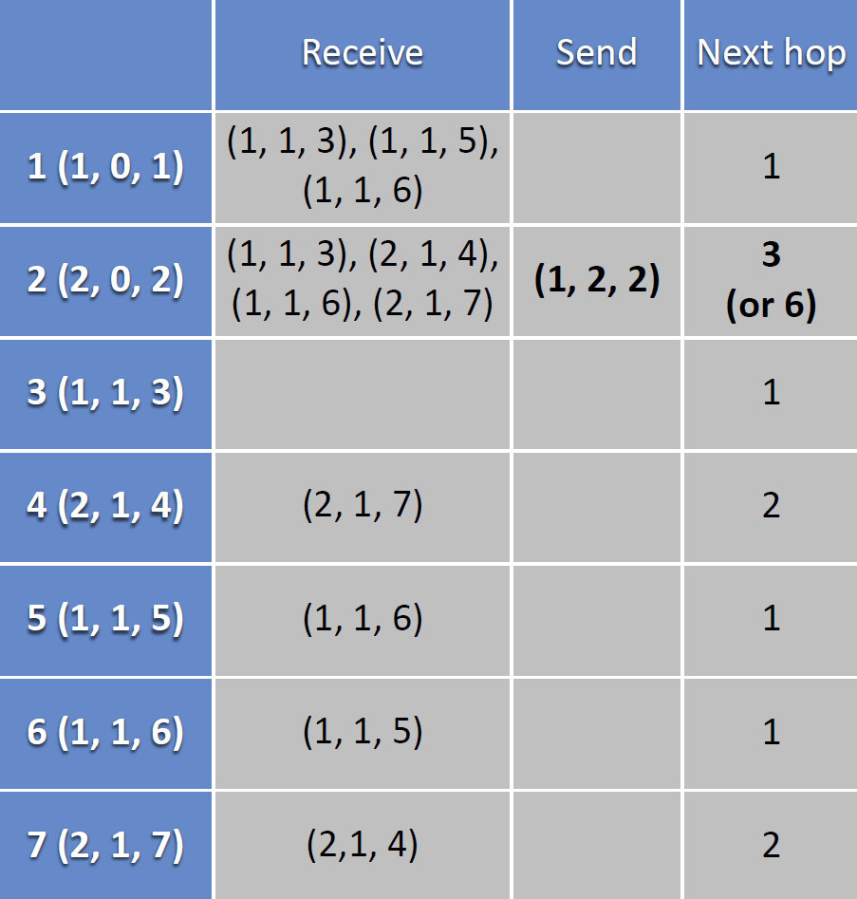
STP Example, Round 3
1
3
5
2
6
4
7

Slide 21
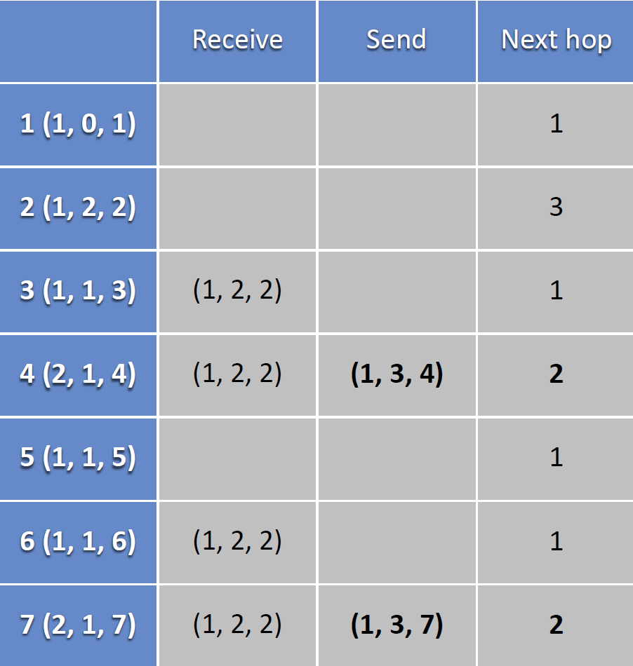
STP Example, Round 4
1
3
5
2
6
4
7

Slide 22
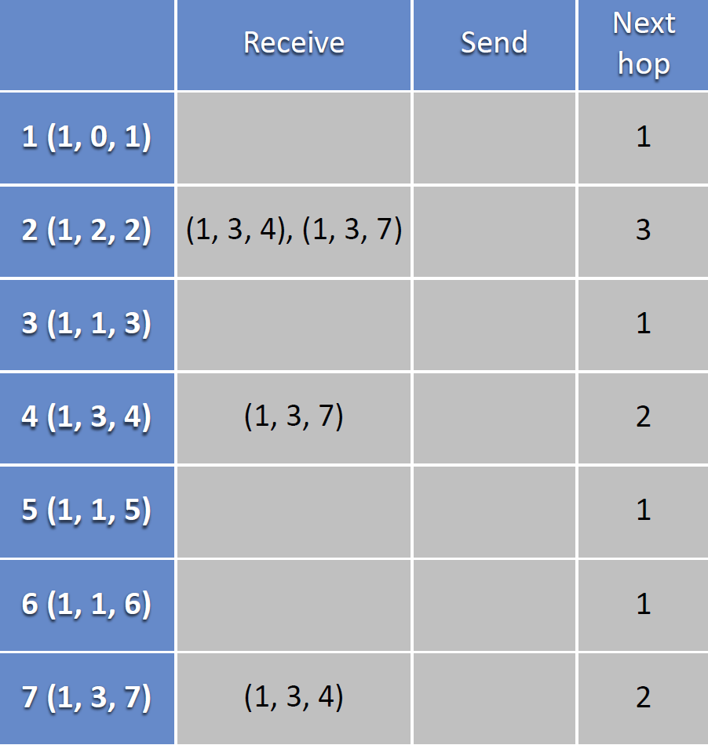
STP Example, Round 5
1
3
5
2
6
4
7

Slide 23
After Round 5: We have our Spanning Tree
1
3
5
2
6
4
7

Slide 24
Summary
Forwarding frames in L2 is possible by:
Spanning Tree Protocol + Learning Switches
STP avoids loop by restricting to spanning tree
This makes flooding possible
Flooding allows packet to reach destination
And in the process switches learn how to reach source of flood
Thus, no route “computation” is needed
Forwarding entries are the consequence of traffic pattern

Slide 25
Robust Spanning Tree Algorithm
Algorithm must react to failures
Failure of the root node: Need to elect a new root
Failure of other switches and links: Need to recompute the spanning tree
Root switch continues sending STP messages
Periodically reannouncing itself as the root
Other switches continue forwarding messages
Detecting failures through timeout (soft state)
If no word from root, time out and send a (Y, 0, Y) message to all neighbors
If multiple messages with a new root received,
Update your view if necessary and send your (Y, d, X) to the neighbor sending the message

Slide 26
Strength/Weakness of Learning Switches with STP
Strengths of this forwarding approach:
Plug-n-Play (i.e., zero-configuration), simple, cheap
Weaknesses of this forwarding approach:
Slow to react to host movement
Entries must time out
Underutilization of network bandwidth
Forwarding is only over the spanning tree
Delay in reestablishing spanning tree
Network is “down” until spanning tree rebuilt
And rebuilt spanning tree may be quite different
Poor predictability
Location of root and traffic pattern determines forwarding efficiency

Slide 27
So Far …
Sending data over a single link, single shared LAN, and from one LAN to another, and over switched LAN
Over Single Link: Encoding, Framing
Single shared LAN: Ethernet
From one LAN to another: Repeaters/hubs, bridges/switches
In switched LANs: Learning switches and STP

Slide 28
How do We Build a Global Network?
Can we build a global network (Internet) using LANs?
No – not scalable
Imagine broadcasting in a global network …
Imagine building a spanning tree that spans across the globe with millions of switches …
Imagine remembering the MAC address of all billion nodes in a global Internet
Also, networks are heterogeneous (e.g., Wifi vs. Ethernet)
They have different frame formats, different service models, different packet sizes/bandwidths
How do we build a global network?
In LANs we could connect nodes by packet forwarding in data link layer (L2)
In a global network, we need to route packets in the network layer (L3)
In the next part of the course, we’ll study routing in Network Layer with IP address
When more scalability is needed, a hierarchical structure can be used
That’s why IP addresses have hierarchy, and MAC addresses di not (i.e., flat addressing scheme)

