Slide 1












CSC358: Principles of Computer Networks
Lecture 6 – Part 2: Subnetting Example
mobile network
4G
national or global ISP
Streaming
video
Skype
IP
local or regional ISP
home network
content
provider
network
HTTP
datacenter
network
Ethernet
TCP
enterprise
network
Erfan Meskar
Winter 2025, University of Toronto, Mississauga

Slide 2
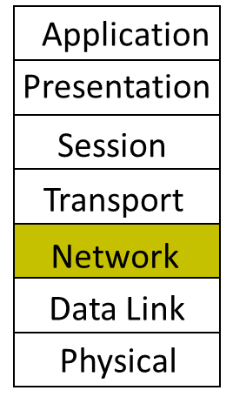
Today
IP Addressing
Subnetting
The IP Packet format
Packet Forwarding
Internet Control Message Protocol (ICMP)
Discovery protocols: ARP and DHCP
Turning names into addresses (DNS)

Slide 3
Subnetting
The idea behind subnetting is very intuitive. Let’s see it in example.
You have been assigned the IP network 192.168.10.0/24, and you need to create C subnets to divide the network for different departments in a company.
Department A needs IP address for 7 devices
Department B needs IP address for 120 devices
Department C needs IP address for 60 devices
Assign subnet addresses so that the amount of address space assigned is minimal, and at the same time leaving the largest possible contiguous address space available for assignment if new subnets were to be added.

Slide 4
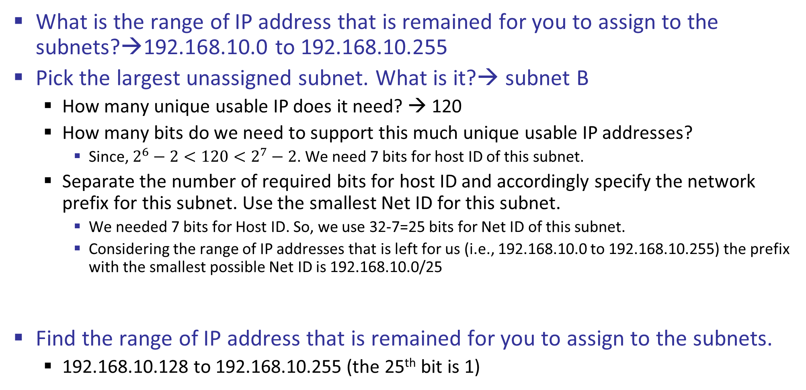
Subnetting, cont’d
What is the range of IP address that is remained for you to assign to the subnets?→192.168.10.0 to 192.168.10.255
Pick the largest unassigned subnet. What is it?→ subnet B
How many unique usable IP does it need? → 120
How many bits do we need to support this much unique usable IP addresses?
Since, $2^{6}−2<120<2^{7}−2$. We need 7 bits for host ID of this subnet.
Separate the number of required bits for host ID and accordingly specify the network prefix for this subnet. Use the smallest Net ID for this subnet.
We needed 7 bits for Host ID. So, we use 32-7=25 bits for Net ID of this subnet.
Considering the range of IP addresses that is left for us (i.e., 192.168.10.0 to 192.168.10.255) the prefix with the smallest possible Net ID is 192.168.10.0/25
Find the range of IP address that is remained for you to assign to the subnets.
192.168.10.128 to 192.168.10.255 (the 25th bit is 1)
1 1 0 0 0 0 0 0
1 0 1 0 1 0 0 0
0 0 0 0 1 0 1 0
0 0 0 0 0 0 0 0

Slide 5
Subnetting, cont’d
We can use these bits
Fixed bits
What is left to work with
1 1 0 0 0 0 0 0
1 0 1 0 1 0 0 0
0 0 0 0 1 0 1 0
0 0 0 0 0 0 0 0
1 1 0 0 0 0 0 0
1 0 1 0 1 0 0 0
0 0 0 0 1 0 1 0
1 1 1 1 1 1 1 1
1 1 0 0 0 0 0 0
1 0 1 0 1 0 0 0
0 0 0 0 1 0 1 0
0 0 0 0 0 0 0 0
1 1 0 0 0 0 0 0
1 0 1 0 1 0 0 0
0 0 0 0 1 0 1 0
0 1 1 1 1 1 1 1
What subnet B gets
Net ID for this subnet
We reserve 7 bits for hosts
Thus, we use 25 bits for Net ID
What is left to work with after assigning the above prefix
1 1 0 0 0 0 0 0
1 0 1 0 1 0 0 0
0 0 0 0 1 0 1 0
1 0 0 0 0 0 0 0
1 1 0 0 0 0 0 0
1 0 1 0 1 0 0 0
0 0 0 0 1 0 1 0
1 1 1 1 1 1 1 1
Fixed bits
We can use these bits

Slide 6
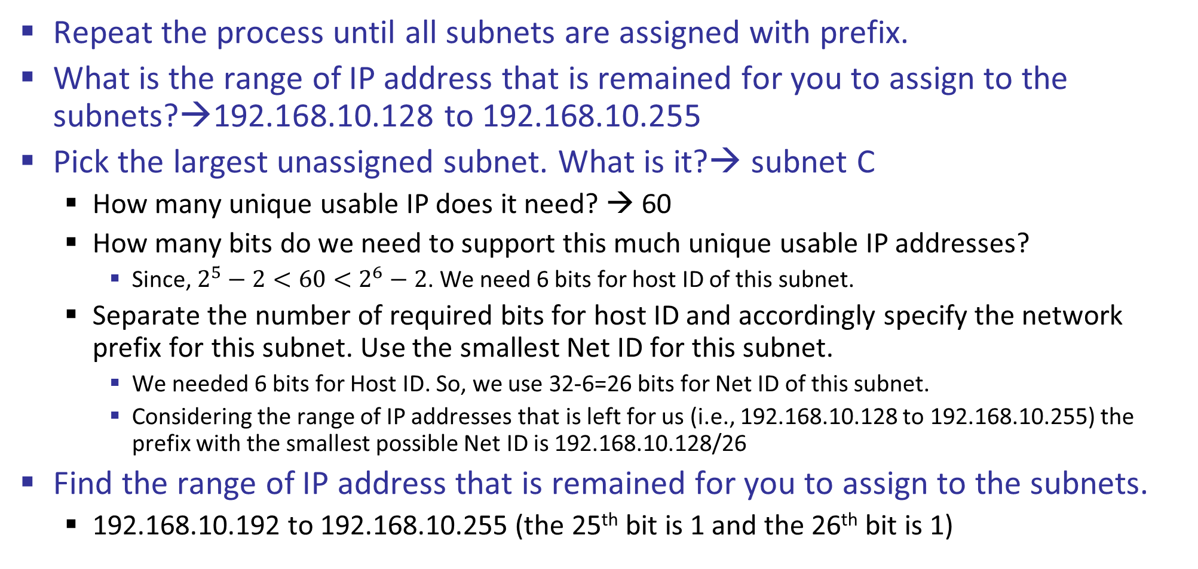
Subnetting, cont’d
Repeat the process until all subnets are assigned with prefix.
What is the range of IP address that is remained for you to assign to the subnets?→192.168.10.128 to 192.168.10.255
Pick the largest unassigned subnet. What is it?→ subnet C
How many unique usable IP does it need? → 60
How many bits do we need to support this much unique usable IP addresses?
Since, $2^{5}−2<60<2^{6}−2$. We need 6 bits for host ID of this subnet.
Separate the number of required bits for host ID and accordingly specify the network prefix for this subnet. Use the smallest Net ID for this subnet.
We needed 6 bits for Host ID. So, we use 32-6=26 bits for Net ID of this subnet.
Considering the range of IP addresses that is left for us (i.e., 192.168.10.128 to 192.168.10.255) the prefix with the smallest possible Net ID is 192.168.10.128/26
Find the range of IP address that is remained for you to assign to the subnets.
192.168.10.192 to 192.168.10.255 (the 25th bit is 1 and the 26th bit is 1)

Slide 7
Subnetting, cont’d
We can use these bits
Fixed bits
What is left to work with
1 1 0 0 0 0 0 0
1 0 1 0 1 0 0 0
0 0 0 0 1 0 1 0
1 0 0 0 0 0 0 0
1 1 0 0 0 0 0 0
1 0 1 0 1 0 0 0
0 0 0 0 1 0 1 0
1 1 1 1 1 1 1 1
1 1 0 0 0 0 0 0
1 0 1 0 1 0 0 0
0 0 0 0 1 0 1 0
1 0 0 0 0 0 0 0
1 1 0 0 0 0 0 0
1 0 1 0 1 0 0 0
0 0 0 0 1 0 1 0
1 0 1 1 1 1 1 1
What subnet C gets
Net ID for this subnet
We reserve 6 bits for hosts
Thus, we use 26 bits for Net ID
What is left to work with after assigning the above prefix
1 1 0 0 0 0 0 0
1 0 1 0 1 0 0 0
0 0 0 0 1 0 1 0
1 1 0 0 0 0 0 0
1 1 0 0 0 0 0 0
1 0 1 0 1 0 0 0
0 0 0 0 1 0 1 0
1 1 1 1 1 1 1 1
Fixed bits
We can use these bits

Slide 8
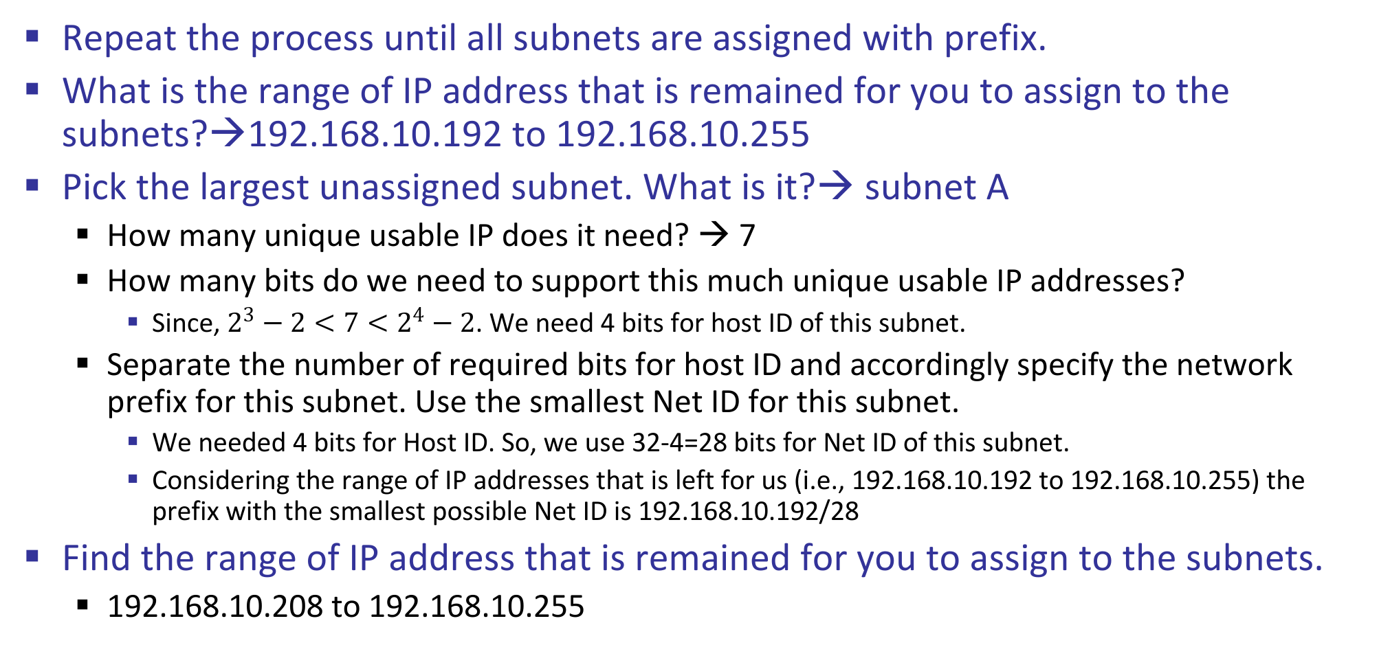
Subnetting, cont’d
Repeat the process until all subnets are assigned with prefix.
What is the range of IP address that is remained for you to assign to the subnets?→192.168.10.192 to 192.168.10.255
Pick the largest unassigned subnet. What is it?→ subnet A
How many unique usable IP does it need? → 7
How many bits do we need to support this much unique usable IP addresses?
Since, $2^{3}−2<7<2^{4}−2$. We need 4 bits for host ID of this subnet.
Separate the number of required bits for host ID and accordingly specify the network prefix for this subnet. Use the smallest Net ID for this subnet.
We needed 4 bits for Host ID. So, we use 32-4=28 bits for Net ID of this subnet.
Considering the range of IP addresses that is left for us (i.e., 192.168.10.192 to 192.168.10.255) the prefix with the smallest possible Net ID is 192.168.10.192/28
Find the range of IP address that is remained for you to assign to the subnets.
192.168.10.208 to 192.168.10.255

Slide 9
Subnetting, cont’d
We can use these bits
Fixed bits
What is left to work with
1 1 0 0 0 0 0 0
1 0 1 0 1 0 0 0
0 0 0 0 1 0 1 0
1 1 0 0 0 0 0 0
1 1 0 0 0 0 0 0
1 0 1 0 1 0 0 0
0 0 0 0 1 0 1 0
1 1 1 1 1 1 1 1
1 1 0 0 0 0 0 0
1 0 1 0 1 0 0 0
0 0 0 0 1 0 1 0
1 1 0 0 0 0 0 0
1 1 0 0 0 0 0 0
1 0 1 0 1 0 0 0
0 0 0 0 1 0 1 0
1 1 0 0 1 1 1 1
What subnet A gets
Net ID for this subnet
We reserve 4 bits for hosts
Thus, we use 28 bits for Net ID
1 1 0 0 0 0 0 0
1 0 1 0 1 0 0 0
0 0 0 0 1 0 1 0
1 1 0 1 0 0 0 0
What is left to work with after assigning the above prefix
1 1 0 0 0 0 0 0
1 0 1 0 1 0 0 0
0 0 0 0 1 0 1 0
1 1 0 1 1 1 1 1
1 1 0 0 0 0 0 0
1 0 1 0 1 0 0 0
0 0 0 0 1 0 1 0
1 1 1 0 0 0 0 0
1 1 0 0 0 0 0 0
1 0 1 0 1 0 0 0
0 0 0 0 1 0 1 0
1 1 1 1 1 1 1 1

