Slide 1












CSC358: Principles of Computer Networks
Lecture 6 – Part 3: IP Packet Format
mobile network
4G
national or global ISP
Streaming
video
Skype
IP
local or regional ISP
home network
content
provider
network
HTTP
datacenter
network
Ethernet
TCP
enterprise
network
Erfan Meskar
Winter 2025, University of Toronto, Mississauga

Slide 2
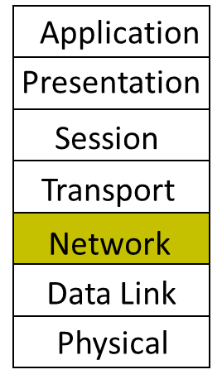
Today
IP Addressing
Subnetting
The IP Packet format
Packet Forwarding
Internet Control Message Protocol (ICMP)
Discovery protocols: ARP and DHCP
Turning names into addresses (DNS)

Slide 3
IP Packet Structure
4 bits
16 bits
32 bits
version | header length | Type of service (TOS) | Total Length
Identification |  |  | Flags | Fragment offset
Time to Live |  | Protocol | Header Checksum
Source IP Address
Destination IP Address
Options (if any)
Payload

Slide 4
IP Packet Structure
Version field: The version number
Tells us what other fields to expect, typically it is set to “4” for IPv4, or “6” for IPv6
4 bits
version | header length | Type of service (TOS) | Total Length
Identification |  |  | Flags | Fragment offset
Time to Live |  | Protocol | Header Checksum
Source IP Address
Destination IP Address
Options (if any)
Payload

Slide 5
IP Packet Structure
Header Length Field: The number of 32-bit (i.e., 4 byte) words in the header
typically set to 5 (20 bytes header)
Can be more when “IP options” are used.
4 bits
version | header length | Type of service (TOS) | Total Length
Identification |  |  | Flags | Fragment offset
Time to Live |  | Protocol | Header Checksum
Source IP Address
Destination IP Address
Options (if any)
Payload
Counts in Words (i.e., in 4 bytes)

Slide 6
IP Packet Structure
TOS Field: Allows different packets to be treated differently
e.g., low delay for voice, high bandwidth for video
4 bits
version | header length | Type of service (TOS) | Total Length
Identification |  |  | Flags | Fragment offset
Time to Live |  | Protocol | Header Checksum
Source IP Address
Destination IP Address
Options (if any)
Payload

Slide 7

IP Packet Structure
Total Length Field: Number of bytes in the entire packet, with a maximum of 65 535 bytes
Counts in Bytes
4 bits
version | header length | Type of service (TOS) | Total Length
Identification |  |  | Flags | Fragment offset
Time to Live |  | Protocol | Header Checksum
Source IP Address
Destination IP Address
Options (if any)
Payload
$≤\left(2^{16}−1\right)$ Bytes

Slide 8
IP Packet Structure
Supports dividing a large IP packet into fragments, in case a link cannot handle a large IP packet
Don't Fragment bit
If set, this packet should not be fragmented.
More Fragments bit
is set on all fragmented packets except the last one
Always 0
4 bits
version | header length | Type of service (TOS) | Total Length
Identification |  |  | 0 | DF | MF | Fragment offset
Time to Live |  | Protocol | Header Checksum
Source IP Address
Destination IP Address
Options (if any)
Payload
indicates the number of 8-byte data preceding or ahead of the fragment (e.g., if this field is set to 100, it means that 800 bytes of data precedes the data part of this fragment.

Slide 9
IP Fragmentation
Problem:
A router may receive a packet larger than the maximum transmission unit (MTU) of the outgoing link.
Source
Destination
A
B
Ethernet
MTU=1500 bytes
MTU=1500 bytes
MTU<1500 bytes
R1
R2

Slide 10
IP Fragmentation, cont’d
Solution:
R1 fragments the IP datagram into multiple, self-contained datagrams
Data
HDR (ID=x)
Offset=0
More Frag=1
Data
HDR (ID=x)
Offset>0
More Frag=1
Data
HDR (ID=x)
Offset>0
More Frag=0
Data
HDR (ID=x)

Slide 11
IP Fragmentation, cont’d
Fragments are re-assembled by the destination host
not by intermediate routers
To avoid fragmentation, hosts commonly use path MTU discovery to find the smallest MTU along the path.
Path MTU discovery involves sending various size datagrams until they do not require fragmentation along the path.

Slide 12
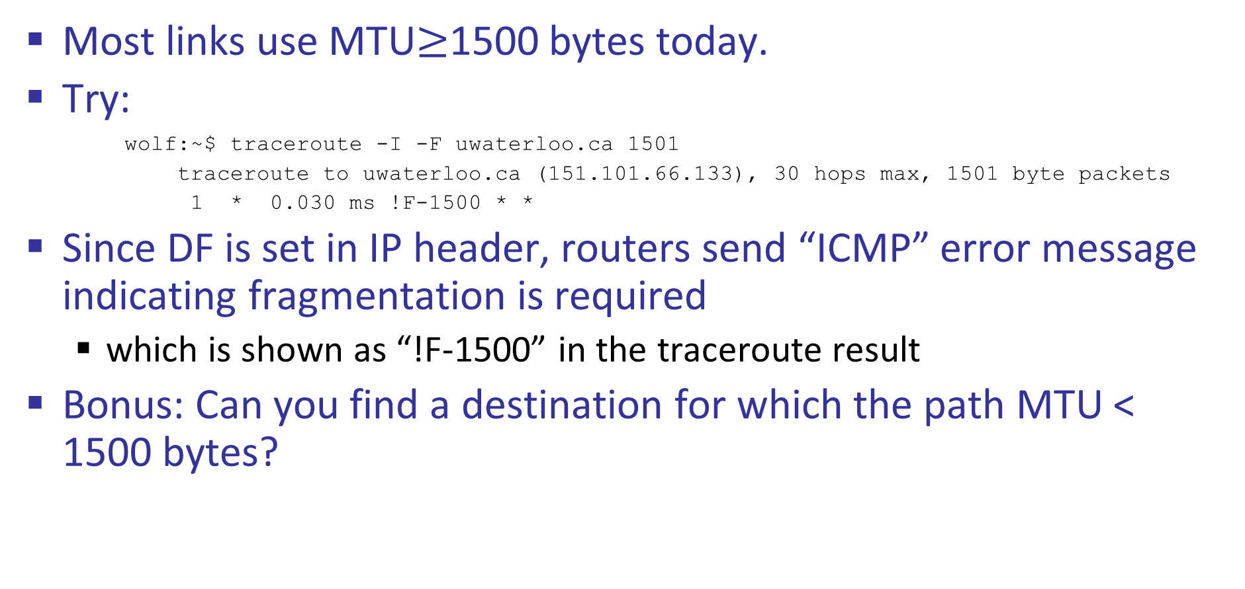
IP Fragmentation, cont’d
Most links use MTU$≥$1500 bytes today.
Try:
wolf:~$ traceroute -I -F uwaterloo.ca 1501
traceroute to uwaterloo.ca (151.101.66.133), 30 hops max, 1501 byte packets
1 * 0.030 ms !F-1500 * *
Since DF is set in IP header, routers send “ICMP” error message indicating fragmentation is required
which is shown as “!F-1500” in the traceroute result
Bonus: Can you find a destination for which the path MTU < 1500 bytes?

Slide 13
IP Packet Structure
Used to identify packets trapped in a loop, and eventually discard them
4 bits
version | header length | Type of service (TOS) | Total Length
Identification |  |  | Flags | Fragment offset
Time to Live |  | Protocol | Header Checksum
Source IP Address
Destination IP Address
Options (if any)
Payload
Hop count

Slide 14
IP Packet Structure
The upper-level protocol carried in the packet
e.g., “6” for TCP, “17” for UDP, “1” for ICMP
4 bits
version | header length | Type of service (TOS) | Total Length
Identification |  |  | Flags | Fragment offset
Time to Live |  | Protocol | Header Checksum
Source IP Address
Destination IP Address
Options (if any)
Payload

Slide 15
IP Packet Structure
Header Internet Checksum
Does not protect the payload
If header bits are corrupted, checksum won’t match, and receiver discards corrupted packets
version | header length | Type of service (TOS) | Total Length
Identification |  |  | Flags | Fragment offset
Time to Live |  | Protocol | Header Checksum
Source IP Address
Destination IP Address
Options (if any)
Payload

Slide 16
IP Packet Structure
Uniquely identify the source and destination host
Why do we need source IP?
4 bits
version | header length | Type of service (TOS) | Total Length
Identification |  |  | Flags | Fragment offset
Time to Live |  | Protocol | Header Checksum
Source IP Address
Destination IP Address
Options (if any)
Payload

