Slide 1












CSC358: Principles of Computer Networks
Lecture 6 – Part 5: Internet Control Message Protocol
mobile network
4G
national or global ISP
Streaming
video
Skype
IP
local or regional ISP
home network
content
provider
network
HTTP
datacenter
network
Ethernet
TCP
enterprise
network
Erfan Meskar
Winter 2025, University of Toronto, Mississauga

Slide 2
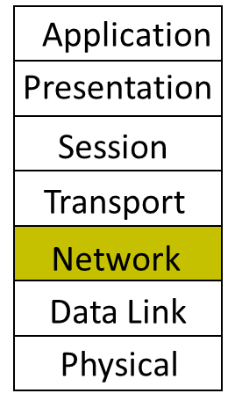
Today
IP Addressing
Subnetting
The IP Packet format
Packet Forwarding
Internet Control Message Protocol (ICMP)
Discovery protocols: ARP and DHCP
Turning names into addresses (DNS)

Slide 3
Error Reporting with ICMP
Internet Control Message Protocol (ICMP)
Like IPv4 and IPv6, ICMP is a L3 protocol.
It is used by a router/end-host to report some types of error, e.g.,
Destination Unreachable: packet can’t be forwarded to/towards its destination.
Time Exceeded: TTL reached zero, or fragment didn’t arrive in time. traceroute uses this error to its advantage.
Note:
ICMP message are created by ICMP (the protocol)
Then, they will be passed to IP to encapsulate the message with proper IP headers and send them.

Slide 4
An ICMP Packet Inside an IPv4 Packet
+-----------------------------------------------------------------+
| IPv4 Header |
+-----------------------------------------------------------------+
| Version | IHL | DSCP | ECN | Total Length |
+-----------------------------------------------------------------+
| | | |
| Identification | Flags | Fragment |
| | | Offset |
+-----------------------------------------------------------------+
| Time to Live (TTL) | Protocol | Header |
| | (1 for | Checksum |
| | ICMP) | |
+-----------------------------------------------------------------+
| Source IP Address |
+-----------------------------------------------------------------+
| Destination IP Address |
+-----------------------------------------------------------------+
| ICMP | ICMP | ICMP |
| Type | Code | Checksum |
+-----------------------------------------------------------------+
| ICMP Rest of Header |
+-----------------------------------------------------------------+
| ICMP Content |
| |
| |

Slide 5
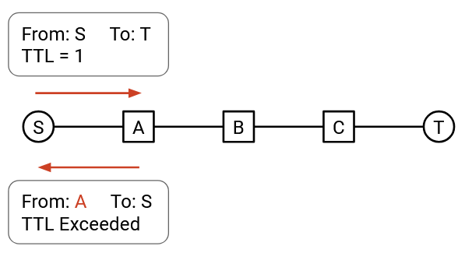
Traceroute and Network Topology Discovery
Traceroute is a tool that exploits the TTL field to force routers along the path to send back an ICMP error message back to the source.
It is based on setting TTL field in the header and receiving ICMP Time Exceeded message back back from routers.
You could send a packet with TTL 1.
The packet will expire at the first hop,
and the first router will send you an error message,
allowing you to learn the identity of the first router.

Slide 6
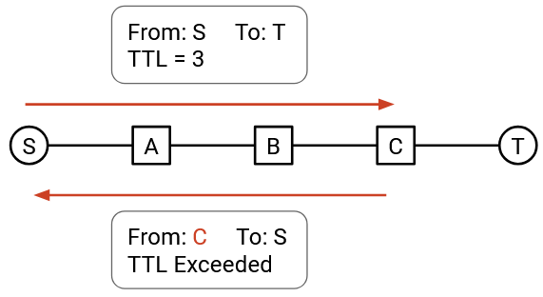
Traceroute and Network Topology Discovery, cont’d
Then, you could send a packet with TTL 2.
The packet will expire at the second hop,
The second router will send you an error message,
allowing you to discover the identity of the second router.
By repeating this with TTL 3, TTL 4, and so on, you can discover all the routers on your path.

Slide 7
Try Traceroute on Your Machine
On your Unix machine, try:
Traceroute -I --resolve-hostnames cs.utoronto.ca
Traceroute -I --resolve-hostnames google.com
traceroute to www.google.com (74.125.159.147), 30 hops max, 40 byte packets
1 butler.syslab.sandbox (192.168.70.100) 0.103 ms 0.092 ms 0.082 ms
2 foundry0.cs.toronto.edu (128.100.5.210) 2.146 ms 4.061 ms 5.977 ms
3 sf-cs1.gw.utoronto.ca (128.100.1.253) 2.184 ms 2.175 ms 2.168 ms
4 murus-gpb.gw.utoronto.ca (128.100.96.2) 2.146 ms 2.483 ms 3.037 ms
5 skye2murus-blue.gw.utoronto.ca (128.100.200.210) 7.088 ms 7.207 ms 7.198 ms
6 murus2skye-yellow.gw.utoronto.ca (128.100.200.217) 3.310 ms 11.325 ms 12.061 ms
7 ut-hub-utoronto-if.gtanet.ca (205.211.94.129) 12.681 ms 2.541 ms 2.535 ms
8 ORION-GTANET-RNE.DIST1-TORO.IP.orion.on.ca (66.97.23.57) 3.638 ms 4.391 ms 4.384 ms
9 BRDR2-TORO-GE2-1.IP.orion.on.ca (66.97.16.121) 4.368 ms 4.729 ms 4.844 ms
10 74.125.51.233 (74.125.51.233) 12.459 ms 12.453 ms 12.808 ms
11 216.239.47.114 (216.239.47.114) 4.681 ms 4.795 ms 12.661 ms
12 209.85.250.111 (209.85.250.111) 23.666 ms 23.659 ms 13.226 ms
13 209.85.242.215 (209.85.242.215) 32.436 ms 32.431 ms 32.913 ms
14 72.14.232.213 (72.14.232.213) 33.537 ms 72.14.232.215 (72.14.232.215) 33.525 ms 72.14.232.213 (72.14.232.213) 164.315 ms
15 209.85.254.14 (209.85.254.14) 45.864 ms 209.85.254.10 (209.85.254.10) 42.232 ms 209.85.254.6 (209.85.254.6) 42.346 ms
16 yi-in-f147.google.com (74.125.159.147) 34.728 ms 34.727 ms 34.713 ms

