Slide 1












CSC358: Principles of Computer Networks
Lecture 6 – Part 6: DHCP and ARP
mobile network
4G
national or global ISP
Streaming
video
Skype
IP
local or regional ISP
home network
content
provider
network
HTTP
datacenter
network
Ethernet
TCP
enterprise
network
Erfan Meskar
Winter 2025, University of Toronto, Mississauga

Slide 2
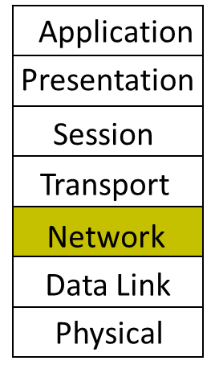
Today
IP Addressing
Subnetting
The IP Packet format
Packet Forwarding
Internet Control Message Protocol (ICMP)
Discovery protocols: ARP and DHCP
Turning names into addresses (DNS)
DHCP
Network
ARP

Slide 3


What Happens at The Link Layer?
What does it mean to send to IF1?
IF0
IF1
IF2
1.2.1.3
1.2.1.1
1.2.2.1
1.2.2.100
Prefix | IF/Next hop
1.2.1.0/24 | IF1
1.2.2.0/24 | IF2
8.0.0.0/30 | IF0
Default | 8.0.0.2

Slide 4
Discovery
Suppose I am host A and I want to communicate with B (say, www.google.com)
I was “born” knowing only my name – my MAC address
Must discover some information before I can communicate with B
What is my IP address?
What is B’s IP address?
Using DNS
Is B within my LAN?
If yes, what is B’s MAC address?
If not, what is the address of my first-hop router to B?
…

Slide 5
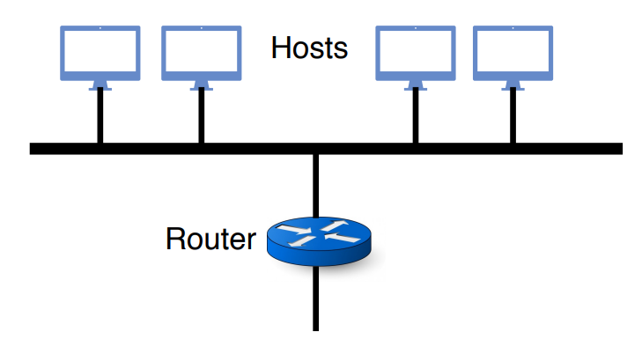
DHCP and ARP
Discovery protocols
DHCP – Dynamic Host Configuration Protocol
ARP – Address Resolution Protocol
Configured to a single LAN
Rely on broadcast capability

Slide 6
DHCP and ARP
Serve two functions
By DHCP: Bootstrap communication with remote hosts
What’s my IP address?
What’s my subnet masks? Allows to test whether an IP address is local or not
What’s the IP address(es) for my local DNS name server(s)
What’s the IP address(es) for my first-hop “default” router(s)
By ARP: Discovery of local end-hosts
For communication between hosts on the same LAN

Slide 7
DHCP: Operation
Dynamic Host Configuration Protocol
Defined in RFC 2131
One or more local DHCP servers maintain required information
IP address pool, netmask, DNS servers, etc.
Application that listens on UDP port 67

Slide 8
DHCP: Operation
Dynamic Host Configuration Protocol
Defined in RFC 2131
One or more local DHCP servers maintain required information
Client broadcasts a DHCP discovery message
L2 broadcast, to MAC address ff:ff:ff:ff:ff:ff

Slide 9
DHCP: Operation
Dynamic Host Configuration Protocol
Defined in RFC 2131
One or more local DHCP servers maintain required information
Client broadcasts a DHCP discovery message
One or more DHCP servers respond with a DHCP “offer” message
Proposed IP address for client, lease time
Other parameters

Slide 10
DHCP: Operation
Dynamic Host Configuration Protocol
Defined in RFC 2131
One or more local DHCP servers maintain required information
Client broadcasts a DHCP discovery message
One or more DHCP servers respond with a DHCP “offer” message
Client broadcasts a DHCP request message
Specifies which offer it wants
Echoes accepted parameters
Other DHCP servers learn they were not chosen

Slide 11
DHCP: Operation
Dynamic Host Configuration Protocol
Defined in RFC 2131
One or more local DHCP servers maintain required information
Client broadcasts a DHCP discovery message
One or more DHCP servers respond with a DHCP “offer” message
Client broadcasts a DHCP request message
Selected DHCP server responds with an ACK

Slide 12
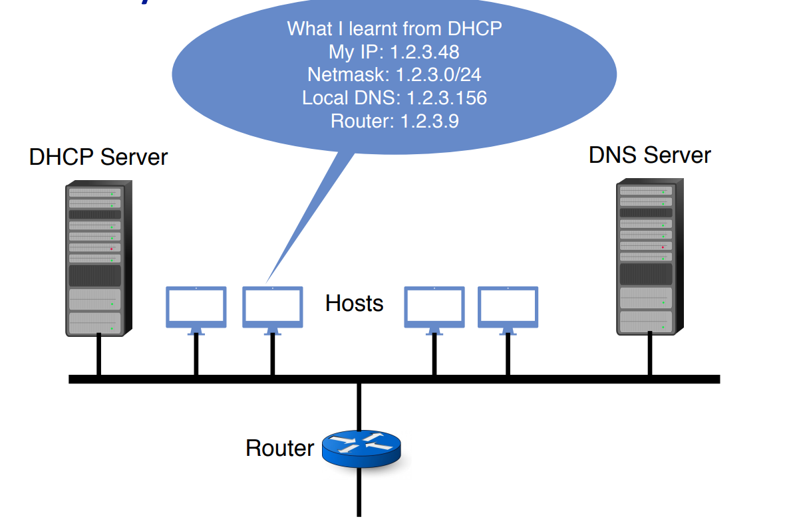
Are We There Yet?

Slide 13
ARP: Address Resolution Protocol
Every host maintains an ARP table
List of (IP address – MAC address) pairs
For IP addresses within the same LAN
Consult the table when sending a packet
Map destination IP address to destination MAC address
But what if IP address not in table?
Either its not local (detected using DHCP)
So, send it to the router (i.e., destination MAC address is router’s MAC)
If it’s local:
Sender broadcasts: “Who has IP address 1.2.3.156?”
The device with that IP address replies and report its MAC address.
Caches the answer in ARP table

