Slide 1












CSC358: Principles of Computer Networks
Lecture 6 – Part 7: Domain Name System
mobile network
4G
national or global ISP
Streaming
video
Skype
IP
local or regional ISP
home network
content
provider
network
HTTP
datacenter
network
Ethernet
TCP
enterprise
network
Erfan Meskar
Winter 2025, University of Toronto, Mississauga

Slide 2
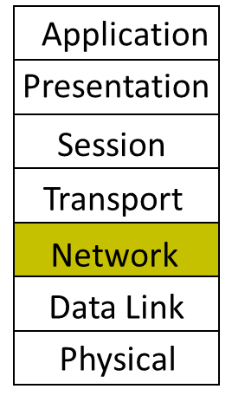
Today
IP Addressing
Subnetting
The IP Packet format
Packet Forwarding
Internet Control Message Protocol (ICMP)
Discovery protocols: ARP and DHCP
Turning names into addresses (DNS)
DNS
Network

Slide 3
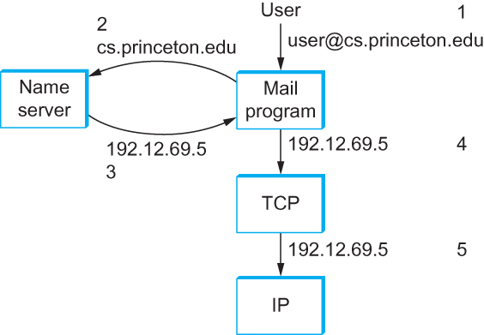
Domain Name System (DNS)
User has name of entity she/he wants to access
However, Internet routes and forwards requests based on IP addresses
Need to convert name to an IP address
Domain Name System (DNS)
Provides the mapping from name to IP address
User asks DNS: what is the IP address for www.cnn.com
DNS responds: 157.166.255.18

Slide 4
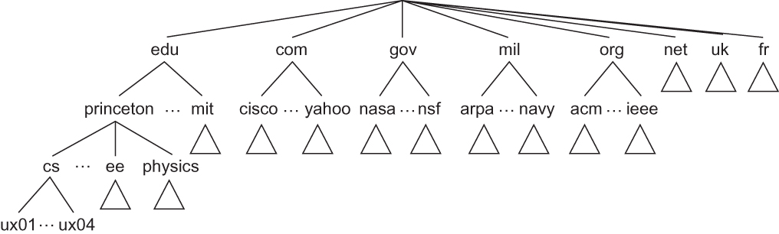
Domain Hierarchy
Names are hierarchical and belong to a domain:
e.g., apps0.cs.utoronto.ca
Common domain names: .com, .edu, .gov, .org, .net, .ca (or other country-specific domain)
Top-level names are assigned by the Internet Corporation for Assigned Names and Numbers (ICANN)
A unique name is assigned to each organization

Slide 5
DNS Query
A DNS Query
Client asks local server.
If local server does not have address, it asks the root server of the requested domain.
Addresses are cached in case they are requested again.

Slide 6
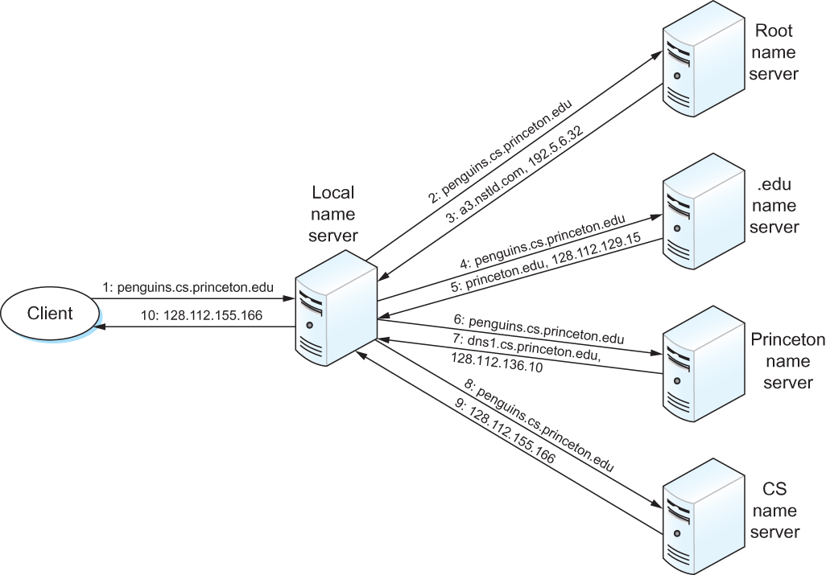
DNS: Mapping Computer Name to IP addresses
DNS Client-Server Model
DNS maintains a hierarchical, distributed database of names.
Servers are arranged in a hierarchy.
Each domain has a “root” server.
An application needing an IP address is a DNS client.

Slide 7
Resolution Services
Layer | Examples | Structure | Configuration | Resolution Service
App Layer | cs.toronto.edu | Organizational hierarchy | ~manual
Network Layer | 128.100.30.100 | Topological hierarchy | DHCP
Link Layer | 45-CC-4E-12-F0-97 | Vendor(flat) | Hard-coded
DNS
ARP

