Slide 1












CSC358: Principles of Computer Networks
Lecture 7 – Part 1: Routing Concept
mobile network
4G
national or global ISP
Streaming
video
Skype
IP
local or regional ISP
home network
content
provider
network
HTTP
datacenter
network
Ethernet
TCP
enterprise
network
Erfan Meskar
Winter 2025, University of Toronto, Mississauga

Slide 2
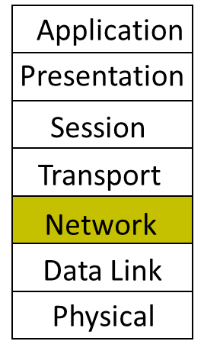
Today
Part 1: The Routing Concept & Algorithms
Part 2: Distance vector: Distributed Bellman Ford Algorithm
Part 3: Link state: Dijkstra’s Shortest Path First-based Algorithm
“A”
A quotation from RFC 791 (INTERNET PROTOCOL)
“A name indicates what we seek.
An address indicates where it is.
A route indicates how we get there.” - Jon Postel (a.k.a "god of the Internet")
R₂
R₁
R₄
“B”
How does R₁ choose a next-hop on the path towards host B?
R₃

Slide 3
Forwarding vs. Routing
Recall Data Plane and Control Plane:
Forwarding: data plane
Directing a data packet to an outgoing link
Individual router using a forwarding table
Routing: control plane
Computing paths the packets will follow
Routers communicate amongst themselves so that each router can Individually router creating a forwarding table

Slide 4
Why Does Routing Matter?
End-to-end performance
Quality of the path affects user performance
Propagation delay, throughput, and packet loss
Use of network resources
Balance of the traffic over the routers and links
Avoiding congestion by directing traffic to lightly-loaded links
Transient disruptions during changes
Failures, maintenance, and load balancing
Limiting packet loss and delay during changes

Slide 5
Routing State Validity
Objective 1: validity, i.e., populate routers’ tables such that every destination is reachable from anywhere.
A
R2's Table
Destination | Next Hop
B | R5
$$⋮$$ | $$⋮$$
R4's Table
Destination | Next Hop
B | R7
$$⋮$$ | $$⋮$$
R6's Table
Destination | Next Hop
B | R8
$$⋮$$ | $$⋮$$
R1's Table
Destination | Next Hop
B | R2
$$⋮$$ | $$⋮$$
R₁
R₂
R₄
R₆
R₇
R₅
R₃
R₈
B
R5's Table
Destination | Next Hop
B | R8

Slide 6
When is a Routing State Valid?
A global routing state is a collection of tables in all routers.
Given a global state, how can you tell if it's valid?
A global routing state is valid if and only if there are no dead ends and no loops.
B
R1's Table
Destination | Next Hop
A | Direct
B | R2
C | R2
D | R2
R2's Table
Destination | Next Hop
A | R4
B | R3
C | R3
D | R4
R3's Table
Destination | Next Hop
A | R2
B | Direct
C | Direct
D | R4
R4's Table
Destination | Next Hop
A | R3
B | R2
C | R2
D | Direct
R3
C
A
R1
R2
R4
D

Slide 7
Verifying Routing State Validity
How do we apply these conditions to check if a global state is valid?
Strategy: Check each destination separately.
For a given destination: Use the tables to see how each router forwards packets.
The next-hop becomes an outgoing arrow.
The result is a directed delivery tree for that destination.
A valid directed delivery tree is an oriented spanning tree rooted at the destination.
Is the routing state below valid?
Check for destination A, B, C, and D
Consider destination B
B
R1's Table
Destination | Next Hop
A | Direct
B | R2
C | R2
D | R2
R2's Table
Destination | Next Hop
A | R4
B | R3
C | R3
D | R4
R3's Table
Destination | Next Hop
A | R2
B | Direct
C | Direct
D | R4
R4's Table
Destination | Next Hop
A | R3
B | R2
C | R2
D | Direct
R3
C
A
R1
R2
R4
D

Slide 8
Least Cost Routing
We know what makes a solution valid. What makes a solution “good”?
Objective 2: least-cost routing, i.e., routers should forward packets such that they take the least-cost path to the destination.
Where do costs come from?
Costs are local to a router. Each router knows the cost of its own links.
In practice, generally configured by an operator.
Some protocols allow for auto-configuration.
Examples of link cost:
Distance, data rate, price, congestion/delay, …
R₁
1
R₂
1
R₄
4
R₆
2
2
3
2
R₇
3
R₅
2
R₃
4
R₈
1
B

Slide 9
Least Cost Routing
Good news:
Under realistic assumptions for costs, Good paths (least-cost) are also valid paths (no loops, no dead ends).
Assumption 1: Costs are positive
We usually assume costs are positive integers to make analysis simpler.
Assumption 2: Costs are symmetric
R₁
1
R₂
1
R₄
4
R₆
2
2
3
2
R₇
3
R₅
2
R₃
4
R₈
1
B

Slide 10
Least Cost Routes
So, we should find the lowest cost path from any router to any router.
Find the lowest cost route from each of (R₁, …, R₇) to B
R₁
1
R₂
1
R₄
4
R₆
2
2
3
2
R₇
3
R₅
2
R₃
4
R₈
1
B

Slide 11
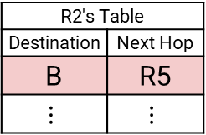
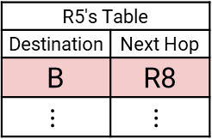
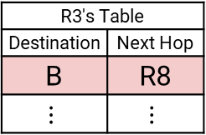
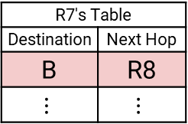
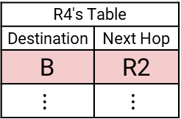
Least Cost Routes
The solution is a spanning tree with B as the root of the tree.
R6's Table
Destination | Next Hop
B | R8
$$⋮$$ | $$⋮$$
R2's Table
Destination | Next Hop
B | R5
$$⋮$$ | $$⋮$$
R4's Table
Destination | Next Hop
B | R2
$$⋮$$ | $$⋮$$
4
R₆
R1's Table
Destination | Next Hop
B | R2
$$⋮$$ | $$⋮$$
R₁
1
R₂
1
R₄
2
3
R7's Table
Destination | Next Hop
B | R8
$$⋮$$ | $$⋮$$
2
R₇
R5's Table
Destination | Next Hop
B | R8
$$⋮$$ | $$⋮$$
R₅
2
3
2
R3's Table
Destination | Next Hop
B | R8
$$⋮$$ | $$⋮$$
4
1
R₃
R₈
B

Slide 12
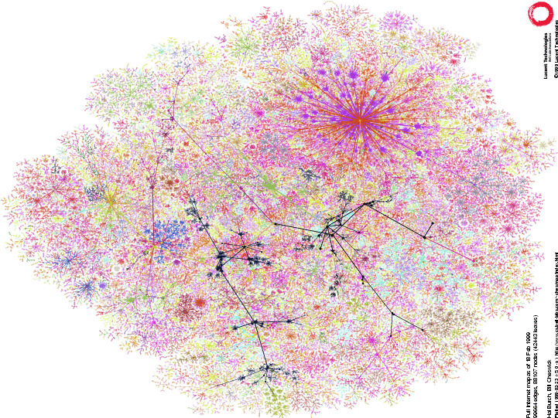
It’s Challenging
In this simple case, solution is clear from inspection.
How about this network?
Net. A
R₁
1
R₂
1
R₄
4
R₆
2
2
3
2
R₇
3
R₅
2
R₃
4
R₈
Net. B
http://www.lumeta.com

Slide 13
Finding Least Cost Routes Distributedly
We’ll see two algorithms that build spanning trees automatically
The distributed Bellman-Ford algorithm
Dijkstra’s shortest path first algorithm

