Slide 1












CSC358: Principles of Computer Networks
Lecture 8 – Part 2: Intra-Domain vs. Inter-Domain
mobile network
4G
national or global ISP
Streaming
video
Skype
IP
local or regional ISP
home network
content
provider
network
HTTP
datacenter
network
Ethernet
TCP
enterprise
network
Erfan Meskar
Winter 2025, University of Toronto, Mississauga

Slide 2
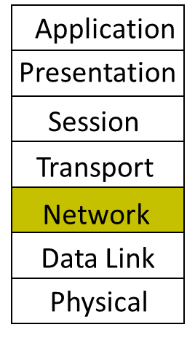
Today
Part 1: Routing Techniques, cont’d
Link state routing protocol
Part 2:
Intra-domain vs. Inter-domain Routing
Business relationship among ASes
Part 3:
BGP vs. DV
Gao-Rexford Rules for Selecting and Exporting Path
Part 4:
Joining BGP and IGP Information
BGP protocol details

Slide 3
What Does Internet Look Like?
The Internet is a network of networks.
In fact, the Internet is made of a collection of Autonomous Systems (AS)
An AS (sometimes called “domain”) is one or more local networks, all under a single administrative control.
Currently over 100,000
Example: AT&T, IBM, UofT, etc.
Each AS is assigned a unique 32-bit number (ASN), e.g., UofT is 239
Interior Routers
AS 2
AS 1
Border Routers
AS 3

Slide 4
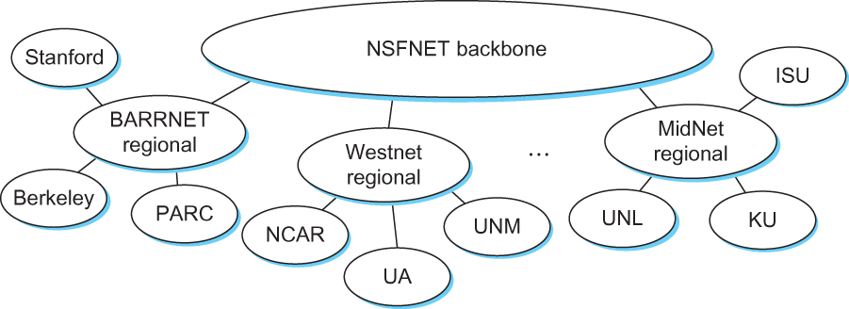
The Structure of the Internet in 1990

Slide 5
DV and LS are Intra-domain Routing Protocols
So far, we studied “intra-domain” routing, i.e., how to route packets within an AS (i.e., domain).
We saw DV and LS as two examples of intra-domain routing protocols.
In both DV and LS, routers had the same goal (“policy”), i.e., choose the path that minimizes the cost.
That’s why they can be used for routing packets within an AS, as all routers are governed under a single administration, i.e., the AS.
This network is mine, and it is important to me to forward traffic along the path with minimum distance.
So, I use DV or LS with distance as link cost.
A
t
C
E
s
B
D

Slide 6
Inter-Domain Routing
Today's focus is inter-domain routing:
finding paths between ASes
AS graph:
A graph of ASes, with the individual routers and hosts abstracted away. Each node is an AS.
AS 4
AS 2
AS 1
AS 3

Slide 7
Inter-domain Routing is Challenging
When designing routing protocol for inter-domain routing, we are faced with challenges that did not exist in intra-domain routing.
These challenges are:
Each AS wants freedom to pick routes based on its own local policy
“My traffic can’t be carried over my competitor’s network!”
“I don’t want to carry A’s traffic through my network!”
As a result, the policy is no longer just “least cost” policy.
Each AS’s policy could be different from others.
Each AS wants autonomy.
Each AS wants to choose its own intra-domain routing protocol.
Each AS wants privacy.
ASes don’t like to share their network topology, local policies, intra-domain routing protocol, etc.

Slide 8
Choice of Routing Algorithm for Interdomain routing
Intra-domain routing: Link State (LS) and Distance Vector (DV)
Can we use them for inter-domain routing, too?
LS offers no privacy (broadcasts all network information) and limits autonomy (need agreement on metric)
DV is a decent starting point
Per-destination updates by intermediate nodes give us a hook
But, wasn’t designed to implement AS local policy
… and is vulnerable to loops if shortest paths not taken
The “Border Gateway Protocol” (BGP) is “the” protocol for inter-domain routing that extends DV ideas to accommodate policy.
But before talking about BGP, we need to talk about the business relationship among ASes.

Slide 9
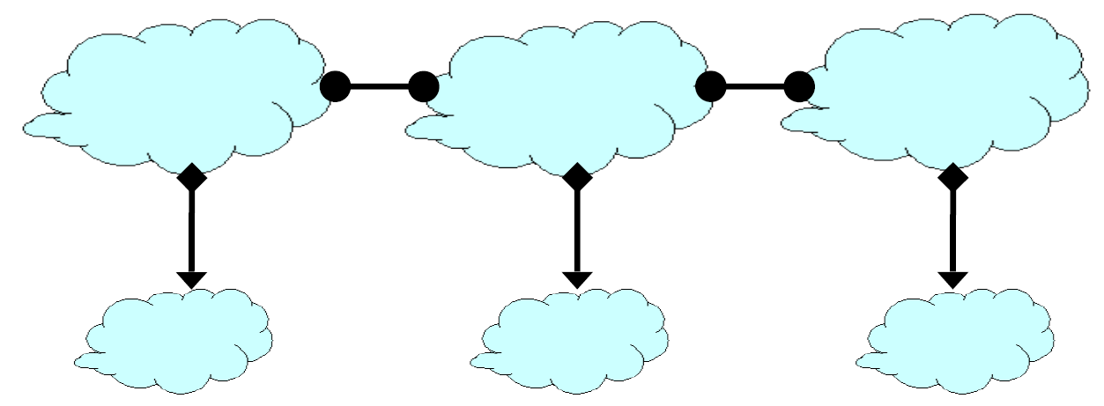
Business Relationships Shape Topology and Policy
The business relationship among ASes shapes their policy.
Three basic kinds of relationships between ASes
AS A can be AS B’s customer
AS A can be AS B’s provider
AS A can be AS B’s peer
Business implications
Customer pays provider
Peers don’t pay each other
I forward traffic for you and you forward roughly equal traffic for me.
AS Relationship Graph
Relationship between ASes
Provider Customer
Peer Peer
Note: The direction of edges in an AS Relationship Graph has nothing to do with the direction of traffic.

Slide 10

Why Peering? (It’s All About Money)
A
B
C
e.g., D and E talk a lot
Peering saves B and C money
Relationship between ASes
Business Implications
Provider Customer
peer peer
D
E
Customers pay providers
Peers don’t pay each other

Slide 11
ASes Provide “Transit” Between Their Customers; (It’s All About Money)
Q
Provider
Customer
Peer
Peer
A
B
C
D
E
F
traffic allowed
ASes provide “transit” between their customers

Slide 12
Peers Do Not Provide Transit Between Other Peers (It’s All About Money)
Q
Provider
Customer
Peer
Peer
A
B
C
D
E
F
traffic not allowed
Peers do not provide transit between other peers

Slide 13
An AS Only Carries Traffic to/from Its Own Customers over a Peering link (It’s All About Money)
Q
Provider
Customer
Peer
Peer
A
B
C
D
E
F
traffic not allowed
An AS only carries traffic to/from its own customers over a peering link

Slide 14
ASes Do Not Provide “Transit” Between Their Providers (It’s All About Money)
Provider
Customer
C
Peer
Peer
A
F
traffic not allowed
ASes Do Not Provide “Transit” Between Their Provider
Routes are “valley free”

