Slide 1












CSC358: Principles of Computer Networks
Lecture 8 – Part 3: BGP vs. DV; Gao-Rexford Rules
mobile network
4G
national or global ISP
Streaming
video
Skype
IP
local or regional ISP
home network
content
provider
network
HTTP
datacenter
network
Ethernet
TCP
enterprise
network
Erfan Meskar
Winter 2025, University of Toronto, Mississauga

Slide 2
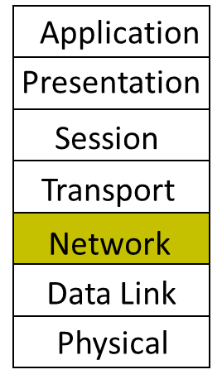
Today
Part 1: Routing Techniques, cont’d
Link state routing protocol
Part 2:
Intra-domain vs. Inter-domain Routing
Business relationship among ASes
Part 3:
BGP vs. DV
Gao-Rexford Rules for Selecting and Exporting Path
Part 4:
Joining BGP and IGP Information
BGP protocol details

Slide 3
Inter-domain Routing: Setup
Destinations are IP prefixes (12.0.0.0/8)
Nodes are Autonomous Systems (ASes)
Internals of each AS are hidden
Links represent both physical links and business relationships
BGP (Border Gateway Protocol) is the Interdomain routing protocol
Implemented by AS border routers

Slide 4
BGP
BGP Inspired by Distance Vector
Per-destination route advertisements
No global sharing of network topology
Iterative and distributed convergence on paths
But, four key differences
An AS advertises (“exports”) its “best” routes to one or more IP prefixes
Each AS selects the “best” route it hears advertised for a prefix
You’ve heard this story before!

Slide 5
BGP vs. DV
BGP does not pick the least-cost path routes!
BGP selects route based on policy, not shortest distance/least cost
By picking the least-cost path, we could guarantee loop free routes.
How do we avoid loops in BGP that does not use least-cost policy?
2
3
Node 2 may prefer “2, 3, 1” over “2, 1”
1

Slide 6
BGP vs. DV
Path-vector Routing
BGP advertises the entire path
Distance Vector: send distance metric per destination prefix d
Path Vector: send the entire path for each destination prefix d
“d: path (B,A)”
“d: path (A)”
d
C
B
A
data traffic
data traffic

Slide 7
Loop Detection with Path-Vector
Benefits of path-vector routing:
ASes can simply discard paths with loops
Look for its own node identifier in the path
e.g., node 1 sees itself in the path “(3, 2, 1)” and simply discards the advertisement
ASes can accept/discard an advertisement based on their local policies.
e.g., AS K received the advertised path “(A, B, C, D)” for destination prefix d.
AS K really hates AS C and doesn’t want its traffic to be carried over C’s network.
So, AS K discard the advertisement.
d
“d: path (2,1)”
“d: path (1)”
3
2
1
“d: path (3,2,1)”

Slide 8
BGP vs. DV
Selective Route Advertisement
For policy reasons, an AS may choose not to advertise a route to a destination
This is different from DV. In DV, a router will always advertise its routes to all neighbors.
As a result, reachability is not guaranteed even if the graph is connected
AS1
AS3
e.g., if AS2 does not want to carry traffic between AS1 and AS3, then it won’t advertise its routes to AS1 and AS3.
Although there exists a physical path between AS1 and AS3, they will never be aware of it. Thus, AS1 and AS3 cannot reach each other.
AS2

Slide 9
BGP vs. DV
BGP may aggregate path
For scalability, BGP may aggregate path for different prefixes

Slide 10
In Summary
Per-destination route advertisements
No global sharing of network topology
Iterative and distributed convergence on paths
But, four key differences
BGP does not pick shortest paths
Each node announces one or multiple PATHs per destination
Selective Route advertisement: not all paths are announced
BGP may aggregate paths
may announce one path for multiple destinations

Slide 11
Today
Part 1: Routing Techniques, cont’d
Link state routing protocol
Part 2:
Intra-domain vs. Inter-domain Routing
Business relationship among ASes
Part 3:
BGP vs. DV
Gao-Rexford Rules for Selecting and Exporting Path
Part 4:
Joining BGP and IGP Information
BGP protocol details

Slide 12
Policy
Policy is imposed in how routes are selected and exported
Selection: Which path to use
Controls whether/how traffic leaves the network
Export: Which path to advertise
Controls whether/how traffic enters the network
Route export
Route selection
Customer
1
Can reach 128.3/16
blah blah
10
Competitor
5

Slide 13


Gao-Rexford Rules
In theory, ASes can set any weird policy they want.
In practice, most ASes follow standard conventions: Gao-Rexford Rules.
These conventions reflect real-world business practices:
Making money is good.
Don't do work for free.
Gao and Rexford, “Stable Internet Routing Without Global Coordination,” TON 2001
Abstract—The Border Gateway Protocol (BGP) allows an autonomous system (AS) to apply diverse local policies for selecting routes and propagating reachability information to other domains. However, BGP permits ASs to have conflicting policies that can lead to routing instability. This paper proposes a set of guidelines for an AS to follow in setting its routing policies, without requiring coordination with other ASs. Our approach exploits the Internet’s hierarchical structure and the commercial relationships between ASs to impose a partial order on the set of routes to each destination …
Lixin Gao and Jennifer Rexford surveyed various ASes to come up with these rules.

Slide 14
Gao-Rexford Rules for Selecting Path
Gao-Rexford rules: If I'm offered multiple paths, pick the most profitable one.
Best: Path where the next hop is a customer. (They pay me.)
Less good: Path where the next hop is a peer. (I don't make money.)
Worst: Path where the next hop is a provider. (I have to pay.)
Reflects real-world business practice: Making money is good.
I prefer (“select”) the path via C
A (Provider)
I prefer (“select”) the path via B
A (Provider)
“d: path (A,T)”
“d: path (A,T)”
S
B (Peer)
T
S
B (Peer)
T
“d: path (B,T)”
“d: path (B,T)”
d
d
C (Customer)
C
“d: path (C,T)”

Slide 15
Gao-Rexford Rules for Exporting Path
Destination prefix advertised by… | Export route to…
Customer | Everyone (providers, peers, other customers)
Peer | Customers
Provider | Customers

Slide 16
Gao-Rexford Rules for Exporting: An Advertisement from A Customer will be Exported to Everyone
D (G’s Provider)
A (G’s Provider)
“d: path (G, C, …)”
“d: path (G, C, …)”
“d: path (G, C, …)”
“d: path (G, C, …)”
E (G’s Peer)
G
B (G’s Peer)
“d: path (G, C, …)”
F (G’s Customer)
“d: path (C, …)”
C (G’s Customer)

Slide 17
Gao-Rexford Rules for Exporting: An Advertisement from A Peer will be Exported Only to Customers
D (G’s Provider)
A (G’s Provider)
“d: path (B, …)”
E (G’s Peer)
G
B (G’s Peer)
“d: path (G, B, …)”
“d: path (G, B, …)”
F (G’s Customer)
C (G’s Customer)

Slide 18
Gao-Rexford Rules for Exporting: An Advertisement from A Provider will be Exported Only to Customers
D (G’s Provider)
A (G’s Provider)
“d: path (A, …)”
E (G’s Peer)
G
B (G’s Peer)
“d: path (G, A, …)”
“d: path (G, A, …)”
F (G’s Customer)
C (G’s Customer)

Slide 19
What’s the Importance of Gao-Rexford Rules?
Gao and Rexford proved in their seminal paper that …
under a couple of mild and realistic assumptions on the AS graph topology,
If All ASes follow the Gao-Rexford rules,
Then we can guarantee these two properties:
Reachability: Any two ASes in the graph can communicate.
Convergence: All ASes agree on paths.

Slide 20
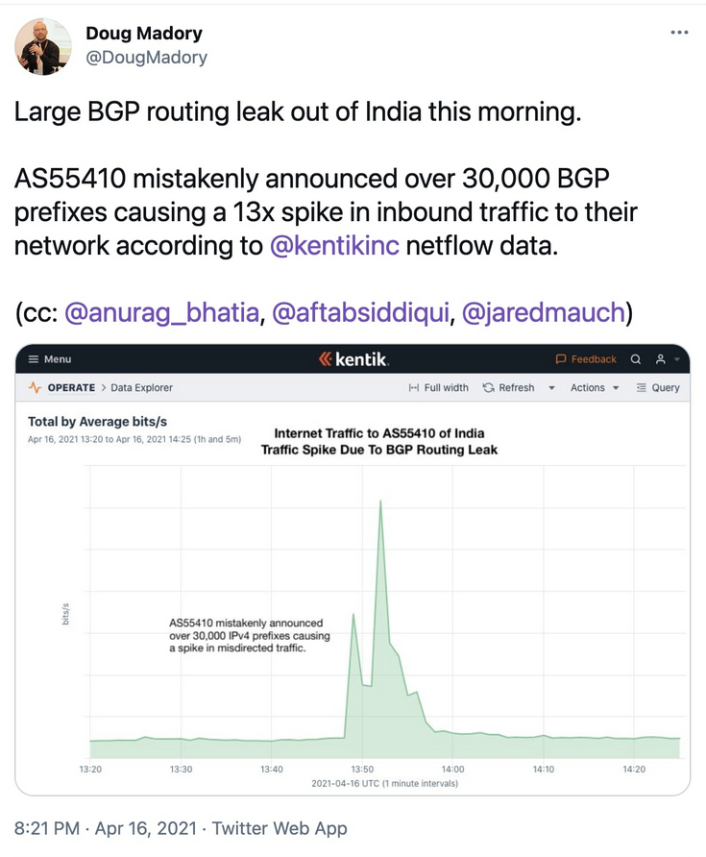
Wrong Advertisements Have Serious Impacts!
“although the BGP routing leak occurred in Vodafone's autonomous network (AS 55410) based in India, it has impacted U.S. companies, including Google”
“… the network mistakenly advertising that it supported over 30,000 BGP prefixes or routes, when it didn't, causing the internet to flood this network with traffic that was not meant to go through it”
https://www.bleepingcomputer.com/news/security/major-bgp-leak-disrupts-thousands-of-networks-globally/

