Slide 1












CSC358: Principles of Computer Networks
Lecture 9 – Part 1: Putting Things Together
mobile network
4G
national or global ISP
Streaming
video
Skype
IP
local or regional ISP
home network
content
provider
network
HTTP
datacenter
network
Ethernet
TCP
enterprise
network
Erfan Meskar
Winter 2025, University of Toronto, Mississauga

Slide 2
Today’s Outline
Part 1:
Putting Things Together (review)
Part 2:
The Final Piece in the Game: Socket
Part 3:
The Web and HTTP
HTTP and improving its performance
Pipelined, Persistent, Caching
Part 4:
Transport Layer

Slide 3
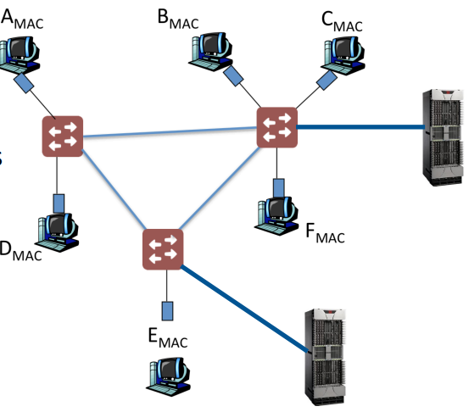
What does the Internet Actually Look Like?
The smallest component:
A Network Interface Card (NIC), or a machine, or a server
Has a globally unique Link Layer MAC name/address
48 bits
Flat addressing scheme (i.e., no hierarchy)
Multiple NICs are connected in a Local Area Network (LAN) via
Shared medium (e.g., 10BASE5 Ethernet) or switched network (e.g., Switched Ethernet)
i.e., in a LAN, nodes are connected via Link layer functionalities, and no router is in between them.

Slide 4
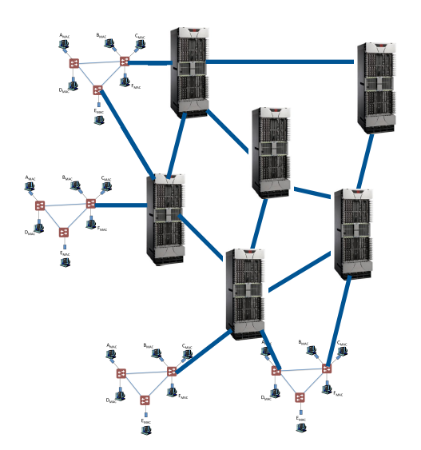
What does the Internet Actually Look Like?
LANs get connected to each other by routers
Each node gets an IP address
32 bits
Hierarchical addressing scheme (i.e., it is not flat)
A device’s IP address is not necessarily globally unique (i.e., multiple may have the same IP address)

Slide 5
What does the Internet Actually Look Like?
A collection of local networks that are under a single administrative control is an AS.
ASes get connected to each other by routers
More precisely, by border routers
Each AS is assigned a unique 32-bit address
Flat addressing scheme (i.e., no hierarchy)

Slide 6
Navigating Packets in a LAN
How do we deliver packets in a switched LAN?
Switches use flooding and MAC learning
If you know the destination can be reached through a port, then use it
Otherwise, send out the frame on all ports (i.e., flooding)
Flooding guarantees that the destination will receive the frame.
Switches do not share their forwarding tables or network topology with each other.
How do we take care of loops in a switched LAN?
Since we use flooding, loops can lead to disaster
Thus, we use STP and deactivate some links to get rid of loops
How do we deliver packets in a shared medium LAN?
Medium Access Control techniques (e.g., CSMA/CD)

Slide 7
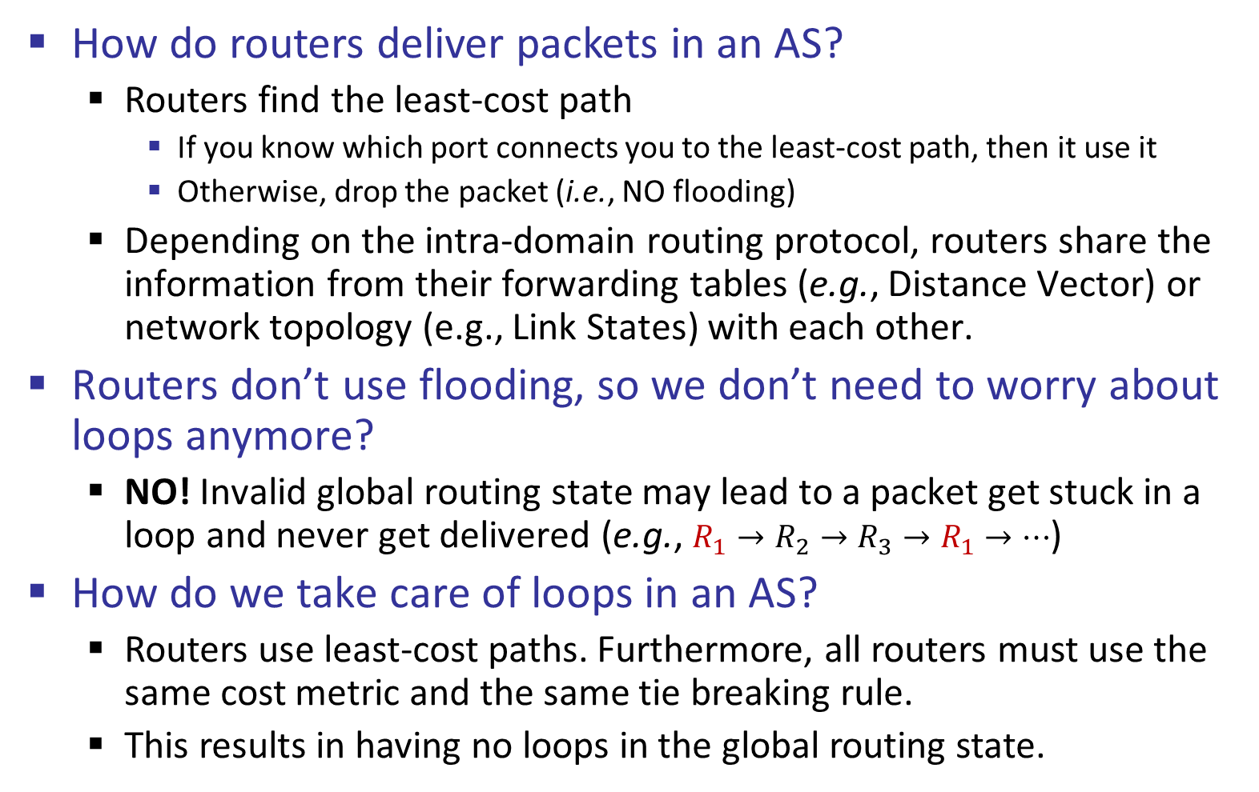
Navigating Packets in an AS (i.e., Intra-domain)
How do routers deliver packets in an AS?
Routers find the least-cost path
If you know which port connects you to the least-cost path, then it use it
Otherwise, drop the packet (i.e., NO flooding)
Depending on the intra-domain routing protocol, routers share the information from their forwarding tables (e.g., Distance Vector) or network topology (e.g., Link States) with each other.
Routers don’t use flooding, so we don’t need to worry about loops anymore?
NO! Invalid global routing state may lead to a packet get stuck in a loop and never get delivered (e.g., $R_{1}→R_{2}→R_{3}→R_{1}→…$)
How do we take care of loops in an AS?
Routers use least-cost paths. Furthermore, all routers must use the same cost metric and the same tie breaking rule.
This results in having no loops in the global routing state.

Slide 8
Navigating Packets Across ASes (i.e., Inter-domain)
How do routers deliver packets from one AS to another?
Routers don’t use least-cost path for inter-domain routing.
Instead, they use their own AS policy to choose a route.
Each AS can have its own strange policy.
Now that we don’t use least-cost paths, how can we handle loops?
BGP speaking routers share the path vector with each other.
Whenever you receive an advertisement, look inside the path vector.
If by adding yourself to the path you will cause a loop, then don’t use the advertised path.

Slide 9
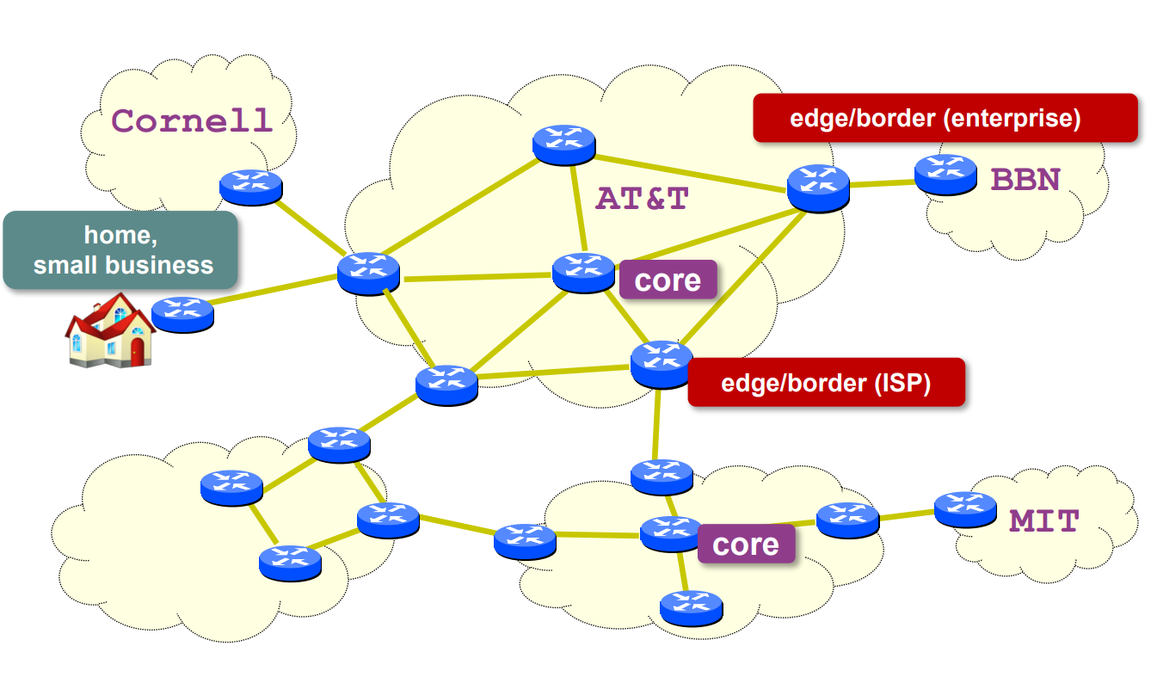
Networks and Routers

Slide 10
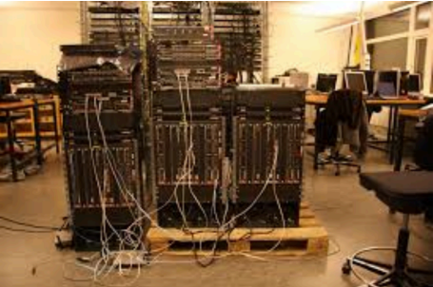
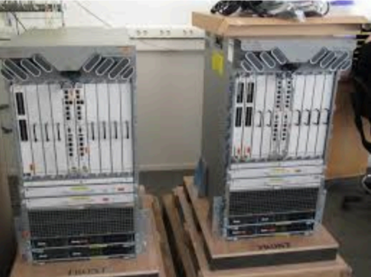
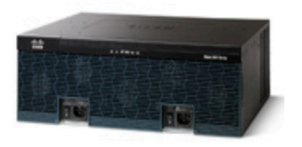
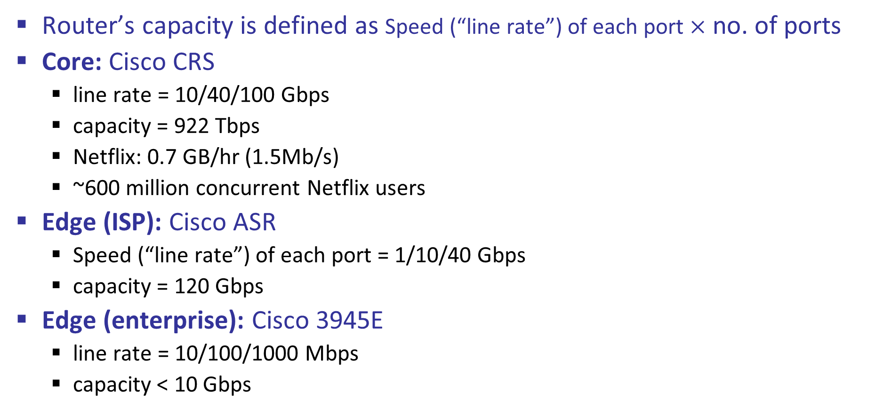
Types of Routers
Router’s capacity is defined as Speed (“line rate”) of each port $×$ no. of ports
Core: Cisco CRS
line rate = 10/40/100 Gbps
capacity = 922 Tbps
Netflix: 0.7 GB/hr (1.5Mb/s)
~600 million concurrent Netflix users
Edge (ISP): Cisco ASR
Speed (“line rate”) of each port = 1/10/40 Gbps
capacity = 120 Gbps
Edge (enterprise): Cisco 3945E
line rate = 10/100/1000 Mbps
capacity < 10 Gbps

Slide 11
How does Internet Work? End-to-end Perspective
Network stack receives data from the application (roughly speaking)
What is my IP address? (DHCP has the answer)
What is the destination IP address? (use DNS)
Encapsulate data into packets (and add an IP header)
Is destination IP address within my LAN? (use the information from DHCP)
What should the host do if the destination address is local?
What should it do if the destination address is remote?

Slide 12
How does Internet Work? End-host Perspective
If destination IP address is local:
What is destination MAC address (use ARP)?
Encapsulate packet into frames (and add a Link layer header)
Convert frames into bits and signal
Forward the bits to the wire (i.e., send the signal)
Switches will take care of the rest …

Slide 13
How does Internet Work? End-host Perspective
If destination IP address is remote:
What is my next-hop router IP address? (DHCP has the answer)
What is my next-hop router MAC address? (use ARP)
Encapsulate packet into frames (and add a Link layer header)
Convert frames into bits and signal
Forward the bits to the wire (i.e., send the signal)
Routers will take care of the rest …

