Slide 1












CSC358: Principles of Computer Networks
Lecture 9 – Part 2: Socket
mobile network
4G
national or global ISP
Streaming
video
Skype
IP
local or regional ISP
home network
content
provider
network
HTTP
datacenter
network
Ethernet
TCP
enterprise
network
Erfan Meskar
Winter 2025, University of Toronto, Mississauga

Slide 2
Today’s Outline
Part 1:
Putting Things Together (review)
Part 2:
Socket Abstraction
Part 3:
The Web and HTTP
HTTP and improving its performance
Pipelined, Persistent, Caching
Part 4:
Transport Layer

Slide 3
Socket Abstraction
How can we write an application that runs over internet?
We need to write some code to interact with the network.
It’s too much trouble to worry about creating packets and adding proper headers for each layer ☹
It would be great to have an API that allows programmers a convenient way to interact with the network, using a standardized set of operations. ☺
Many operating systems use the Berkeley sockets API,
It provides functions like socket(), bind(), listen(), connect(), send(), and recv().
Two Main Types of Sockets:
Stream Sockets (TCP): Provide reliable, connection-oriented communication.
Datagram Sockets (UDP): Provide connectionless, faster, but unreliable communication.

Slide 4
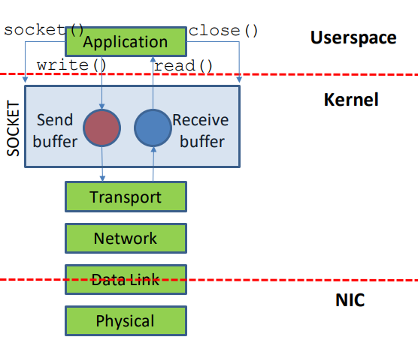
Where does Socket Fit in the Network Stack?
The socket abstraction exists entirely in software.

Slide 5
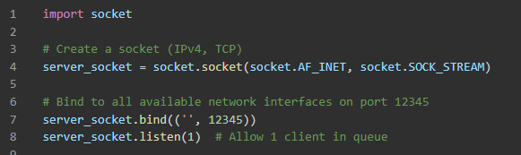
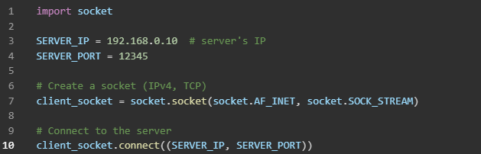
Sockets and Port Numbers
When a process wants access to the network,
it opens a socket, which is associated with a port number
This port is a logical port and different from the physical switch/router port
Server opens a socket, which uses IPv4 (socket.AF_INET) and TCP (socket.SOCK_STREAM) and is associated with a port 12345
Client opens a socket, which uses IPv4 (socket.AF_INET) and TCP (socket.SOCK_STREAM). Client connects to the server’s socket (with IP “SERVER_IP” which is on port “SERVER_PORT”)

Slide 6
Sockets and Port Numbers
Socket: an OS mechanism that connects processes to the network stack
Port: number that identifies that particular socket
The port number is used by the OS to direct incoming packets
Header must include source and destination port (used by the network stack)
In which layer do we include the source and destination port? Transport layer
When a packet arrives at the destination host, packet is delivered to the socket associated with the destination port

Slide 7
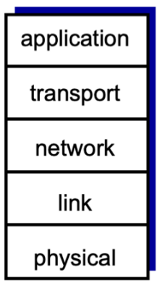
Congratulation!
You know how the Internet works!!!
All that is remaining:
Reliability → TCP in Transport Layer
But before that:
Let’s take a quick look at the Web and HTTP, the famous application layer protocol
HTTP
TCP & UDP

